Slide 1
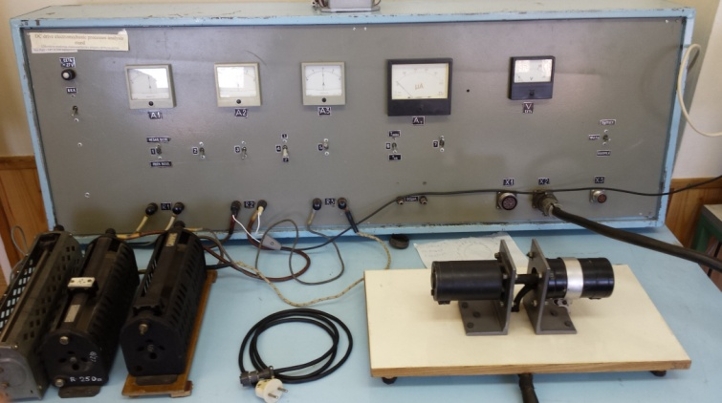
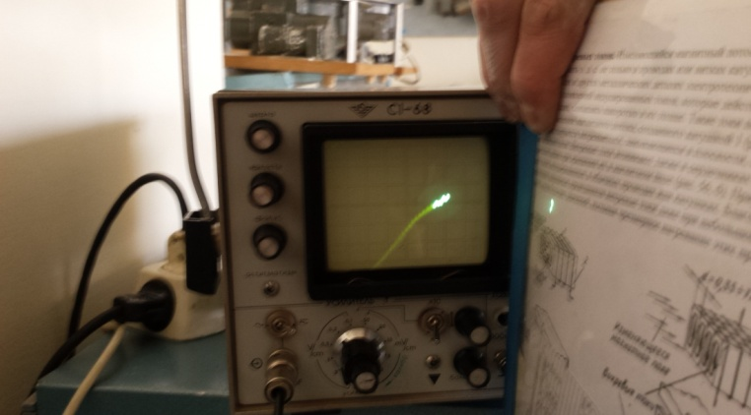
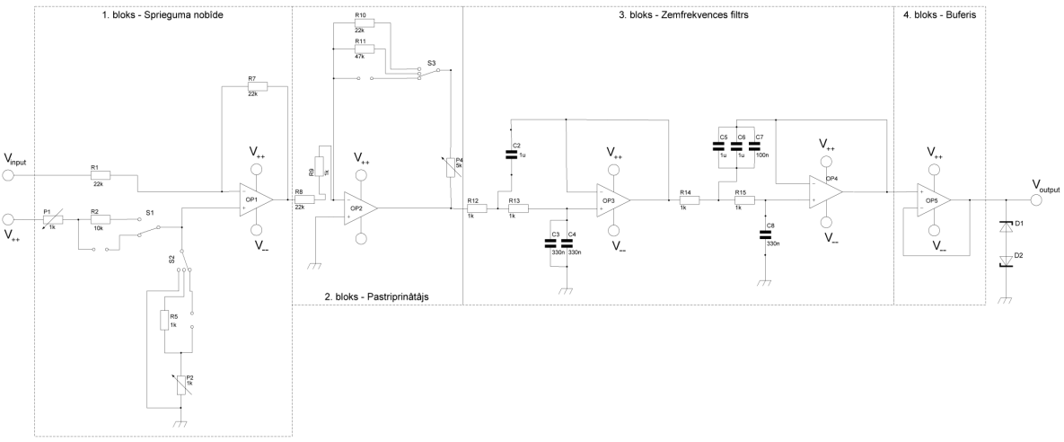
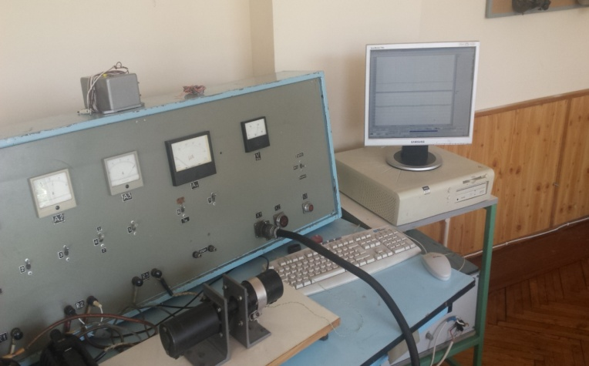
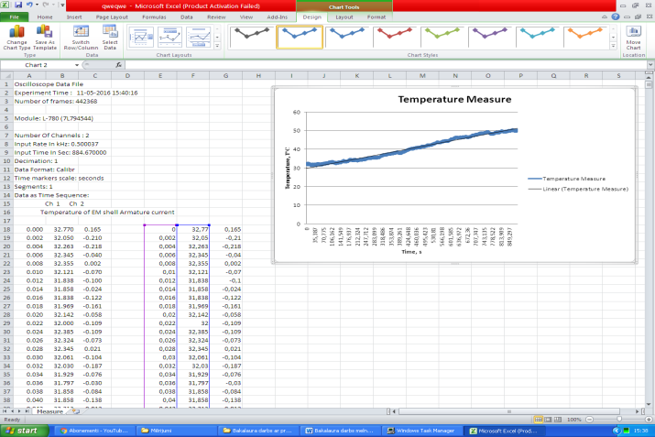
Bachelors degree finals: Rebuild analog motor test bench into digital format for better measurements. Key work performed: * New sensor integration (thermistor bridge, ACS712 hall sensor for up to 20 amps measurement); * PCB design; * Signal range calibration via Opamp circuit to make 0 – 5V range for compatibility with provided ADC converter.

Slide 2
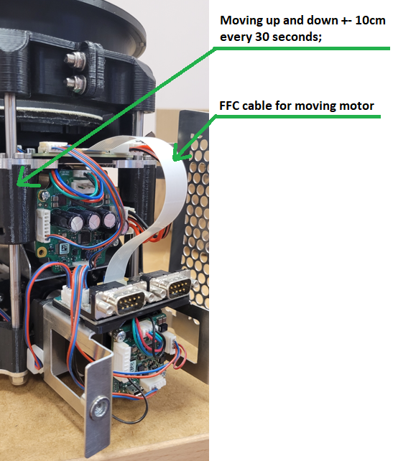
Electronic wiring on moving parts: One motor stationary, other moving up and down. Implement reliable communication and power supply for the upper motor and homing sensor with easy maintenance solutions in mind. Key work performed: * Replacing first prototype +- 10 wires with JST crimping connectors (which didn’t perform well in range of 10k+ cycles) with one FFC cable as it can withstand up to 3 million bending cycles with bending radius of 5 mm as per datasheet; * PCB redesign for FFC cable compatibility; Result: * No more wiring change after few months; * Easy to troubleshoot moving electronic part as there is only one cable left and no more wire crimping needed.

Slide 3
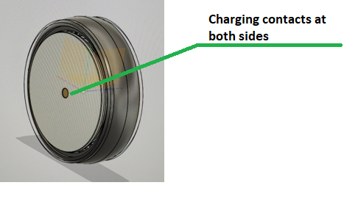
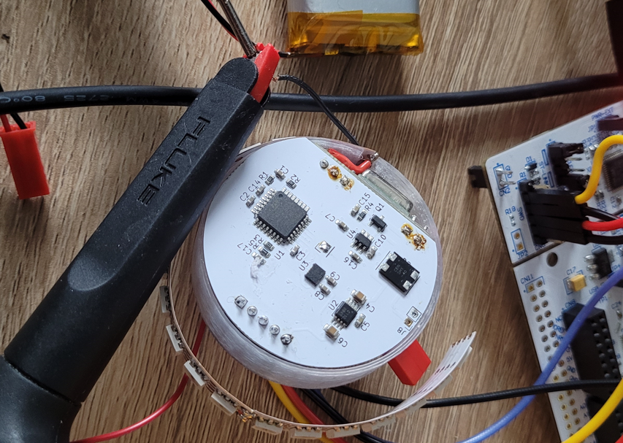
Puck with LED strip: Based on STM32, LED strip control via SPI, accelerometer (LSM6DSOTR) via I2C and specific charging possibility for 3.7v Li-Po battery with user friendly design. LED strip lights up when specific threshold is reached from accelerometer. When no trigger detected system goes in sleep mode with 200uA consumption. Key work performed: * H-bridge rectifier integration at charging input to make it non polar charging; * Charging circuit with MAX1736EUT42+T; * low voltage threshold detection to avoid battery drainage.

Slide 4
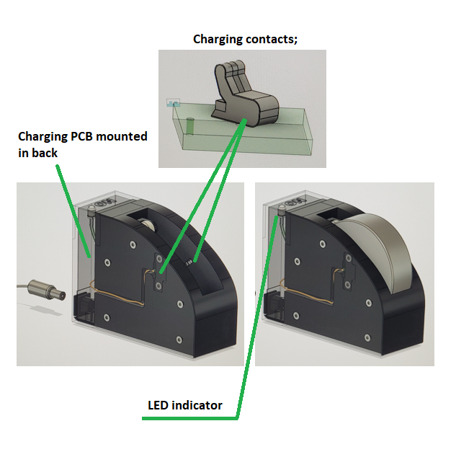
Puck with LED strip charging station: Design charging station for 3.7V Li-Po charging for specific device. Key work performed: * Current monitoring with current sense amplifier INA185 and shunt resistor; * Max current limitation; * One GPIO pin controlling 3 states of LED via NOR gate (RED – charging, GREEN – fully charged, LED off – not charging); * Design 3D printed holder with integrated charging contacts.

