Slide 1

Overview of Electronic Commerce

Slide 2
Learning Objectives
Define electronic commerce (EC) and describe its various categories.
Describe and discuss the content and framework of EC.
Describe the major types of EC transactions.
Discuss e-commerce 2.0.
Describe social commerce and social software.
1-<number>

Slide 3
Learning Objectives
Understand the elements of the digital world.
Describe the drivers of EC as they relate to business pressures and organizational responses.
Describe some EC business models.
Describe the benefits of EC to organizations, consumers, and society.
List and describe the major limitations of EC.
1-<number>

Slide 4
Electronic Commerce:
Definitions and Concepts
electronic commerce (EC)
  The process of buying, selling, or exchanging products, services, or information via computer
e-business
  A broader definition of EC that includes not just the buying and selling of goods and services, but also servicing customers, collaborating with business partners, and conducting electronic transactions within an organization
1-<number>

Slide 5
Electronic Commerce:
Definitions and Concepts
MAJOR EC CONCEPTS
  Pure Versus Partial EC
    EC takes several forms depending on the degree of digitization (the transformation from physical to digital)
      The product (service),
      The process,
      The delivery method
1-<number>

Slide 6
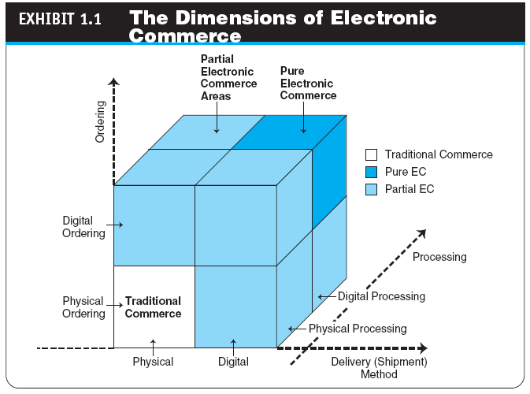
1-<number>

Slide 7
Electronic Commerce:
Definitions and Concepts
  Organizations
    brick-and-mortar (old economy) organizations
    Old-economy organizations (corporations) that perform their primary business offline, selling physical products by means of physical agents
    virtual (pure-play) organizations
    Organizations that conduct their business activities solely online
    click-and-mortar (click-and-brick) organizations
    Organizations that conduct some e-commerce activities, usually as an additional marketing channel
1-<number>

Slide 8
Electronic Commerce:
Definitions and Concepts
ELECTRONIC MARKETS AND NETWORKS
  electronic market (e-marketplace)
  An online marketplace where buyers and sellers meet to exchange goods, services, money, or information
  intranet
  An internal corporate or government network that uses Internet tools, such as Web browsers, and Internet protocols
  extranet
  A network that uses the Internet to link multiple intranets
1-<number>

Slide 9
The Electronic Commerce Field: Classification, Content, and a Brief History
AN EC FRAMEWORK
  EC applications are supported by infrastructure and by the following five support areas:
    People
    Public policy
    Marketing and advertising
    Support services
    Business partnerships
1-<number>

Slide 10
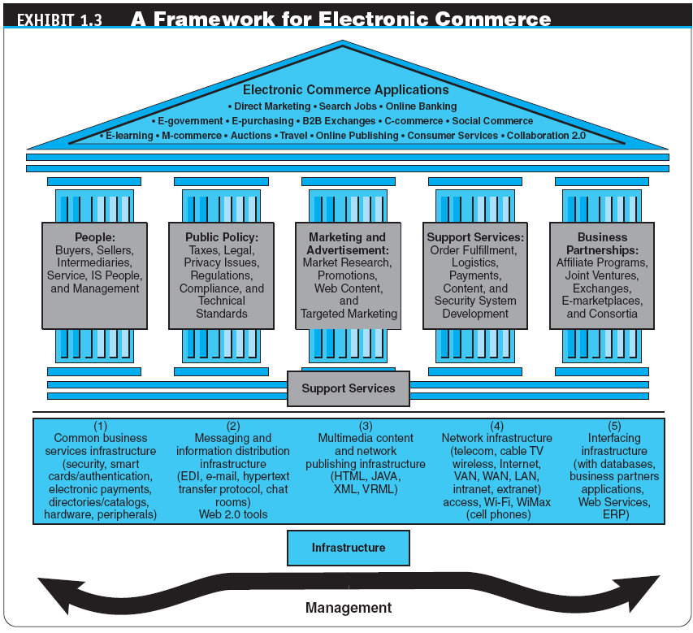
1-<number>

Slide 11
The Electronic Commerce Field: Classification, Content, and a Brief History
CLASSIFICATION OF EC BY THE NATURE OF THE TRANSACTIONS AND THE RELATIONSHIPS AMONG PARTICIPANTS
  business-to-business (B2B)
  E-commerce model in which all of the participants are businesses or other organizations
  business-to-consumer (B2C)
  E-commerce model in which businesses sell to individual shoppers
  e-tailing
  Online retailing, usually B2C
1-<number>

Slide 12
The Electronic Commerce Field: Classification, Content, and a Brief History
  business-to-business-to-consumer (B2B2C)
  E-commerce model in which a business provides some product or service to a client business that maintains its own customers
  consumer-to-business (C2B)
  E-commerce model in which individuals use the Internet to sell products or services to organizations or individuals who seek sellers to bid on products or services they need
1-<number>

Slide 13
The Electronic Commerce Field: Classification, Content, and a Brief History
  intrabusiness EC
  E-commerce category that includes all internal organizational activities that involve the exchange of goods, services, or information among various units and individuals in an organization
  business-to-employees (B2E)
  E-commerce model in which an organization delivers services, information, or products to its individual employees
1-<number>

Slide 14
The Electronic Commerce Field: Classification, Content, and a Brief History
  consumer-to-consumer (C2C)
  E-commerce model in which consumers sell directly to other consumers
  collaborative commerce (c-commerce)
  E-commerce model in which individuals or groups communicate or collaborate online
  e-government
  E-commerce model in which a government entity buys or provides goods, services, or information from or to businesses or individual citizens
1-<number>

Slide 15
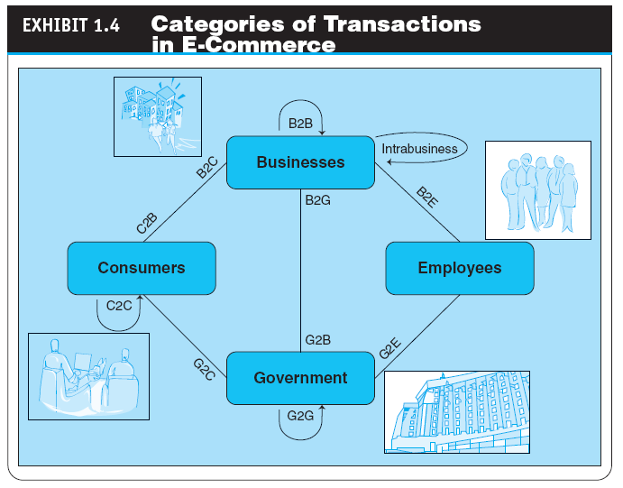
1-<number>

Slide 16
The Electronic Commerce Field: Classification, Content, and a Brief History
A BRIEF HISTORY OF EC
  The Interdisciplinary Nature of EC
  The Google Revolution
  f-commerce
  E-commerce activities conducted on Facebook or influenced by the site
  EC Failures
  EC Successes
THE FUTURE OF EC
1-<number>

Slide 17
E-Commerce 2.0:
From Social Commerce to Virtual Worlds
social computing
An approach aimed at making the human–computer interface more natural
Web 2.0
The second generation of Internet-based services that lets people collaborate and share information online in new ways, such as social networking sites, wikis, communication tools, and folksonomies
1-<number>

Slide 18
E-Commerce 2.0:
From Social Commerce to Virtual Worlds
social network
A category of Internet applications that help connect friends, business partners, or individuals with specific interests by providing free services such as photo presentation, e-mail, blogging, and so on using a variety of tools
1-<number>

Slide 19
E-Commerce 2.0:
From Social Commerce to Virtual Worlds
  social networking service (SNS)
  A service that builds online communities by providing an online space for people to build free homepages and that provides basic communication and support tools for conducting different activities in the social network
1-<number>

Slide 20
E-Commerce 2.0:
From Social Commerce to Virtual Worlds
ENTERPRISE SOCIAL NETWORKS
social commerce
The e-commerce activities conducted in social networks and/or by using social software (i.e., Web 2.0 tools)
1-<number>

Slide 21
E-Commerce 2.0:
From Social Commerce to Virtual Worlds
VIRTUAL WORLDS AND SECOND LIFE
virtual world
A user-defined world in which people can interact, play, and do business; the most publicized virtual world is Second Life
  How Students Make Money in a Virtual World
THE MAJOR TOOLS OF WEB 2.0
  Wikis
  RSS feeds (Rich Site Summary)
  Blogs
  Microblogs (e.g.,Twitter)
1-<number>

Slide 22
The Digital World:
Economy, Enterprises, and Society
digital economy
An economy that is based on digital technologies, including digital communication networks, computers, software, and other related information technologies; also called the Internet economy, the new economy, or the Web economy
1-<number>

Slide 23
The Digital World:
Economy, Enterprises, and Society
digital enterprise
A new business model that uses IT in a fundamental way to accomplish one or more of three basic objectives:
- reach and engage customers more effectively,
- boost employee productivity, and
- improve operating efficiency; uses converged communication and computing technology in a way that improves business processes
  corporate portal
  A major gateway through which employees, business partners, and the public can enter a corporate website.
THE DIGITAL SOCIETY
1-<number>

Slide 24
The Changing Business Environment,
Organizations’ Response, and EC Support
THE CHANGING BUSINESS ENVIRONMENT
  Economic, legal, societal, and technological factors have created a highly competitive business environment in which customers are becoming more powerful
  These environmental factors can change quickly, vigorously, and sometimes in an unpredictable manner
  Companies need to react quickly to both the problems and the opportunities resulting from this new business environment
1-<number>

Slide 25
The Changing Business Environment,
Organizations’ Response, and EC Support
PERFORMANCE, BUSINESS PRESSURES, AND ORGANIZATIONAL RESPONSES AND EC SUPPORT
  The Business Environment and Performance Impact Model
1-<number>

Slide 26
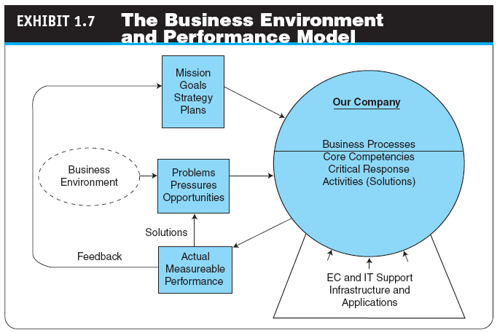
1-<number>

Slide 27
The Changing Business Environment,
Organizations’ Response, and EC Support
  Business Pressures
      Market and economic pressures
      Societal pressures
      Technological pressures
  Organizational Response Strategies
    The support of EC
  The Major Capabilities of E-Commerce
1-<number>

Slide 28
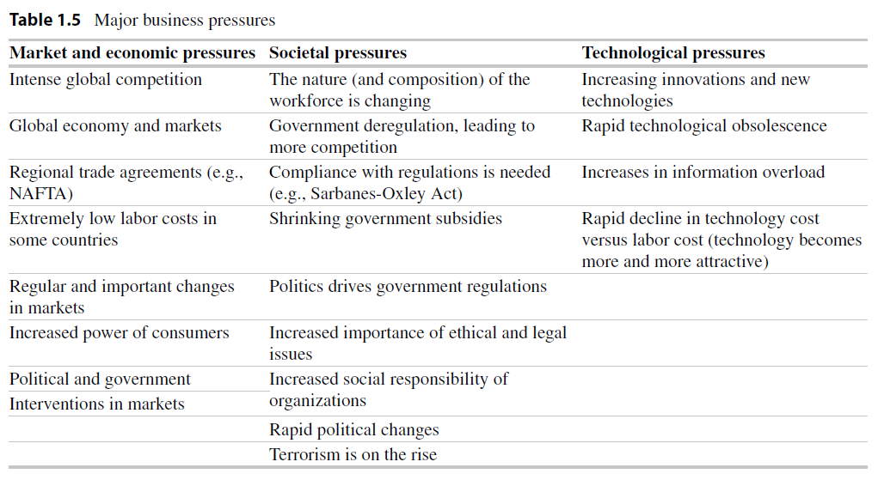
1-<number>

Slide 29
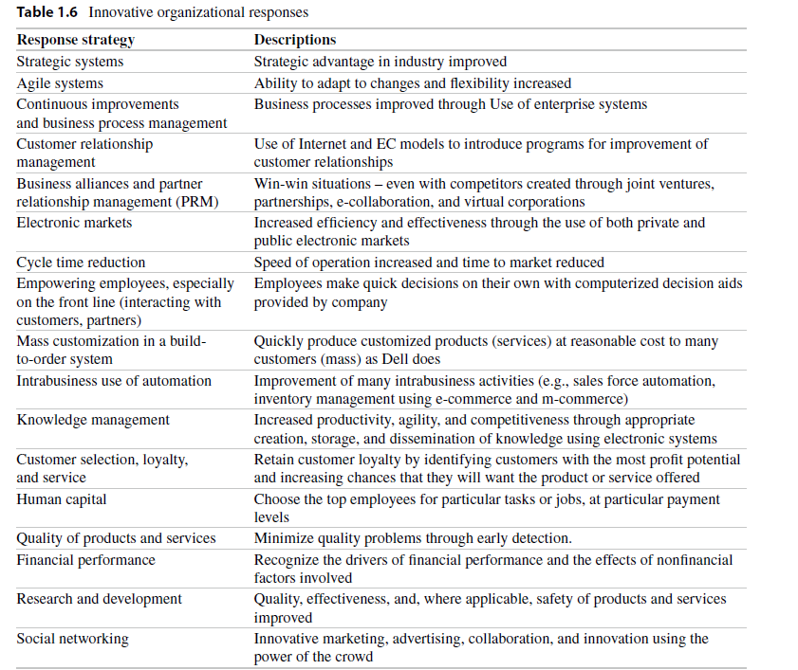
Copyright © 2012 Pearson Education, Inc. Publishing as Prentice Hall
1-<number>

Slide 30
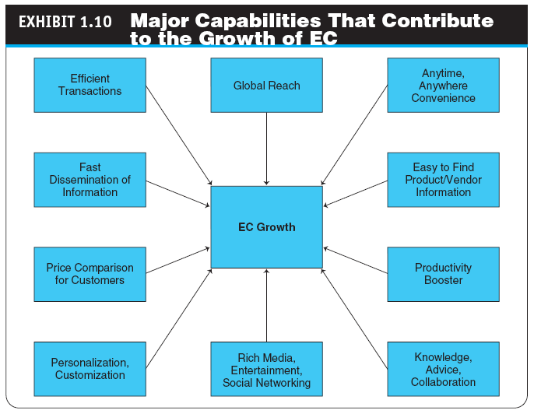
1-<number>

Slide 31
Benefits of e-commerce
Benefits to Organizations
Benefits to Consumers
Benefits to Society
1-<number>

Slide 32
Electronic Commerce Business Models
business model
A method of doing business by which a company can generate revenue to sustain itself
1-<number>

Slide 33
Electronic Commerce Business Models
THE STRUCTURE AND PROPERTIES OF BUSINESS MODELS
  Revenue Models: A revenue model specifies how the organization, or the EC project, will generate revenue
  value proposition
  The benefits a company can derive from using EC
A company uses its revenue model to describe how it will generate revenue and its business model to describe the process it will use to do so.
Functions of a Business Model
1-<number>

Slide 34
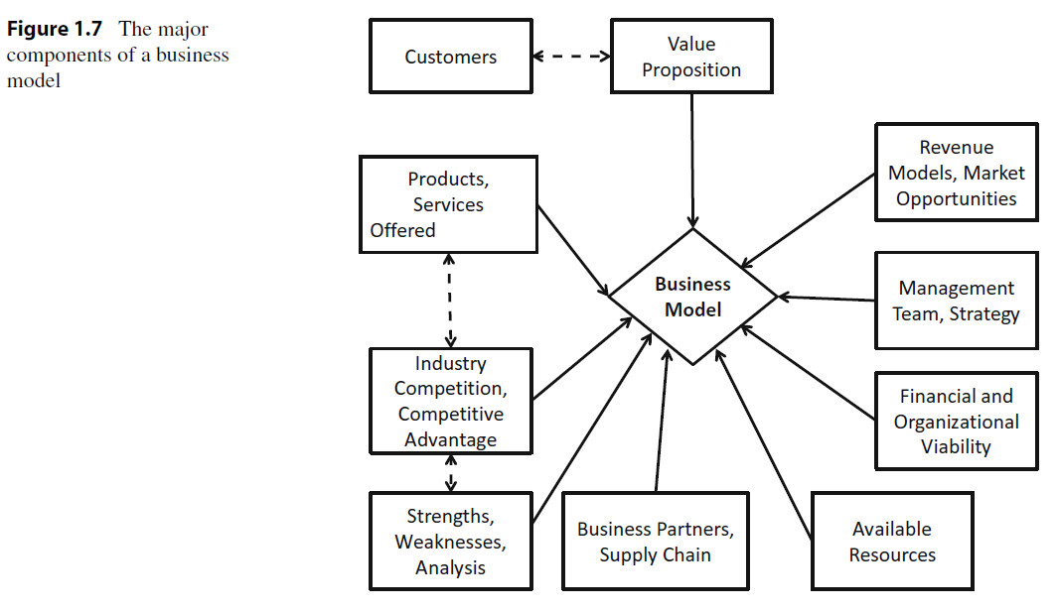
1-<number>

Slide 35
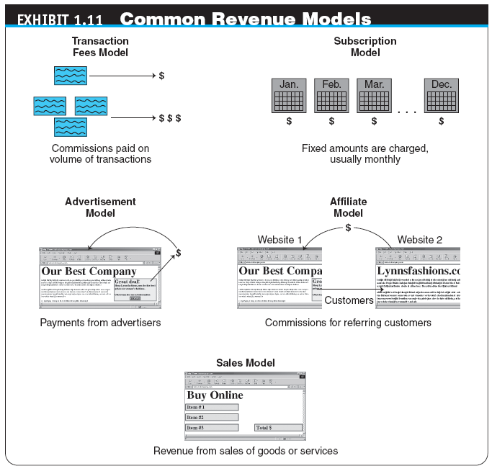
1-<number>

Slide 36
Electronic Commerce Business Models
TYPICAL EC BUSINESS MODELS
  Online direct marketing
  tendering (bidding) system
  Model in which a buyer requests would-be sellers to submit bids; the lowest bidder wins.
  Electronic marketplaces and exchanges
  Viral marketing
  Group purchasing
1-<number>

Slide 37
Benefits, Limitations, and Impacts of Electronic Commerce
THE BENEFITS AND IMPACTS OF EC
  EC as a Provider of Competitive Advantage
THE LIMITATIONS AND BARRIERS OF EC
  ethics
  The branch of philosophy that deals with what is considered to be right and wrong
WHY STUDY E-COMMERCE?
1-<number>

Slide 38
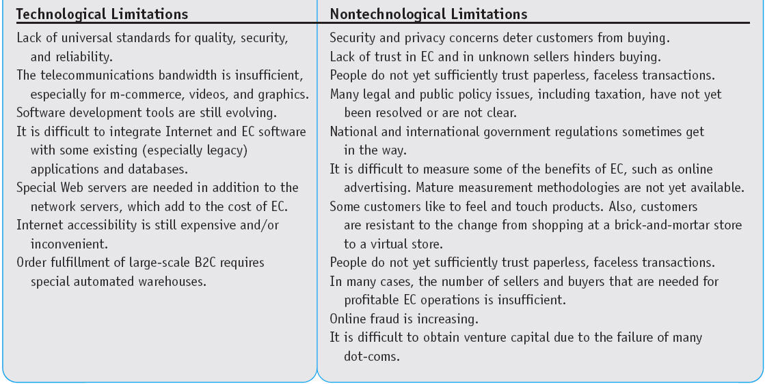
1-<number>

Slide 39
Managerial Issues
Is EC real?
Why is B2B e-commerce so essential and successful?
Which EC business model should I choose?
How can we exploit social commerce?
What are the top challenges of EC today?
1-<number>

Slide 40
Summary
Definition of EC and description of its various categories
The content and framework of EC
The major types of EC transactions
E-commerce 2.0
Description of social commerce and social software
1-<number>

Slide 41
Summary
The elements of the digital world
The drivers of EC
The major EC business models
Benefits of EC to organizations, consumers, and society
Limitations of e-commerce
1-<number>

