Slide 1

Information Literacy (IL)
Rodessa Allen

Slide 2
Definition
Reading/ Writing Literacy
The ability to read and write. These are skills that can be developed over time, and they should be practiced regularly.
Digital Literacy
The ability to critically use technology, to navigate through various online forums and devices, understanding how technology works, and being able to creatively and innovatively manipulate technology to solve problems.

Slide 3
Definition
Media Literacy
The ability to understand the messages you are being told on television, radio, video games, movies, news programs, social media, and more.
Data Literacy
The ability to read, understand, create, and communicate data as information.
Information Literacy
The ability to recognize when information is needed and have the ability to locate, evaluate, and use effectively the needed information.

Slide 4
Role of Academic Libraries
(Relating to Information Literacy)
consult with individuals in analyzing, identifying, and fulfilling their information needs
create campus-wide information literacy programs and deliver classroom instruction to strengthen information literacy skills
select, organize, and facilitate access to information in a variety of formats
keep abreast of technological advancements and develop strategies to take advantage of them
plan, implement, and administer computer-based systems, electronic databases design and manage Web sites
collaborate with classroom faculty, computer specialists, and instructional developers

Slide 5
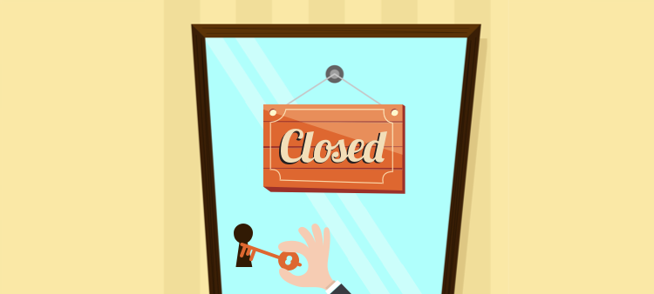
Preparedness for IL Services
Subject Knowledge
Unconventional Sources
Database Knowledge
Time Constraint & Demand
Experience

Slide 6

Subject Literacy
Business/ Entrepreneurship
Art History
Fine Arts
Graphic Design
Travel
Culture
Humanities

Slide 7

IL Experience
Highschool vs. College
Undergrad vs Grad
Major Specifications
IL Program Utilization
Quality of IL
IL Today

Slide 8

University of Colorado-Boulder
IL Initiative
Course-Integrated Research Services
Tailored Research Seminars
Online Course Materials
Assignment Consultations
Research consultations
Information Literacy and Curriculum Courses
Workshops and Seminars

Slide 9

Emory University IL initiative
Request a Research Instruction Session
Subject Librarians
Research Guides
Course Reserve
Ask a Librarian
Library Student Ambassadors
Workshops and Classes

Slide 10
Ruth Curtis & The Information Literacy Advocates (ILA) Scheme
Began in 2013/2014
University of Nottingham
Recruites medicine and health science students
Offered course credit
Help students make use of the libraries resources & services
To help with the influx of one to one literature search requests due to sudden increase in student volume
Student requests from related programs for advice on how to use library resources.

Slide 11
ILA Scheme Requirements
learning outcomes to be achieved
attendance of an induction workshop
provision of peer assistance in information skills sessions
accumulation of 20-hour contact time – to be split between peers (providing information skills support) and librarians (to maintain progress, discuss concerns and benefit from additional training)
accumulation of 40-hour independent learning
submission of a final assessment (reflective portfolio and 10-minute presentation).
Second year students or above
Prior knowledge of library resources and services

Slide 12
ILA Scheme Outcomes & Critiques
Overall positive outcome for ILAs and students
Reduced students anxiety and built confidence in using library resources.
Promoted self research skills by not simply providing answers.
Improved ILAs information research quality and knowledge of library functions.
Improved the ILA and student assignments.
Mainly handled inquiries related to Structuring searches/Searching databases
Librarian now able to handle more complex inquiries or tasks.
Difficulty meeting the 20 hours
Lack of interaction with other ILAs.
Additional administrative work

Slide 13
ILA Scheme Improvements
Making ILAs presence known through different avenues.
Introducing ILAs
Providing support with different communication methods
More group work has developed teamwork skills
Extending the duration of the program to most of the academic year
Mid term review vs just final review
Workshops for ILAs

Slide 14
Qianxiu Liu & Information Literacy (IL) Course Study
University of Science and Technology of China
Credit based Information Literacy Course
Same course material, two teaching modes.
What motivates graduate students to take the IL course?
To what extent do graduate students evaluate their IL skills?
To what extent do graduate students evaluate the contents of IL courses?
Who do graduate students evaluate as the most appropriate person to teach IL courses?
What do graduate students evaluate as the most suitable approach to teaching IL courses?
Are there differences between graduate students' perception and motivation toward IL courses based on class format or gender?

Slide 15
IL Course Objectives
To enhance students' awareness of literature information
To equip students with the skills to search for literature
To equip students with the ability to analyze, process, review and utilize literature
To cultivate students' self-learning ability and independent research ability.
Notes:
Lecture only and blended learning model group

Slide 16
IL Course Study Objectives
& Prior Findings
Shortage of engagement with graduate students.
Graduate students are not prepared to conduct complex research and are not well equipped to assess the sources they find.
Graduate students move from generalist to specialist, which means they need to become more familiar with the journals in their field of study.
Graduate students' search and critical evaluation skills increased with practice and were not based on an academic year or research tasks.
clarify the motivation, self-efficacy, and perceptions of first-year master's students
Notes:
Mary Jane Harkins

Slide 17
IL Study Results
Teacher Qualifications
40.25 % of students preferred faculty who are proficient in IL
28.64 % of students indicated that faculty who are professional at IL and in the same field as themselves.
5.8 % of students thought librarians proficient in information retrieval and analysis were the most appropriate.
3.7 % of students considered faculty majoring in library information science the most appropriate person for teaching IL courses.
2.96 % of students preferred university librarians as their instructors.
Information seeking behavior
46.17 % of students preferred lectures with group activities.
40 % of students will continue to search in various databases.
28.15 % claimed that they would seek help from classmates.
6.42 % of students said they would ask university librarians for help.
Course Type
26.17 % of students preferred flipped classrooms.
19.26 % of students choose lectures with hands-on practice.
3.7 % of students preferred lecture-only.
3.21 % preferred e-learning.

Slide 18
IL Study Results Cont.
Students strongly agreed that the IL course should not be limited to the practice course but should guide students on how to learn.
They believed this course helped them with their lifelong learning.
Students disagreed with the statement that students can use web resources to complete a project without library resources.
They also agreed that students could use the library fully without participating in IL education
Students mentioned that having only lectures is inefficient.
Group work is an output process, making it easy to understand.

Slide 19
Information Literacy Course Ideas
Make a IL course required based on the their major.
Based on the students first writing or research intensive course.
Offer assignment assistance.
Have a library representative speak and offer assistance in the class.
Hold class in the library on occasion.

Slide 20

Final Reflection

Slide 21
References
"Academic Libraries", American Library Association, July 21, 2016.
http://www.ala.org/educationcareers/libcareers/type/academic (Accessed July 25, 2023)
Document ID: f0a79a7b-8ec3-5384-71df-dc25282dd172
Curtis, R. (2016), Information Literacy Advocates: developing student skills through a peer support approach. Health Info Libr J, 33: 334-339. https://doi.org/10.1111/hir.12156
Harkins, M.J., Rodrigues, D., & Orlov, S. (2011). ‘Where to start?’: Considerations for faculty and librarians in delivering information literacy instr
Qianxiu Liu, Information literacy and recent graduates: Motivation, self-efficacy, and perception of credit-based information literacy courses,The Journal of Academic Librarianship, Volume 49, Issue 3, 2023,102682, ISSN 0099-1333, https://doi.org/10.1016/j.acalib.2023.102682.
https://www.colorado.edu/libraries/research/information-literacy
https://libraries.emory.edu/instructors/emory-libraries-information-literacy-programn for graduate students.

