Slide 1
Cross Validation, Bootstrap and Jackknife
Three essential tools

Slide 2
Regression with a Saturated Model
Imagine a regression with 100 data points and 100 X variables (or 99 and a constant).
No colinearity.
What is the residual variance? R²?
Residual variance is 0, so R²=1.
This is true even if the X variables are all random noise.

Slide 3
Two solutions
Penalize R² for adding extra predictors (adjusted R²)
Set aside some data to fit the model, some to test.
Cross Validation

Slide 4
More complicated models
E[Y] = f(X|θ)
f() is a black box (e.g., neural network, support vector machine, Bayes net)
Find set of parameters that minimize
Model will always fit better on training data than out of training sample

Slide 5
Cross Validation
Split data into training and test sets
Often 10% of data
Fit model (pick parameters) using training data.
Evaluate fit using test data
Really useful for comparing models
Sometimes use n-fold cross validation
Divide data into n pieces
Use n-1 for training and the last piece for testing
Repeat using each of the n pieces as the test piece

Slide 6
Cross-Validation in R
Use test.samp <- sample.int(nrow(X), p*nrow(X)) to generate index of test data set.
X.test <- X[test.samp,]
X.train <- X[-test.samp,]
fit <- lm(…, data=X.test)
predict(fit, newdata=X.test)

Slide 7
Akeike Information Criteria (AIC)
Generalization of the idea of adjusted R²
Deviance (negative 2 times log likelihood) is penalized for number of parameters in model.
Can compare non-nested models. Low values of AIC are best
Generic function in R, AIC(fit)

Slide 8
3 methods for getting standard errors
If standard errors are difficult to calculate analytically, they can be calculated by looping over subsamples.
Bootstrap standard errors
Jackknife standard errors

Slide 9

Jackknife
Maurice Quenouille (1949, 1956). John Tukey (1958)
Tukey gave it the name jackknife because it was like a Boy Scout’s “rough and ready” tool
Used in NAEP (jackknife weights are supplied)
http://www.wisegeek.com/what-is-a-jackknife.htm

Slide 10
Key Idea
Standard error is standard deviation of statistic over many possible samples
We can make n samples of a close size by simply leaving out each data point in turn.

Slide 11
Tricks for doing this in R
Use data[-i, ] to remove one row at a time (within loop)
Pre-allocate storage for results (saves time).
Make sure that all the calculations (including missing data imputation) are inside the loop.

Slide 12
Generic R code
est(X) be estimator
imp(X) be imputation function
X.est <- est(imp(X))
n<-nrow(X)
jest <- matrix(NA,n,length(X.est))
for (i in 1:nrow(X)){
X.imp <- imp(X[-i,])
jest[i,] <- est(X.imp)
}
X.jse <- sqrt((n-1)^2/n*diag(var(jest)))
X.jbias <- n*X.est –(n-1)*colMeans(jest))

Slide 13
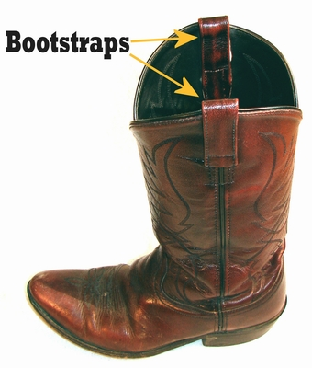
Bootstrap
Name comes from 19th C expression “pull oneself over a fence by one’s bootstrap”
Efron, B. (1979). "Bootstrap methods: Another look at the jackknife". The Annals of Statistics 7 (1): 1–26. doi:10.1214/aos/1176344552.
http://www.lemen.com/imageBootstrap1.html

Slide 14
Tricks for doing this in R
Use sample.int(nrow(X),nrow(X), replace=TRUE)to get each boostrap sample.
Use X[samp,] to get the sample.
Pre-allocate storage for results (saves time).
Make sure that all the calculations (including missing data imputation) are inside the loop.

Slide 15
Generic R code
est(X) be estimator
imp(X) be imputation function
X.est <- est(imp(X))
n<-nrow(X)
B <- 100 ## Number of bootstrap samples
best <- matrix(NA,B,length(X.est))
for (i in 1:B){
samp <- sample.int(n,n,replace=TRUE)
X.imp <- imp(X[samp,])
best[i,] <- est(X.imp)
}
X.bse <- sqrt(diag(var(best)))
X.Bbias <- X.est - colMeans(best)

