Slide 1
EDF 5484 Educational Data Analysis
Russell Almond
Lecture 1
EDF 6937 -- Bayesian Data Analysis
<number>

Slide 2
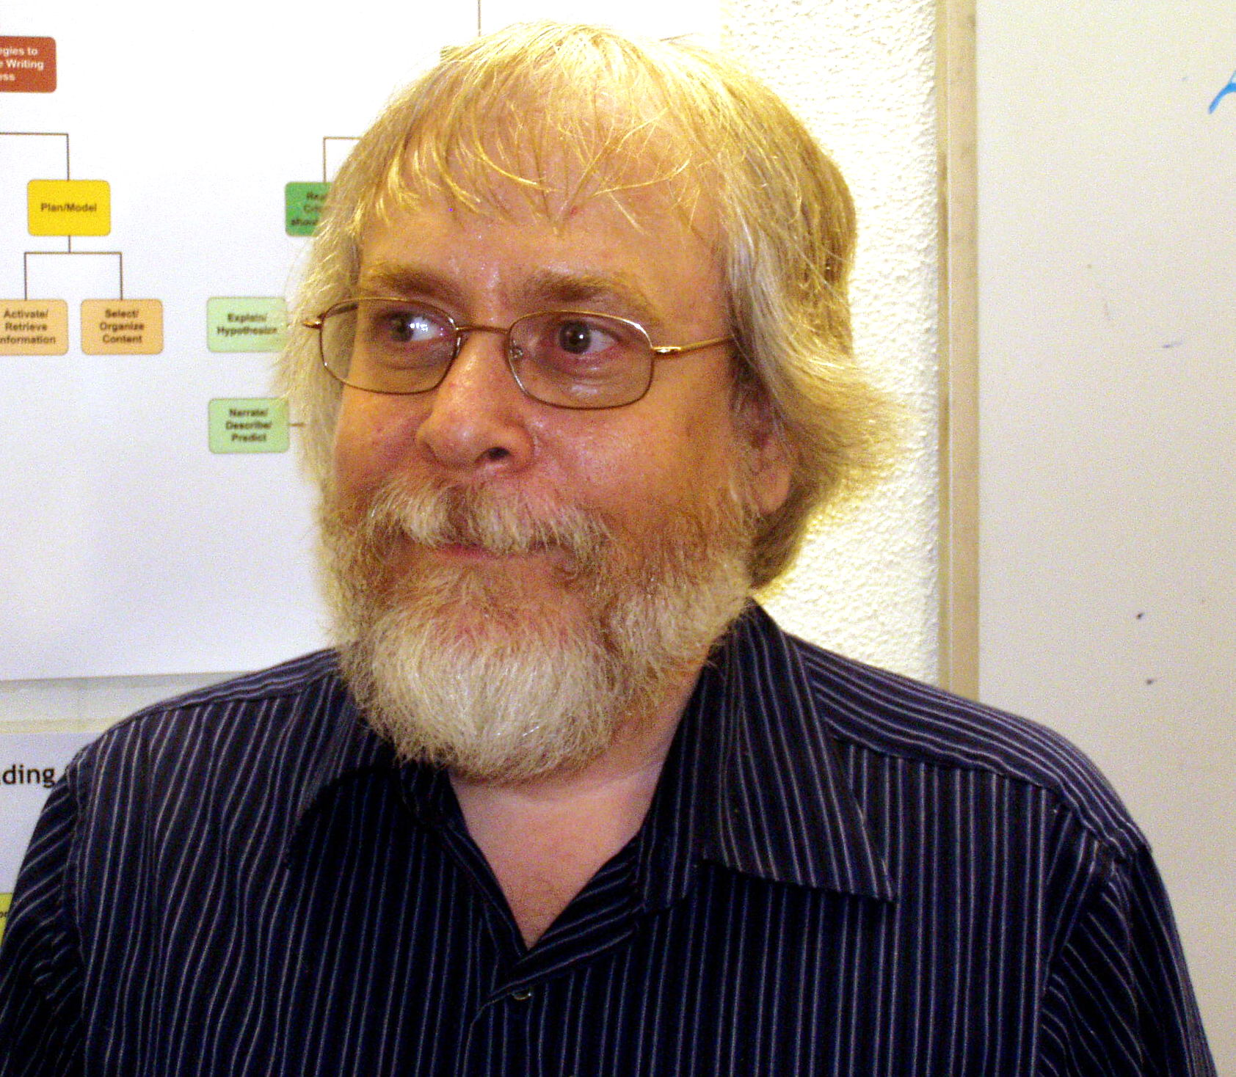
Who am I?
Russell Almond
http://ralmond.net/
Email: ralmond@fsu.edu
Skype: ralmond (in office status)
Questions welcome during lectures
Drop By 3204-J,
On Campus, TThF
Office Hours, T, Th 2—3
Calendar: http://ralmond.net/calendar.html
Lecture 1
EDF 6937 -- Missing Data
<number>
Notes:
Interrupt me with questions
<number>

Slide 3
Course Text
Required:
Gelman, A. & Hill, J. (2007). Data Analysis using Regression and Multilevel/Hierarchical Models. Cambridge University Press.
Lecture 1
<number>

Slide 4
Additional Readings
Posted on Canvas
Andy Gelman’s Blog:
http://andrewgelman.com/
Lecture 1
<number>

Slide 5
Software
R (http://www.r-project.org/)
RStudio (http://Rstudio.com/)
arm package (install.packages(“arm”)
Note R & Bugs user group Time TBD
If you want to use SAS, SPSS or something else on the class computer for case studies, let me know at least 1 week in advance.
Lecture 1
<number>

Slide 6
Concepts Covered (1)
Identify situations in which a particular (generalized) linear model is appropriate to answer a given research question with a given data set.
Perform common data analyses operations with (generalized) linear models in the R programming language.
Interpret the results of (generalized) linear models in terms of the original research questions.
Construct graphical displays (figures and tables) which summarize the results of a data analysis.
Lecture 1
<number>

Slide 7
Concepts Covered (2)
Identify situations in which transforming the variables in the data set before analysis is appropriate.
Interpret the results of analyses with transformed variables.
Employ common diagnostic statistics and plots to identify and correct difficulties with (generalized) linear models.
Simulate data from a (generalized) linear model.
Produce statistical graphics to explain key results of (generalized) linear models.
Write up the results of statistical analyses in a form suitable for the results section of a scientific journal article
Lecture 1
<number>

Slide 8
Grading Scale
Mastered all concepts, Transfer all concepts
Mastered all concepts, Transfer core concepts
Mastered core concepts
Partial Mastery
Insufficient Evidence of Mastery
Lecture 1
<number>

Slide 9
Flipping The Class
With a few exception, I will not lecture
Lecture notes posted in the class are for reference: I may or may not spontaneously talk about them.
Before each class, one of the chapters of Gelman & Hill will be assigned for reading.
Students will take turns working the homework problems in class.
Lecture 1
<number>

Slide 10
Evidence Mix
Case Studies (1/2)
Midterm Project (1/4)
Final Project (1/4)
Evidence turned in after Dec 12th will not be considered unless there are extenuating circumstances (i.e., you are getting an incomplete)
Lecture 1
<number>

Slide 11
Case Studies (1/2)
Serves dual purpose:
Forces you to verbalize your ideas about statistics, this promotes readiness-to-learn
Provides me with formative feedback
NOT graded on correctness
You are assigned problem (from book or BB).
Prepare solution
or partial solution if you get stuck
Present as much as you completed in class
Class will help you complete
Currently 8 are scheduled, but could be more/less depending on schedule.
Lecture 1
<number>

Slide 12
Case Study Procedures
There will be a Canvas discussion forum for posting Case Study solutions (so you can access them easily from class).
Must be present on day of completion
We will try to scheduled approximately when they are due when assigned
Let me know about planned travel, other commitments.
In case of excused absence will try to reschedule
Lecture 1
<number>

Slide 13
Midterm/Final Project
(each ¼ of final grade)
Find a data set and a research question.
(about 6 weeks before final due date) Get data set and research question approved.
Analyze data (however you feel appropriate)
(2 weeks before final due date): Turn in draft for feedback
(1 week before findal due date): Feedback returned
Final paper due.
Lecture 1
EDF 6937 -- Bayesian Data Analysis
<number>

Slide 14
Project Scoring Rubric
Research question properly stated and motivated
Data sufficiently described
Analysis method appropriate for research question and data
Analysis correctly carried out
Graphics and tables included to support analysis
Diagnostic analyses carried out to check appropriateness of model
Results of analysis properly interpreted and summarized
Limitations of analysis recognized
Document text follows style/usage conventions for academic papers
Figures and tables follow style/usage for presentation

Slide 15
Style Points
Commenting Code
Using descriptive variable and function names
Formatting code properly (indentation to show program structure, white space, using “<-” for assignments)
Using human readable label in plots and tables
Editing out dead-end code
Including information about data sources and meta-data.
Documenting function inputs, outputs and side-effects.
Properly parameterizing expressions (i.e., avoiding hard coded constants).
Lecture 1
<number>

Slide 16
Project Schedule
Milestone | Midterm | Final
Proposals Due | Sep 26th | Nov 13th
Project Draft | Oct 17th | Nov 29th
Project Final* | Oct 31th | Dec 12th
Lecture 1
<number>

Slide 17
Collaboration
Case Studies
Larger case studies can be assigned as a team
Use Blackboard discussion groups for help
Projects
Collaboration is possible but must be approved in advance
Each team member provides a unique piece
Lecture 1
<number>

Slide 18
Plagiarism
Plagiarism is a serious problem
People have LOST THEIR DEGREES
First time violations will be reported
See FSU policies and resources
Turn-it-in used for projects
Credit your sources!
Lecture 1
<number>

Slide 19
FSU Resources
Don’t use forums, FSU emails &c for personal purposes
All FSU emails are public record
Must use FSU email for grade-related requests
Don’t use FSU Resources to download copyrighted material not related to your class work or research!
Beware of leaving Bit Torrent clients on while connected to FSU network
Lecture 1
EDF 6937 -- Bayesian Data Analysis
<number>

Slide 20
How’s My Teaching?
Dial: 644-5203
Email: ralmond@fsu.edu
Let me know if you have problems reading material, especially if you have trouble distinguishing red from black.
Lecture 1
EDF 6937 -- Bayesian Data Analysis
<number>

Slide 21
Turning the Battleship Cruiser
 (Thumbs up) I get it already, you can skip ahead
 (Thumbs down) I’m confused, give me more detail
 (Hand up) Stop, I have a question (or issue)
Lecture 1
<number>

Slide 22
What to do if you are lost
Confusion is a part of learning
But it should be temporary
Ask questions in class!
Come visit during office hours, or make an appointment
Be specific about what is confusing you
Lecture 1
<number>

