Slide 1
Bootstrap and Jackknife
Resampling Techniques

Slide 2
Unbiased standard errors
Some single imputation techniques provide unbiased estimates of the mean
Almost all underestimate the standard error
Problem is that we are treating unknown missing data point as if it is known

Slide 3
3 methods with correct s.e.s
Stratified sampling with adjustment for effective sample size
Bootstrap standard errors
Jackknife standard errors
In both of the latter cases, the secret is that the missing data imputation must be done inside of the bootstrap/jackknife loop.

Slide 4

Jackknife
Maurice Quenouille (1949, 1956). John Tukey (1958)
Tukey gave it the name jackknife because it was like a Boy Scout’s “rough and ready” tool
Used in NAEP (jackknife weights are supplied)
http://www.wisegeek.com/what-is-a-jackknife.htm

Slide 5
Key Idea
Standard error is standard deviation of statistic over many possible samples
We can make n samples of a close size by simply leaving out each data point in turn.

Slide 6
Tricks for doing this in R
Use data[-i, ] to remove one row at a time (within loop)
Pre-allocate storage for results (saves time).
Make sure that all the calculations (including missing data imputation) are inside the loop.

Slide 7
Generic R code
est(X) be estimator
imp(X) be imputation function
X.est <- est(imp(X))
n<-nrow(X)
jest <- matrix(NA,n,length(X.est))
for (i in 1:nrow(X)){
X.imp <- imp(X[-i,])
jest[i,] <- est(X.imp)
}
X.jse <- sqrt((n-1)^2/n*diag(var(jest)))
X.jbias <- n*X.est –(n-1)*colMeans(jest))

Slide 8
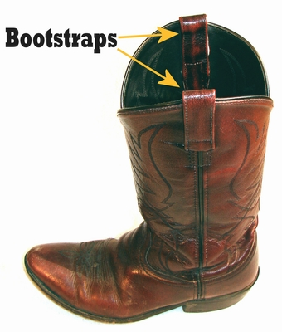
Bootstrap
Name comes from 19th C expression “pull oneself over a fence by one’s bootstrap”
Efron, B. (1979). "Bootstrap methods: Another look at the jackknife". The Annals of Statistics 7 (1): 1–26. doi:10.1214/aos/1176344552.
http://www.lemen.com/imageBootstrap1.html

Slide 9
Tricks for doing this in R
Use sample.int(nrow(X),nrow(X), replace=TRUE)to get each boostrap sample.
Use X[samp,] to get the sample.
Pre-allocate storage for results (saves time).
Make sure that all the calculations (including missing data imputation) are inside the loop.

Slide 10
Generic R code
est(X) be estimator
imp(X) be imputation function
X.est <- est(imp(X))
n<-nrow(X)
B <- 100 ## Number of bootstrap samples
best <- matrix(NA,B,length(X.est))
for (i in 1:B){
samp <- sample.int(n,n,replace=TRUE)
X.imp <- imp(X[samp,])
best[i,] <- est(X.imp)
}
X.bse <- sqrt(diag(var(best)))
X.Bbias <- X.est - colMeans(best)

