Slide 1
Multiple Imputation via Data Augmentation
And the mi package

Slide 2
Rubin’s Lazy Bayesian Approach
In the 1980s, software that did Bayesian estimation was generally unavailable
BUGS took off in mid-1990s
Also many specialized Bayesian methods have appeared since this statement
If sample size is large enough, and you pick a standard non-informative prior, then classical and Bayesian estimates are close
Variance follows an inverse chi-squared distribution with N-1 degrees of freedom and a scale factor related to the normal variance estimator
After integrating out variance, mean follows a Student’s t distribution with mean equal to sample mean and N-1 degrees of freedom
Similar results for regression and ANOVA models
Unless you have strong prior information, just do inference with standard least-squares/MLE software, assume a non-informative prior and interpret the results as classical and/or Bayesian as appropriate.

Slide 3
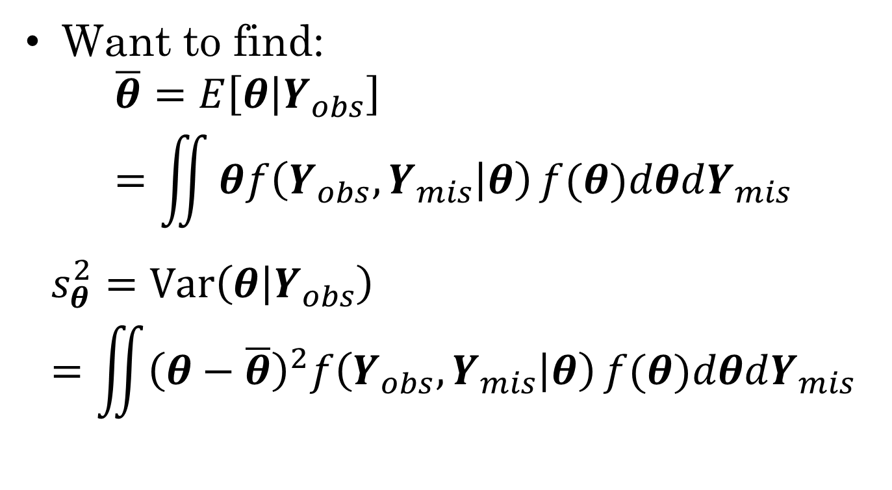
Back to the missing data problem
Want to find:
$$\overline{θ}=E\left[θ | Y_{obs}\right]=\iint{θf\left(Y_{obs},Y_{mis} | θ\right)}f(θ)dθdY_{mis}$$
$$s_{θ}^{2}=Var\left(θ | Y_{obs}\right)=\iint{{\left(θ−\overline{θ}\right)}^{2}f\left(Y_{obs},Y_{mis} | θ\right)}f(θ)dθdY_{mis}$$

Slide 4



Monte Carlo Integration
Suppose we have an integral than can be written:
Or (if X is continuous)
Note that this is an expectation:

Slide 5
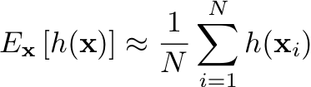

If we can sample from F(x)
Take an i.i.d. sample of size N: x₁, …, x_{N}
Then we have
Approximation (Monte Carlo) error is a random variable with variance:

Slide 6
What if F() is hard to sample from?
Only place we needed “independent” part of i.i.d. assumption was in calculation of random error.
If we relax independence, MC error is bigger, but we can compensate with bigger sample size.

Slide 7

Markov Chain
Series of random variables X₀, X₁, X₂,… such that X_{i+1} is independent of X_{i-1} given X_{i}
Past is independent of future given present
Can be defined via a transition kernel

Slide 8
Stationary distribution
If you run a Markov chain long enough, then the probability distribution of X_{i} reaches a stationary distribution
Example
1—6 are possible states of Markov chain
Stationary distribution is over states 5 & 6
This example is only good if support of distribution is just states 5 and 6
1
2
3
4
5
6

Slide 9
Markov chain Monte Carlo (MCMC)
Construct a Markov chain whose stationary distribution is f(x)
Run it until it achieves stationarity (discard earlier samples as “burn-in”)
Now perform Monte Carlo integration
Expected value is unchanged
MC error is related to the autocorrelation of the series

Slide 10

Autocorrelation
For a given lag, , the autocorrelation is defined as:
The critical factor is the lag 1 autocorrelation
Many MCMC packages and post-processing tools provide an effective sample size for the MCMC sample

Slide 11
How to make a Markov Chain
Two common techniques:
Gibbs sampler
Data Augmentation is a special case of the Gibbs sampler
Metropolis–Hastings algorithm
Gibbs sampler is actually a special case of the Metropolis–Hastings algorithm
More general still Metropolis-Hastings-Green algorithm allows Markov chains with models of different sizes (e.g., do variable selection within MCMC)

Slide 12


Gibbs Sampler
Assume unknown variables are multivariate:
Select a sequence j₁, j₂, …, j_{K}
At each step i, draw from
Note, can exploit conditional independence properties to simplify

Slide 13
Example
M
S₁
S₂
T₁
T₂
T₃
T₄
T₅
T₆
X₁
X₂
X₃
X₄
X₅
X₆
X₇
X₈
X₉
X₁₀

Slide 14
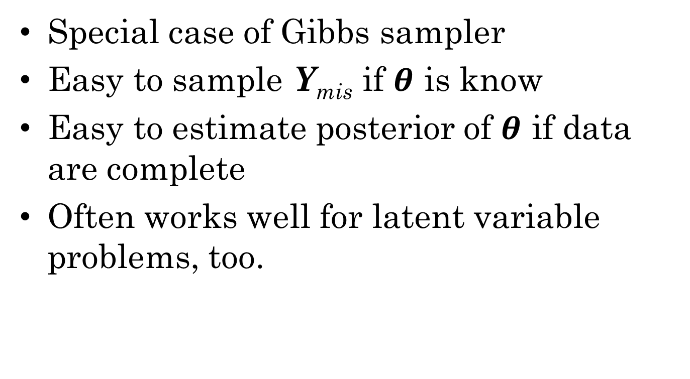
Data Augmentation
Special case of Gibbs sampler
Easy to sample Y_{mis} if $θ$ is know
Easy to estimate posterior of $θ$ if data are complete
Often works well for latent variable problems, too.

Slide 15
Assessing Convergence
MCMC has converged when it reaches is stationary distribution.
Observations before convergence are discarded as “Burn-in”
(Brooks)-Gelman-Rubin R
Start multiple chains from different starting points
Look at ratio of variance within chain to variance between chains
When this gets small (<1.1) chain is converged
Often displayed graphically

Slide 16
Mixing Speed
“Mixing” means how much draws for a given parameter can move around the space each cycle. More autocorrelation goes along with “poor mixing.”
“Better mixing” means the same number of cycles provides more information about the posterior, the ceiling being independent draws from the posterior. “Worse mixing” means more cycles are needed for (a) burn-in and (b) a given level of precision for statistics for the posteriors.
relatively good mixing
relatively bad mixing

Slide 17
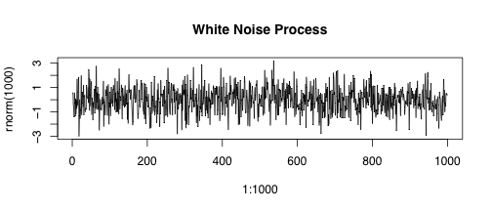
White Noise Trick
Want trace plot to look like white noise (i.i.d. normal) process
Trick: Run chain long enough so that scale compression makes series look like white noise

Slide 18
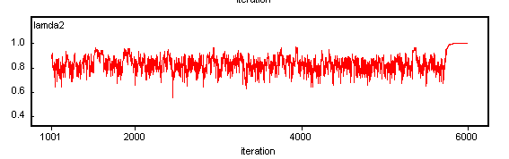
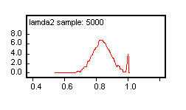
Absorbing States
An example of a violation of regularity conditions:
a Heywood case in a factor analysis run. Needed a prior on factor loadings that bounded them away from +1 and -1.

Slide 19
Multiple Imputation Trick
Inner integral (over theta) is a standard Bayesian inference problem with complete data.
We can do the outer integral by statistical sampling.
The integral asks us to calculate an expected value.
The average of a sample is a consistent estimator of expected value
Create several complete data sets using stochastic integration, then take the average over those data sets

Slide 20
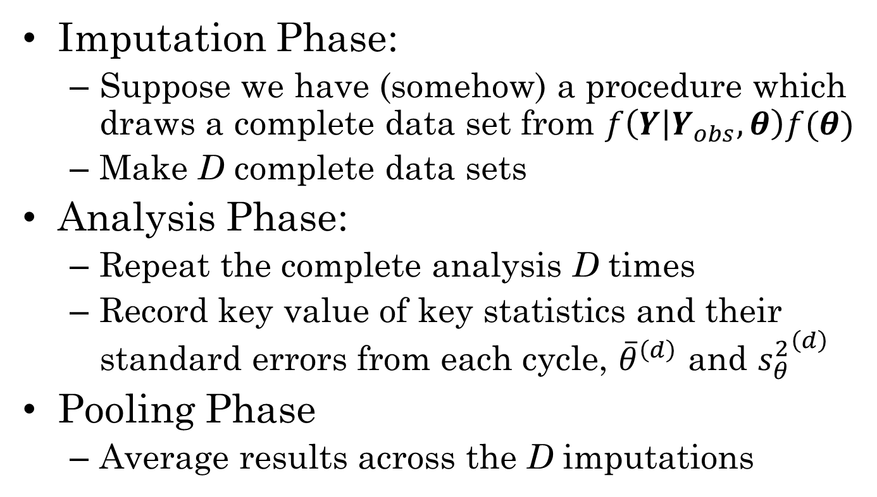
Multiple Imputation by Phases
Imputation Phase:
Suppose we have (somehow) a procedure which draws a complete data set from $f\left(Y | Y_{obs},θ\right)f(θ)$
Make D complete data sets
Analysis Phase:
Repeat the complete analysis D times
Record key value of key statistics and their standard errors from each cycle, ${\overline{θ}}^{\left(d\right)}$ and ${s_{θ}^{2}}^{\left(d\right)}$
Pooling Phase
Average results across the D imputations

Slide 21
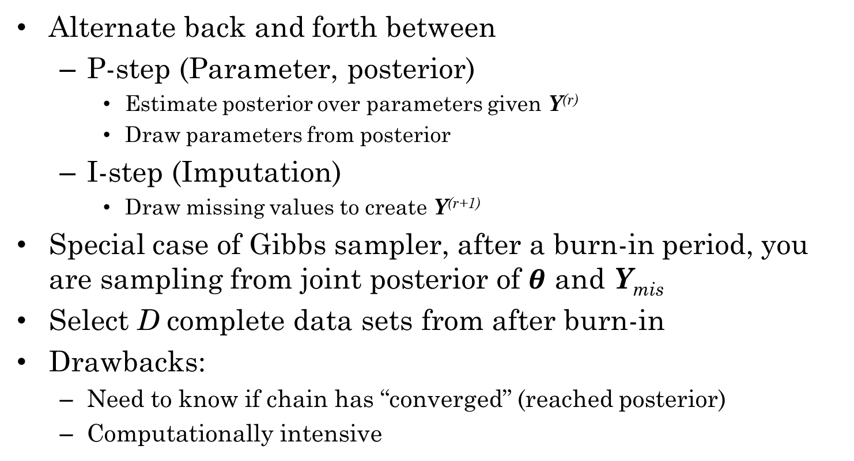
Imputation Phase Method 2: Data Augmentation
Alternate back and forth between
P-step (Parameter, posterior)
Estimate posterior over parameters given Y^{(r)}
Draw parameters from posterior
I-step (Imputation)
Draw missing values to create Y^{(r+1)}
Special case of Gibbs sampler, after a burn-in period, you are sampling from joint posterior of $θ$ and Y_{mis}
Select D complete data sets from after burn-in
Drawbacks:
Need to know if chain has “converged” (reached posterior)
Computationally intensive

Slide 22

Markov chains
Data Augmentation results in a Markov chain whose stationary distribution is $f(Y_{mis},θ)$

Slide 23
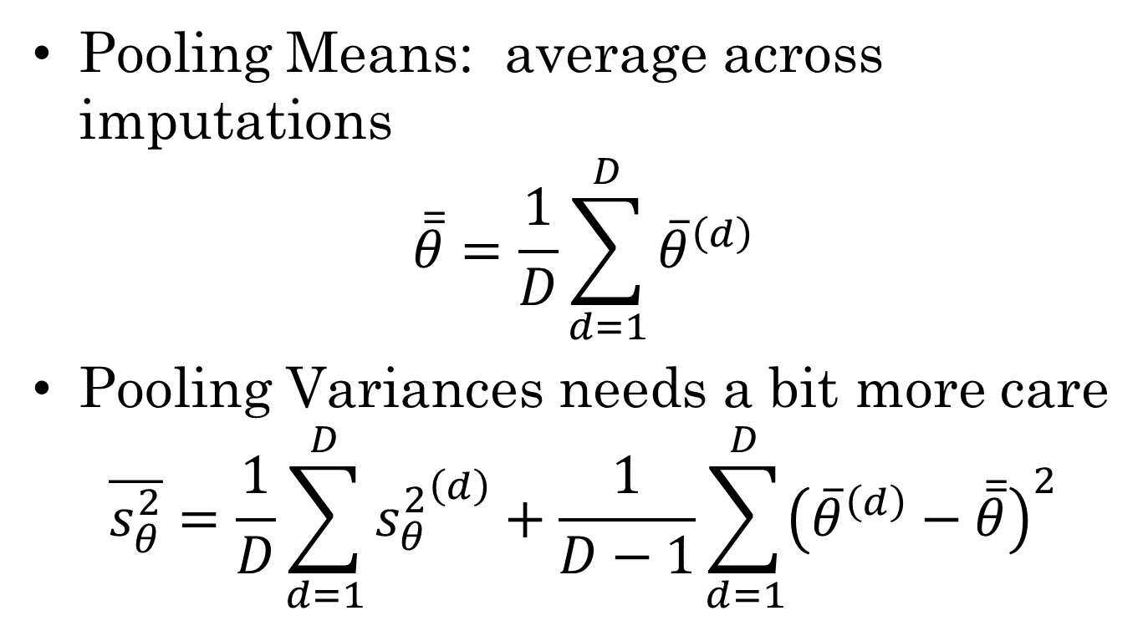
Pooling Phase
Pooling Means: average across imputations
$$\overline{\overline{θ}}=\frac{1}{D}\sum_{d=1}^{D}{{\overline{θ}}^{\left(d\right)}}$$
Pooling Variances needs a bit more care
$$\overline{s_{θ}^{2}}=\frac{1}{D}\sum_{d=1}^{D}{{s_{θ}^{2}}^{\left(d\right)}}+\frac{1}{D−1}\sum_{d=1}^{D}{{\left({\overline{θ}}^{\left(d\right)}−\overline{\overline{θ}}\right)}^{2}}$$

Slide 24
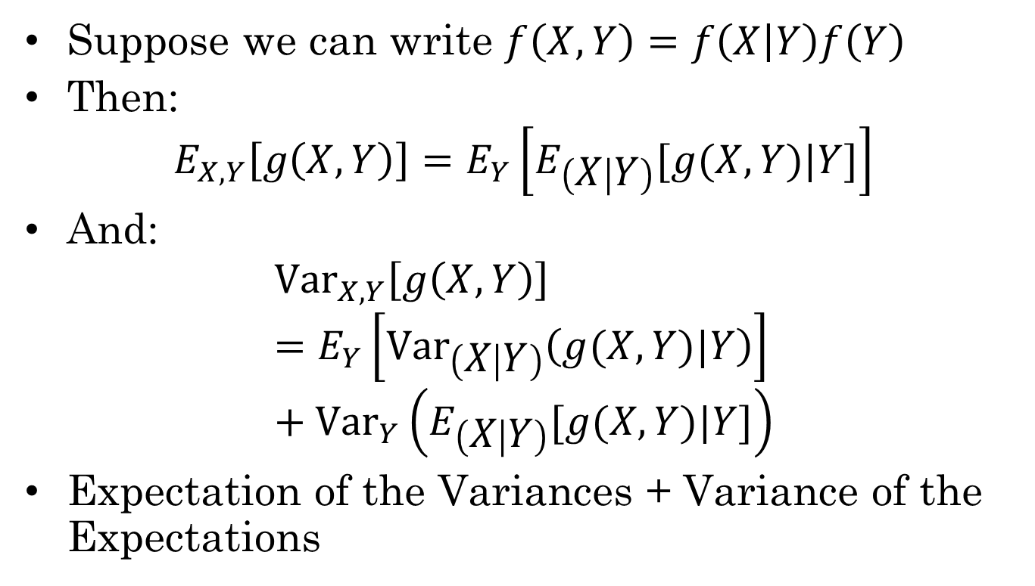
Expectation and Variance of conditional distribution
Suppose we can write $f\left(X,Y\right)=f\left(X | Y\right)f\left(Y\right)$
Then:
$$E_{X,Y}\left[g\left(X,Y\right)\right]=E_{Y}\left[E_{\left(X | Y\right)}[g(X,Y)|Y]\right]$$
And:
$${Var}_{X,Y}\left[g\left(X,Y\right)\right]=E_{Y}\left[{Var}_{\left(X | Y\right)}\left(g(X,Y)|Y\right)\right]+{Var}_{Y}\left(E_{\left(X | Y\right)}[g(X,Y)|Y]\right)$$
Expectation of the Variances + Variance of the Expectations

Slide 25
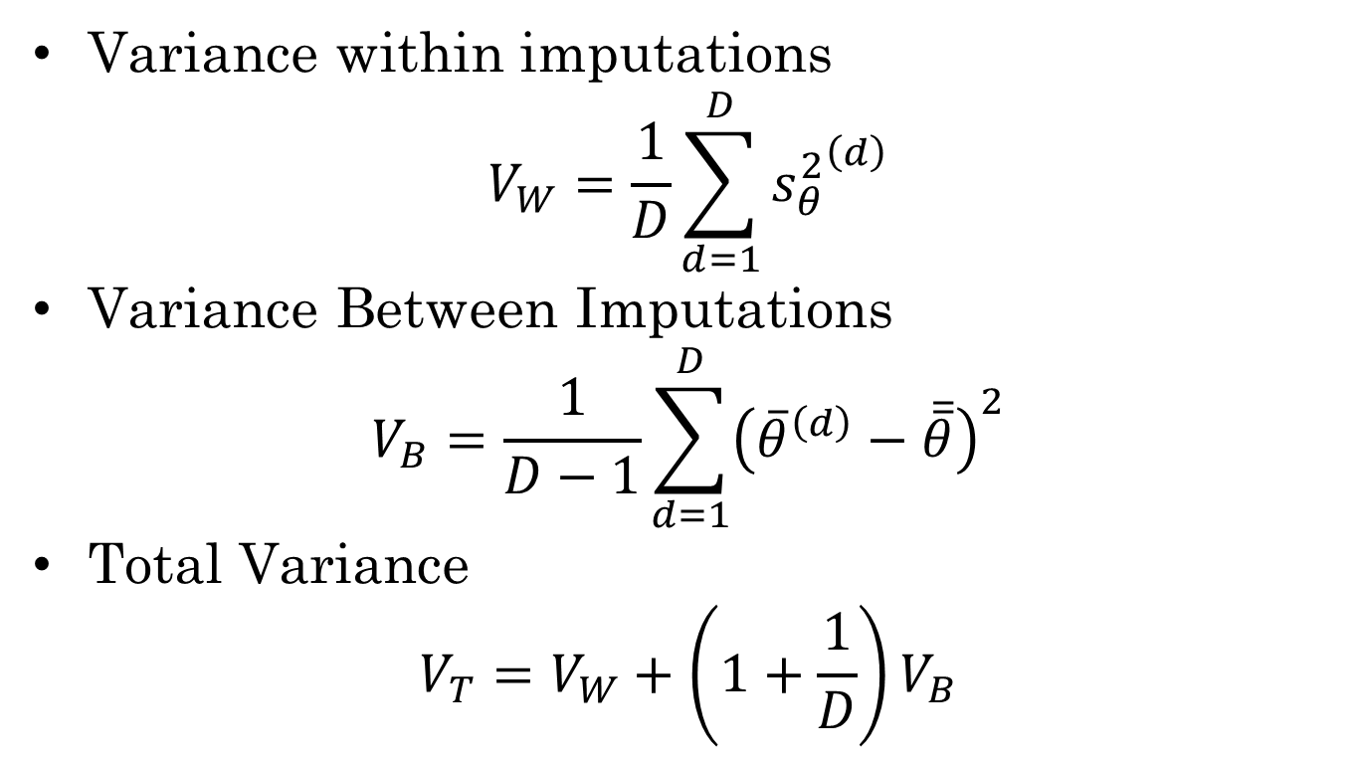
Analysis of Imputation Variance
Variance within imputations
$$V_{W}=\frac{1}{D}\sum_{d=1}^{D}{{s_{θ}^{2}}^{\left(d\right)}}$$
Variance Between Imputations
$$V_{B}=\frac{1}{D−1}\sum_{d=1}^{D}{{\left({\overline{θ}}^{\left(d\right)}−\overline{\overline{θ}}\right)}^{2}}$$
Total Variance
$$V_{T}=V_{W}+\left(1+\frac{1}{D}\right)V_{B}$$

Slide 26
Three R packages
mitools – tools for the analysis and pooling phases
Need other software to handle imputation
Amelia – environment for MI using bootstrap to get parameter information.
Uses Bayesian Bootstrap approach
mi – A bootstrap environment using Data Augmentation
Uses Data Augmentation

Slide 27
mitools
Assumes some other tool used generate the plausible values (possibly stored in an external file).
Create an imputationList from a list of data frames (plausible values)
The with() command applies analyses to each plausible values
MIcombine() combines the results of multiple lm()/glm() analyses.
MIextract() extracts parameter values from list of results.

Slide 28
mi
Does multiple imputation using data augmentation (MCMC) algorithm
Takes care of imputation, analysis and pooling phases.
Uses bayesglm() for analysis phase
Supports family= argument, like glm()
Supports parallel processing on multicore computers.

Slide 29
Parallel Processing
If your computer has multiple CPU cores (most due these days), then simply run MCMC on each of them.
This works very simply under Unix/Linux, Windows has weird load-balancing overhead (mi defaults to parallel on *nix and not-parallel on Windows)
Figure out how many Cores your system has (open TaskManager (Windows), AboutThisMac or SystemMonitor(Ubuntu))
Reserve 1 core for system and GUI, maybe another one or two if you are going to be doing work on the computer while the MCMC is running.
Set the mc.cores option to the number of cores you want to dedicate
options(mc.cores=5)

Slide 30
missing_variable
Variable + meta-data on imputation model
Called by missing_data.frame()
Type argument tells what the data is (guessed if not supplied)
Use ordered and factor classes to help guessing.
favor_ordered = TRUE : guess the variables with small number of possible values are ordered categories
favor_positive = FALSE : guess that variables are positive

Slide 31
Missing Variable Classes
Class Name | Default Family & Link | Default fit_model
missing_variable | <abstract> | <error>
categorical | <abstract> | <error>
unordered-categorical | binomial(link=‘logit’) | multinom
ordered-categorical | binomial(link=‘logit’) | bayespolr
binary | binomial(link=‘logit’) | bayesglm
interval | gaussian(link=‘identity’) | survreg
continuous[standardize] | gaussian(link=‘identity’) | bayesglm
semi-continuous[identity]
nonnegative-continuous [logshift]
SC_proportion[squeeze] | binomial(link=‘logit’) | betareg
positive-continuous [log]
proportion[identity] | binomial(link=‘logit’) | betareg
bounded-continuous [identity]
count | quasipoisson(link=‘log’) | Bayesglm
irrelevant |  | <error>
fixed |  | <error>

Slide 32
missing_data.frame
Like an ordinary data frame, but has extra meta-data on how to impute missing values.
Default coercion method: mdat <- missing_data.frame(data)
Arguments:
favor_ordered = TRUE
favor_positive = FALSE

Slide 33
Methods on the mi class.
change() – fixes bad guesses on variable classes
hist() – histograms for variables
image() – visualize missingness pattern
mi() – do the imputations
show() – describes missing variable classes
summary() – same as summary.data.frame()

Slide 34
To fix bad guesses use change()
change(data, y, to, what, …)
The first arg is the missing_data.frame, second is name of variable to change.
The what arg says what is to be changed
family
link
imputation_method
model
size
transformation (to= identity, standardize, log, logshift, sqrt]
type
The to arg gives the new value.

Slide 35
Do the imputations
imps <- mi(mdf, n.iter=30, n.chains=3, max.minutes=20)
n.iter – number of iterations. Should probably be at least 20, can add more later if needed.
mi(imps, n.iter=10) adds another 10 imputations.
n.chains – number of chains. Need at least 2 to get Rhats
max.minutes – time limit

Slide 36
Checking Convergence
round(mipply(imputations, mean, to.matrix=TRUE), 3)
mipply() is like sapply() only over imputations.
Rhats(imputations) calculates Gelman-Rubin R (requires at least two chains).

Slide 37
Analysis and pooling
pool(formula, imputations, m= , FUN=, …)
Figures out what model to use depending on dependent variable in formula, or using FUN argument.
By default uses all imputations, but can select a subset using m argument
Fits model and does pooling

Slide 38
Saving imputed data sets
complete(imputations, m) returns a list of m fully imputed data sets.
Can then write these out to files (use lapply to iterate over the imputed data sets).
imputationList() -- can be used on the output to allow using the mitools package.
mi2stata() – saves all imputations as one big data set, can use “.csv” on filename argument to get CSV output instead.

