Slide 1
Deletion and Imputation Methods
Simple and Traditional Ways of Handling Missing Data

Slide 2
Deleting Incomplete Cases
List-wise Deletion (Complete Case Analysis)
Pair-wise Deletion (Available Case Analysis)
Both require MCAR to produce unbiased estimates of means, variances & correlations

Slide 3
List-wise Deletion
If any variable is missing delete the whole row
Unbiased only if MCAR
Loss of power
Depends on fraction of data lost
Size of complete data sample

Slide 4
Pair-wise Deletion
For calculations involving X and Y, only omit the pair if one of X or Y is missing for that row, not if some other variable Z is missing for this row.
Less severe data loss than with List-wise deletion
Normally used with correlation matrixes
Multiple regression
Factor Analysis/SEM

Slide 5
Bad Correlations
Use all available X values to calculate Var(X)
Use all available Y values to calculate Var(Y)
Use all values available for both X and Y to calculate Cov(X,Y)
The correlation might be bigger than 1 if the pattern of missing values for X and Y are not the same

Slide 6
Positive Definite Covariance Matrix
For a normal distribution, a covariance matrix must be positive definite, that is, we must be able to find a matrix A, such that Σ=A^{T}A.
If this is not true, we will run into problems when performing a regression
Pair-wise deletion does not guarantee that the covariance matrix will be positive definite

Slide 7
Imputation Method
Key idea: Fill in missing values with a plausible value
Can then do normal complete data analysis (using SPSS or whatever)
Depending on method, may work alright in MAR cases
Overstates power (as power goes with the filled in sample)

Slide 8
Mean Imputation
Take the mean of each column. Fill in the missing values with the column mean.
Sometimes the imputed value is not a legal value (proportion instead of a binary response, rational number instead of an integer)
If MCAR
Unbiased for estimating marginal means
Underestimates variances
Overestimates correlations

Slide 9
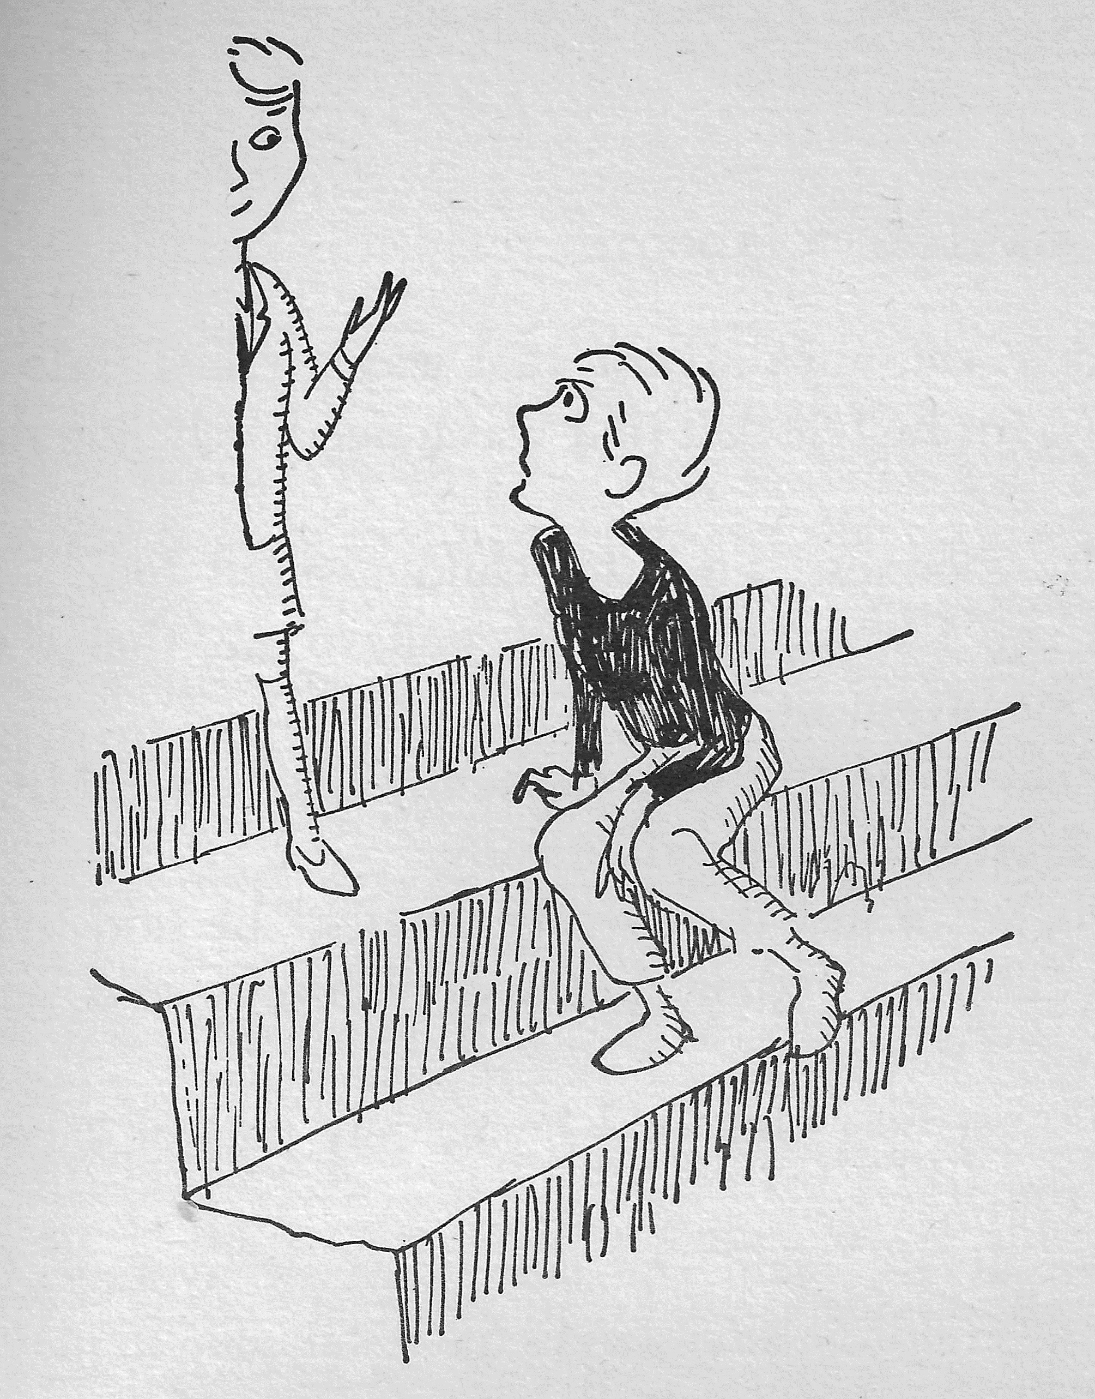
The .58 Boy
“Oh, we’re just the average family,” he said thoughtfully; “mother, father, and 2.58 children—and, as I explained, I’m the .58”
Norman Juster, The Phantom Tollbooth, p196
Illustration by Jules Feiffer, p 195

Slide 10
Conditional Mean/Regression Imputation
Conditional Mean
ANOVA framework, divide data up into cells based on discrete variables
Impute the cell mean
Regression Imputation
Build regression model for missing values given complete cases
Use the prediction from the regression model to impute missing value
Two methods are mathematically equivalent (code categorical variables with dummy variables)
Poststratification/Raking is a version of conditional mean imputation

Slide 11
Stratified Random Sampling
Divide population up into J strata
N = N₁ + … + N_{J}
Let r_{j} be the number of people in strata j who responded and let r=r₁+…+r_{J}
Assume data are MCAR within strata

Slide 12
Variance Estimate
Can make an adjustment to S.E. to get a better estimate of the variance
Related to the idea of “raking” in a classification table.

Slide 13
Stochastic Regression Imputation
Instead of sampling from the predicted value, sample a residual as well and add that to the prediction
Improves the estimates of correlations, but it still overstates our confidence in the sample (variances are too high and apparent power is higher than actual power).

Slide 14
Residual Variance
Recall that our model had a nuisance parameter, the variance of the the residuals (book, )
Almost all of the standard errors we will calculate are based on this

Slide 15
Standard Error of the Slope
The standard error for b₁ is
Can perform a t-test for b₁=0
t-values bigger than 2 unlikely due to chance error
(Also confidence interval)
Often used as alternative for F-test or test for correlation coefficient

Slide 16
Prediction Error
Two sources of prediction error:
True regression coefficients are unknown and must be estimated from data
Data points do not typically fall exactly on regression line
Standard error of predict depends on what question you are asking:
How good is the prediction for the expected value (mean) of Y when X=x_{p}? (In SPSS Mean)
How good is the prediction for an individual Y when X=x_{p}? (In SPSS Individual)

Slide 17
Mean Prediction
“What is the average math scores across all students with a self-efficacy score of 7.0?”
Error sources:
Estimation error in estimating regression line

Slide 18
Mean Prediction Interval
The standard error for the mean can be estimated from the residual variance s²
Note: The estimation error is smallest at the mean and gets bigger as you get farther away

Slide 19
Standard Error of Regression Line

Slide 20
Individual Prediction
“What are likely values for the math score for James Goodfellow, who has a self-efficacy of 7.0?”
Expected value from regression line
Two sources of variability:
Estimation of regression line
Individual variability around regression line (residual standard error)

Slide 21
Individual Prediction
Now need to add variability around the regression line to variability of the regression line
Can use t-distribution to form confidence intervals

Slide 22
Prediction standard errors

Slide 23
Conditional Means properties
If MAR
Unbiased estimates of means
Variances underestimated
Correlations overestimated
Assumes residuals are approximately normal

Slide 24
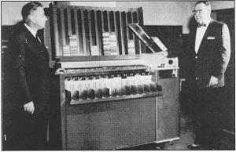
Hot Deck Imputation
Sort the data set into groups based on complete variables (e.g., census tract)
Pull a random card off of the stack to impute
Stochastic conditional means imputation that does not assume normality
Card sorter, image credit, Wikipedia

Slide 25
Similar Response Pattern
Similar to Hot Deck, except we look at a neighborhood of the data point
Define a distance metric over observable variables
Scaling can be difficult, Mahalanobis distance?
Implemented in Lisrel

Slide 26
Averaging Available Items
Usually done on using questionnaires
All items on the same scale (e.g., depression) are averaged and then divide by the number of items answered.
Assumes that all items have the same “difficulty”
Does skipping “Have thoughts about HOW to commit suicide” = skipping “Fatigue”

Slide 27
Time Series Methods
In panel data, if somebody drops out, you can carry their last observation forward
Will be a biased estimate if there is growth going on.
Many filters have a “smoothing” option that will fill in whole is missing values according to the local trend

Slide 28
Single vs Multiple Imputation
All single imputation methods underestimate variances
Pretend we know Y_{mis} when we actually only have partial information about it
Rubin suggests multiple imputation, that is creating 3 – 5 data sets to capture that variability
Multiple imputation and EM methods generally do better than single imputation, but understanding single imputation is the basis of multiple imputation.

