Slide 1
EM Algorithm
An iterative answer to ML/MAP estimation

Slide 2
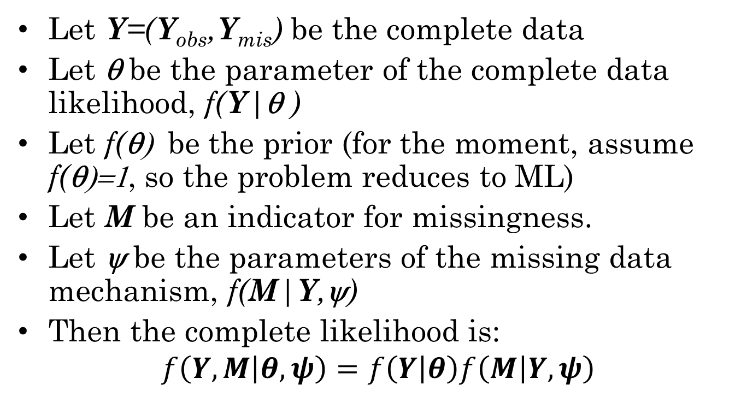
ML (MAP) with missing data
Let Y=(Y_{obs},Y_{mis}) be the complete data
Let θ be the parameter of the complete data likelihood, f(Y|θ )
Let f(θ) be the prior (for the moment, assume f(θ)=1, so the problem reduces to ML)
Let M be an indicator for missingness.
Let ψ be the parameters of the missing data mechanism, f(M|Y,ψ)
Then the complete likelihood is:
$$f\left(Y,M | θ,ψ\right)=f\left(Y | θ\right)f\left(M | Y,ψ\right)$$

Slide 3
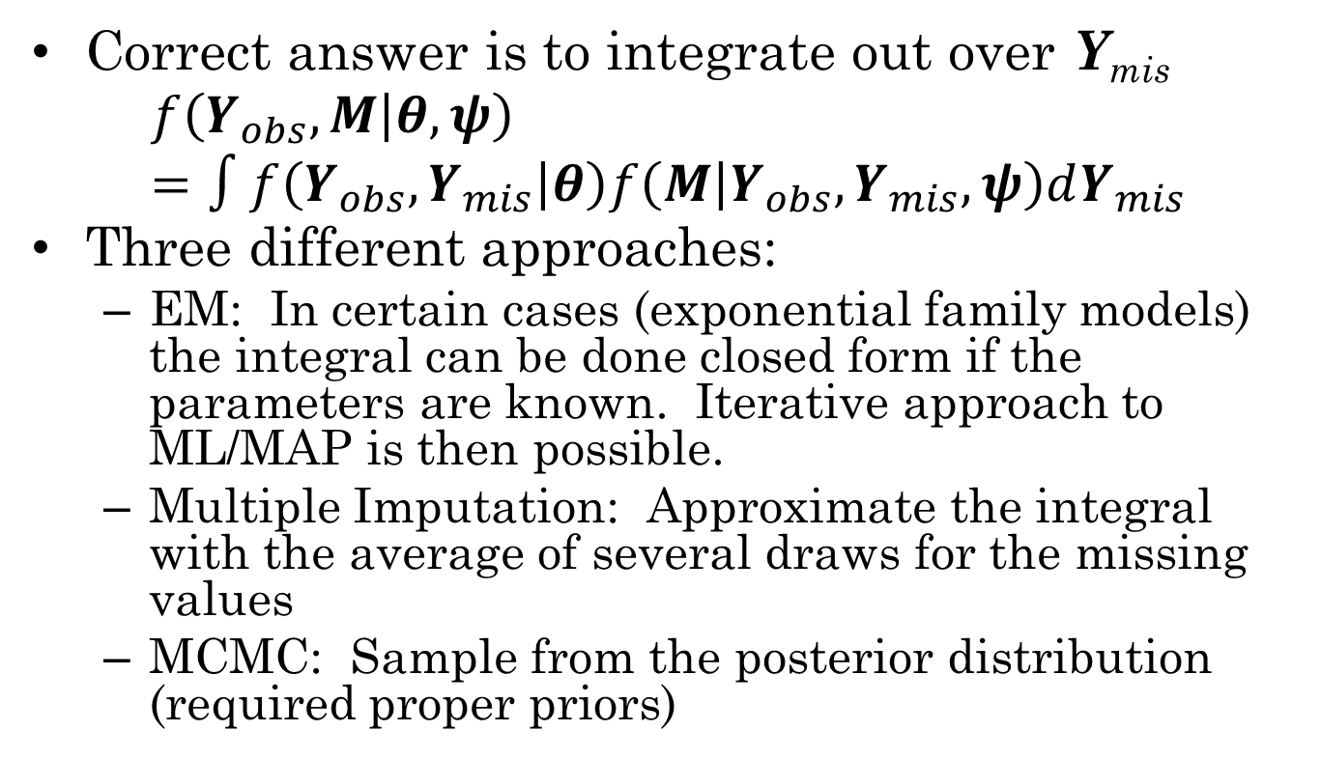
Getting rid of Y_{mis}
Correct answer is to integrate out over Y_{mis}
$$f\left(Y_{obs},M | θ,ψ\right)=∫f\left(Y_{obs},Y_{mis} | θ\right)f\left(M | Y_{obs},Y_{mis},ψ\right)dY_{mis}$$
Three different approaches:
EM: In certain cases (exponential family models) the integral can be done closed form if the parameters are known. Iterative approach to ML/MAP is then possible.
Multiple Imputation: Approximate the integral with the average of several draws for the missing values
MCMC: Sample from the posterior distribution (required proper priors)

Slide 4
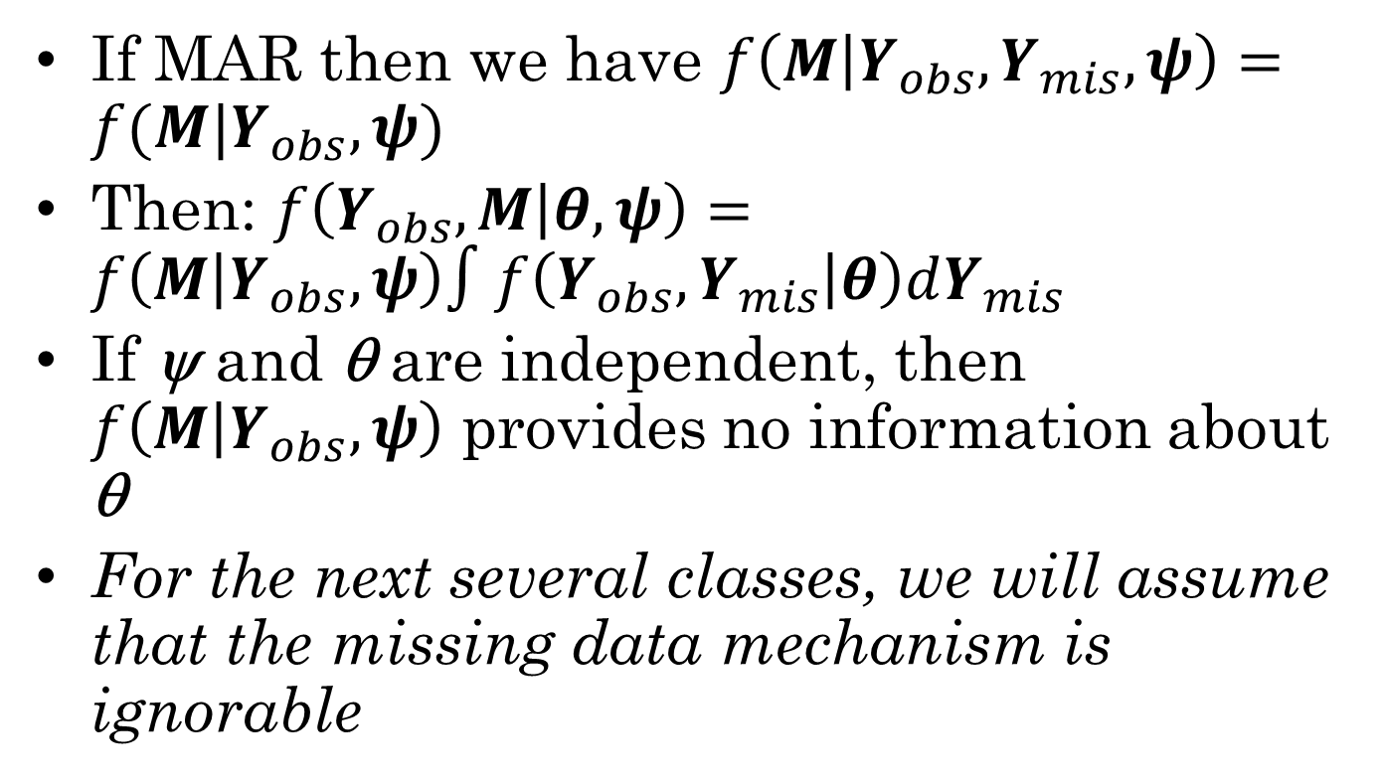
Ignorable Mechanisms
If MAR then we have $f\left(M | Y_{obs},Y_{mis},ψ\right)=f(M|Y_{obs},ψ)$
Then: $f\left(Y_{obs},M | θ,ψ\right)=f\left(M | Y_{obs},ψ\right)∫f\left(Y_{obs},Y_{mis} | θ\right)dY_{mis}$
If ψ and θ are independent, then $f\left(M | Y_{obs},ψ\right)$ provides no information about θ
For the next several classes, we will assume that the missing data mechanism is ignorable

Slide 5
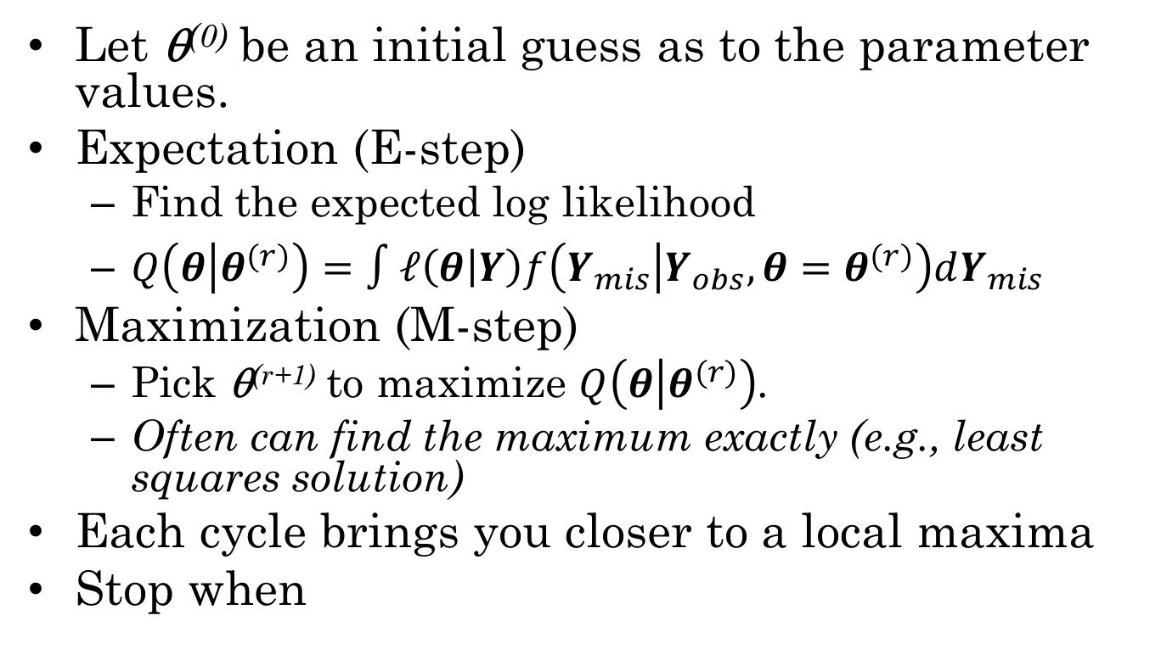
EM Algorithm
Let θ⁽⁰⁾ be an initial guess as to the parameter values.
Expectation (E-step)
Find the expected log likelihood
$Q\left(θ | θ^{(r)}\right)=∫ℓ\left(θ | Y\right)f\left(Y_{mis} | Y_{obs},θ=θ^{(r)}\right)dY_{mis}$
Maximization (M-step)
Pick θ^{(r+1)} to maximize $Q\left(θ | θ^{(r)}\right)$.
Often can find the maximum exactly (e.g., least squares solution)
Each cycle brings you closer to a local maxima
Stop when

Slide 6
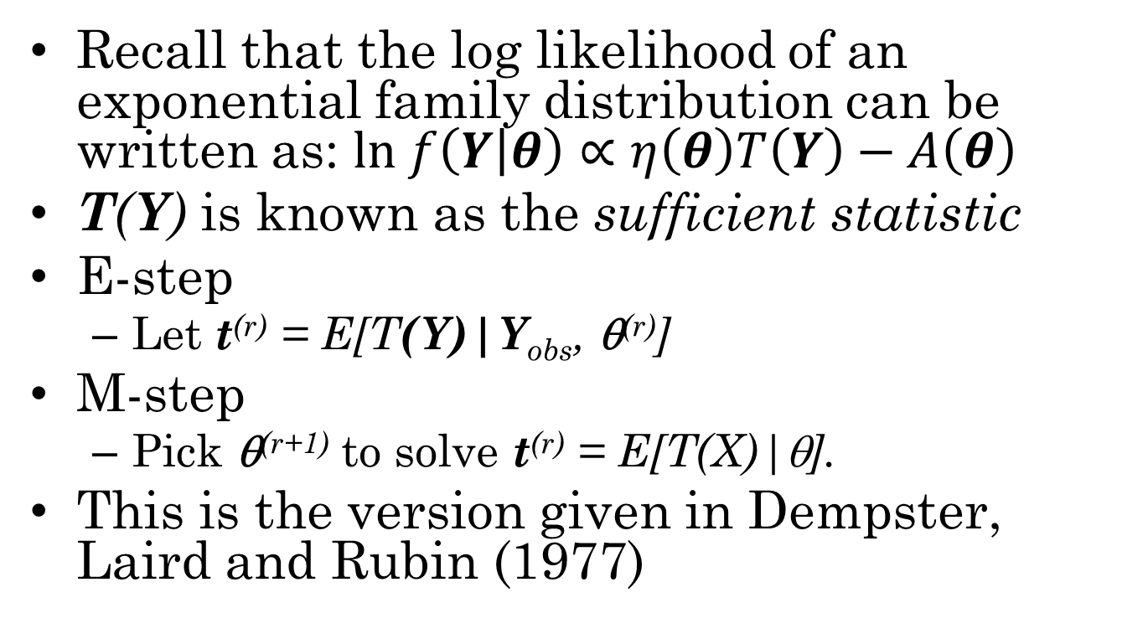
EM for Exponential Family
Recall that the log likelihood of an exponential family distribution can be written as: $ln f\left(Y | θ\right)∝η\left(θ\right)T\left(Y\right)−A\left(θ\right)$
T(Y) is known as the sufficient statistic
E-step
Let t^{(r)} = E[T(Y)|Y_{obs}, θ^{(r)}]
M-step
Pick θ^{(r+1)} to solve t^{(r)} = E[T(X)|θ].
This is the version given in Dempster, Laird and Rubin (1977)

Slide 7
Intuition
An intuitive view of the algorithm is that we are alternatively doing a mean (regression) imputation on the missing values and maximizing the likelihood.
This, however, works only if the log likelihood is liner in the missing values.
The log likelihood is linear in the sufficient statistics, so we can fill those in instead.

Slide 8
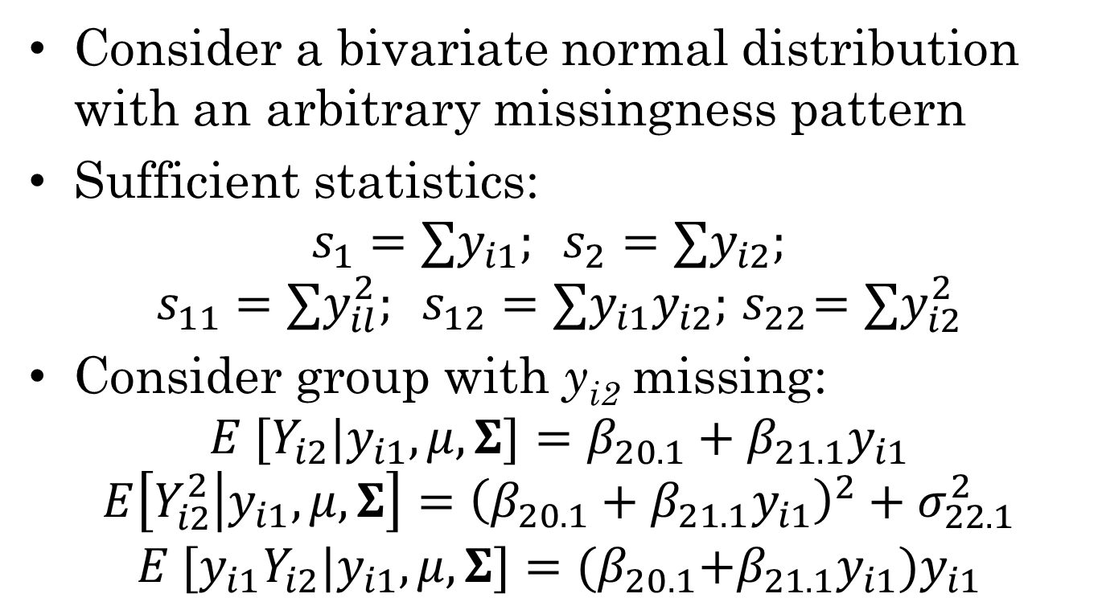
Bivariate Normal Example
Consider a bivariate normal distribution with an arbitrary missingness pattern
Sufficient statistics:
$$s_{1}=∑y_{i1}; s_{2}=∑y_{i2};$$
$$s_{11}=∑y_{il}^{2}; s_{12}=∑y_{i1}y_{i2};{ s}_{22}=∑y_{i2}^{2}$$
Consider group with y_{i2} missing:
$$E [Y_{i2}|y_{i1},μ,Σ]=β_{20.1}+β_{21.1}y_{i1}$$
$$E\left[Y_{i2}^{2} | y_{i1},μ,Σ\right]={\left(β_{20.1}+β_{21.1}y_{i1}\right)}^{2}+σ_{22.1}^{2}$$
$$E [{y_{i1}Y}_{i2}|y_{i1},μ,Σ]={(β}_{20.1}+β_{21.1}y_{i1})y_{i1}$$

Slide 9
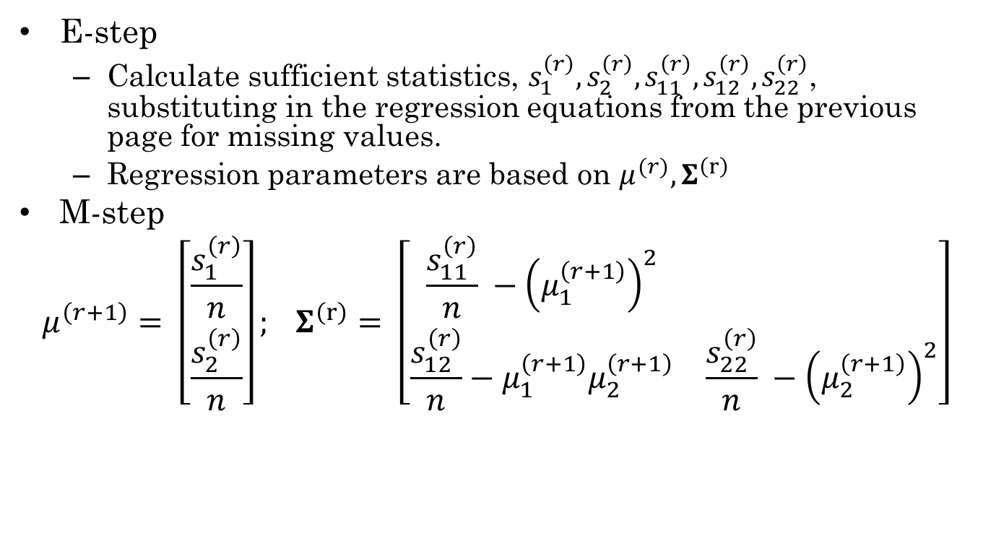
EM Algorithm
E-step
Calculate sufficient statistics, $s_{1}^{\left(r\right)},s_{2}^{\left(r\right)}, s_{11}^{\left(r\right)}, s_{12}^{\left(r\right)},s_{22}^{\left(r\right)}$, substituting in the regression equations from the previous page for missing values.
Regression parameters are based on $μ^{(r)}, Σ^{\left(r\right)}$
M-step
$$μ^{\left(r+1\right)}= \left[\begin{aligned}\frac{s_{1}^{\left(r\right)}}{n} \\ \frac{s_{2}^{\left(r\right)}}{n}\end{aligned}\right]; Σ^{\left(r\right)}= \left[\begin{matrix}\frac{s_{11}^{\left(r\right)}}{n} −{\left(μ_{1}^{\left(r+1\right)}\right)}^{2} & \\ \frac{s_{12}^{\left(r\right)}}{n}−μ_{1}^{\left(r+1\right)}μ_{2}^{\left(r+1\right)} & \frac{s_{22}^{\left(r\right)}}{n} −{\left(μ_{2}^{\left(r+1\right)}\right)}^{2}\end{matrix}\right]$$

Slide 10
Problems with EM
Can be slow (sometimes glacially)
Converges to local not global maximum
Second derivative of likelihood around maximum gives standard errors for parameters, but …
Standard errors for functions of parameters may be difficult to determine

Slide 11
Multiple Starting Points
For missing data problems, first use deletion methods to get an approximate mean vector and s.e.s for parameters
中Center of distribution – Stick in the mean vector
上 Up – Go 2 or 3 s.e.’s up from the center
下 Down – Go 2 or 3 s.e.’ down from the center
上下 Mixed some parameters up, some down.

Slide 12
Latent Variable Models
EM is the go-to algorithm for models with latent variables (e.g., factor analysis, item response theory)
Latent variables are “missing variables”
Algorithm alternates between finding expected values over latent variables, and maximizing the likelihood.

Slide 13
Marginal Maximum Likelihood as EM
E-step
Calculate expected θ_{i} distribution for every individual
In BILOG this was done by calculating probability θ_{i} was at one of a number of quadrature points
M-step
Maximize item parameters (now just a logistic regression model)

Slide 14
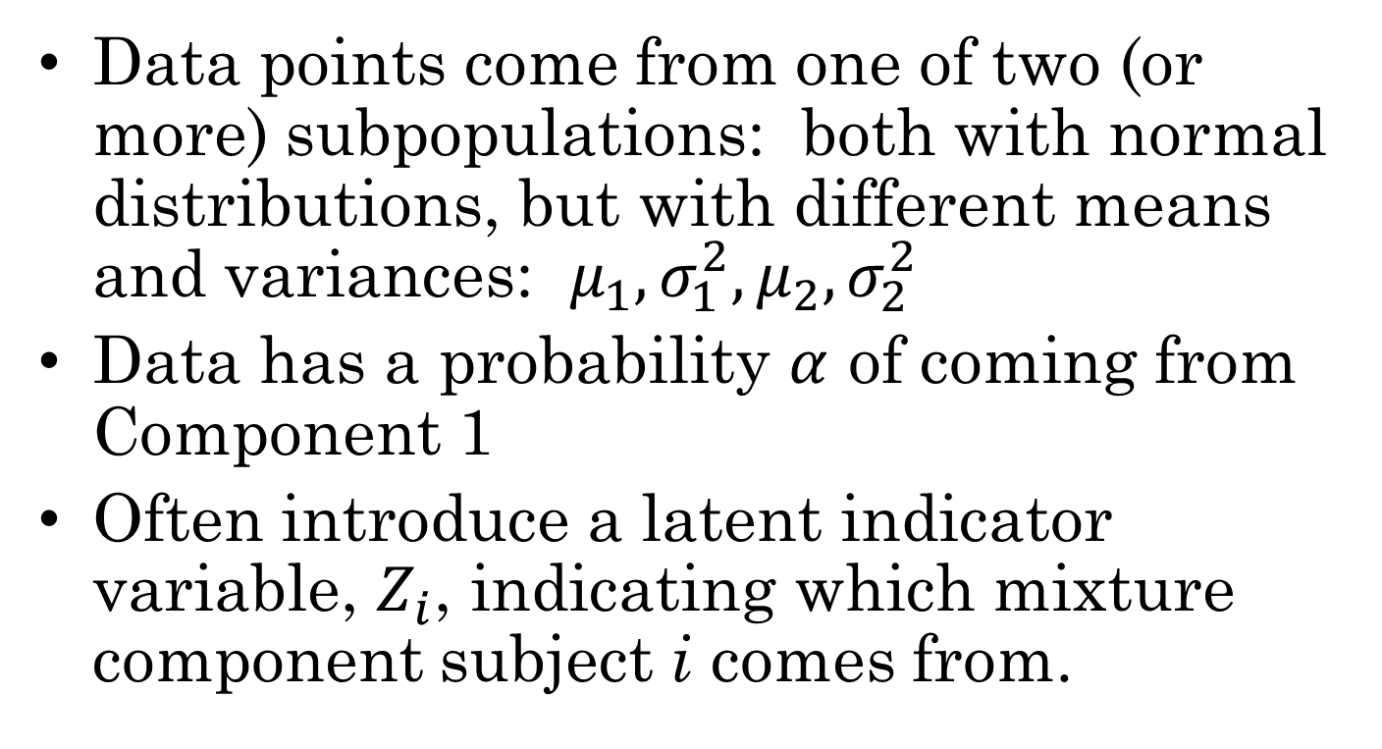
Mixture Model
Data points come from one of two (or more) subpopulations: both with normal distributions, but with different means and variances: $μ_{1},σ_{1}^{2}, μ_{2}, σ_{2}^{2}$
Data has a probability $α$ of coming from Component 1
Often introduce a latent indicator variable, $Z_{i}$, indicating which mixture component subject i comes from.

Slide 15
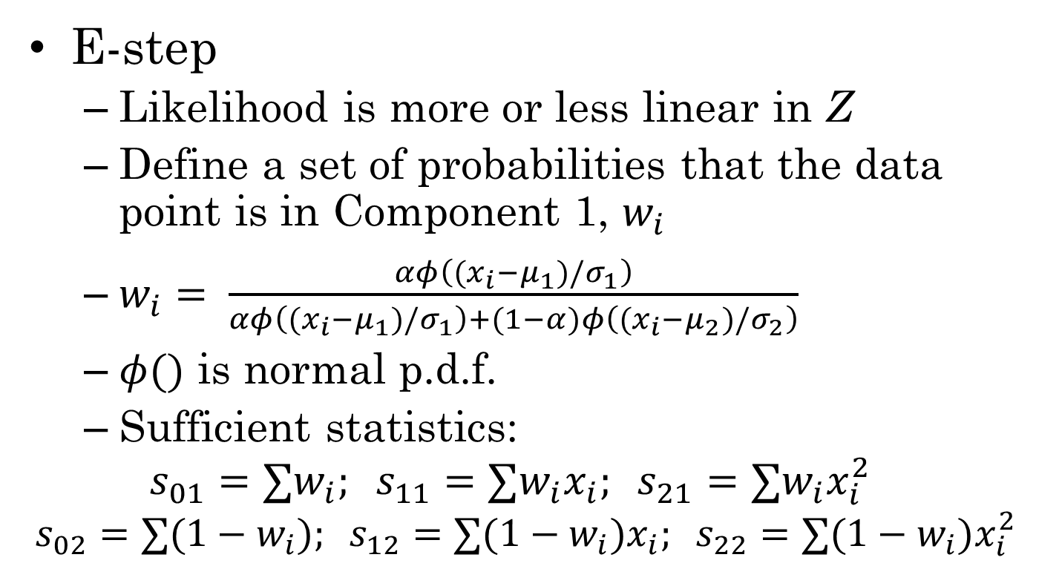
The EM algorithm for mixture data
E-step
Likelihood is more or less linear in Z
Define a set of probabilities that the data point is in Component 1, $w_{i}$
$w_{i}= \frac{αφ\left((x_{i}−μ_{1})/σ_{1}\right)}{αφ\left((x_{i}−μ_{1})/σ_{1}\right)+(1−α)φ\left((x_{i}−μ_{2})/σ_{2}\right)}$
$φ()$ is normal p.d.f.
Sufficient statistics:
$$s_{01}=∑w_{i}; s_{11}=∑w_{i}x_{i}; s_{21}=∑w_{i}x_{i}^{2}$$
$$s_{02}=∑(1−w_{i}); s_{12}=∑{(1−w}_{i})x_{i}; s_{22}=∑{(1−w}_{i})x_{i}^{2}$$

Slide 16

The EM algorithm for mixture data
The M-step
$$μ_{k}^{\left(r+1\right)}=\frac{s_{1k}^{\left(r\right)}}{s_{0k}^{\left(r\right)}}$$
$${\left(σ_{k}^{\left(r+1\right)}\right)}^{2}=\frac{s_{2k}^{\left(r\right)}−{\left(s_{1k}^{\left(r\right)}\right)}^{2}}{s_{0k}^{\left(r\right)}}$$
$$α^{\left(r+1\right)}=\frac{s_{01}^{\left(r\right)}}{s_{01}^{\left(r\right)}+s_{02}^{\left(r\right)}}$$

Slide 17
“Data Augmentation”
Often can introduce an extra variables to make a non-exponential family model into an exponential family model.
Example 1: Normal mixture model. Introduce an indicator variable for which mixture component each subject comes from.
Distribution is now product of categorical and normal distributions.
M-step is a weighted least squares, were weights are expected probabilities that the data point come from that component.

Slide 18
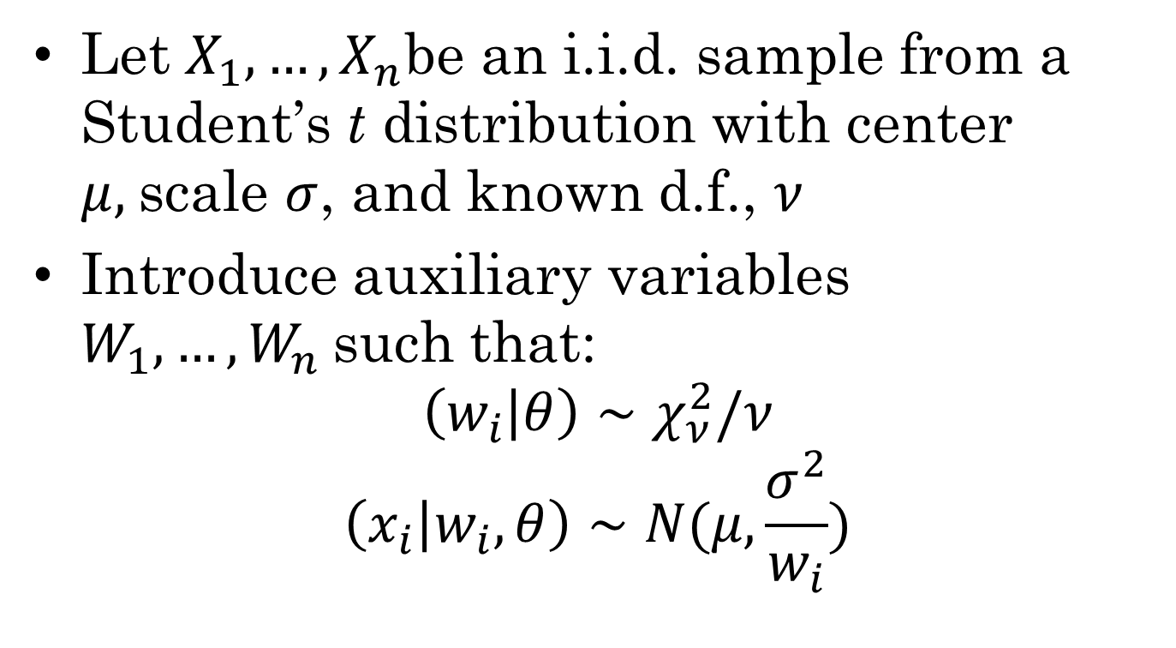
EM for Student’s t
Let $X_{1}, …, X_{n}$be an i.i.d. sample from a Student’s t distribution with center $μ,$scale $σ$, and known d.f., $ν$
Introduce auxiliary variables $W_{1},…,W_{n}$such that:
$$\left(w_{i} | θ\right)∼χ_{ν}^{2}/ν$$
$$\left(x_{i} | w_{i},θ\right)∼N(μ,\frac{σ^{2}}{w_{i}})$$

Slide 19
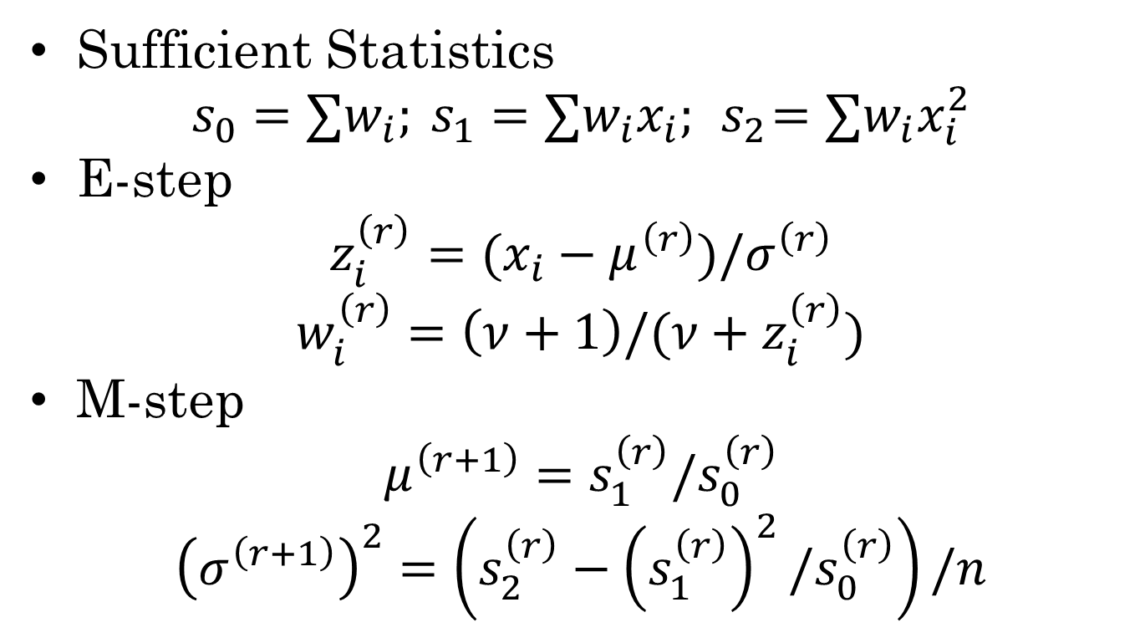
EM Algorithm
Sufficient Statistics
$$s_{0}=∑w_{i}; s_{1}=∑w_{i}x_{i};{ s}_{2}=∑w_{i}x_{i}^{2}$$
E-step
$$z_{i}^{\left(r\right)}=(x_{i}−μ^{\left(r\right)})/σ^{\left(r\right)}$$
$$w_{i}^{\left(r\right)}=\left(ν+1\right)/(ν+z_{i}^{\left(r\right)})$$
M-step
$$μ^{\left(r+1\right)}=s_{1}^{\left(r\right)}/s_{0}^{\left(r\right)}$$
$${\left(σ^{\left(r+1\right)}\right)}^{2}=\left(s_{2}^{\left(r\right)}−{\left(s_{1}^{\left(r\right)}\right)}^{2}/s_{0}^{\left(r\right)}\right)/n$$

Slide 20
More Variations
Generalized EM
Instead of maximizing likelihood (posterior) take one or more Newton steps towards maximum
ECM (Expectation Conditional Maximization)
Instead of maximizing over all parameters at once maximize one at a time (or in blocks)
Stochastic EM
Instead of E-step, randomly draw values from posterior using current parameters
This forms a MC which converges towards a stationary distribution which has same maximum as posterior

Slide 21
Structural EM
Meng and van Dyk (1997)
Partition the missing data into blocks Z₁,…,Z_{k}
Perform a separate E-step for each block
Perform an M-step between each E-step

Slide 22
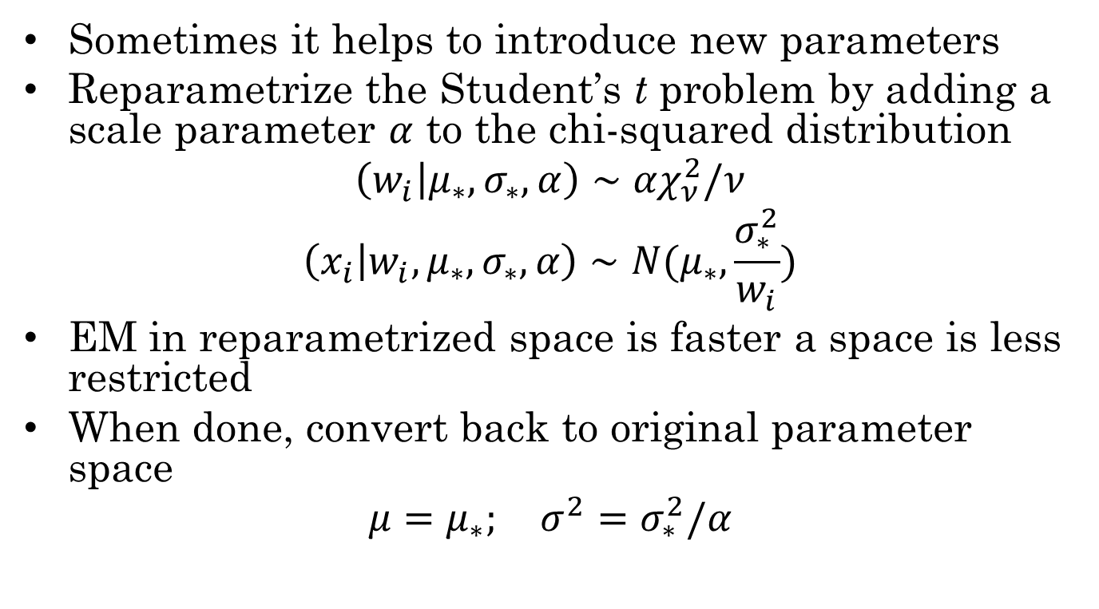
PX-EM Algorithm
Sometimes it helps to introduce new parameters
Reparametrize the Student’s t problem by adding a scale parameter $α$ to the chi-squared distribution
$$\left(w_{i} | μ_{∗},σ_{∗},α\right)∼{αχ}_{ν}^{2}/ν$$
$$\left(x_{i} | w_{i},μ_{∗},σ_{∗},α\right)∼N(μ_{∗},\frac{σ_{∗}^{2}}{w_{i}})$$
EM in reparametrized space is faster a space is less restricted
When done, convert back to original parameter space
$$μ=μ_{∗}; σ^{2}=σ_{∗}^{2}/α$$

Slide 23



Neal and Hinton (1998)
E-step: Compute a distribution over the unobserved variables
M-step: Find that maximizes
Variants should work as long as

Slide 24
References
Dempster, Laird and Rubin (1977)
THE reference
Read it if you want to cite it.
Little, R. J. A. & Rubin, D. B. (2002). Statistical Analysis with Missing Data, Second Edition. Hoboken, NJ: John Wiley & Sons.
Chapter 8 has a fairly accessible summary of EM
Neal and Hinton (1998)
Intuitive reformulation
Meng and van Dyk (1997)
Review paper covering EM variants

Slide 25
EM or MCMC
EM
MCMC
(Relatively) Fast
Convergence not guaranteed
Only gives point estimate (plus standard error)
Only finds a single maxima (unless you run it multiple times)
Works with flat priors
Slow (maybe extremely)
Convergence not guaranteed
Covers complete posterior (eventually)
Can find multiple modes (but could get stuck in one)
Requires a proper prior

