Slide 1
Fully Bayesian Models
Part 1: Regression-like models

Slide 2
Three Approaches to Missing Data Problems
EM Algorithm
Concentrates on getting MLE/MAP and standard error
Built into some packages for limited models (e.g., multivariate normal)
Does not require priros
Multiple Imputation
Posterior Mean and SD (assumes posterior is approximately normal)
Sometimes uses MCMC to generate imputations
Numerous packages to work with various model classes (e.g., generalized line models)
Full MCMC
Can look at full posterior distribution
Handles arbitrary models
BUGS & descendants make this simple

Slide 3
Non-ignorable missingness
Off-the-shelf EM and MI packages work when data are MAR
Suppose missing data mechanism is known (at least up to parameters)
EM can be adapted to include the missing data mechanism, but usually requires custom code
Straightforward under MCMC, just include a model for M (missingness indicator).

Slide 4
Bayesian modeling
Every variable is either
Fixed and known
Random variable with known distribution
Data will have both a distribution and a known value
JAGS uses the term “data” for everything with a known value including hyperparameters.
In building a fully Bayesian model, it is important to make sure distribution or value is provided for every component.

Slide 5
Russell’s Usage
Variable – This is a quantity that is specific to a sampling unit (person), could be observed or latent
Distribution – Used for the probability distribution for a variable
Parameter – A changeable value in a distribution or law, usually unknown and hence a random variable.
Law – Distribution of a parameter
…
Hyperparameter – a parameter of a law with a known value.
Some hyperparameters might occur in distributions (e.g., d.f. in a t distribution)
Some things not normally thought of as parameters, like N, are often best thought of as hyperparameters.

Slide 6
Writing the model: Bottom Up
Write down distributions for all of the variables.
Make sure this is in a sensible order, you might need to write down observed variables first, then latent variable
For every parameter in those distributions:
Write down a value for the [hyper]parameter, or
Write down a law for the parameter
For every parameter in those laws:
Write down a value for the [hyper]parameter, or
Write down a law for the parameter
Keep going until there are only known hyperparameters left

Slide 7
Writing a data generation model
Write code for setting all hyperparameters up at the top
Write code for randomly sampling the parameters given the hyperparameters
Keep going until all parameters have sampled values
Now write code to sample all of the random variables using the distributions

Slide 8
A simple linear Regression (line)
### Hyperparameters
N <- 100
a0 <- b0 <- 0
asd <- bsd <- 100
tnu <- tbeta <- .001
X <- rnorm(N) # Need some set of X values
### Priors for parameters
a <- rnorm(1,a0,asd)
b <- rnorm(1,b0,bsd)
tau <- rgamma(1,tnu,tbeta) # Precision
sigma <- 1/sqrt(tau) #SD
### Distributions for data
x.bar <- mean(x[])
mu <- a + b*(x[] – x.bar) # vectorized
Y <- rnorm(N,mu[],sigma) # vectorized

Slide 9
Data generation and BUGS/JAGS models
R data generation
BUGS and JAGS model
Uses: val <- rXXX()
Can loop over cases by vectorization
Normal distribution is parameterized with mean and standard deviation
Semicolon or newline to terminate commands
R commands can be arbitrarily complex
Uses: val ~ dXXX()
Loops must be written out
Normal distribution is parameterized with mean and precision (1/variance)
Semicolon to terminate lines
T(0,) to make truncated distributions
Can assign values to logit(val) and other tricks.
Not all R commands work

Slide 10
Line as a JAGS model
model {
for (i in 1:N) {
mu[i] <- a + b*(x[i] - x.bar);
Y[i] ~ dnorm(mu[i],tau);
}
x.bar <- mean(x[]);
alpha ~ dnorm(a0,pow(asd,-2));
beta ~ dnorm(b0,pow(bsd,-2));
tau ~ dgamma(tnu,tbeta);
sigma <- 1.0/sqrt(tau);
}

Slide 11
Data statement
Allows one-time transformations and other setup variables to be calculated
Comes before model (in file and conceptually)

Slide 12
Line using data statement
var xc[N];
data {
x.bar <- mean(x[])
for (i in 1:N) {
xc[i] <- x[i] – x.bar
}
}
model {
for (i in 1:N) {
mu[i] <- a + b*xc[i];
Y[i] ~ dnorm(mu[i],tau);
}
alpha ~ dnorm(a0,aprec);
beta ~ dnorm(b0,bprec);
tau ~ dgamma(tnu,tbeta);
sigma <- 1.0/sqrt(tau);
}

Slide 13
Picking Priors
Often prior information is mostly vague
If strong information about prior shape is unavailable often
Use a conjugate distribution
Pick appropriate mean and s.d.
Pick a mean and “effective sample size”
Fully non-informative priors (e.g., normal distribution with infinite variance) are often not proper so can’t be used with MCMC [Stan can as long as posterior is proper]
Instead what is often used are weak priors, priors with a very large SDs, very low effective sample sizes
Make sure all plausible parameter values have a high probability.

Slide 14
Priors for means and slopes
Conjugate family (conditioned on sd known) is normal distribution
Non-informative prior is normal with infinite variance (zero precision)
Weakly informative prior is normal with (usually) 0 mean and large SD, small precision
Sometimes means and variances are of themselves of interest and are parameters, e.g., hlm
R: mu <- rnorm(1, 0, 100)
JAGS: mu ~ dnorm(0,1e-4)

Slide 15
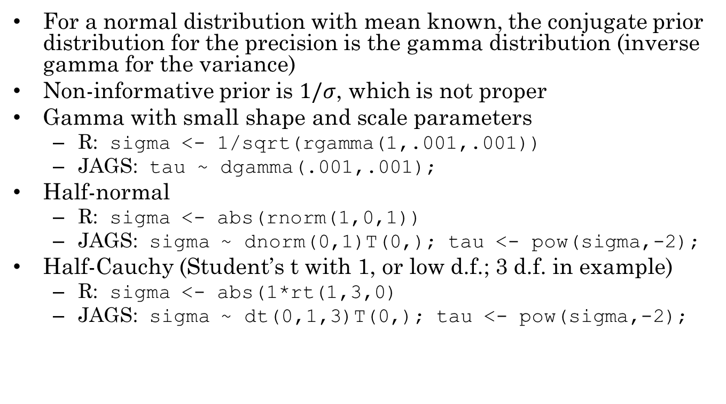
Priors for SDs and Precisions
For a normal distribution with mean known, the conjugate prior distribution for the precision is the gamma distribution (inverse gamma for the variance)
Non-informative prior is $1/σ$, which is not proper
Gamma with small shape and scale parameters
R: sigma <- 1/sqrt(rgamma(1,.001,.001))
JAGS: tau ~ dgamma(.001,.001);
Half-normal
R: sigma <- abs(rnorm(1,0,1))
JAGS: sigma ~ dnorm(0,1)T(0,); tau <- pow(sigma,-2);
Half-Cauchy (Student’s t with 1, or low d.f.; 3 d.f. in example)
R: sigma <- abs(1*rt(1,3,0)
JAGS: sigma ~ dt(0,1,3)T(0,); tau <- pow(sigma,-2);

Slide 16
Multivariate Normal Priors
The mvtnorm package contains an rmvnorm() function for generating normal random vectors
In JAGS it is built in and called dmnorm(mu,Omega)
datmat <- rmvnorm(n,mean,sigma)
Second argument is mean vector
Third argument is a covariance matrix; inverse covariance matrix (precision matrix) in JAGS
Advantage over multiple calls to rnorm() is that is can capture covariance structure among variables.

Slide 17
R Matrix Functions
The function matrix() turns a vector of values (column major order) into a matrix
Matrix multiplication operator is %*%
The function t() transposes a matrix
The function solve() inverts a matrix
The JAGS function is inverse()
The function chol(A) produces the Choleski decomposion of A (a matrix R, such that t(R)%*%R == A

Slide 18
Building Covariance Matrixes
Use the matrix() command
Build a diagonal matrix:
Sig <- diag(p)
diag(Sig) <- c(var1,var2,var3)
Or just Sig <- diag(c(var1,var2,var3))
Build a correlation matrix and multiple both sides by SD
Make correlation matrix
cormat <- diag(2)
cormat[1,2] <- cormat[2,1] <- cor12
Make a diagonal matrix with SDs on the diagonal
sdmat <- diag(c(sd1,sd2))
Multiply it out
Sig <- sdmat %*% cormat %*% sdmat

Slide 19
Non-informative prior for mean vector
Truly non-informative prior has an infinite variance
Weak prior has a very large variance
Make correlation matrix
Make a diagonal matrix with SDs on the diagonal
sdmat <- diag(rep(100,nrow(cormat))
Multiply it out
Sig <- sdmat %*% cormat %*% sdmat

Slide 20
Priors for Covariance matrixes
The natural conjugate for the covariance matrix is the inverse Wishart distribution
The natural conjugate for the precision matrix (inverse covariance) is the Wishart distribution
There is a built in R (and JAGS) function rWishart(n, df, Sigma) which generates random matrixes according to a Wishart distribution
The df parameter is degrees of freedom (like Chi-squared or T distributions).
Non-informative priors are small d.f.
But to be a proper prior, d.f. must at least equal rank (number of rows) of matrix.

Slide 21
Rats example
Original example is from Gelfland et al. (1990)
Growth curves of rats:
X_{j} – age (days) of rats at jth measurement
Y_{ij} – weight (g) of rat i at jth measurement
Y _{i j} ~ Normal( a _{i} + b _{i} (x _{j} - x _{bar} ), t _{c} ) a _{i} ~ Normal( a _{c} , t _{a} ) b _{i} ~ Normal( b _{c} , t _{b} ) http://www.openbugs.net/Examples/Rats.html

Slide 22
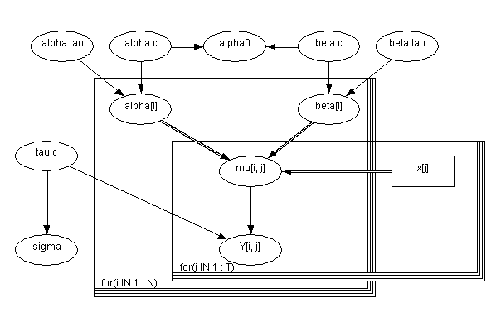
Doodles (Bayes Nets)
Nodes represent variables or parameters
Single arrows represent conditioning f(child|parents)
Double arrows represent functional relationships
Plates represent repetition over indexes
One plate for rats
One plate for time points

Slide 23
Aside on Bayes Nets
Similar, but not quite the same as SEMs
Variables/parameters in model correspond to nodes in graph
Separation in graph represents conditional independence
Error terms not explicitly represented
No undirected arrows
Must be acyclic! (No directed cycles)
To ensure your graph is acyclic, number your variables
Make sure each variable is defined in terms of only variables with lower numbers
Same thing for parameters
This still captures dependency

Slide 24
Returning to Rats
## Hyperparameters
N <- 30
T <- 5
x <- 1+7*(1:T); x.bar <- mean(X)
alpha.cmu <- beta.cmu <- 0
alpha.csd <- beta.csd <- 100
tau.cnu <- tau.alphanu <- tau.betanu <- .001
tau.cr <- tau.alphar <- tau.betar <- .001
## High level (Level-2) parameters
alpha.c <- rnorm(1,alpha.cmu,alpha.csd)
beta.c <- rnorm(1,beta.cmu,beta.csd)
tau.c <- rgamma(1,tau.cnu,tau.cr)
tau.alpha <- rgamma(1,tau.alphanu, tau.alphar)
tau.beta <- rgamma(1, tau.betanu, tau.betar)

Slide 25
More Rats Data Gen
## Level-1 (Rat) parameters; *Vectorized*
alpha <- rnorm(N,alpha.c,1/sqrt(tau.alpha))
beta <- rnorm(N,beta.c, 1/sqrt(tau.beta.c))
Either need to do fancy matrix operations, or explicitly loop over either rats or time points. I’ll pick time points.
## Rats data
mu <- matrix(NA,N,T) #Preallocate storage
Y <- matrix(NA,N,T)
for (j in 1:T) {
mu[,j] <- alpha[] + beta[]*(x[j]-x.bar)
Y[,j] <- rnorm(mu[,j],1/sqrt(tau.c))
}

Slide 26
The JAGS Model (1)
model {
for (i in 1:N) {
for (j in 1:T) {
mu[i,j] <- alpha[i] + beta[i]*(x[j] - x.bar);
Y[i,j] ~ dnorm(mu[i,j],tau.c)
}
alpha[i] ~ dnorm(alpha.c,tau.alpha);
beta[i] ~ dnorm(beta.c,tau.beta);
}

Slide 27
The JAGS Model (2)
## hyperparameters directy entered
alpha.c ~ dnorm(0,1.0E-4);
beta.c ~ dnorm(0,1.0E-4);
tau.c ~ dgamma(1.0E-3,1.0E-3);
tau.alpha ~ dgamma(1.0E-3,1.0E-3);
tau.beta ~ dgamma(1.0E-3,1.0E-3);
## Extra parameters for monitoring
sigma <- 1.0/sqrt(tau.c);
x.bar <- mean(x[]);
alpha0 <- alpha.c - beta.c*x.bar;
}

Slide 28
Correlation between Alpha and Beta
Often in such models the slope and intercept will be correlated.
In the simple Rats model, alpha and beta are modeled as a priori independent
that does not imply they will be independent a posteriori
Could use imputed parameter values to calculate cor(alpha,beta)
Could explicitly model multivariate distribution for alpha and beta.

Slide 29
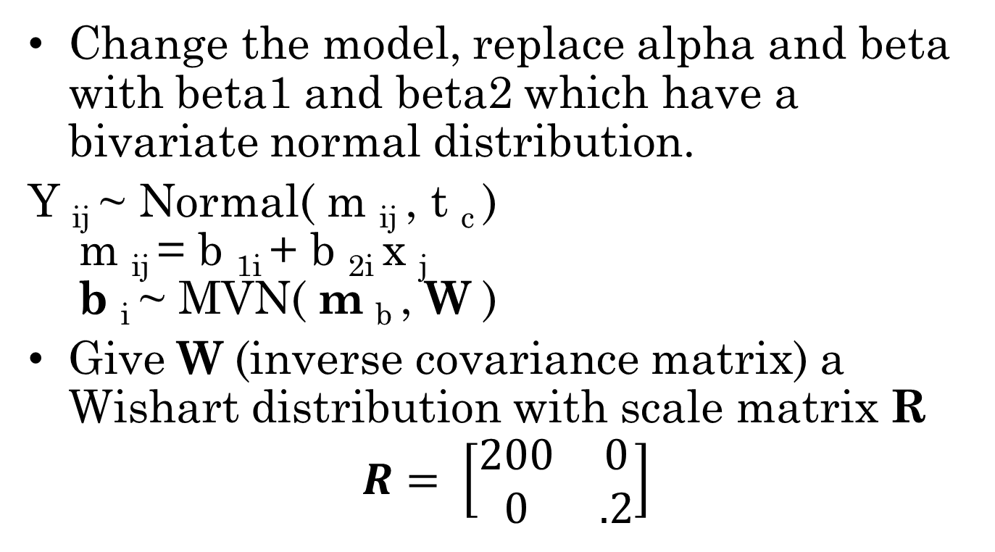
BiRats
Change the model, replace alpha and beta with beta1 and beta2 which have a bivariate normal distribution.
Y _{ij} ~ Normal( m _{ij} , t _{c} ) m _{ij} = b _{1i} + b _{2i} x _{j} b _{i} ~ MVN( m _{b} , W )
Give W (inverse covariance matrix) a Wishart distribution with scale matrix R
$$R= \left[\begin{matrix}200 & 0 \\ 0 & .2\end{matrix}\right]$$

Slide 30
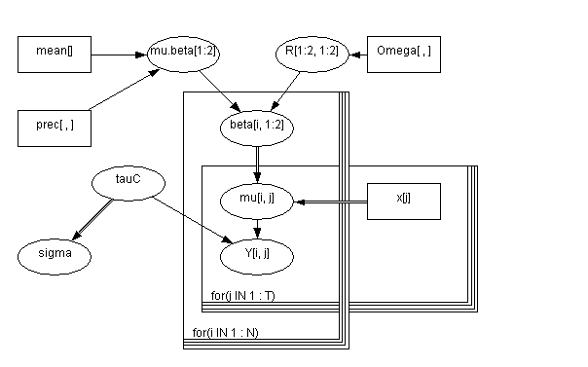
BiRats Doodle

Slide 31
Updated Data Generation
## Hyperparameters
N <- 30
T <- 5
x <- 1+7*(1:T); x.bar <- mean(X)
beta.mean <- c(0,0)
beta.cov <- diag(c(1e6,1e6))
R <- matrix(c(200,0,0,0.2),2,2)
nu <- 2
tau.cnu <- .001
tau.cr <- .001
## High level (Level-2) parameters
tau.c <- rgamma(1,tau.cnu,tau.cr)
mu.beta <- rmvnorm(1,beta.mean[],beta.cov[,])
W <- rWishart(1,nu,R[,])
Sig <- solve(W) # Convert to Variance matrix

Slide 32
More BiRats Data Gen
## Level-1 (Rat) parameters; *Vectorized*
beta <- rmvtnorm(1,mu.beta[],Sig[,]
Either need to do fancy matrix operations, or explicitly loop over either rats or time points. I’ll pick time points.
## Rats data
mu <- matrix(NA,N,T) #Preallocate storage
Y <- matrix(NA,N,T)
for (j in 1:T) {
mu[,j] <- beta[,1] + beta[,2]*(x[j]-x.bar)
Y[,j] <- rnorm(mu[,j],1/sqrt(tau.c))
}

Slide 33
JAGS model
var
x[T],mu[N,T],Y[N,T],beta[N,2],mu.beta[2],Omega.beta[2,2],
Sigma2.beta[2,2],sigma.beta[2],tau.c,sigma,R[2,2],r,alpha0;
model {
for (i in 1:N) {
for (j in 1:T) {
Y[i,j] ~ dnorm(mu[i,j],tau.c); #
mu[i,j] <- beta[i,1] + beta[i,2]*(x[j]-mean(x[]));
}
beta[i,] ~ dmnorm(mu.beta[],Omega.beta[,]);
# bivariate Normal
}

Slide 34
JAGS model (2)
tau.c ~ dgamma(1.0E-3,1.0E-3);
# intercept at zero for centred model
alpha0 <- mu.beta[1] - mu.beta[2]* mean(x[]);
# parameters considered MVN
Omega.beta[,] ~ dwish(R[,],2); # Wishart prior on precision matrix
Sigma2.beta[,] <- inverse(Omega.beta[,]);
sigma.beta[1] <- sqrt(Sigma2.beta[1,1]);
sigma.beta[2] <- sqrt(Sigma2.beta[2,2]);
r <- Sigma2.beta[1,2] / (sqrt(Sigma2.beta[1,1])
*sqrt(Sigma2.beta[2,2])); # correlation
mu.beta[1] ~ dnorm(0,.00001); # `flat' univariate Normal prior on mean
mu.beta[2] ~ dnorm(0,.00001); # `flat' univariate Normal prior on mean
}

Slide 35
ANOVA and ANCOVA
If we dummy code the factor variables, the ANOVA and ANCOVA are similar to the linear models we have been exploring
The R command model.matrix() will generate the dummy variables and produce the augmented data set which can then be passed to JAGS
See next lecture for info about how to model discrete variables/parameters

Slide 36
Example
## Set up levels
gender <- as.factor(c("male","female"))
treat <- as.factor(c("control","treat1","treat2"))
Reps <- 5
## Continuous variables
X <- rnorm(Reps*length(gender)*length(treat))
Y <- rnorm(Reps*length(gender)*length(treat))
aov.frame <-
data.frame(Y=round(Y,digits=2),
X=round(X,digits=2),
gender=rep(gender,length(treat),each=Reps),
treat=rep(treat,each=Reps*length(gender)))
model.matrix(Y ~ X*gender + gender*treat,
data=aov.frame)

Slide 37
Installing JAGS
JAGS has a standalone program and a R interface (rjags)
http://mcmc-jags.sourceforge.net/
Installing
Windows download installer
Mac download prebuilt code
Linux, available on most distros (including macports)
Use install.packages(“rjags”) to install
Optionally, download manual and examples from sourceforge
Windows users may need 7zip to unbundle example tarball
Documentation for examples is on the OpenBUGS site: http://www.openbugs.net/w/Examples

