Slide 1
Markov chain Monte Carlo: A Practical Introduction
Russell Almond
FSU

Slide 2



Monte Carlo Integration
Suppose we have an integral than can be written:
Or (if X is continuous)
Note that this is an expectation:

Slide 3

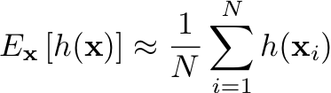
If we can sample from F(x)
Take an i.i.d. sample of size N: x₁, …, x_{N}
Then we have
Approximation (Monte Carlo) error is a random variable with variance:

Slide 4
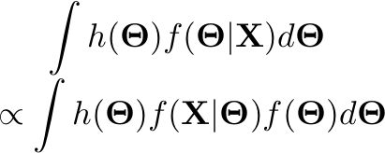
Bayesian Application
Generally interested in various statistics of the posterior distribution
Get normalization constant when h(.) =1.
Two sources of error: posterior variance and MC approximation error

Slide 5
What if F() is hard to sample from?
Only place we needed “independent” part of i.i.d. assumption was in calculation of random error.
If we relax independence, MC error is bigger, but we can compensate with bigger sample size.

Slide 6

Markov Chain
Series of random variables X₀, X₁, X₂,… such that X_{i+1} is independent of X_{i-1} given X_{i}
Past is independent of future given present
Can be defined via a transition kernel

Slide 7
Stationary distribution
If you run a Markov chain long enough, then the probability distribution of X_{i} reaches a stationary distribution
Example
1—6 are possible states of Markov chain
Stationary distribution is over states 5 & 6
1
2
3
4
5
6

Slide 8
Markov chain Monte Carlo (MCMC)
Construct a Markov chain whose stationary distribution is f(x)
Run it until it achieves stationarity (discard earlier samples as “burn-in”)
Now perform Monte Carlo integration
Expected value is unchanged
MC error is related to the autocorrelation of the series

Slide 9

Autocorrelation
For a given lag, , the autocorrelation is defined as:
The critical factor is the lag 1 autocorrelation
BUGS & Coda provide an effective sample size for the MCMC sample

Slide 10
How to make a Markov Chain
Two common techniques:
Gibbs sampler
Metropolis—Hastings algorithm

Slide 11


Gibbs Sampler
Assume unknown variables are multivariate:
Select a sequence j₁, j₂, …, j_{K}
At each step i, draw from
Note, can exploit conditional independence properties to simplify

Slide 12
Example
M
S₁
S₂
T₁
T₂
T₃
T₄
T₅
T₆
X₁
X₂
X₃
X₄
X₅
X₆
X₇
X₈
X₉
X₁₀

Slide 13
More about Gibbs
Gibbs works when conditional probabilities can be expressed in closed form
Conjugate distributions with missing data
BUGS actually uses the slice sampler, which tries to produce negatively correlated samples

Slide 14
Metropolis Sampling (1)
a variable in the posterior we are interested in.
its value in cycle t of a Gibbs sampler.
the full conditional for z, which includes data and most recent draws for all other variables.
the proposal distribution, which we note may depend on z^{t}-- for example, N(z^{t},1).
a draw from the proposal distribution. Then…
y

Slide 15
Metropolis Sampling (2)
Metropolis algorithm holds when the proposal distribution is symmetric:
(E.g., this is the case when the proposal distribution is the normal with a specified distribution and mean given by the previous value.)
Then accept y as z^{t+1} with probability

Slide 16

Metropolis Sampling (3)
Proposal distribution: Normal with mean at previous cycle’s value

Slide 17
Metropolis Sampling (4)
y
(new proposal) y
Accept this y as z^{t+1} with probability 1

Slide 18
Metropolis Sampling (5)
y
y (new proposal)
Accept this y as z^{t+1} with probability ~.75

Slide 19
Metropolis-Hastings Sampling
Extension of Metropolis sampling, in which the proposal distribution need not be symmetric; i.e.,
Now accept y as z^{t+1} with probability
Simplifies to M when symmetry holds.

Slide 20
Tuning (Adaption)
Often proposal distribution has a tuning parameter (size of variance in a normal step, random walk)
Take too small a step, and high autocorrelation (mixes slowly through space)
Take too big a step and high autocorrelation because it rejects all the time
Optimal rejection rate 30—50% of the time.
BUGS uses random walk proposal and automatically adapts the size of the steps to get optimal rejection rate
Can’t use samples while adapting (wrong stationary distribution).

Slide 21
Metropolis within Gibbs
Original Metropolis et al. paper worked on full multivariate space all at once
BUGS uses Metropolis within Gibbs
Visits each unknown variable in turn
If conditional probability has closed form it uses slice or Gibbs sampler
If not, it takes a Metropolis step with that parameter
Automagically switches between Gibbs and Metropolis mode, but Metropolis requires extra adaption phase

Slide 22
Assessing Convergence
MCMC has converged when it reaches is stationary distribution.
Observations before convergence are discarded as “Burn-in”
(Brooks)-Gelman-Rubin R
Start multiple chains from different starting points
Look at ratio of variance within chain to variance between chains
When this gets small (<1.1) chain is converged
Often displayed graphically

Slide 23
Starting Points
Random draws from prior
Run very long chains, look at pieces of the chain
Russell’s Recommendation：
中 Start one chain at prior mean/median/mode
下 Start one chain at 95% percentile of all marginal prior distributions
上 Start one chain at 5% percentile of all marginal prior distributions
下上 Mix ½ at high value and ½ at low value
上下 Swap halves from the first

Slide 24
Mixing Speed
“Mixing” means how much draws for a given parameter can move around the space each cycle. More autocorrelation goes along with “poor mixing.”
“Better mixing” means the same number of cycles provides more information about the posterior, the ceiling being independent draws from the posterior. “Worse mixing” means more cycles are needed for (a) burn-in and (b) a given level of precision for statistics for the posteriors.
relatively good mixing
relatively bad mixing

Slide 25
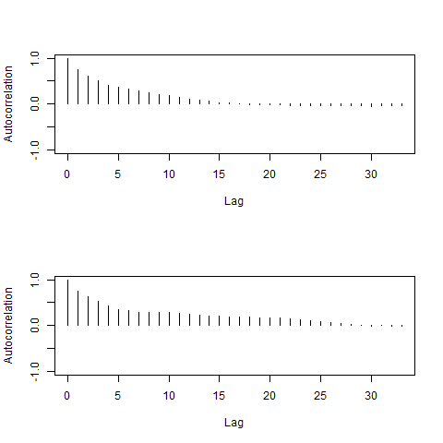
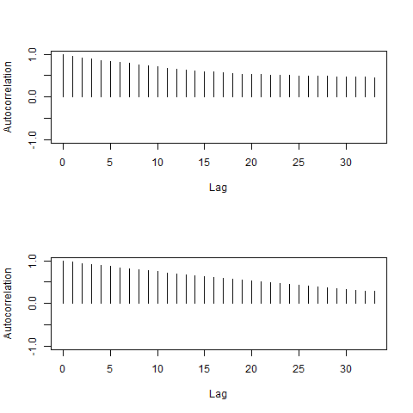
Autocorrelation
Adequate Mixing
Slow mixing
Lag 5

Slide 26
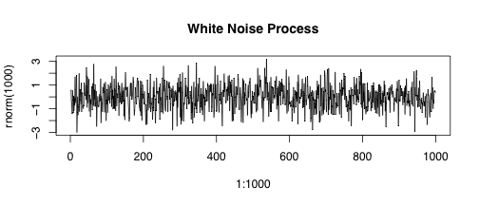
White Noise Trick
Want trace plot to look like white noise (i.i.d. normal) process
Trick: Run chain long enough so that scale compression makes series look like white noise

Slide 27
Thinning
If series has high autocorrelation, you could record every k cycles of the MCMC. This is called thinning
Lag 1 autocorrelation in the thinned series is the same as lag k autocorrelation in the original series.
Standard errors are better in the original series (sample size m) than in the thinned series (sample size m/k) even when corrected for autocorrelation
Storage space for history of series is smaller with thinning (important if need to run really long chains)
If running long chains to make multiply imputed data sets, probably want to select from various places in various chains.

Slide 28
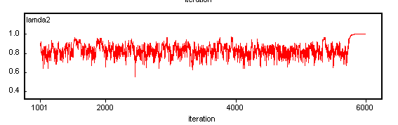
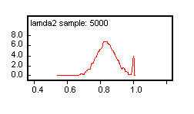
Absorbing States
An example of a violation of regularity conditions:
a Heywood case in a factor analysis run. Needed a prior on factor loadings that bounded them away from +1 and -1.

Slide 29
Identifiability
Technically not a problem, as prior “identifies” model. But:
If prior=posterior, we want to know
Averaging across variant models may not produce satisfactory results
State label swapping
Exchange meaning of High and Low states of proficiency variable
Often appears as swapped rows in CPTs
Usually need more constrained model to get rid of problem
Frühwirth-Schnatter suggests mixing across label swapped variants and then switching them back post hoc.
Hetroscedasticity - Proficiency variables are typically correlated
Location and scale of latent variables
Scale anchor (set of parameters whose average difficulty/discrimination is constrained)
Notes:
In cases where the prior and the posterior are always identical, we have religion and not science

Slide 30
BUGS History
Classic BUGS (David Speigelhalter)
BUGS modeling language (Based on S)
BUGS command language (e.g., start chain, monitor variable, run 1000 cycles)
S package CODA for processing output
WinBUGS http://www.mrc-bsu.cam.ac.uk/bugs/
GUI for command language
Doodle tool for drawing graphical models
Built in plots for monitoring convergence
Weird .odc file format
Windows only
Depricated, has had no new updates in about 10 years.

Slide 31
Bugs Variants
OpenBugs (Andrew Thomas)
http://www.openbugs.net/w/
Current Development version of bugs
Written in a language called “BlackBox” which is mostly Windows based
Linux version called LinBUGS
Should run on Macs under WINE (Wineskin or Crossover Mac)
JAGS (Just Another Gibbs Sampler; Martyn Plumber)
http://mcmc-jags.sourceforge.net/
Rewrite in C of Classic BUGS
Coda is now an R package
rjags gives R interface

Slide 32
Stan
http://mc-stan.org/
Named after Stanislaw Ulam (one of the co-authors on the Metropolis et al. paper)
Uses Hamiltonian MC instead of random-walk Metropolis
C-like syntax (not R-like)
rstan is R interface, but also standalone, Python and a number of other interfaces
Priors can be omitted if posterior is proper

Slide 33
Random-Walk Metropolis
What is usually simply called “Metropolis” is really random-walk metropolis.
Proposal distribution is usually either a normal distribution, or a uniform on a unit hyper-cube or hyper-sphere (depending on how many parameters are considered at once).
Step size (width of cube, diameter of sphere, sd of normal) is a critical tuning parameter
Too small a step means that the chain mixes slowly
Too big a step means that the chain gets rejected too often so mixes slowly
Rejection rates of 1/2 to 2/3 seem about right
BUGS/JAGS adaptation phase is finding right step size.

Slide 34
Hamiltonian Monte Carlo
Still a Metropolis-Hastings algorithm, but uses a different proposal mechanism
Posterior is a hilly surface, and current point is a puck riding on top of that surface.
Puck is given a random velocity. It then moves following the Hamiltonian dynamics (conservation of energy).
When going downhill, it speeds up
When going uphill, it slows down
Go for several time steps along the random trajectory, then stop and do a Metropolis accept/reject decision

Slide 35
No U-Turn Sampling (NUTS)
Go for several time steps along the random trajectory, but stop if energy will start pushing the puck back towards starting point.
Each step takes longer than random-walk Metropolis, but steps are usually longer
MUCH lower autocorrelation than random-walk Metropolis
Trading cost per cycle for fewer cycles required.

Slide 36
Installing JAGS
JAGS has a standalone program and a R interface (rjags)
http://mcmc-jags.sourceforge.net/
Installing
Windows download installer
Mac download prebuilt code
Linux, available on most distros (including macports)
Use install.packages(“rjags”) to install
Optionally, download manual and examples from sourceforge
Windows users may need 7zip to unbundle example tarball

