Slide 1
Maximum Likelihood Estimation
And Maximum A Posteriori (MAP) Estimation

Slide 2
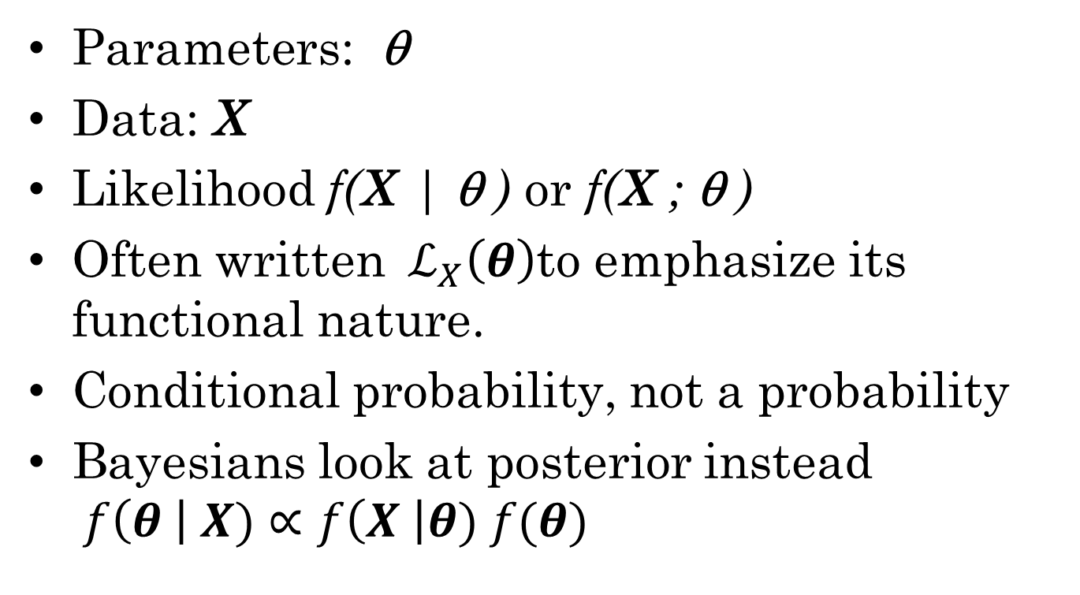
The Likelihood
Parameters: θ
Data: X
Likelihood f(X | θ ) or f(X ; θ )
Often written ${ ℒ}_{X}\left(θ\right)$to emphasize its functional nature.
Conditional probability, not a probability
Bayesians look at posterior instead $f\left(θ \right| X)∝f\left(X \right|θ) f(θ)$

Slide 3
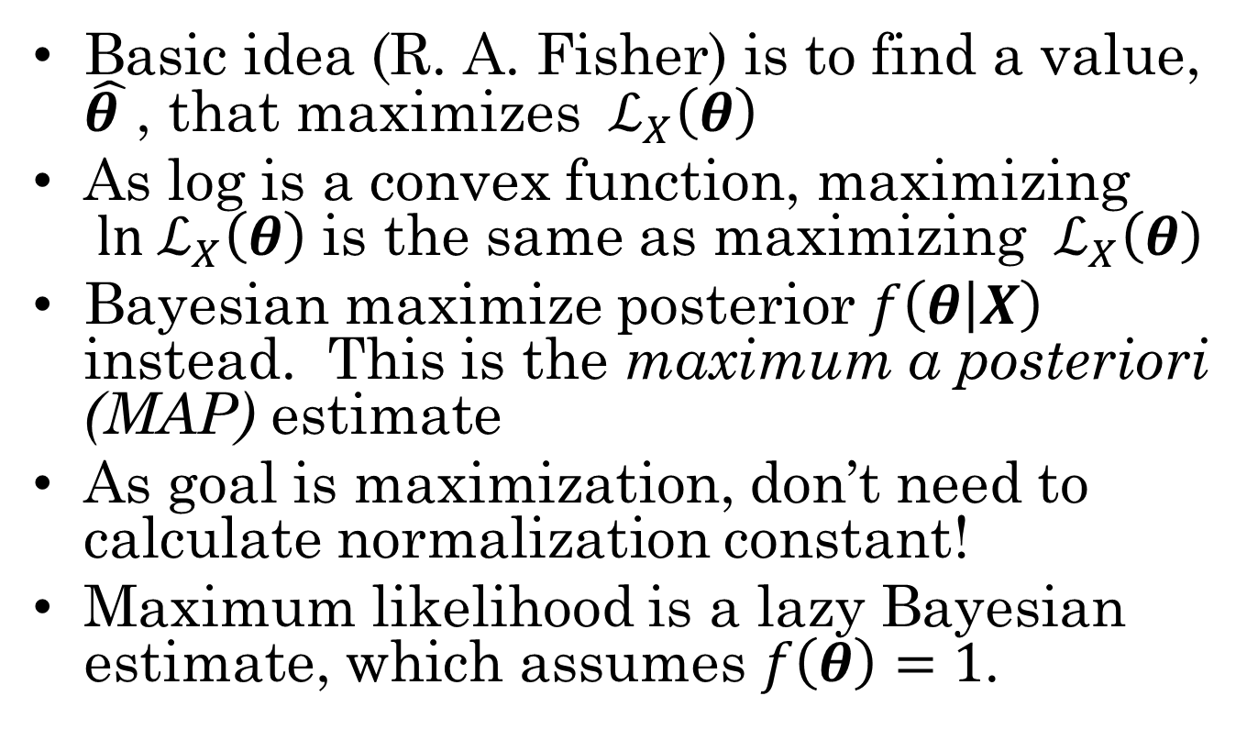
Maximum Likelihood (ML) and Maximum A Posteriori (MAP)
Basic idea (R. A. Fisher) is to find a value, $\hat{θ }$, that maximizes ${ ℒ}_{X}\left(θ\right)$
As log is a convex function, maximizing ${ ln ℒ}_{X}\left(θ\right)$ is the same as maximizing ${ ℒ}_{X}\left(θ\right)$
Bayesian maximize posterior $f\left(θ | X\right)$ instead. This is the maximum a posteriori (MAP) estimate
As goal is maximization, don’t need to calculate normalization constant!
Maximum likelihood is a lazy Bayesian estimate, which assumes $f\left(θ\right)=1$.

Slide 4
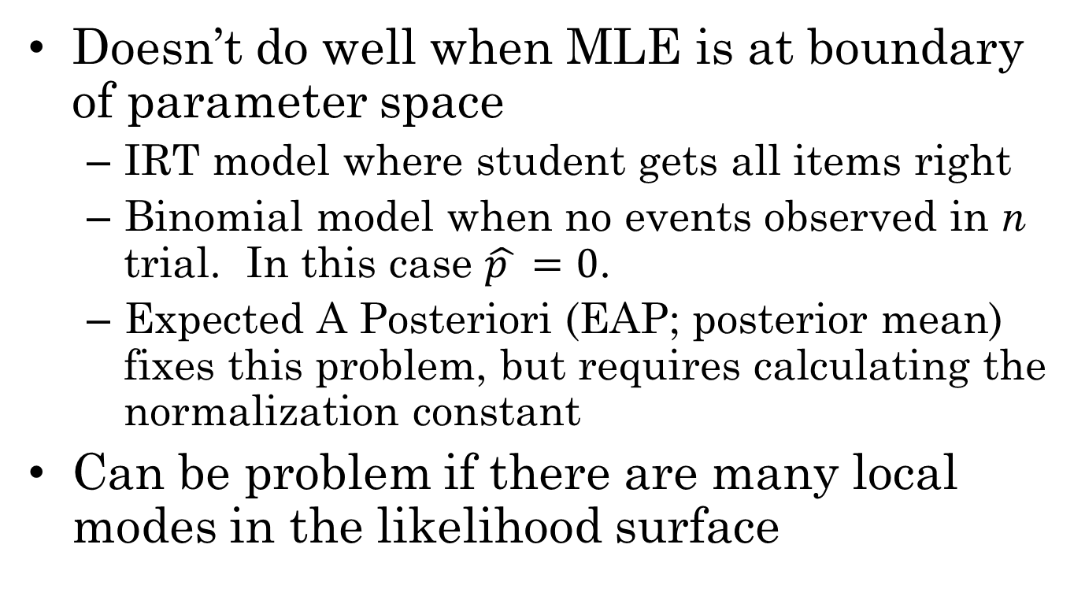
Limits of ML and MAP
Doesn’t do well when MLE is at boundary of parameter space
IRT model where student gets all items right
Binomial model when no events observed in n trial. In this case $\hat{p }=0$.
Expected A Posteriori (EAP; posterior mean) fixes this problem, but requires calculating the normalization constant
Can be problem if there are many local modes in the likelihood surface

Slide 5
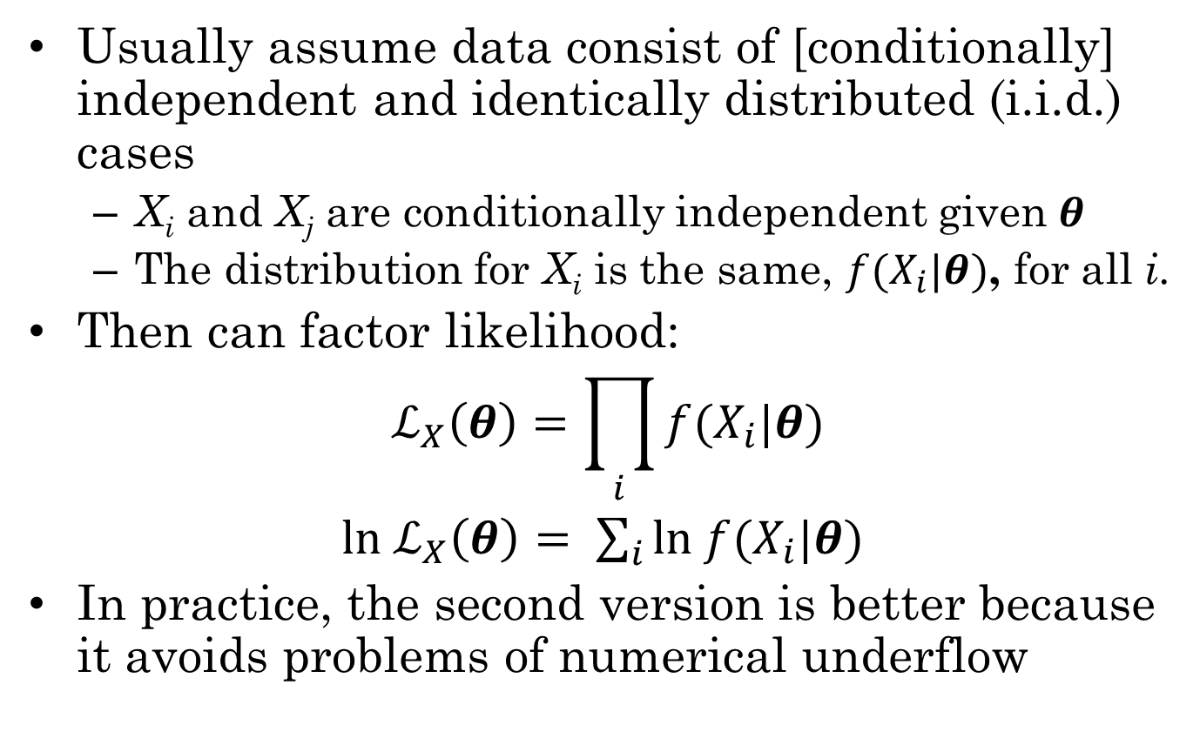
Independent and Identically (i.i.d.) Distributed observations
Usually assume data consist of [conditionally] independent and identically distributed (i.i.d.) cases
X_{i} and X_{j} are conditionally independent given $θ$
The distribution for X_{i} is the same, $f(X_{i}|θ)$, for all i.
Then can factor likelihood:
$${ ℒ}_{X}\left(θ\right)=\prod_{i}{f(X_{i}|θ)}$$
$ln{ ℒ}_{X}\left(θ\right)= \sum_{i}{ln f(X_{i}|θ)}$
In practice, the second version is better because it avoids problems of numerical underflow

Slide 6
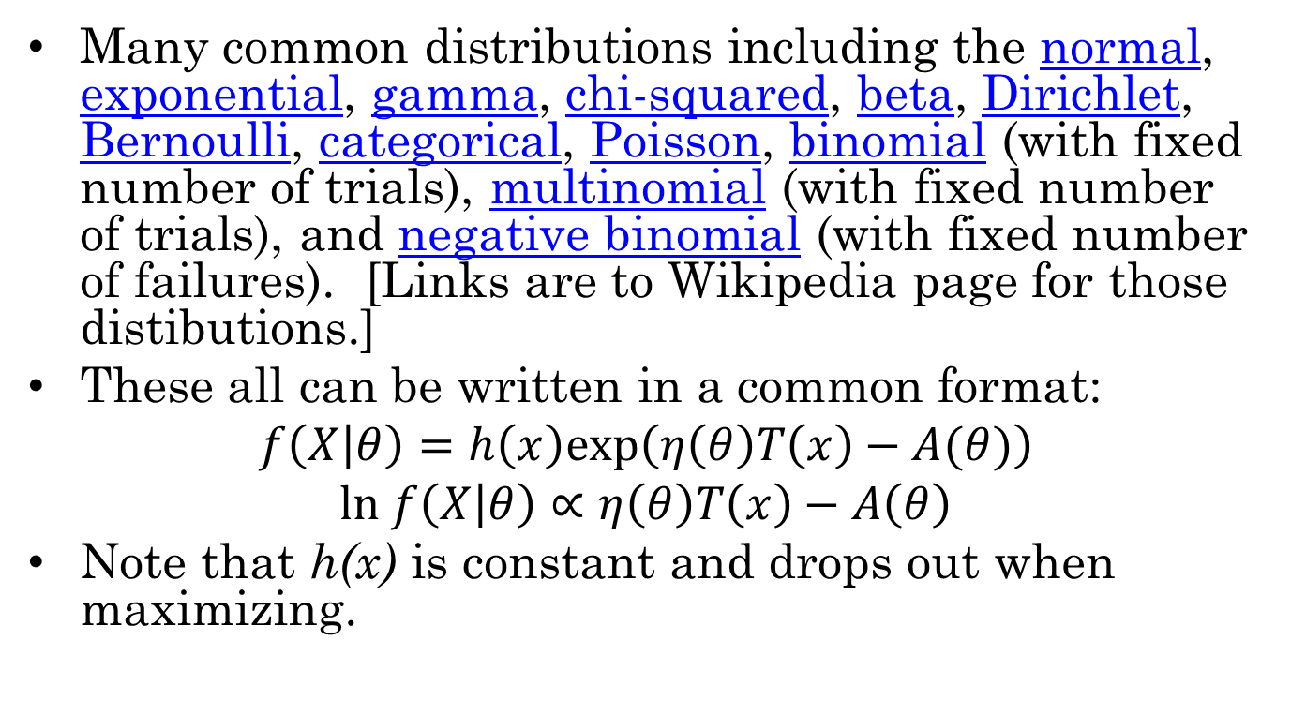
Exponential Family
Many common distributions including the normal, exponential, gamma, chi-squared, beta, Dirichlet, Bernoulli, categorical, Poisson, binomial (with fixed number of trials), multinomial (with fixed number of trials), and negative binomial (with fixed number of failures). [Links are to Wikipedia page for those distibutions.]
These all can be written in a common format:
$$f\left(X | θ\right)=h\left(x\right)exp\left(η\left(θ\right)T\left(x\right)−A(θ)\right)$$
$$ln f\left(X | θ\right)∝η\left(θ\right)T\left(x\right)−A\left(θ\right)$$
Note that h(x) is constant and drops out when maximizing.

Slide 7
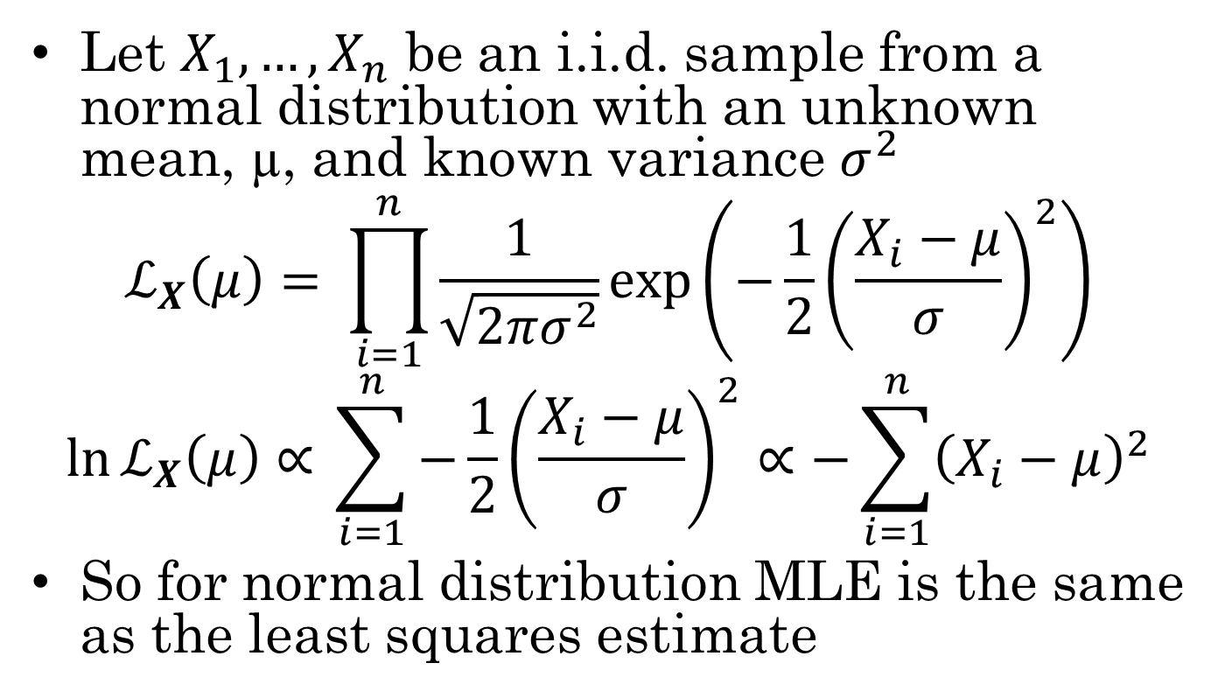
Normal Distribution
Let $X_{1},…, X_{n}$ be an i.i.d. sample from a normal distribution with an unknown mean, µ, and known variance $σ^{2}$
$$ℒ_{X}\left(μ\right)= \prod_{i=1}^{n}{\frac{1}{\sqrt{2πσ^{2}}}exp\left(−\frac{1}{2}{\left(\frac{X_{i}−μ}{σ}\right)}^{2}\right)}$$
$$\ln{ℒ_{X}\left(μ\right)∝ }\sum_{i=1}^{n}{−\frac{1}{2}{\left(\frac{X_{i}−μ}{σ}\right)}^{2}}∝−\sum_{i=1}^{n}{{\left(X_{i}−μ\right)}^{2}}$$
So for normal distribution MLE is the same as the least squares estimate

Slide 8
Newton-Raphson Method
Originally for finding zeros of a function, but if we apply it to the first derivative, then it finds local maxima and minima of the function
Each step moves closer to the maximum
May be multiple maxima
Multiple starting points
Simulated annealing & other modifications
EDF 6937 BDA
8

Slide 9
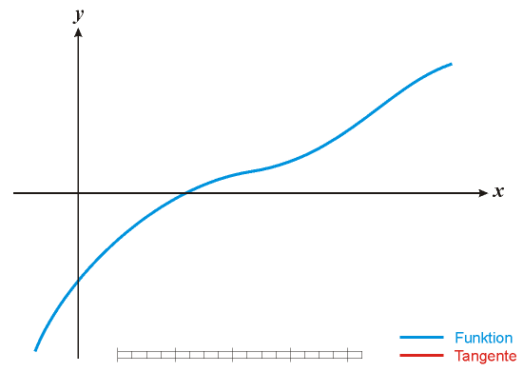
Netwon-Raphson Animation
http://en.wikipedia.org/wiki/File:NewtonIteration_Ani.gif
EDF 6937 BDA
9

Slide 10
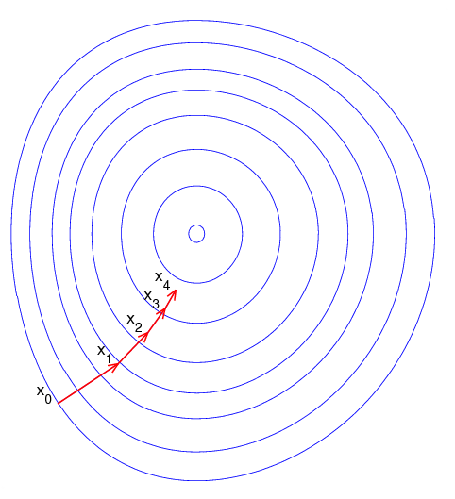
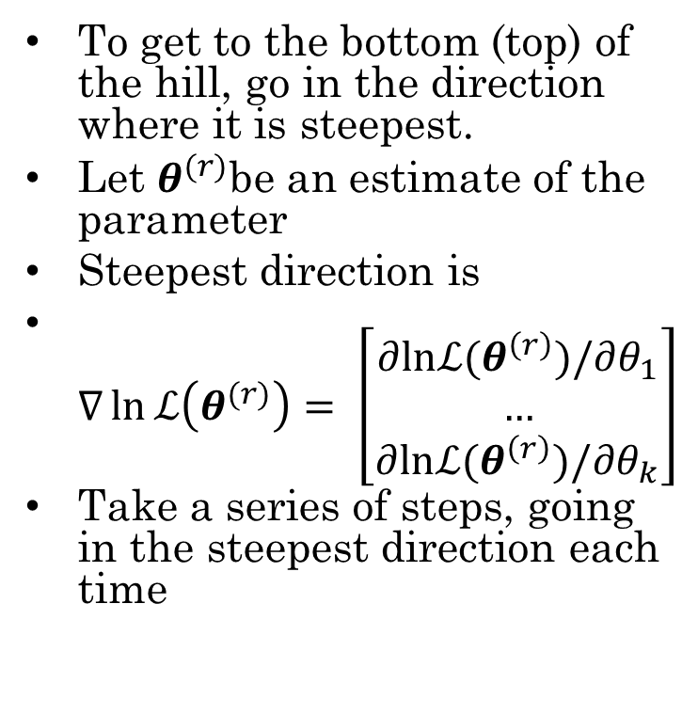
Gradient Decent
To get to the bottom (top) of the hill, go in the direction where it is steepest.
Let $θ^{(r)}$be an estimate of the parameter
Steepest direction is
$∇\ln{ℒ\left(θ^{(r)}\right)= \left[\begin{matrix}∂lnℒ(θ^{\left(r\right)})/∂θ_{1} \\ … \\ ∂lnℒ(θ^{\left(r\right)})/∂θ_{k}\end{matrix}\right]}$
Take a series of steps, going in the steepest direction each time
https://en.wikipedia.org/wiki/Gradient_descent

Slide 11
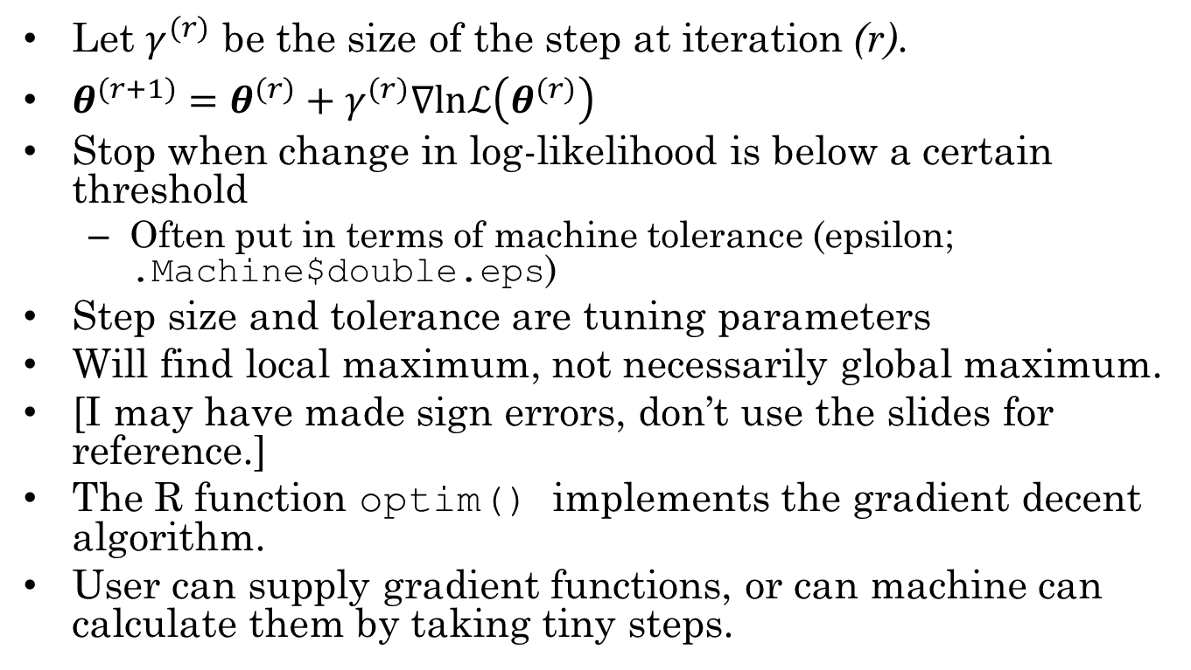
Tuning Parameters
Let $γ^{(r)}$ be the size of the step at iteration (r).
$θ^{(r+1)}=θ^{(r)}+γ^{(r)}∇lnℒ\left(θ^{(r)}\right)$
Stop when change in log-likelihood is below a certain threshold
Often put in terms of machine tolerance (epsilon; .Machine$double.eps)
Step size and tolerance are tuning parameters
Will find local maximum, not necessarily global maximum.
[I may have made sign errors, don’t use the slides for reference.]
The R function optim() implements the gradient decent algorithm.
User can supply gradient functions, or can machine can calculate them by taking tiny steps.

Slide 12
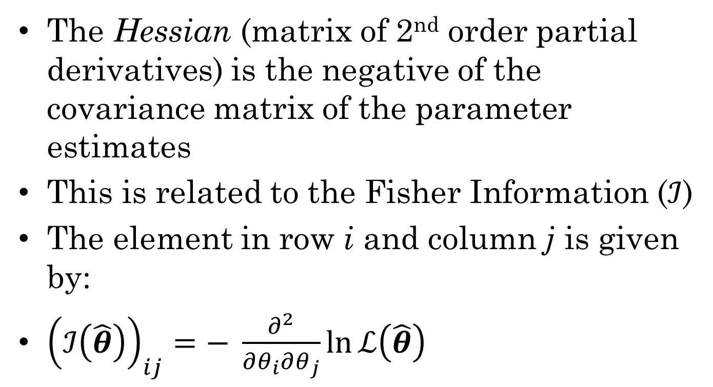
Estimating Standard Errors
The Hessian (matrix of 2nd order partial derivatives) is the negative of the covariance matrix of the parameter estimates
This is related to the Fisher Information ($ℐ$)
The element in row i and column j is given by:
${\left(ℐ\left(\hat{θ}\right)\right)}_{ij}=− \frac{∂^{2}}{∂θ_{i}∂θ_{j}}\ln{ℒ\left(\hat{θ}\right)}$

Slide 13
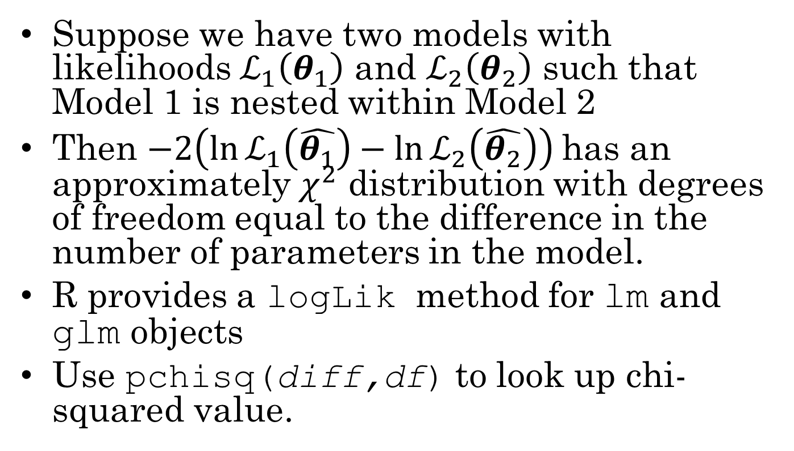
Likelihood Ratio Tests
Suppose we have two models with likelihoods $ℒ_{1}\left(θ_{1}\right)$ and $ℒ_{2}\left(θ_{2}\right)$ such that Model 1 is nested within Model 2
Then $−2\left(\ln{ℒ_{1}\left(\hat{θ_{1}}\right)}−\ln{ℒ_{2}\left(\hat{θ_{2}}\right)}\right)$has an approximately $χ^{2}$ distribution with degrees of freedom equal to the difference in the number of parameters in the model.
R provides a logLik method for lm and glm objects
Use pchisq(diff,df) to look up chi-squared value.

Slide 14
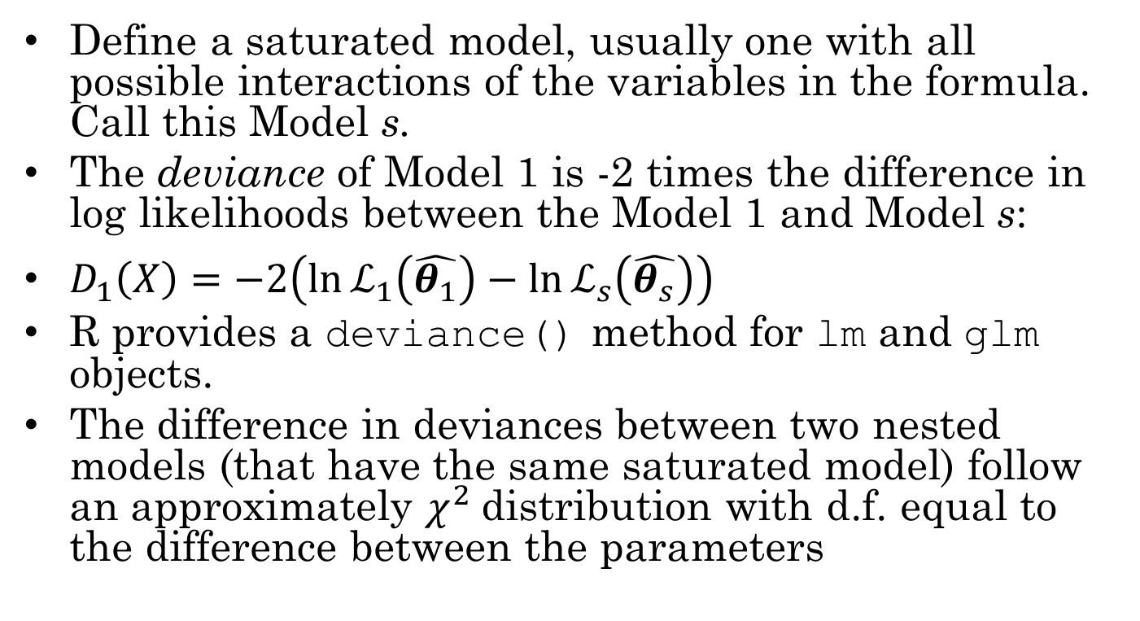
Deviance
Define a saturated model, usually one with all possible interactions of the variables in the formula. Call this Model s.
The deviance of Model 1 is -2 times the difference in log likelihoods between the Model 1 and Model s:
$D_{1}\left(X\right)=−2\left(\ln{ℒ_{1}\left(\hat{θ_{1}}\right)}−\ln{ℒ_{s}\left(\hat{θ_{s}}\right)}\right)$
R provides a deviance() method for lm and glm objects.
The difference in deviances between two nested models (that have the same saturated model) follow an approximately $χ^{2}$distribution with d.f. equal to the difference between the parameters

Slide 15
Analysis of Deviance in R
Suppose we fit a bunch of linear models:
fit1 <- lm(formula1,data)
…
fitm <- lm(formulam,data)
If models are nested, we might want to make an ANOVA table
aov(fit1,…,fitm)
If the models are glm’s instead of lm’s, R will produce an analysis of deviance instead.

Slide 16
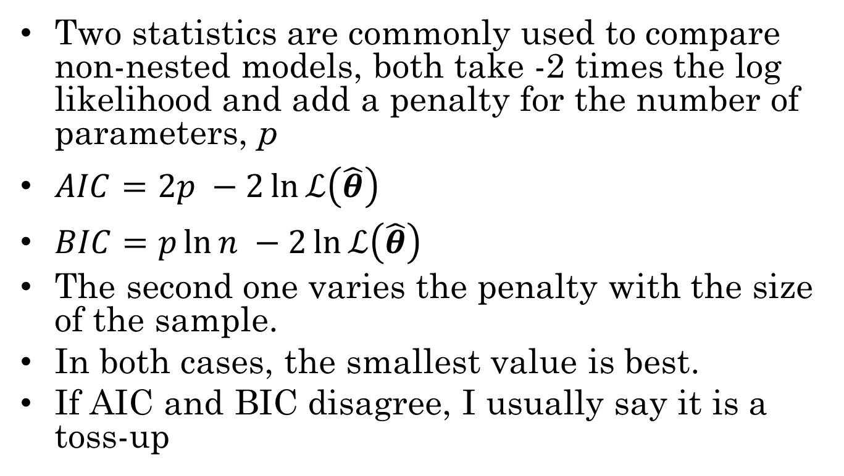
AIC and BIC
Two statistics are commonly used to compare non-nested models, both take -2 times the log likelihood and add a penalty for the number of parameters, p
$AIC=2p −2\ln{ℒ\left(\hat{θ}\right)}$
$BIC=p\ln{n} −2\ln{ℒ\left(\hat{θ}\right)}$
The second one varies the penalty with the size of the sample.
In both cases, the smallest value is best.
If AIC and BIC disagree, I usually say it is a toss-up

Slide 17
AIC and BIC in R
R has defined AIC() and BIC() functions for lm and glm objects.
Trick:
sapply(list(fit1,…,fitm),AIC)
will produce a table of AIC values.

