Slide 1
Missing Data Mechanisms and Patterns
A more formal approach

Slide 2
Notation
Y – complete data matrix
Y_{obs} – observed portion of the data
Y_{miss} – unobserved portion of the data
R – observed indicator, r_{ij}=0 iff y_{ij} is missing; is.na(Y)
M – missingness indicator, m_{ij}=0 iff y_{ij} is observed; !is.na(Y)
φ, θ – generic parameter sets.

Slide 3
Missing Completely At Random (MCAR)
p(R|Y_{obs}, Y_{miss}, φ) = p(R| φ)
In other words missing data indicator is conditionally independent of both observed and missing data given the parameters
Only case for which complete case analysis (listwise and pairwise deletion) works

Slide 4
Missing At Random (MAR)
p(R|Y_{obs}, Y_{miss}, φ) = p(R| Y_{obs}, φ)
Often Y=(X, Z), where X is completely observed (often demographic data) and all of the missing values are in Z
Most of the missing data techniques we will learn in class require MAR

Slide 5
Missing Not at Random (MNAR)
Non-ignorable missingness
In order to make progress, we must make assumptions about p(R|Y_{obs}, Y_{miss}, φ)
Try taking a sample of the missing responses
Capture recapture

Slide 6
Monotone Missingness Pattern
Rows can be sorted to look like figure
Handy for conditional mean or regression imputation
Y₁
Y₂
Y₃
Y₄
Regress Y₂ on Y₁ and impute values for Y₂
Regress Y₃ on Y₁, Y₂ and impute values for Y₃
Regress Y₄ on Y₁, Y_{2,} Y₃ and impute values for Y₄

Slide 7
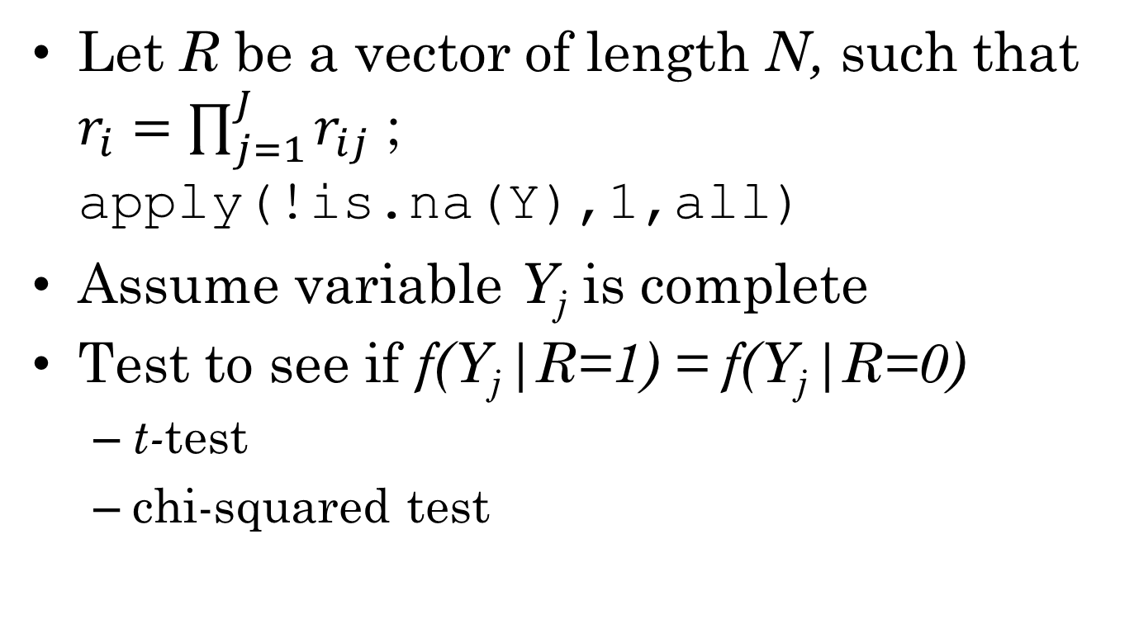
Testing MCAR
Let R be a vector of length N, such that $r_{i}=\prod_{j=1}^{J}{r_{ij}}$ ; apply(!is.na(Y),1,all)
Assume variable Y_{j} is complete
Test to see if f(Y_{j}|R=1) = f(Y_{j}|R=0)
t-test
chi-squared test

Slide 8
Test Results
If missing and nonmissing values are similar on demographic variables, then might be reasonable to assume MCAR
Unfortunately, test rules out MAR (unless also MCAR), but not MNAR!
Conditional Mean/Regression Imputation won’t help much in this case

Slide 9
Missing Data in R
Code for missing data in R is NA
NA_integer_, NA_real_, NA_character_
The functions is.na()and anyNA()(any(is.na()) test for the presence of NAs.
NA is distinct from
NaN (not a number), is.nan()
Inf, -Inf (infinity), is.infinite()
NULL (empty list), is.null()
NAs are contagious:
is.na(NA + anything) == TRUE
is.na(exp(NA)) == TRUE
is.na(mean(c(1,2,NA)) == TRUE
mean(c(1,2,NA),na.rm=TRUE) == 1.5

Slide 10
Setting Values to be Missing
Y[rows, cols] <- NA
is.na(Y[rows, cols]) <- TRUE
Coding values as missing
Y <- read.table(file,…, na.strings=“-9”)
is.na(Y[Y==-9]) <- TRUE
Y <- ifelse(Y==-9,NA,Y)

Slide 11
Matrix-like objects
Assume Y is a matrix or data.frame
nrow(Y) is number of rows
ncol(Y) is number of columns
rownames(Y) is names of rows (or NULL)
colnames(Y) is names of columns (or NULL)
dim(Y) give dimension of Y (as vector)
In a matrix, all variables are the same type (integer, real, character, factor)
as.matrix(Y) – force Y to be a matrix
is.matrix(Y) – check if Y is a matrix
In a data.frame, variables can have different types
as.data.frame(Y) – force Y to be a data frame
is.data.frame(Y) – check to see if Y is a data frame

Slide 12
Making matrixes
matrix(data = NA, nrow=1, ncol=1, byrow = FALSE)
data can be a single value (repeated) or a vector of values (e.g., 1:12 or c(2,3,4))
Data is assumed to be done by columns unless byrow is TRUE.
Examples:
matrix(1:12,3,4)
matrix(1:12,3,4,byrow=TRUE)
matrix(NA,100,5) ## Create blank matrix
matrix(NA_Integer_,100,5) ## Integers!
matrix(rnorm(500),100,5) ## Random matrix
Can set colnames to indicate variable names.

Slide 13
Making data.frames
data.frame(…,row.names=NULL)
Each value in … is a column
name = value
value
All columns must be the same length
df <- data.frame(x=1:50, y=rnorm(50),z=runif(50)<.5)
Can add column names by setting names(df)
Can add new columns by setting df$newcol

Slide 14
Useful tricks
Sequence function
1:N ## integers from 1 to N
seq(from, to, by)
Repetition function
rep(1:3,2)
rep(1:3,each=2)
Paste function (put together strings)
paste(“Var”,1:5,sep=“”)
Factor variables
factor(X, …)
ordered(X, levels=c(…), …)
Only useful with data frames

Slide 15
Random Numbers
Most R distributions come in families
XXX – family name, not a function, but there is a help page for it
dXXX(x,…) – density function for XXX (or probability function for discrete distributions)
pXXX(q, …) – cumulative distribution function for XXX
qXXX(p, …) – inverse cumulative distribution function for XXX
rXXX (n, …) – draw random numbers for XXX
Most have family specific parameters (common to all functions) [Check man pages as sometimes uses unusual parameterizations]
First argument for all random number functions is n, length of output vector
Useful special cases:
runif(n) ## Uniform random numbers
rnorm(n) ## Standard normal random numbers
runif(n) < p ## Bernoulli (logical) random numbers
Sampling from data
sample(vec, size, replace=FALSE)
sample.int(n, size=n, replace=FALSE)

Slide 16
Numeric Selectors
If rows or cols is a single integer, that row or column is selected
If rows or cols is left blank, all rows or columns are selected
Y[i, ] – select row i
Y[ ,j] – select column j
If rows or cols is a vector of integers, then the corresponding set of rows, columns are slected
Y[1:10, ] – first ten rows
Y[c(2,4,6), ] – rows 2, 4 and 6
If rows or cols are a negative number, leave out the indicated rows or columns
Y[ -i, ] – every row but row j
Y[-outliers, ] – omit the rows indicated in the variable outliers
Order is important
Y[order(Y[,4]), ] -- sorts Y by the forth column

Slide 17
Character Selectors
If rows or columns is a character scalar, then the row or column with the corresponding name will be selected
Same thing is true for character vectors Y[,c(“Var1”, “Var2”)]
Using character selectors for columns is good practice because (a) the intent of the code is usually clearer and (b) it is more robust to insterting/deleting columns.
With a data.frame you can create a new variable by assigning values to Y[,”NewVar”], doesn’t work with matrixes

Slide 18
Logical Selectors
If rows is a logical vector of length nrow(Y), then the rows were rows=TRUE will be selected (same thing for columns)
Y[Y[,1] < 0, 4] – selects values of Y[,4] corresponding to rows where Y[,1] is negative.
Y[!is.na(Y[,1]),1] – selects all of the observed values of Y[,1]
Matrixes only – matrix is stored internally as a large vector length(Y) = nrow(Y)*ncol(Y)
Can use this with logical selection to find missing values anywhere they appear
Y[Y==-9] <- NA – recode -9 as NA anywhere it appears in the matrix.

Slide 19
Special rule for data frames
Internally a data.frame is stored as a list of columns
length(Y) = ncol(Y)
rownames(Y) = names(Y)
Special selector Y[[j]] selects column j, (or column with name j, if j is a character scalar)
Be careful Y[j] creates a list (data.frame) with just the column j, which is usually NOT what you want.
The $ operator selects a single column by name.
Y$var1 – selects var1
Y$missspeled – returns NULL
Y$newvar <- NA_real_ – creates a new variable and fills it with NAs.

Slide 20
A few more notes
These selection rules work on both LHS and RHS of assignment (<- or =) operator
Make sure both LHS and RHS have same length/shape
Exception, if RHS is a scalar, then all values are set to the same thing
help(“[“) gets the relevant help page.

Slide 21
apply and sweep
The function apply() summarizes a matrix by rows or columns
The function sweep() applies the same operation to every row/column of a matrix
Powerful in combination
Should be faster than explicit loops
Loops aren’t too slow in R, so if you are more comfortable using loops, use the loops.
mat <- matrix(1:12,3,4) – makes 3 by 4 matrix, good for testing these functions.

Slide 22
Summarize by rows & columns: apply()
apply(X, 1, fun, …) summarizes across columns leaving a vector of length nrow(X).
apply(X, 2, fun, …) summarizes across columns leaving a vector of length ncol(X).
Useful values for fun: min, max, sum, mean, sd, var, median, prod, “+”, “*”
For logical values: any, all
Most take extra argument, na.rm=TRUE to ignore missing values
apply(X, 1 or 2, fun, na.rm=TRUE)

Slide 23
Sweeping out values from a matrix
sweep(X, MARGIN, STATS, FUN,…)
STATS is almost always the result of apply() with the same MARGIN
X.scaled <- sweep(X,2,apply(X,2,max),”/”) ## Scale all values so that maximum is 1 (assumes min is 0).
X.cent <- sweep(X,2,apply(X,2,mean,na.rm=TRUE),”-”) ## Centers data
Z <- sweep(X.cent,2,apply(X.cent,2,sd,na.rm=TRUE),”/”) ## Scales centered data to make z-scores.

Slide 24
Data frames: lapply and sapply
The functions lapply() and sapply() work with lists (data.frame is a special case)
The function lapply() (l for list) always returns a list; sapply() (s for simplify) tries to simplify the result into a vector or a matrix
Often sapply() plays the same role for data frames that apply() plays for matrixes
sapply(X,max)
sapply(X,mean,na.rm=TRUE)
Margin argument is omitted (it is always operates on columns).

Slide 25
Sweep for data frames: loops
df.z <- df # Make a working copy
for (col in names(df.z)) {
df.z[[col]] <-
(df[[col]]-mean(df[[col]]))/
sd(df[[col]],na.rm=TRUE)
} ## Next column
### Alternative loop
for (j in 1:length(df.z))

Slide 26
Sweep for data frames: lapply
Trick, use lapply with an anonymous function
Attempt 1
df1 <- lapply(df,
function(c) {
(c-min(c))/(max(c)-min(c))
})
Problem: list not a data frame
df1 <- as.data.frame(df1)

