Slide 1
Multiple Imputation
A slightly more Bayesian approach

Slide 2
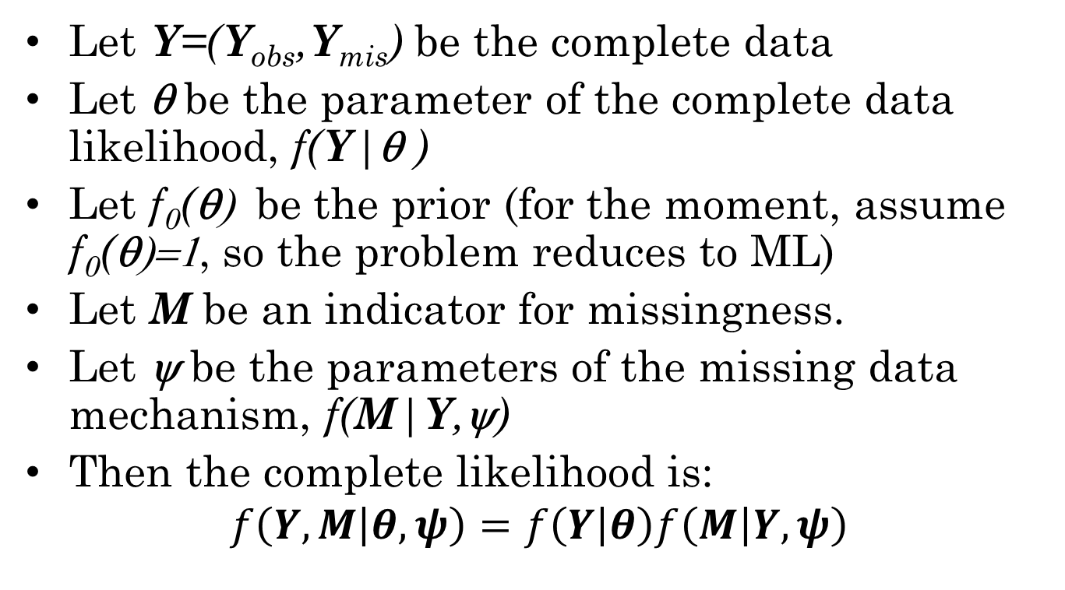
Estimation with missing data
Let Y=(Y_{obs},Y_{mis}) be the complete data
Let θ be the parameter of the complete data likelihood, f(Y|θ )
Let f₀(θ) be the prior (for the moment, assume f₀(θ)=1, so the problem reduces to ML)
Let M be an indicator for missingness.
Let ψ be the parameters of the missing data mechanism, f(M|Y,ψ)
Then the complete likelihood is:
$$f\left(Y,M | θ,ψ\right)=f\left(Y | θ\right)f\left(M | Y,ψ\right)$$

Slide 3
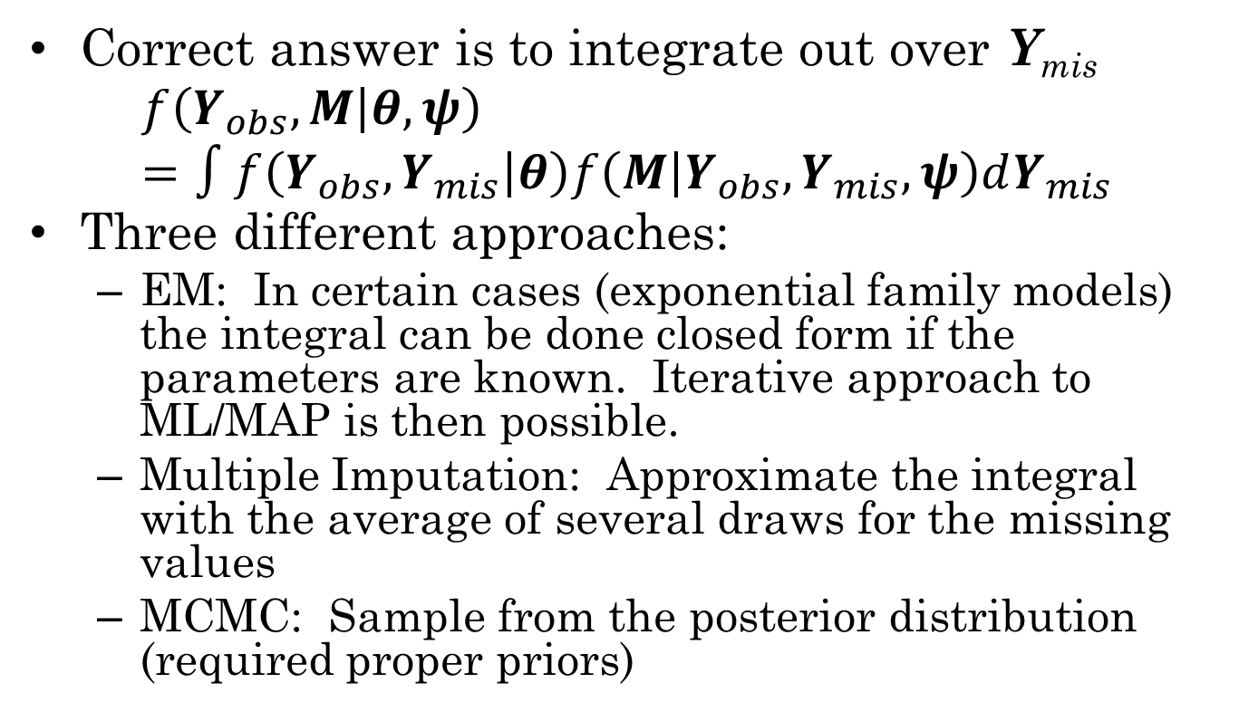
Getting rid of Y_{mis}
Correct answer is to integrate out over Y_{mis}
$$f\left(Y_{obs},M | θ,ψ\right)=∫f\left(Y_{obs},Y_{mis} | θ\right)f\left(M | Y_{obs},Y_{mis},ψ\right)dY_{mis}$$
Three different approaches:
EM: In certain cases (exponential family models) the integral can be done closed form if the parameters are known. Iterative approach to ML/MAP is then possible.
Multiple Imputation: Approximate the integral with the average of several draws for the missing values
MCMC: Sample from the posterior distribution (required proper priors)

Slide 4
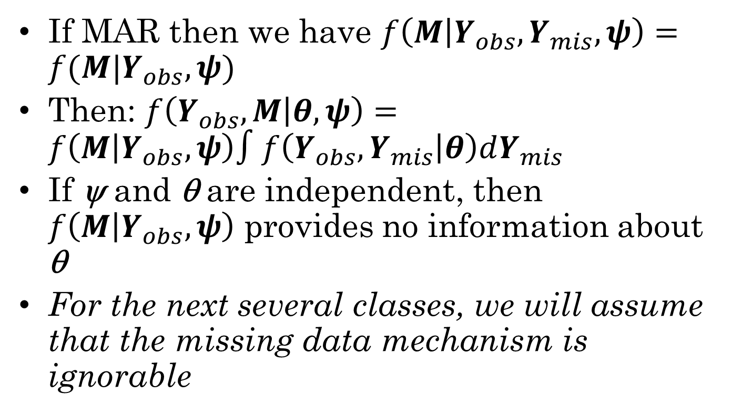
Ignorable Mechanisms
If MAR then we have $f\left(M | Y_{obs},Y_{mis},ψ\right)=f(M|Y_{obs},ψ)$
Then: $f\left(Y_{obs},M | θ,ψ\right)=f\left(M | Y_{obs},ψ\right)∫f\left(Y_{obs},Y_{mis} | θ\right)dY_{mis}$
If ψ and θ are independent, then $f\left(M | Y_{obs},ψ\right)$ provides no information about θ
For the next several classes, we will assume that the missing data mechanism is ignorable

Slide 5
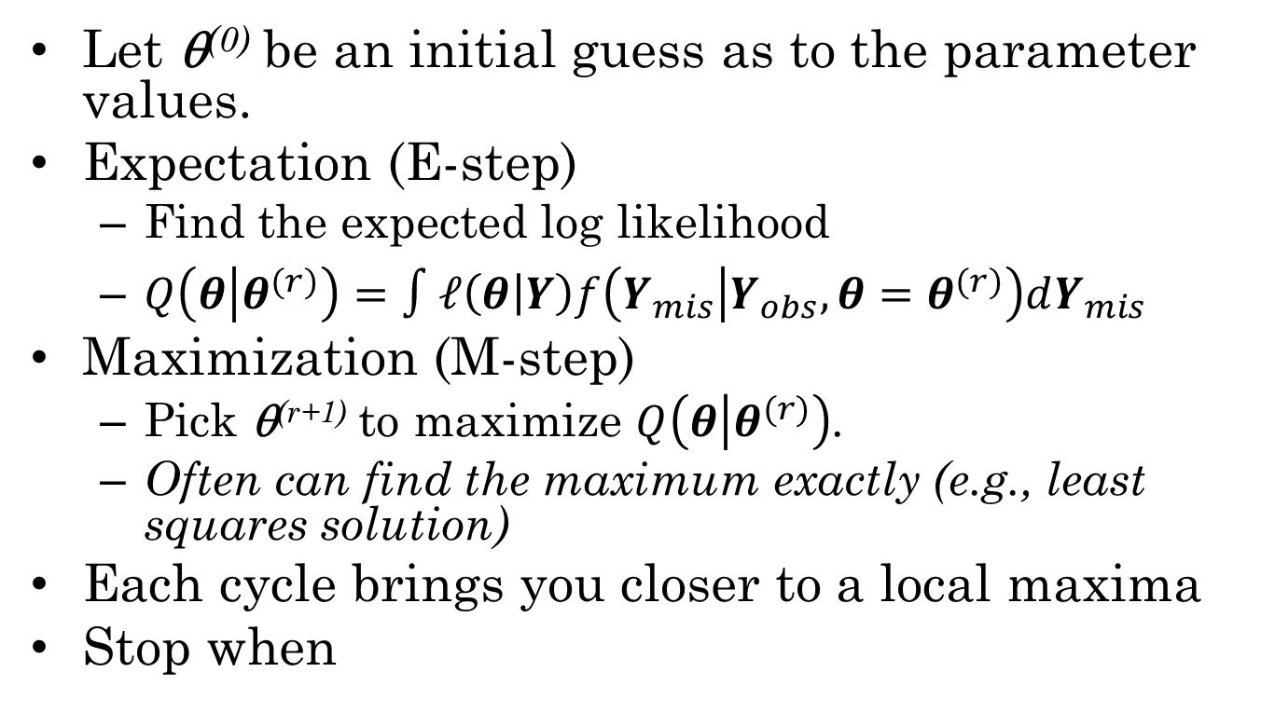
EM Algorithm
Let θ⁽⁰⁾ be an initial guess as to the parameter values.
Expectation (E-step)
Find the expected log likelihood
$Q\left(θ | θ^{(r)}\right)=∫ℓ\left(θ | Y\right)f\left(Y_{mis} | Y_{obs},θ=θ^{(r)}\right)dY_{mis}$
Maximization (M-step)
Pick θ^{(r+1)} to maximize $Q\left(θ | θ^{(r)}\right)$.
Often can find the maximum exactly (e.g., least squares solution)
Each cycle brings you closer to a local maxima
Stop when

Slide 6
Intuition
An intuitive view of the algorithm is that we are alternatively doing a mean (regression) imputation on the missing values and maximizing the likelihood.
This, however, works only if the log likelihood is liner in the missing values.
The log likelihood is linear in the sufficient statistics, so we can fill those in instead.

Slide 7
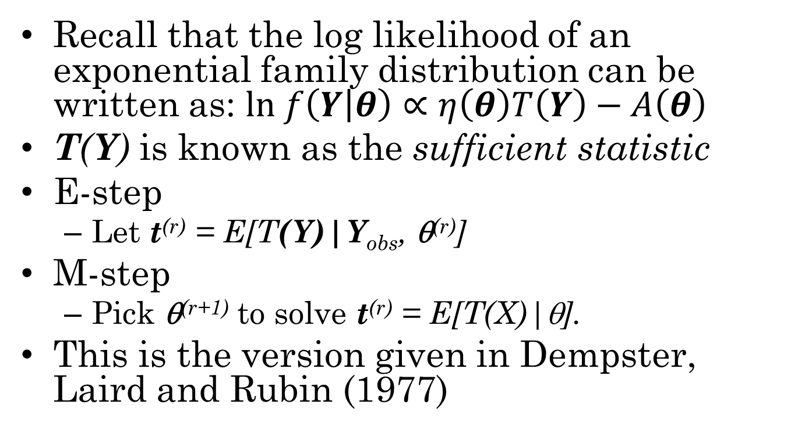
EM for Exponential Family
Recall that the log likelihood of an exponential family distribution can be written as: $ln f\left(Y | θ\right)∝η\left(θ\right)T\left(Y\right)−A\left(θ\right)$
T(Y) is known as the sufficient statistic
E-step
Let t^{(r)} = E[T(Y)|Y_{obs}, θ^{(r)}]
M-step
Pick θ^{(r+1)} to solve t^{(r)} = E[T(X)|θ].
This is the version given in Dempster, Laird and Rubin (1977)

Slide 8
Drawbacks of EM
Heavily depends on modeling assumptions about data (likelihood form)
Algebra of EM must be worked out for each model
Great if somebody has already done the work (Mplus or mvnmle package)
Not so great if we need to do the work ourselves (MLE regression in R)
Difficult to calculate the standard errors
Often resort to bootstrap, which requires large samples
Restricted to MLE/MAP estimation
Consider estimation of a binomial p with data of no events in n attempts
Prior information needs to be informative before it helps

Slide 9
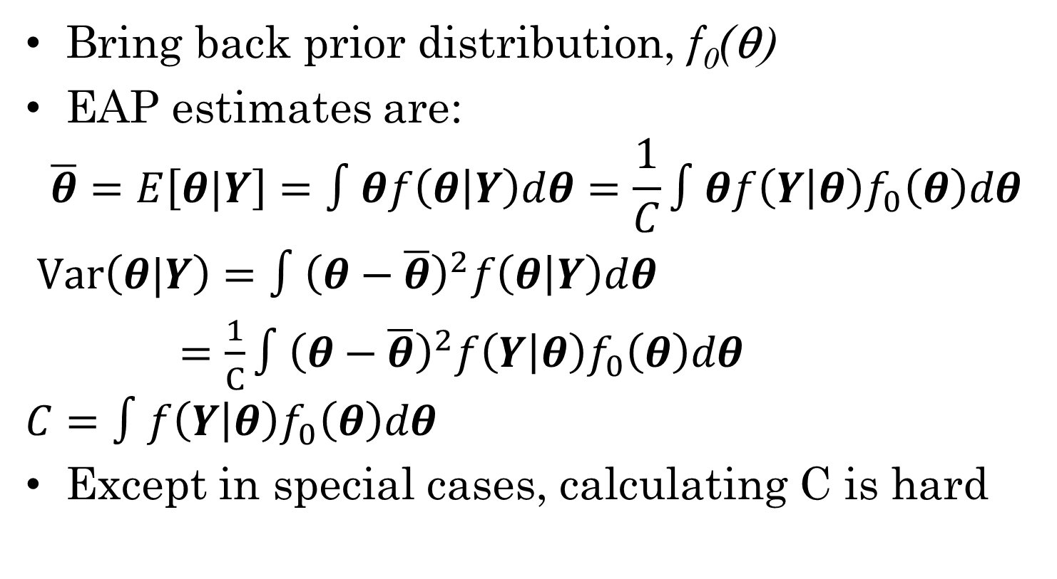
Expected A Posteriori (EAP)
Bring back prior distribution, f₀(θ)
EAP estimates are:
$$\overline{θ}=E\left[θ|Y\right]=∫θf\left(θ | Y\right)dθ=\frac{1}{C}∫θf\left(Y | θ\right)f_{0}\left(θ\right)dθ$$
$Var\left(θ|Y\right)=∫{\left(θ−\overline{θ}\right)}^{2}f\left(θ | Y\right)dθ$
$=\frac{1}{C}∫{\left(θ−\overline{θ}\right)}^{2}f\left(Y | θ\right)f_{0}\left(θ\right)dθ$
$$C=∫f\left(Y | θ\right)f_{0}\left(θ\right)dθ$$
Except in special cases, calculating C is hard

Slide 10
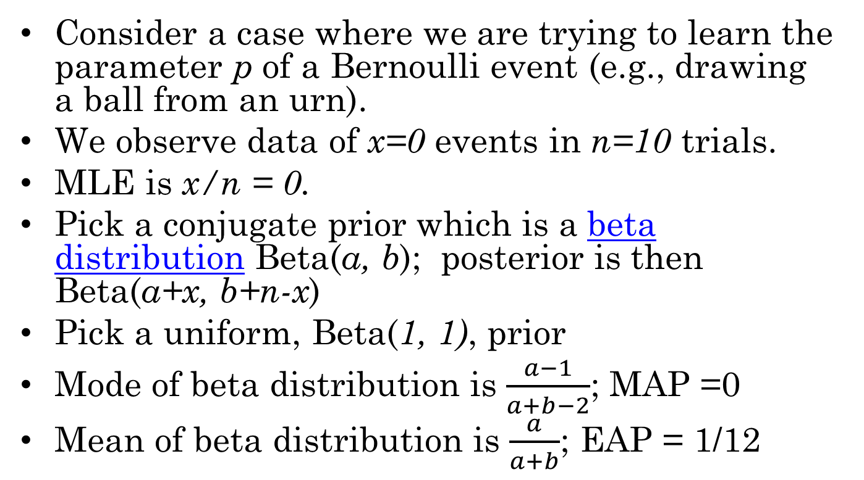
EAP vs MLE/MAP a simple example
Consider a case where we are trying to learn the parameter p of a Bernoulli event (e.g., drawing a ball from an urn).
We observe data of x=0 events in n=10 trials.
MLE is x/n = 0.
Pick a conjugate prior which is a beta distribution Beta(a, b); posterior is then Beta(a+x, b+n-x)
Pick a uniform, Beta(1, 1), prior
Mode of beta distribution is $\frac{a−1}{a+b−2}$; MAP =0
Mean of beta distribution is $\frac{a}{a+b}$; EAP = 1/12

Slide 11
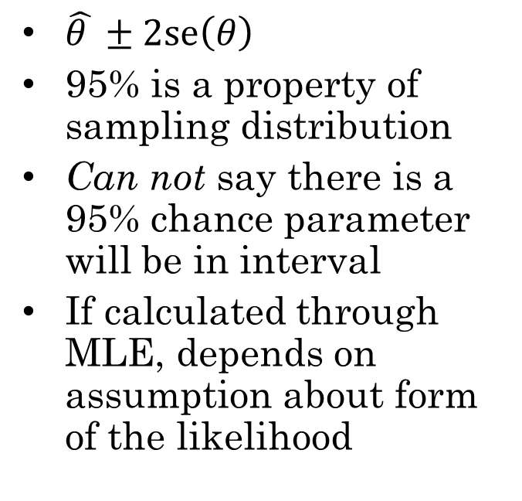
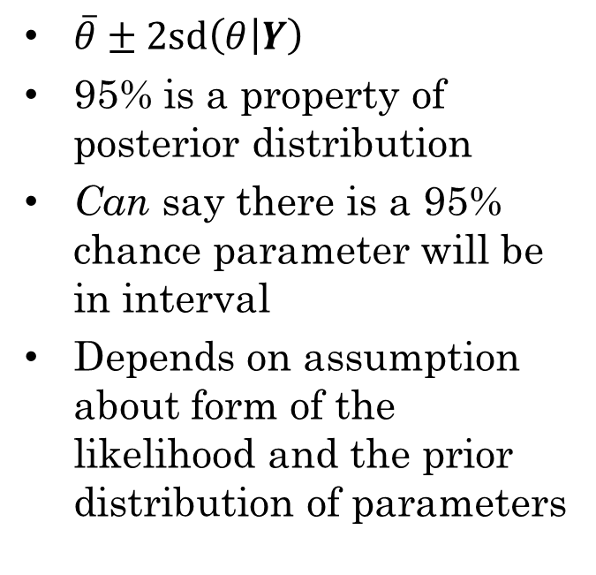
Credibility vs Confidence Intervals
Classical 95% confidence interval
Bayesian 95% credibility interval
$\hat{θ }±2se\left(θ\right)$
95% is a property of sampling distribution
Can not say there is a 95% chance parameter will be in interval
If calculated through MLE, depends on assumption about form of the likelihood
$\overline{θ}±2sd\left(θ | Y\right)$
95% is a property of posterior distribution
Can say there is a 95% chance parameter will be in interval
Depends on assumption about form of the likelihood and the prior distribution of parameters

Slide 12
Some Colorful Thoughts
Rubin: We want our c.i.’s to be well calibrated; sometimes Bayesian intervals are better calibrated than classical ones
In problems with missing data this is often the case
Savage: “Can’t make a Bayesian Omelet without breaking the Bayesian Egg”
If you want the credibility interval interpretation, you need to make the prior assumption
But, if sample is large and prior is weak (high variance) then prior should not matter much
Gelman: Standing at the back door with a shotgun making sure no subjective information creeps in with the prior while letting the subjective choice of likelihood walk in through the wide open front door.
Choice of likelihood matters much more than choice of prior

Slide 13
Rubin’s Lazy Bayesian Approach
In the 1980s, software that did Bayesian estimation was generally unavailable
BUGS took off in mid-1990s
Also many specialized Bayesian methods have appeared since this statement
If sample size is large enough, and you pick a standard non-informative prior, then classical and Bayesian estimates are close
Variance follows an inverse chi-squared distribution with N-1 degrees of freedom and a scale factor related to the normal variance estimator
After integrating out variance, mean follows a Student’s t distribution with mean equal to sample mean and N-1 degrees of freedom
Similar results for regression and ANOVA models
Unless you have strong prior information, just do inference with standard least-squares/MLE software, assume a non-informative prior and interpret the results as classical and/or Bayesian as appropriate.

Slide 14
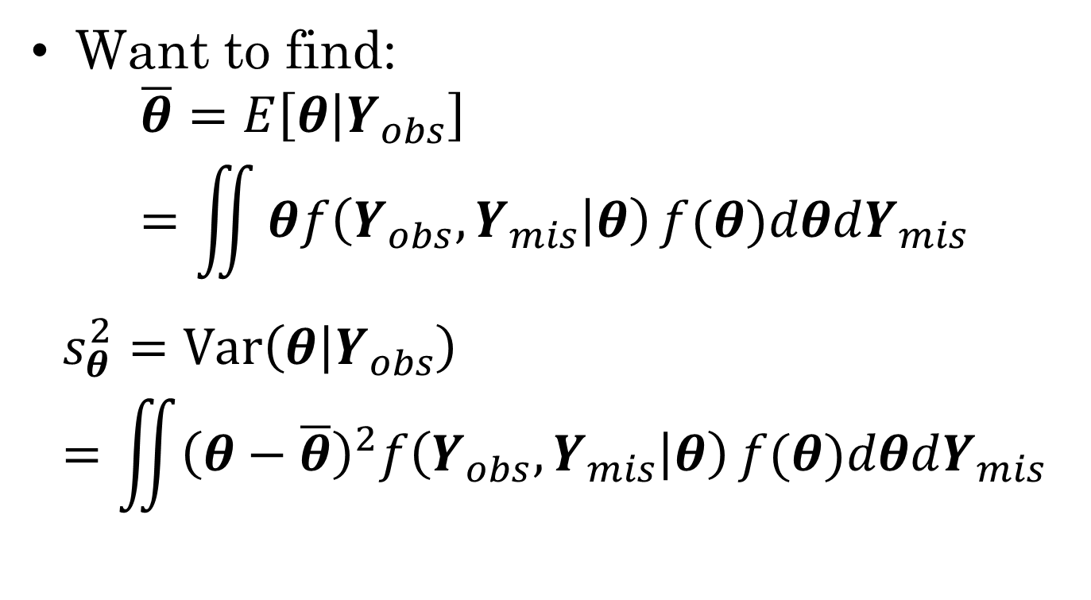
Back to the missing data problem
Want to find:
$$\overline{θ}=E\left[θ | Y_{obs}\right]=\iint{θf\left(Y_{obs},Y_{mis} | θ\right)}f(θ)dθdY_{mis}$$
$$s_{θ}^{2}=Var\left(θ | Y_{obs}\right)=\iint{{\left(θ−\overline{θ}\right)}^{2}f\left(Y_{obs},Y_{mis} | θ\right)}f(θ)dθdY_{mis}$$

Slide 15
Multiple Imputation Trick
Inner integral (over theta) is a standard Bayesian inference problem with complete data.
We can do the outer integral by statistical sampling.
The integral asks us to calculate an expected value.
The average of a sample is a consistent estimator of expected value
Create several complete data sets using stochastic integration, then take the average over those data sets

Slide 16
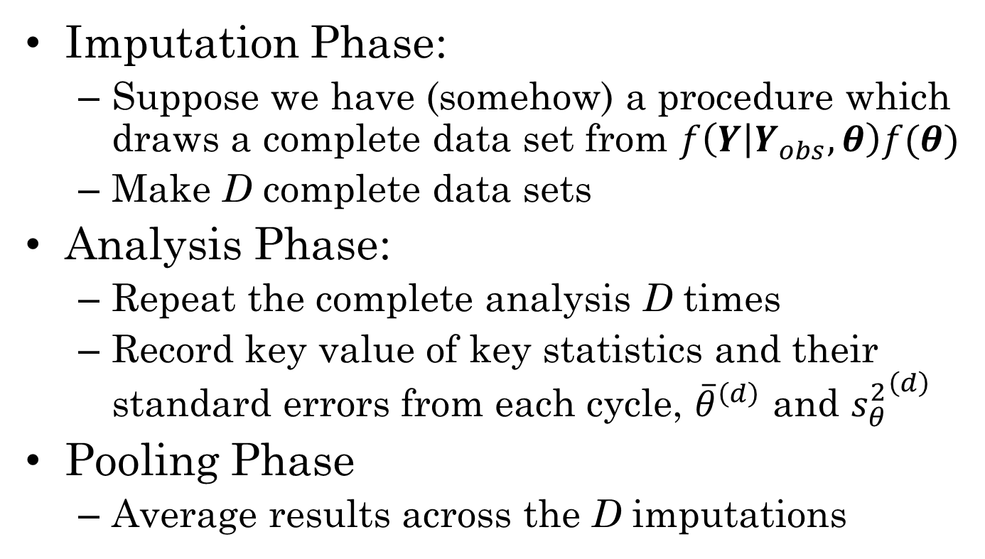
Multiple Imputation by Phases
Imputation Phase:
Suppose we have (somehow) a procedure which draws a complete data set from $f\left(Y | Y_{obs},θ\right)f(θ)$
Make D complete data sets
Analysis Phase:
Repeat the complete analysis D times
Record key value of key statistics and their standard errors from each cycle, ${\overline{θ}}^{\left(d\right)}$ and ${s_{θ}^{2}}^{\left(d\right)}$
Pooling Phase
Average results across the D imputations

Slide 17
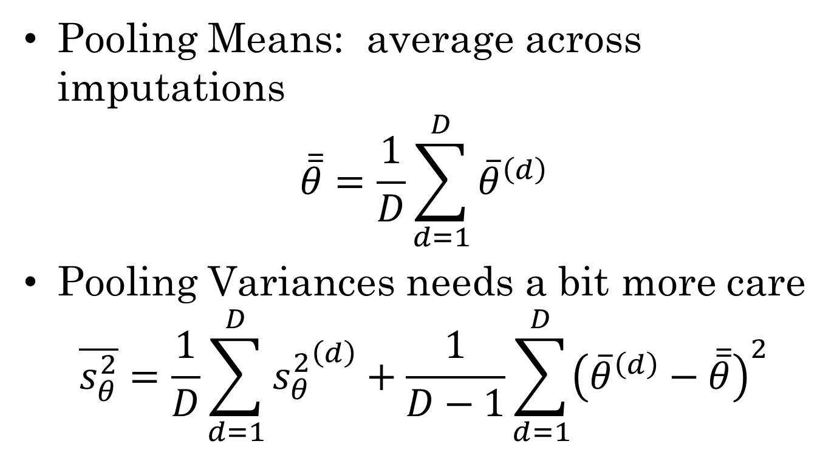
Pooling Phase
Pooling Means: average across imputations
$$\overline{\overline{θ}}=\frac{1}{D}\sum_{d=1}^{D}{{\overline{θ}}^{\left(d\right)}}$$
Pooling Variances needs a bit more care
$$\overline{s_{θ}^{2}}=\frac{1}{D}\sum_{d=1}^{D}{{s_{θ}^{2}}^{\left(d\right)}}+\frac{1}{D−1}\sum_{d=1}^{D}{{\left({\overline{θ}}^{\left(d\right)}−\overline{\overline{θ}}\right)}^{2}}$$

Slide 18
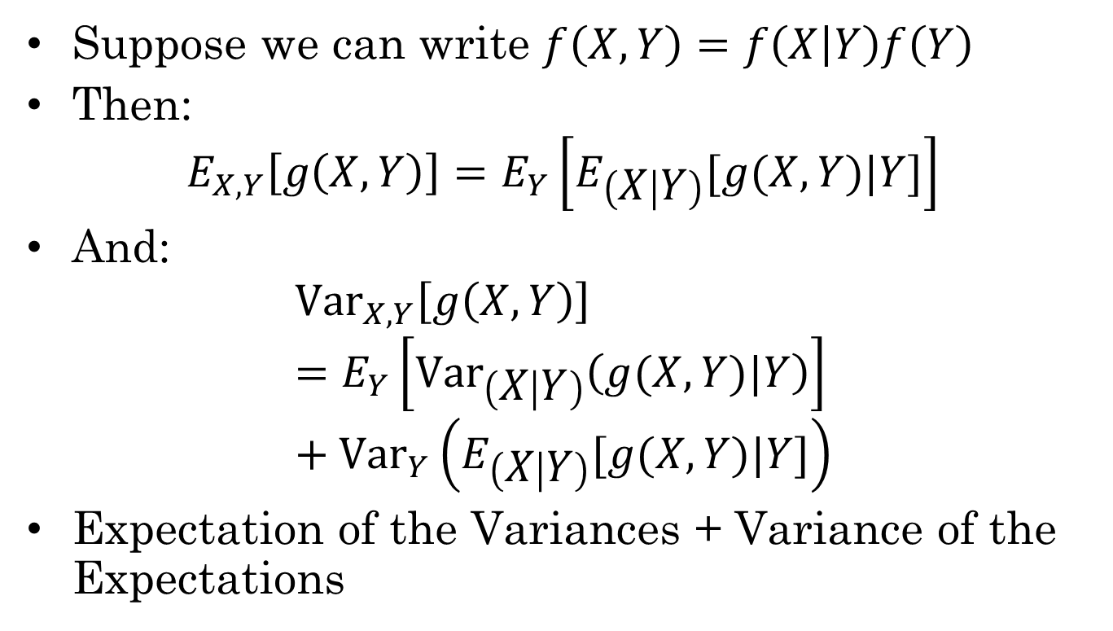
Expectation and Variance of conditional distribution
Suppose we can write $f\left(X,Y\right)=f\left(X | Y\right)f\left(Y\right)$
Then:
$$E_{X,Y}\left[g\left(X,Y\right)\right]=E_{Y}\left[E_{\left(X | Y\right)}[g(X,Y)|Y]\right]$$
And:
$${Var}_{X,Y}\left[g\left(X,Y\right)\right]=E_{Y}\left[{Var}_{\left(X | Y\right)}\left(g(X,Y)|Y\right)\right]+{Var}_{Y}\left(E_{\left(X | Y\right)}[g(X,Y)|Y]\right)$$
Expectation of the Variances + Variance of the Expectations

Slide 19
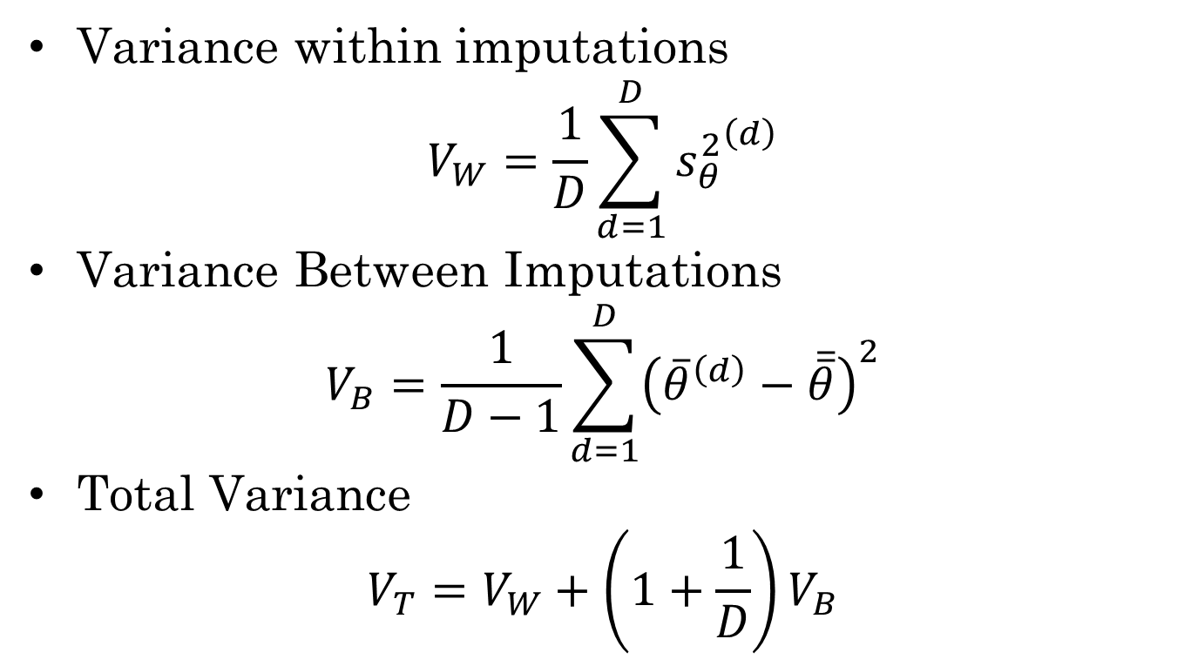
Analysis of Imputation Variance
Variance within imputations
$$V_{W}=\frac{1}{D}\sum_{d=1}^{D}{{s_{θ}^{2}}^{\left(d\right)}}$$
Variance Between Imputations
$$V_{B}=\frac{1}{D−1}\sum_{d=1}^{D}{{\left({\overline{θ}}^{\left(d\right)}−\overline{\overline{θ}}\right)}^{2}}$$
Total Variance
$$V_{T}=V_{W}+\left(1+\frac{1}{D}\right)V_{B}$$

Slide 20
Multiple vs Single Imputation
Single imputation
Unbiased estimates for means even in MAR case
But underestimates the standard errors
Complete-case analysis
Mean estimates unbiased only for MCAR case
Overestimates the standard errors
Multiple Imputations
Unbiased estimates for means even in MAR case
Estimates for s.e. are not bad even for D=5 or even D=3!

Slide 21
Multiple Imputation Advantages
Analysis Phase uses existing techniques, so can draw on existing software/knowledge
Pooling Phase is straightforward, can easily be done by hand for small D and a small number of statistics
Software exists to do the imputation step for common statistical models

Slide 22
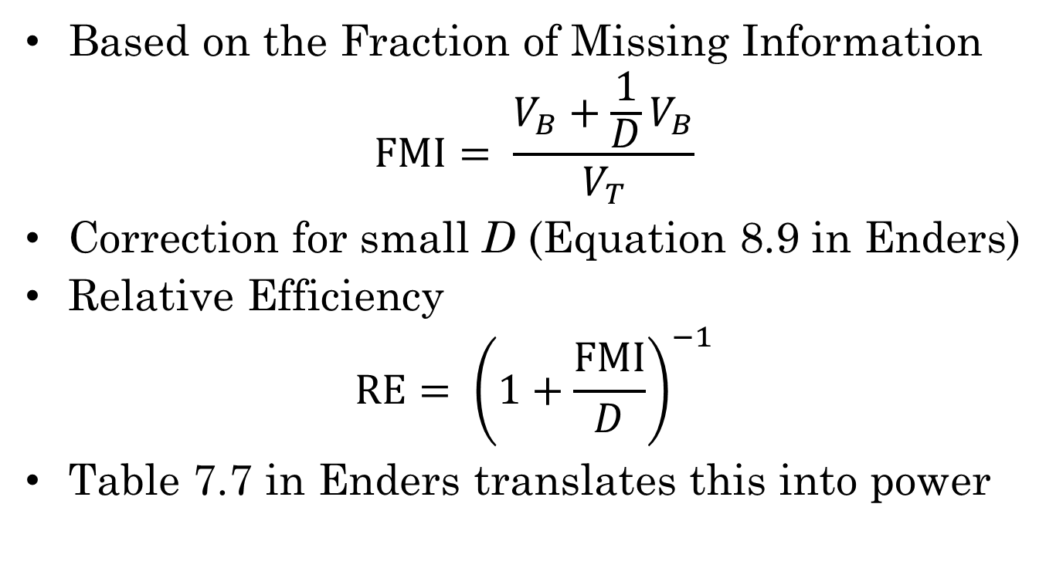
How many imputations
Based on the Fraction of Missing Information
$$FMI= \frac{V_{B}+\frac{1}{D}V_{B}}{V_{T}}$$
Correction for small D (Equation 8.9 in Enders)
Relative Efficiency
$$RE= {\left(1+\frac{FMI}{D}\right)}^{−1}$$
Table 7.7 in Enders translates this into power

Slide 23
Large Sample Imputations
If the data set is large and the fraction of missing values is small, then complete case analysis is not too bad approximation of parameters (slight overestimate of s.e.)
Can draw multiple stochastic regression imputations from the data
Two sources of variability
Uncertainty about the parameters (regression line)
Uncertainty about the size of the residual for this particular observation
Imputation in two phases:
P-step – draw random parameters from posterior
I-step – draw random values for Y_{mis}

Slide 24
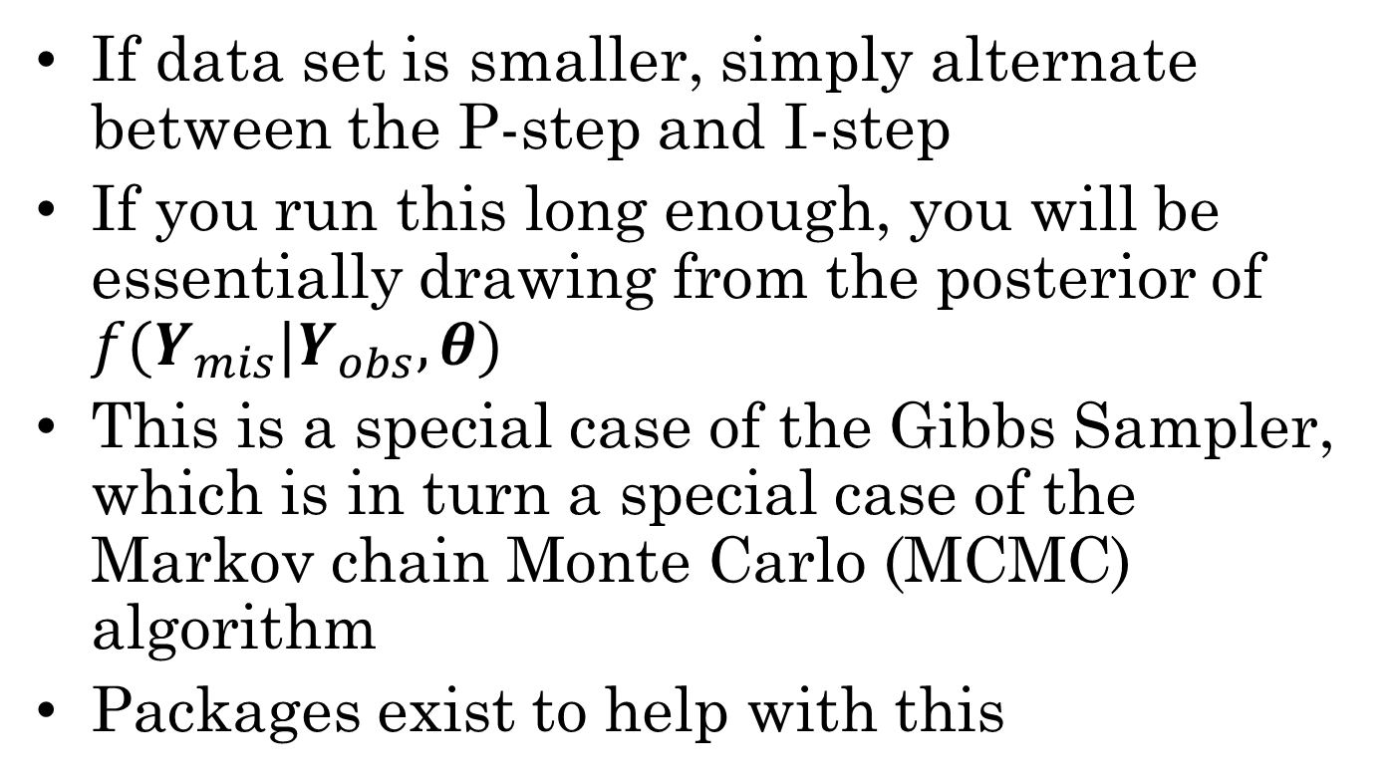
Data Augmentation
If data set is smaller, simply alternate between the P-step and I-step
If you run this long enough, you will be essentially drawing from the posterior of $f(Y_{mis}|Y_{obs}, θ)$
This is a special case of the Gibbs Sampler, which is in turn a special case of the Markov chain Monte Carlo (MCMC) algorithm
Packages exist to help with this

Slide 25
MI and Public Data Sources
A government agency could provide pre-imputed data sets for large public-use data sets.
Agency provides base data plus D sets of plausible values for the missing values.
Secondary users do the analysis phase and pooling phase on their own
Imputation model should incorporate all of the variables likely to be included in an analysis model.

Slide 26
Imputation and Analysis Model
In general the imputation model should contain more terms and interactions than the analysis model.
It doesn’t matter if non-significant terms are included in the imputation model: the goal is to do prediction, non-significant terms will have coefficients close to zero
A proper Bayesian prior which shrinks some of the small coefficients closer to zero helps here

Slide 27
National Assessment of Educational Progress
Now annual (was biannual) survey of state of education in US
National Center for Educational Statistics (Part of Department of Education)
Sample, not a census!
Prime contractors
ETS, development and scoring
WestStat, sampling and administration
NAEP explorer and Restricted Use data sets

Slide 28
Multistage stratified cluster sampling with oversampled minorities
Very complex sampling design
Primary Sampling Units (PSAs)
School Districts
Schools
Classrooms
Oversample schools with high minority populations
Need to stratify over school types: Public, Charter, Private (religious and other)
WestStat/ETS provide primary sample weights for calculating mean and jackknife replicate weights for estimating standard errors.

Slide 29
Matrix Sampling
NAEP testing blueprint would require each student to test for around 8 hours
Typically students are only tested for 1 or 2 class periods
Solution is matrix sampling
Items are divided up into forms
Forms are put together into booklets: each booklet has 2 or 3 forms
There is overlap between booklets
Booklets are shipped in a spiral pattern, so that consecutive students get different booklets, and all booklets get roughly equal exposure

Slide 30
Plausible Values
Typical target of inference is proficiency, which is latent
Proficiency is usually multidimensional
And multiple dimensions are highly correlated
Because of matrix sampling, estimates are highly variable
Solution: Impute 5 plausible values for each proficiency. Sets of plausible values capture correlations among dimensions
Estimates at individual level are highly inaccurate, but higher level aggregates are good (CLT in action)
Restricted data users promise not to report individual scores.

Slide 31
NEAP Imputation Model
NAEP data has many (over 999) columns
Weights and Jackknife weights (about 50 columns)
Item responses (several hundred columns)
Questionnaire responses
Student questionnaire
Teacher questionnaire
School questionnaire
Other background variables (e.g., school type, information about location, &c)
Some redundancy
Sex (self-report), Sex (school-report), Sex (reconciled)
Type of location (urban, suburban, rural): TOL3, TOL5, TOL8, TOL3Old, TOL5Old, TOL5Old (Old definitions retained for longitudinal analyses)
Can’t anticipate every single analysis question that might be asked
Solution: Do a PCA with most commonly used background questions
Impute conditioned on PCA factors

Slide 32
NAEP Data Analysis
For each set of plausible values:
Calculate means using primary weights
Calculate standard errors using jackknife
Now combine using the pooling formulas
Or use NAEP Data Explorer:
http://nces.ed.gov/nationsreportcard/naepdata/
Basically builds up tables of conditional means

