Slide 1
Multiple Imputation in R
A slightly more Bayesian approach

Slide 2
Rubin’s Lazy Bayesian Approach
In the 1980s, software that did Bayesian estimation was generally unavailable
BUGS took off in mid-1990s
Also many specialized Bayesian methods have appeared since this statement
If sample size is large enough, and you pick a standard non-informative prior, then classical and Bayesian estimates are close
Variance follows an inverse chi-squared distribution with N-1 degrees of freedom and a scale factor related to the normal variance estimator
After integrating out variance, mean follows a Student’s t distribution with mean equal to sample mean and N-1 degrees of freedom
Similar results for regression and ANOVA models
Unless you have strong prior information, just do inference with standard least-squares/MLE software, assume a non-informative prior and interpret the results as classical and/or Bayesian as appropriate.

Slide 3
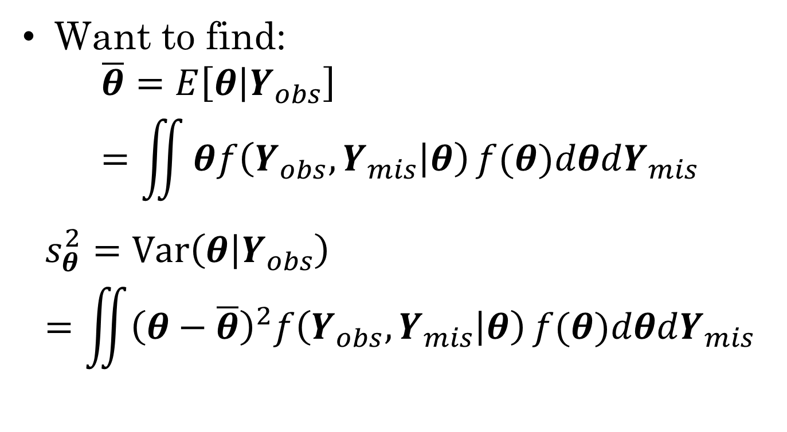
Back to the missing data problem
Want to find:
$$\overline{θ}=E\left[θ | Y_{obs}\right]=\iint{θf\left(Y_{obs},Y_{mis} | θ\right)}f(θ)dθdY_{mis}$$
$$s_{θ}^{2}=Var\left(θ | Y_{obs}\right)=\iint{{\left(θ−\overline{θ}\right)}^{2}f\left(Y_{obs},Y_{mis} | θ\right)}f(θ)dθdY_{mis}$$

Slide 4
Multiple Imputation Trick
Inner integral (over theta) is a standard Bayesian inference problem with complete data.
We can do the outer integral by statistical sampling.
The integral asks us to calculate an expected value.
The average of a sample is a consistent estimator of expected value
Create several complete data sets using stochastic integration, then take the average over those data sets

Slide 5
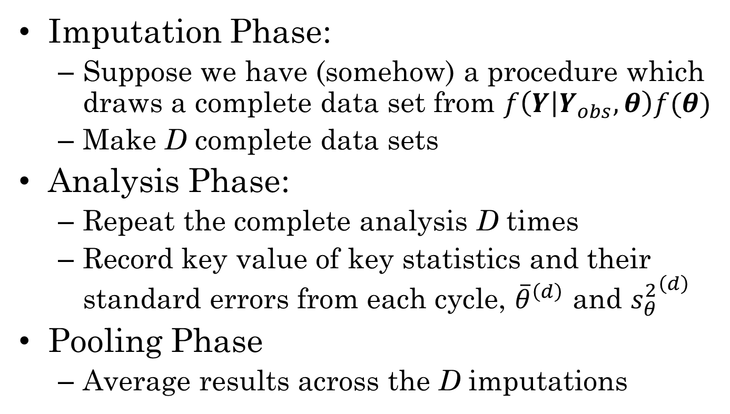
Multiple Imputation by Phases
Imputation Phase:
Suppose we have (somehow) a procedure which draws a complete data set from $f\left(Y | Y_{obs},θ\right)f(θ)$
Make D complete data sets
Analysis Phase:
Repeat the complete analysis D times
Record key value of key statistics and their standard errors from each cycle, ${\overline{θ}}^{\left(d\right)}$ and ${s_{θ}^{2}}^{\left(d\right)}$
Pooling Phase
Average results across the D imputations

Slide 6
Imputation Phase Method 1: Bayesian Bootstrap
Form somehow (e.g., bootstrap) an approximate posterior distribution for parameters
For d=1, …, D
draw a set of parameters
draw a set of values for Y_{mis}
Drawbacks
may not fully take in information from incomplete information in forming approximate posterior
Posterior is only approximate

Slide 7
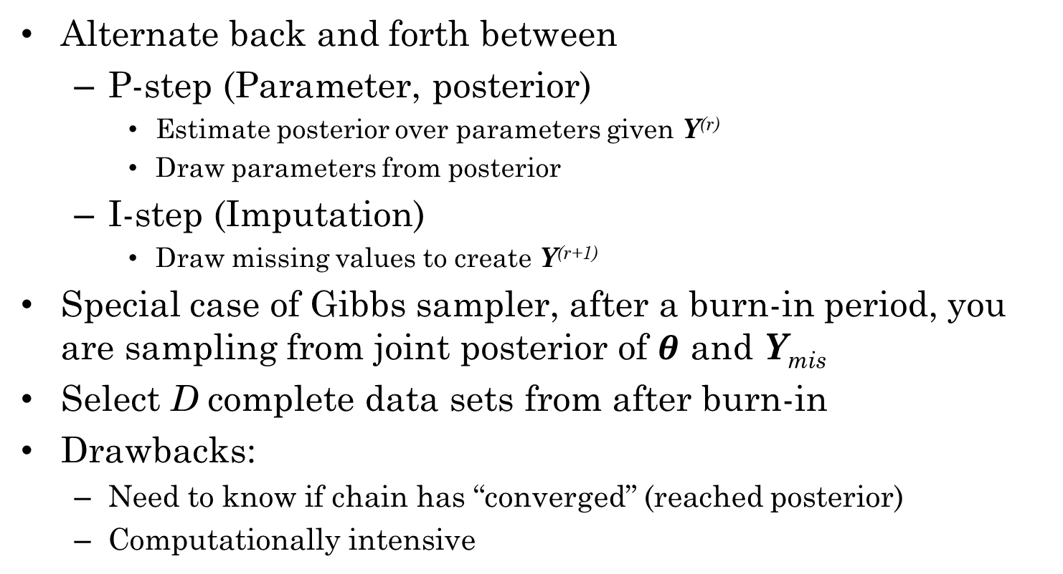
Imputation Phase Method 2: Data Augmentation
Alternate back and forth between
P-step (Parameter, posterior)
Estimate posterior over parameters given Y^{(r)}
Draw parameters from posterior
I-step (Imputation)
Draw missing values to create Y^{(r+1)}
Special case of Gibbs sampler, after a burn-in period, you are sampling from joint posterior of $θ$ and Y_{mis}
Select D complete data sets from after burn-in
Drawbacks:
Need to know if chain has “converged” (reached posterior)
Computationally intensive

Slide 8
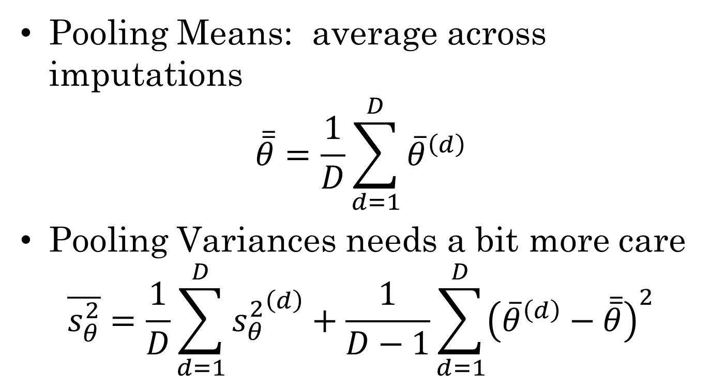
Pooling Phase
Pooling Means: average across imputations
$$\overline{\overline{θ}}=\frac{1}{D}\sum_{d=1}^{D}{{\overline{θ}}^{\left(d\right)}}$$
Pooling Variances needs a bit more care
$$\overline{s_{θ}^{2}}=\frac{1}{D}\sum_{d=1}^{D}{{s_{θ}^{2}}^{\left(d\right)}}+\frac{1}{D−1}\sum_{d=1}^{D}{{\left({\overline{θ}}^{\left(d\right)}−\overline{\overline{θ}}\right)}^{2}}$$

Slide 9
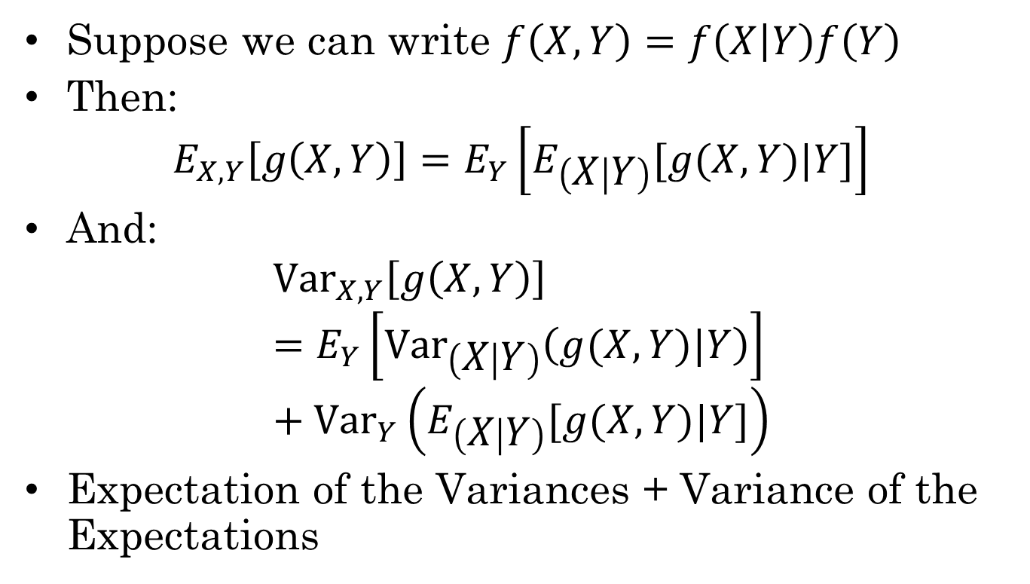
Expectation and Variance of conditional distribution
Suppose we can write $f\left(X,Y\right)=f\left(X | Y\right)f\left(Y\right)$
Then:
$$E_{X,Y}\left[g\left(X,Y\right)\right]=E_{Y}\left[E_{\left(X | Y\right)}[g(X,Y)|Y]\right]$$
And:
$${Var}_{X,Y}\left[g\left(X,Y\right)\right]=E_{Y}\left[{Var}_{\left(X | Y\right)}\left(g(X,Y)|Y\right)\right]+{Var}_{Y}\left(E_{\left(X | Y\right)}[g(X,Y)|Y]\right)$$
Expectation of the Variances + Variance of the Expectations

Slide 10
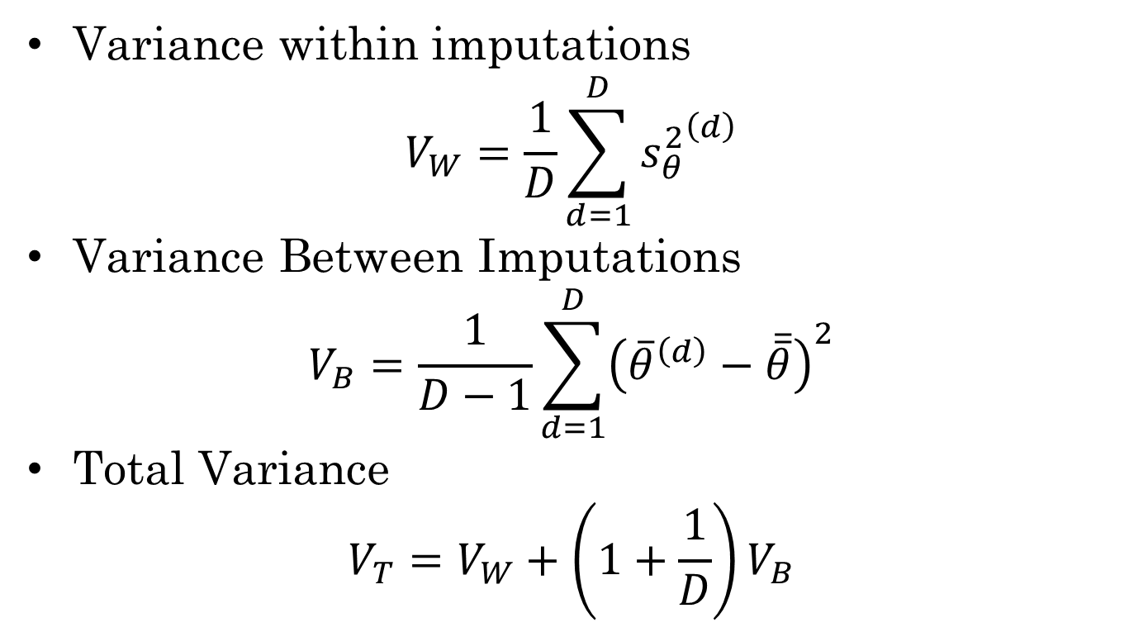
Analysis of Imputation Variance
Variance within imputations
$$V_{W}=\frac{1}{D}\sum_{d=1}^{D}{{s_{θ}^{2}}^{\left(d\right)}}$$
Variance Between Imputations
$$V_{B}=\frac{1}{D−1}\sum_{d=1}^{D}{{\left({\overline{θ}}^{\left(d\right)}−\overline{\overline{θ}}\right)}^{2}}$$
Total Variance
$$V_{T}=V_{W}+\left(1+\frac{1}{D}\right)V_{B}$$

Slide 11
Multiple vs Single Imputation
Single imputation
Unbiased estimates for means even in MAR case
But underestimates the standard errors
Complete-case analysis
Mean estimates unbiased only for MCAR case
Overestimates the standard errors
Multiple Imputations
Unbiased estimates for means even in MAR case
Estimates for s.e. are not bad even for D=5 or even D=3!

Slide 12
Multiple Imputation Advantages
Analysis Phase uses existing techniques, so can draw on existing software/knowledge
Pooling Phase is straightforward, can easily be done by hand for small D and a small number of statistics
Software exists to do the imputation step for common statistical models

Slide 13
Three R packages
mitools – tools for the analysis and pooling phases
Need other software to handle imputation
Amelia – environment for MI using bootstrap to get parameter information.
Uses Bayesian Bootstrap approach
mi – A bootstrap environment using Data Augmentation
Uses Data Augmentation

Slide 14
mitools
Assumes some other tool used generate the plausible values (possibly stored in an external file).
Create an imputationList from a list of data frames (plausible values)
The with() command applies analyses to each plausible values
MIcombine() combines the results of multiple lm()/glm() analyses.
MIextract() extracts parameter values from list of results.

Slide 15
Amelia
Does both imputation (recommends Zelig for pooling)
Uses Bayesian Bootstrap approach to MI
Has a GUI interface: launch with AmeliaView() command, and standalone version
Has tools for checking imputations, visualizing missing data patterns
Recommends use of Zelig package to combine across imputations.
Supports parallel computing (use parallel package)
Can put some priors on missing variables (ridge, individual priors, bounded supports)

Slide 16
amelia() command
First argument is data set (with missing values)
Other arguments
m = number of imputations
p2s = 0, 1 or 2 (how much diagnostics are printed)
ords=, noms= -- character vectors giving lists of ordinal and nominal variables
logs=, sqrts=, lgstc= -- character vectors giving names of variables to be transformed
idvars = variables that are not part of model but retained
ts=, cs= -- Time variable and cross-section variable for time series

Slide 17
Transforming variables
Amelia assumes world is multivariate normal (according to Joe Schafer, this is not such a bad assumption)
Declaring ordinal and nominal variables causes exact values to be imputed (rather than a predicted gender or 0.57)
If variables have high skewness, kurtosis, can declare to use log, sqrt or logistic transformations

Slide 18
Working with imputations
a.out <- amelia(mydata, m=5, …)
Imputations are in a.out$imputations
a.out$imputations[[3]] – 3rd imputation
data.impList <- imputationList(a.out$imputations)
Write out
As single R object save(a.out, file=“imps.RData”)
As multiple CSV files write.amelia(a.out, file.stem=“mydata_imps”)
Adding more imputations
a.out.10 <- ameliabind(a.out.5a, a.out.5b)

Slide 19
Imputation Checks
Comparing densities
compare.density(a.out, var=“signed”)
plot(a.out, which.vars=3:6)
If data are not fully observed, shows density of observed cases in black and imputed values in red

Slide 20
Overimputing
Temporarily make each variable missing
Impute a large number (~100) cases and get a 90% interval for the imputations.
Plot the 90% intervals against the expected values, around 90% of the cases intervals should overlap the y=x reference line
Done through the overimpute() function

Slide 21
Overdispersed starting values
Start the EM algorithm from different places, see if all of the EM algorithms change.
disperse(a.out, dims=1, m=5)
dims = number of principle components to track
m= number of starting points.

Slide 22
Two more commands
missmap(a.out) – produces a missing data pattern map
transform(a.out, newvar=) adds new variables to all data frames (similar to update() with an imputationList object.

