Slide 1


Bayesian Networks and Applications
Session 2: Bayes Net Applications I
Duanli Yan, ETS
Russell Almond, FSU

Slide 2
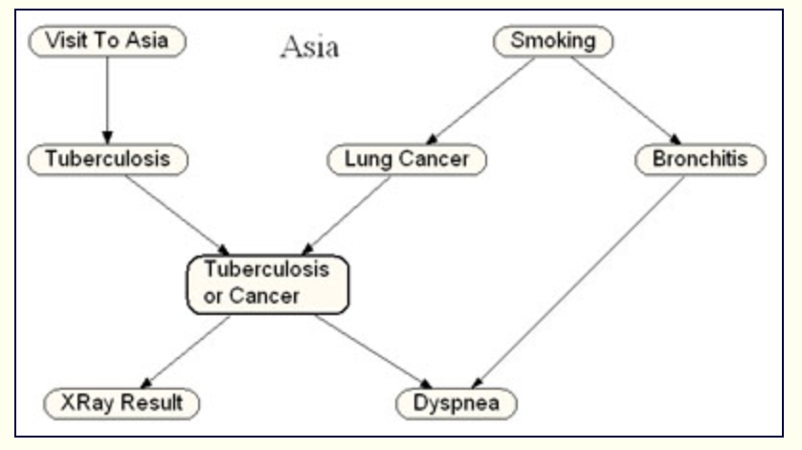
Bayes nets for Medical Diagnosis -revise
Norsys.com
A popular simple Bayes nets example: Chest Clinic (Lauritzen&Spiegelhalter88).
Each node in the network corresponds
to some condition of the patient
E.g., "Visit to Asia" indicates whether
the patient recently visited Asia.
The arrows (links) between any two
nodes indicate that there are probability
relationships that are know to exist
between the states of those two nodes
E.g., smoking increases the chances of
getting lung cancer and of getting bronchitis. Both lung cancer and bronchitis
increase the chances of getting dyspnea (shortness of breath). Both lung
cancer and tuberculosis, but not usually bronchitis, can cause an abnormal
lung x-ray.
The direction of the link arrows roughly corresponds to "causality".
i.e., the nodes higher up in the diagram tend to influence those below rather than, or, at least, more so than the other way around.

Slide 3
Why are Bayes nets useful?
Norsys.com
A model is generally useful if
it helps us to greater understand the world we are modeling
if it allows us to make useful predictions about how the world will behave
It is often easier to experiment with the model as compared to reality
Example: Chest Clinic, suppose:
30% of the US population smokes.
Lung cancer can be found in about 70 people per 100,000.
TB occurs in about 10 people per 100,000.
Bronchitis can be found in about 800 people per 100,000.
Dyspnea can be found in about 10% of people, but most of that is due to asthma and causes other than TB, lung cancer, or bronchitis.

Slide 4
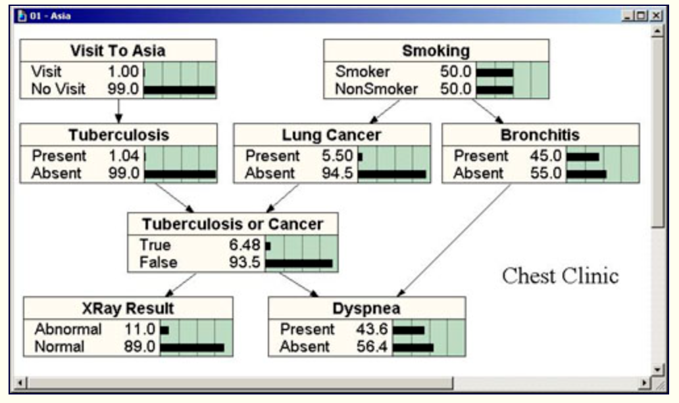
Bayes net in Diagnosis: Chest Clinic
Norsys.com
Data collection reveal:
50% of your patients smoke
1% have TB
5.5% have lung cancer
45% have some form of mild or chronic bronchitis

Slide 5
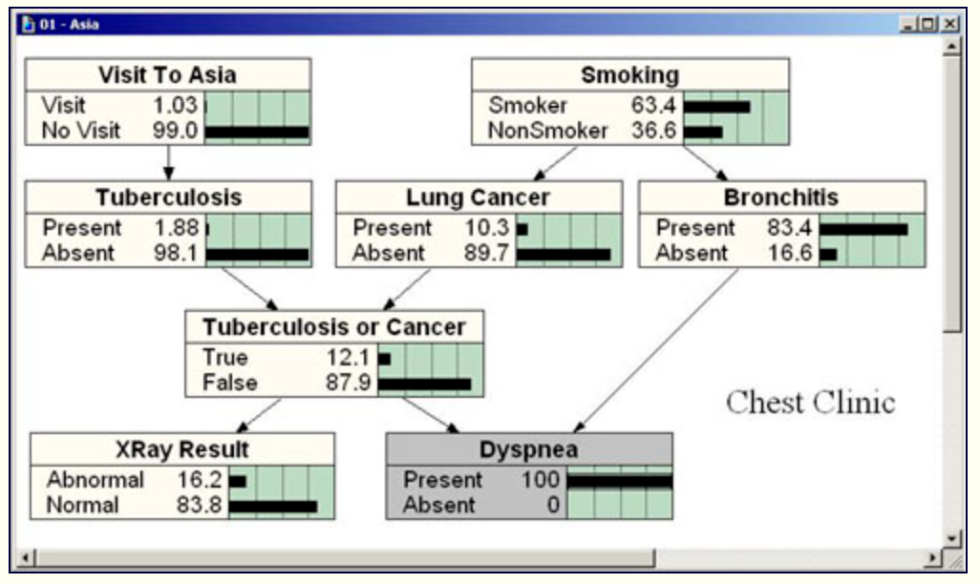
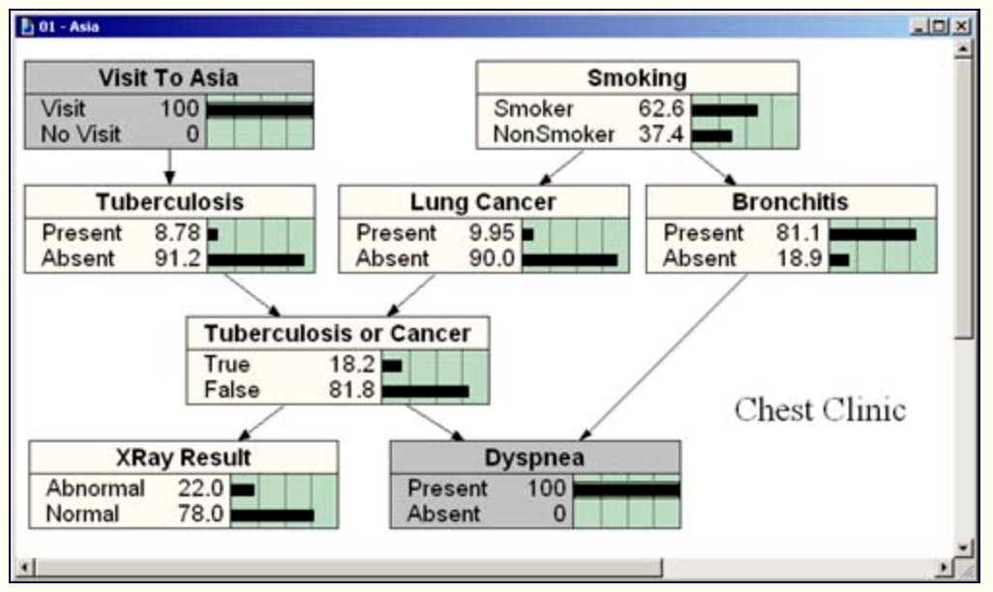
Bayes net in Diagnosis: Chest Clinic
Norsys.com

Slide 6
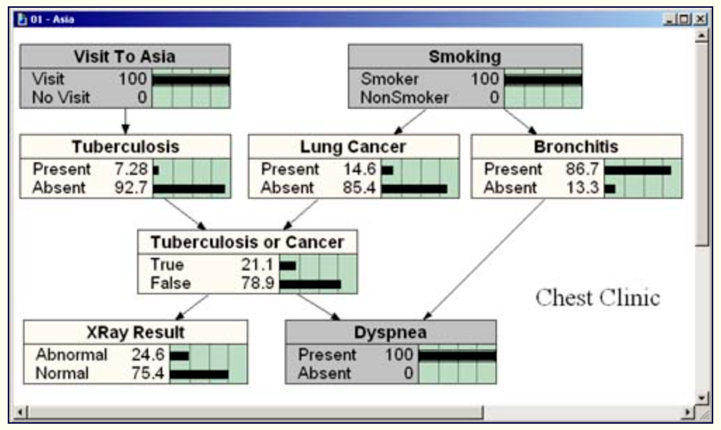
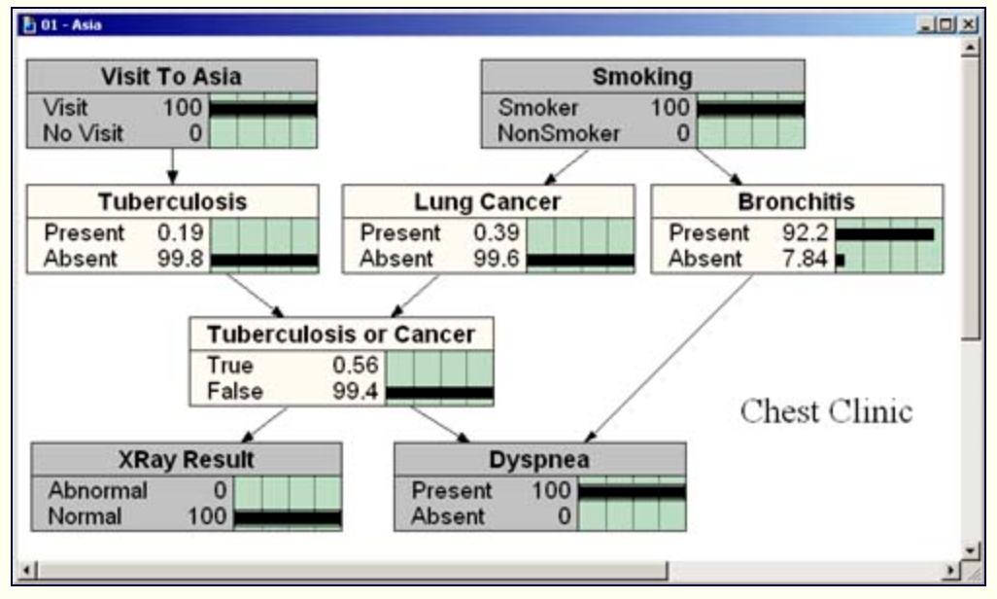
Bayes net in Diagnosis: Chest Clinic
Norsys.com

Slide 7
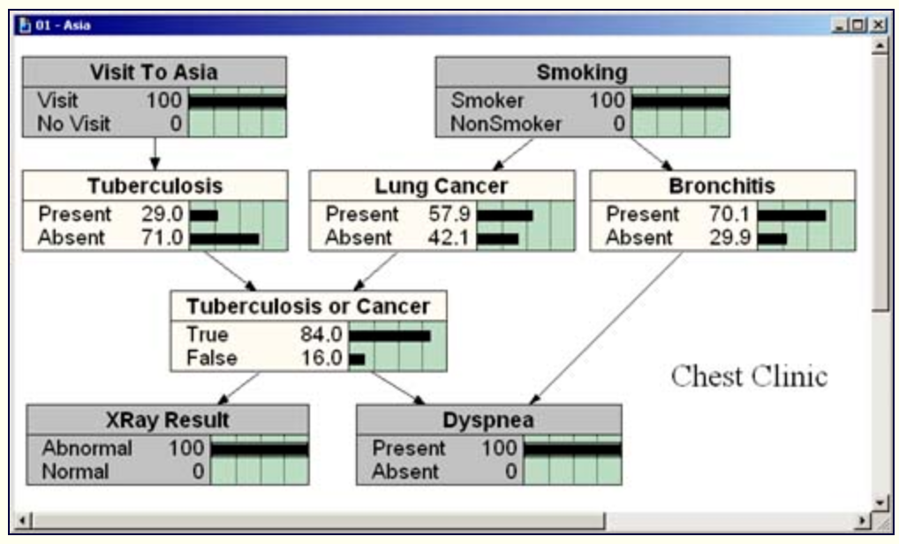
Bayes net in Diagnosis: Chest Clinic - revise
Norsys.com
Note:
TB or Lung Cancer has shot up enormously in probability
Bronchitis is still the most probable of the three separate illnesses, but it is less than the combination hypothesis of TB or Lung Cancer
So, we would then decide to perform further tests, order blood tests, lung tissue biopsies, etc.
The current Bayes net does not cover those tests, but it would be easy to extend it by simply adding extra nodes as we acquire new statistics for those diagnostic procedures.
We do not need to throw away any part of the previous net. This is another powerful feature of Bayes nets. They are easily extended (or reduced, simplified) to suit your changing needs and your changing knowledge.

Slide 8
Bayes nets Assisting Decision Making
Norsys.com
When making decision:
To predict reality as accurately as is possible,
To weigh the states of your model with degrees of "goodness" or "badness”, a natural and extremely useful extension
i.e., if some states of the world lead to pleasure/survival/value/wealth, while others to pain, you simply want to find out how can you change the world to maximize the pleasure and minimize the pain
Decision Theory or Utility Theory
a science of decision making that mixes probability with measurements of value
Bayes nets are easily extended to computing utility, given the degree of knowledge on a situation
Bayes net becomes very popular: business, education, scientific and economic modeling.
We use Netica: Decision nodes, Utility nodes

Slide 9
Bayes nets in Education
Discrete Item Response Theory (IRT)
Proficiency Model
Task/Evidence Models
Assembly Model
Some Numbers

Slide 10
IRT Proficiency Model
There is one proficiency variable, θ. (Sometimes called an “ability parameter”, but we reserve the term parameter for quantities which are not person specific.)
θ takes on values {-2, -1, 0, 1, 2} with prior probabilities of (0.1, 0.2, 0.4, 0.2, 0.1) (Triangular distribution).
Observable outcome variables are all independent given θ
Goal is to draw inferences about θ
Rank order students by θ
Classify students according to θ above or below a cut point

Slide 11
IRT Task/Evidence Model
Tasks yield a work product which can be unambiguously scored right/wrong.
Each task has a single observable outcome variable.
Tasks are often called items, although the common usage often blurs the distinction between the presentation of the item and the outcome variable.

Slide 12
IRT (Rasch) Evidence Model
Let X_{j} be observable outcome variable from Task j
P(X_{j} =right | θ, β_{j} ) =
β_{j} is the difficulty of the item.
Can crank through the formula for each of the five values of θ to get values for Conditional Probability Tables (CPT)

Slide 13
IRT Assembly Model
5 items
Increasing difficulty:
β ∈ {-1.5, -0.75, 0, 0.75, 1.5}.
Adaptive presentation of items

Slide 14
IRT Conditional Probability Tables
θ | Prior | Item 1 | Item 2 | Item 3 | Item 4 | Item 5
-2 | 0.1 | 0.3775 | 0.2227 | 0.1192 | 0.0601 | 0.0293
-1 | 0.2 | 0.6225 | 0.4378 | 0.2689 | 0.1480 | 0.0759
0 | 0.4 | 0.8176 | 0.6792 | 0.5000 | 0.3208 | 0.1824
1 | 0.2 | 0.9241 | 0.8520 | 0.7311 | 0.5622 | 0.3775
2 | 0.1 | 0.9707 | 0.9399 | 0.8088 | 0.7773 | 0.6225

Slide 15
Problems Set 1
Assume θ =1, what is expected score (sum X_{j})
Calculate P(θ |X₁=right), E(θ |X₁=right)
Calculate P(θ |X₅=right), E(θ |X₅=right)
Score three students who have the following observable patterns (Tasks 1--5):
1,1,1,0,0
1,0,0,1,1
1,1,1,0,1
5. Suppose we have observed for a given student X₂=right and X₃=right, what is the next best item to present (hint, look for expected probabilities closest to .5,.5
6. Same thing, with X₂=right and X₃=wrong
7. Same thing, with X₂=wrong and X₃=wrong

Slide 16
Problem Set 2
Compare the following quantities in the context and no context models:
P(X₂), P(X₃), P(X₄)
P(θ|X₂=right), P(θ|X₃=right)
P(X₄|X₂=right), P(X₄ |X₃=right)
P(θ|X₃=wrong, X₄=wrong), P(θ|X₃=right, X₄=wrong),
P(θ|X₃=wrong, X₄=right), P(θ|X₃=right, X₄=right)

Slide 17
Bayes net in Education
3. Combination Models a task which requires two Proficiencies:
Three different ways to combine those proficiencies:
Compensatory: More of Proficiency 1 compensates for less of Proficiency 2. Combination rule is sum.
Conjunctive: Both proficiencies are needed to solve the problem. Combination rule is minimum.
Disjunctive: Two proficiencies represent alternative solution paths to the problem. Combination rule is maximum.

Slide 18
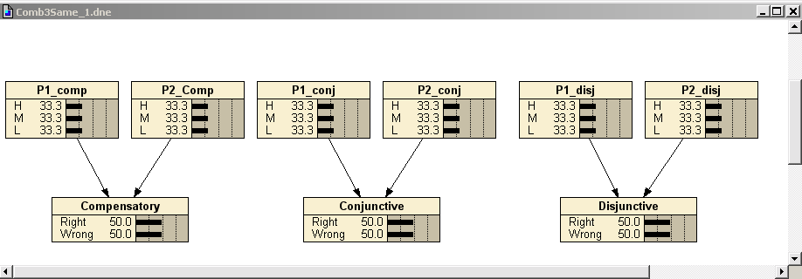
Combination Model Graphs

Slide 19
Common Setup for All Three Models
There are two parent nodes, and both parents are conditionally independent of each other. The difference among the three models lies in the third term below:
P(P₁, P₂, X) = P(P₁ ) • P(P₂ ) • P(X | P₁, P₂)
The priors for the parent nodes are the same for the three models with 0.3333 of probability at each of the H, M, and L states.
The initial marginal probability for X is the same for the three models (50/50).

Slide 20
Conditional Probability Tables
This table contains the conditional probabilities for the parent nodes (P1 and P2) and the combination model for the three models.
Table 3 – Part 2
Conditional Problems for Compensatory, Conjunctive, and Disjunctive
P1 P2 Compensatory Conjunctive Disjunctive “Right” “Right” “Right”
H H 0.9 0.9 0.7
H M 0.7 0.7 0.7
H L 0.5 0.3 0.7
M H 0.7 0.7 0.7
M M 0.5 0.7 0.3
M L 0.3 0.3 0.3
L H 0.5 0.3 0.7
L M 0.3 0.3 0.3
L L 0.1 0.3 0.1
Notes:
These three models have exactly same priors, but different conditional probabilities for the combination nodes reflecting their relationship with their parents.
Cond prob are scaled to between 0 and 1.

Slide 21
Problem Set 3
Verify that P(P₁), P(P₂), and P(Obs) are the same for all three models. (Obs represents either the node Compensatory, Conjunctive, or Disjunctive )
Assume Obs=right, Calculate P(P₁) and P(P₂) for all three models.
Assume Obs=wrong, Calculate P(P₁) and P(P₂) for all three models.
Assume Obs=right, and P₁ = H. Calculate P(P₂) for all three models.
Assume Obs=right, and P₁ = M. Calculate P(P₂) for all three models.
Assume Obs=right, and P₁ = L. Calculate P(P₂) for all three models.
Explain the differences

Slide 22
Activity 3
Go back to the Driver’s License Exam you built in Session I and add some numbers
Now put in some observed outcomes
How did the probabilities change?
Is that about what you expected?

