Slide 1


Bayesian Networks and Applications
Session 1: Evidence Centered Design
Bayesian Networks
Duanli Yan, ETS
Russell Almond, FSU
Unpublished work © 2023

Slide 2
The Interplay of Design and Statistical Modeling
Statistical models must be selected/tailored according to the needs of the diagnosis and assessment
Such selection and adaptation is only meaningful in the larger context of the assessment design
Understanding the discipline of assessment design is a necessary prerequisite for statistical modeling
Evidence Centered Design is an assessment design framework with general applicability and utility

Slide 3
Assessment Design
Stakeholders and Clients
Requirements
Purpose of the test
Intended population
Prospective Assessment Report
Evidence-Centered Measurement Design
Claims
Validity
Specifications
Notes:
The first step in designing a test is to ascertain the purpose of the test. What is the intended use? Is it a test of general knowledge? Is it a test of minimum competence? It is a placement test? The more specific you can be at this point, the better able you are to design a successful test.
Test design should also consider the intended population. Test assemblers need to make sure they construct a test at the appropriate level of difficulty for the target population. For example, a history test designed for 10-year-olds will probably look much different than a history test designed for college students.

Slide 4
Evidence Centered Design
Evidence Centered Design (ECD) provides a mechanism for
Capturing and documenting information about the structure and strength of evidentiary relationships.
Coordinating the work of test developers in authoring tasks and psychometricians in calibrating the measurement model.
Documenting the scientific information that provides the foundation for the assessment and its validity.

Slide 5
Evidence Centered Design
Evidence Centered Design process is a series of procedures which center around the questions:
What can we observe about a subject's performance which will provide evidence that the subject has or does not have the knowledge, skills and abilities we wish to make claims about?
How can we structure situations to be able to make those observations?
ECD is to support modeling, diagnosis, evaluation, and assessment, and measurement.
This process results in a formal design for an assessment we call the Conceptual Assessment Framework (CAF)

Slide 6
The Initial Frame
Why are we measuring?
What are the goals and the desires for use of this assessment?
Prospective Score Report
Who are we measuring?
Who would take the assessment?
Who would view results and for what purpose?
Goals of the assessment that represent the targets around which the rest of the design process is oriented

Slide 7
Conceptual Assessment Framework (CAF)
What we measure = Subject Skills/Disease-State Model
Proficiency Model(s)

Slide 8
Conceptual Assessment Framework (CAF)
What we measure = Subject Skills/Disease-State Model
How we measure = Evidence Model
Proficiency Model(s)
Evidence Models
Stat
Evidence
model
Rules

Slide 9
Conceptual Assessment Framework (CAF)
What we measure = Subject Skills/Disease-State Model
How we measure = Evidence Model
Where we measure = Task Model
Proficiency Model(s)
Evidence Models
Task Models
Stat
Evidence
model
Rules
Features
1.
xxxxx
2.
xxxxx
3.
xxxxx

Slide 10
Conceptual Assessment Framework (CAF)
What we measure = Subject Skills/Disease-State Model
How we measure = Evidence Model
Where we measure = Task Model
How Much we measure = Assembly Model
Assembly Model
Proficiency Model(s)
Evidence Models
Task Models
Stat
Evidence
model
Rules
Features
1.
xxxxx
2.
xxxxx
3.
xxxxx

Slide 11
Conceptual Assessment Framework (CAF)
What we measure = Subject Skills/Disease-State Model
How we measure = Evidence Model
Where we measure = Task Model
How Much we measure = Assembly Model
Customization = Presentation & Delivery Models
Assembly Model
Proficiency Model(s)
Evidence Models
Task Models
Presentation Model
Stat
Evidence
model
Rules
Features
1.
xxxxx
2.
xxxxx
3.
xxxxx
Delivery Model

Slide 12
Activity 1: Driver’s License Exam
Redesign the driver’s licensure exam
Write down several claims you would like to make about people who receive a driver’s license
Group your claims into several proficiency variables related to the driver’s test
Do the claims hold for high, medium or low values of those variables?
Use Netica as a drawing tool and add your variables

Slide 13
Activity 1 (cont)
List a bunch of activities that you may want prospective drivers to do in their exam
What is environment of the task
What are manipulable features of the task?
Pick one of the tasks you created and build an evidence model for it.
What are some observable outcomes? their possible values?
Which proficiencies do they measure?

Slide 14
Activity 1 (cont)
Think a bit about putting this driver’s test together
How many tasks do we need of what types?
How much time will be spent in written tests? On the road? In simulators?
How do we verify the identity of applicants?

Slide 15
ECD  Bayes Nets -- revise
Represent Qualitative ECD argument with a graph (Domain Modeling) (Session 1)
Turn graphical structure into probability distribution over proficiency variables and observable outcomes (Bayes net; Session 2)
Perform inference (diagnosis, scoring) using that Bayes net (Session 3)
Dynamic Bayes net (Session 4)
Refine model based on how well it fits data (Session 5)
RNetica and Peanut (Session 6)

Slide 16
What is a Bayes net? Norsys.com
A Bayes net is a model for a subject
It reflects the states of some part of a world being modeled
It describes how those states are related by probabilities
E.g., your house, your car, your body, your community, an ecosystem, a stock-market, anything
All the possible states of the model represent all the possible worlds that can exist
E.g., the car engine can be running normally or giving trouble
E.g., your body can be sick or healthy
So where do the probabilities come in?
Typically, some states will tend to occur more frequently, when other states are present
E.g., if you are sick, the chances of a runny nose are higher
E.g., if it is cloudy, the chances of rain are higher

Slide 17
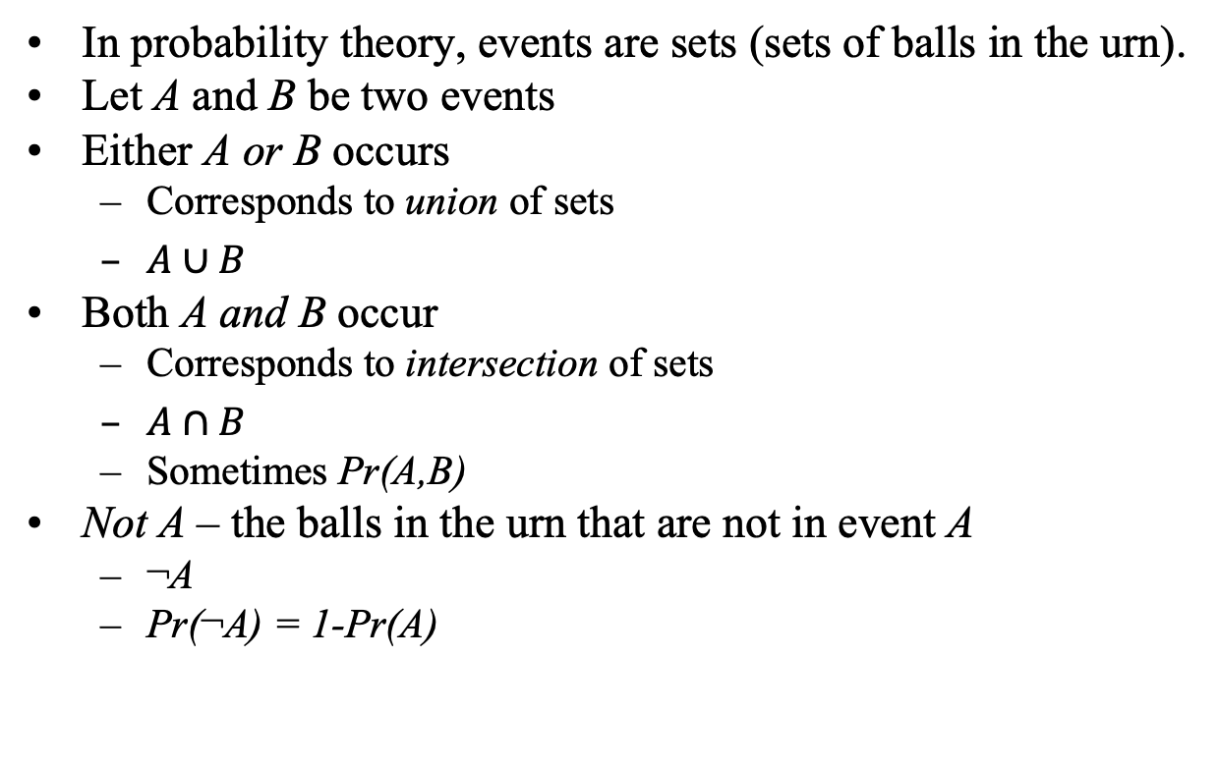
Probabilities -- Cup and Cap notation
In probability theory, events are sets (sets of balls in the urn).
Let A and B be two events
Either A or B occurs
Corresponds to union of sets
$A∪B$
Both A and B occur
Corresponds to intersection of sets
$A∩B$
Sometimes Pr(A,B)
Not A – the balls in the urn that are not in event A
¬A
Pr(¬A) = 1-Pr(A)

Slide 18

Conditional Probability
H
¬ H
E
Definition
Law of Total Probability

Slide 19
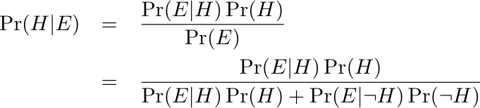



Bayes Theorem
Prior
Likelihood
Posterior

Slide 20
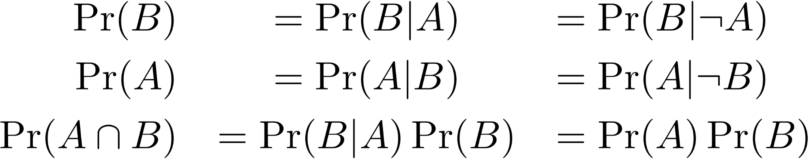

Independence
A
¬ A
B
A provides no information about B

Slide 21
Accident Proneness (Feller, 1968)
Driving Skill: 5/6 Normal, 1/6 Accident Prone
Probability of an accident in a given year
1/100 for Normal drivers
1/10 for Accident prone drivers
Accidents happen independently in each year
What is the probability a randomly chosen driver will have an accident in Year 1?
Given a driver had an accident in Year 1, what is probability of accident in Year 2?

Slide 22

Accident Proneness (cont)
What is the probability a randomly chosen driver will have an accident in Year 1? Year 2?

Slide 23
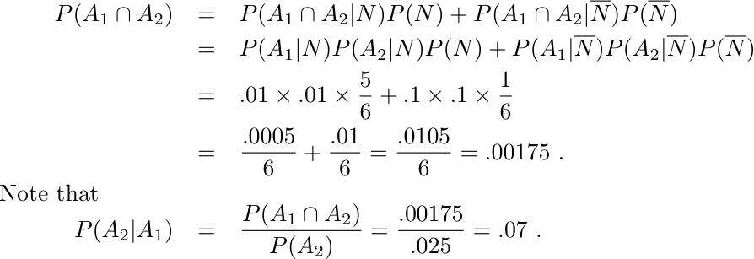
Accident Proneness (cont)
Given a driver had an accident in Year 1, what is probability of accident in Year 2?

Slide 24

Conditional Independence
Years are conditionally independent given driving skill
Years are marginally dependent
Separation in graph tells the story

Slide 25

Competing Explanations
Skill 1 and Skill 2 are (a priori) independent in population
Task X requires both skills (conjunctive model)
Answer the following questions:
What is posterior after learning X=False, and θ₁=High?
What is posterior after learning X=False, and θ₂=High?
What is true of joint posterior of θ₁ and θ₂  after learning X=False?

Slide 26

D-Separation
For ←→, →→, and ←← edges conditioning on middle variables renders outer variables independent
For →← (collider) edges, if middle variable (or descendent is known) then variables are dependent
A path is active if collider with middle node observed, or non-collider with middle node unobserved

Slide 27
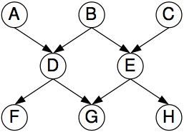
D-Separation Exercise
Are A and C independent if
We have observed no other variables?
What could we condition on to make A and C independent?
We have observed F and H?
What else could we condition on to make A and C independent?
We have observed G?
What else could we condition on to make A and C independent?

Slide 28
Building Up Complex Networks
Recursive representation of probability distributions:
All orderings are equally correct, but some are more beneficial because they capitalize on causal, dependence, time-order, or theoretical relationships that we posit: Terms simplify when there is conditional independence –
in ed measurement, due to unobservable student variables.

Slide 29
Building Up Complex Networks, cont.
For example, in IRT, item responses are conditionally independent given θ:

Slide 30
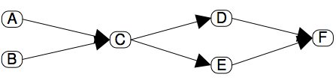
Bayes net
One factor for each node in graph in recursive representation
This factor is conditioned on parents in graph
“Prior” nodes have no parents
p(A)p(B)p(C|A,B)p(D|C)p(E|C)p(F|D,E) = p(A,B,C,D,E,F)
Digraph must be acyclic

Slide 31
Activity 2: Build a Bayes Net
Pick one of the tasks you created and build a Bayes net in Netica:
Proficiency variables, their possible values
Observable variables, their possible values
Conditional probabilities between Proficiency variables and Observable variables
Add your observables to the proficiency model you made in Netica

