Slide 1


Bayesian Networks and Applications
Session 3: Bayes Net Applications II
ACED: ECD in Action
Russell Almond, FSU
Duanli Yan, ETS

Slide 2
Bayes Net for Medical Diagnosis Almond & Madigan (1994)
Medical knowledge about risks consists of a combination of
structural information about known biological facts
probabilistic or actuarial information about exposures to hazards and recovery rates
Making appropriate medical decisions is a difficult task. It usually involves at least three steps:
make a comprehensive list of available options
evaluate the risks and benefits of those options
select a “best” option from among the alternatives

Slide 3
Bayes Net for Medical Diagnosis, challenges Almond & Madigan (1994)
Significant practical challenges, esp., probabilistic information, due to
it requires constant maintenance as new studies provide new data
it usually comes in the form of study results which are not ideally suited for making individual predictions
the data must be integrated into a complete model which can be used for inference
the calculations themselves are too complex for the physician to perform while on rounds, so they are often “simplified” into tables or simply ignored
furthermore, the risk model rapidly gets out of date and must be updated with new information

Slide 4
Bayes Net for Medical Diagnosis: can Almond & Madigan (1994)
Bayes net
is an environment for building risk models and assessing such risk probabilities
it provides more than a simple calculator for risks
Bayes net can help with planning options
finding the value of medical tests
alerting the physician to possible complications or alternative therapies
Bayes net tool
can be used to build and manipulate complex risk models
can store and manipulate both structural and probabilistic knowledge
physician can update the knowledge inherent in the models
can be used for prediction and decision making
decision maker can understand the impact of various factors on the decision

Slide 5
Bayes Net for Medical Diagnosis: Heart Almond & Madigan (1994)
Goal: predict the risk of coronary artery disease
Data
303 patients,
clinical and test variables
Cleveland Clinic for coronary angiography (Murphy & Aha, 1992)
Variables
Healthy?
Gender
Age
Chest Pain
Rest BP
Max Heart Rate

Slide 6
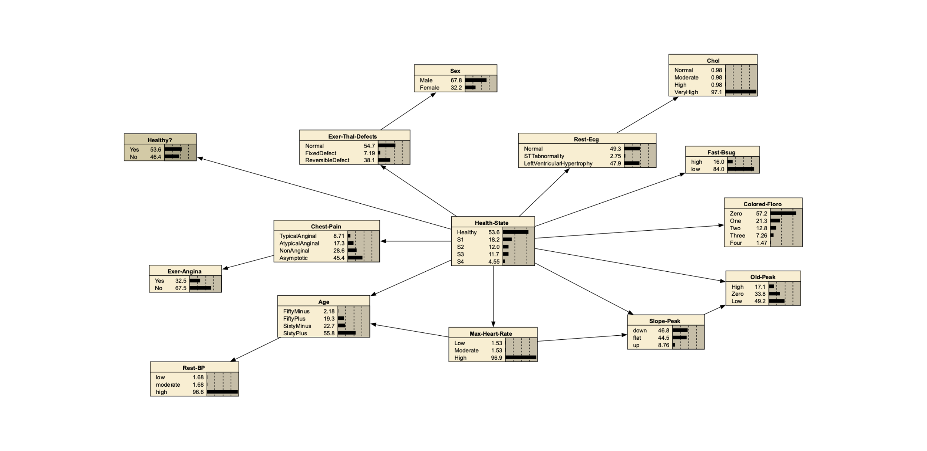
Bayes Net for Medical Diagnosis: Heart Almond & Madigan (1994)

Slide 7
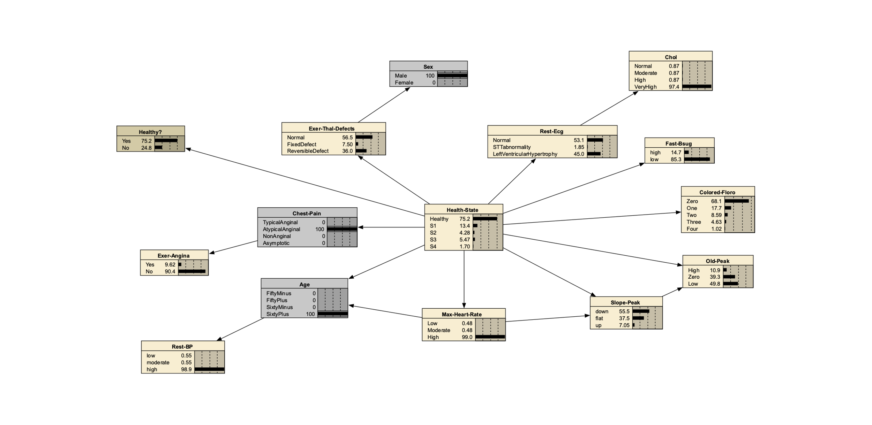
Bayes Net for Medical Diagnosis: Data Almond & Madigan (1994)
Example: Mr. Jones is a 62-year-old man complaining of atypical-anginal chest pain.

Slide 8
Bayes Net for Medical Diagnosis: Prediction Almond & Madigan (1994)
Example: His blood pressure on admission was 130 mm Hg. The risk of coronary artery disease for this patient is 0.311.

Slide 9
Bayes Net for Medical Diagnosis: Prediction Almond & Madigan (1994)
Example: If the test results show the cholesterol concentration was moderate (225 mg/dl), and the fasting blood sugar was > 120 mg/dl, the risk drops to .307.

Slide 10
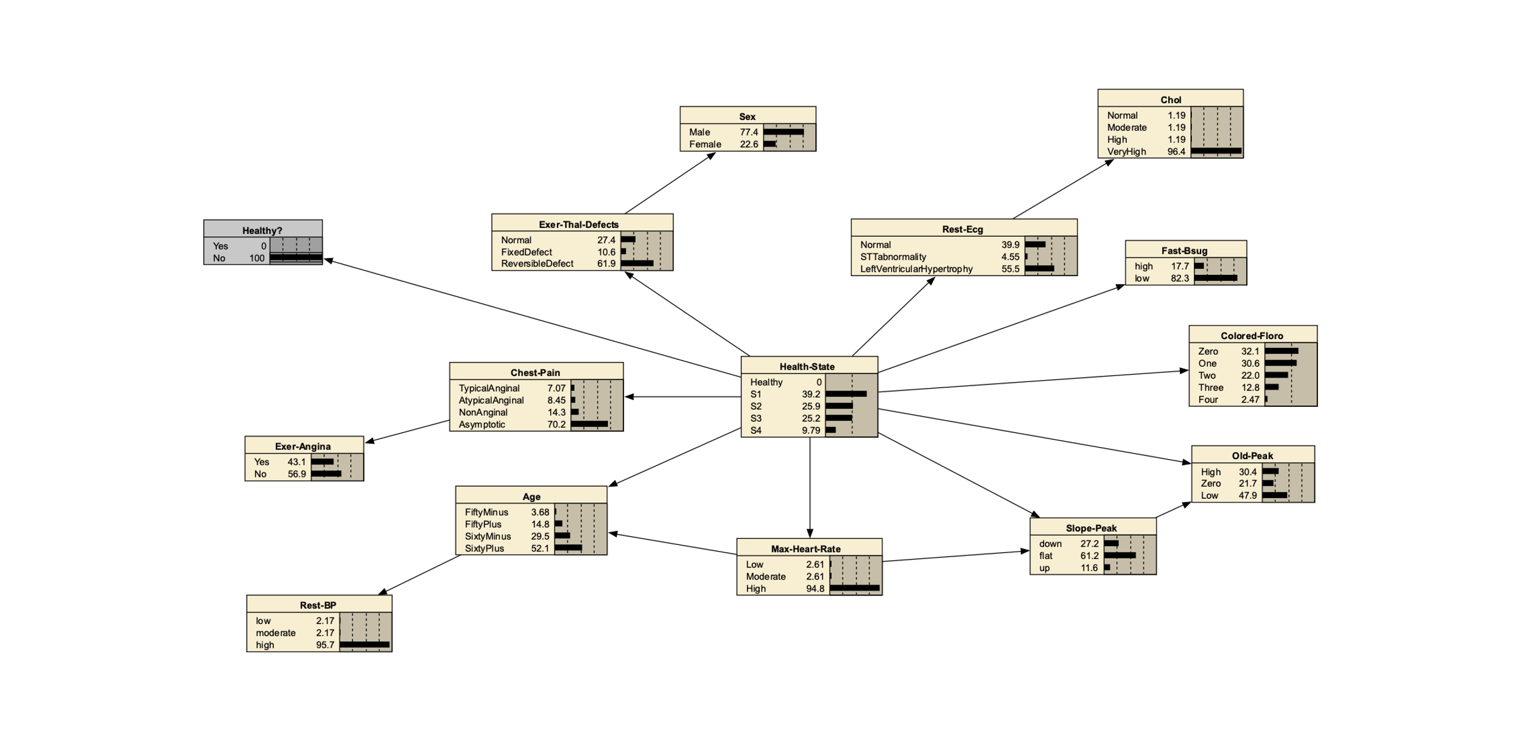
Bayes Net for Medical Diagnosis: Estimation Almond & Madigan (1994)
Example: If a patient is NOT healthy. He/She may have the following symptooms

Slide 11
Bayes Net for Medical Diagnosis: VOI Almond & Madigan (1994)
Value of information: “What is the value of a given medical test?”
Example: for Mr. Jones,
given the information already entered (Age, Sex, Rest-Bp, Chest-Pain, Chol and Fast-Bsug)
his risk of coronary artery disease is 0.308
If the result of the test is 0 , the probability that the patient has coronary artery disease drops to 0.142
If the results of the test is 1, then the risk rises to .519.
For results of 2 and 3+ the risk is .731 and .736

Slide 12
Bayes Net for Medical Diagnosis: VOI, cont Almond & Madigan (1994)
Example: for Mr. Jones
If not knowing the cholesterol results, we can calculate the value of cholesterol screening as an alternative test
before the cholesterol reading, the risk was 0.311
If the cholesterol was Normal, the risk would drop to 0.295
If the cholesterol was Moderate, the risk would be 0.302
If the cholesterol was High or Very-High, the risk would be 0.331 or 0.319
This indicant is much less powerful
cholesterol is not an expensive test, often routinely administered.
it may still be considered cost effective

Slide 13
Bayes Net for Medical Diagnosis: WOE Almond & Madigan (1994)
Weight of Evidence (WOE):
Example: for Mr. Jones,
the expected WOE for the Colored-Floro test is 0.524
the expected WOE for the the Chol screening is 0.00204

Slide 14
Bayes Net for Medical Diagnosis: Treatment Almond & Madigan (1994)
Value of Treatment or interventions: the expected effect of a treatment
Example: for Mr. Jones,
Suppose he had a very-high serum cholesterol, additionally
If he could lower his serum cholesterol, that would lower his risk of coronary artery disease
Bayes net shows he would lower his risk from 0.319 to 0.295
As this reduction is rather small, it is probably not worth spending too much energy trying to control his cholesterol.

Slide 15
Bayes Net for Medical Diagnosis: Treatment Almond & Madigan (1994)

Slide 16
Bayes Net for Medical Diagnosis: Sensitivity Analysis Almond & Madigan (1994)
Assessing the effect of small changes in the model: sensitivity analysis
All calculations were based a statistical model, and statistical models are only approximations of the truth
If the model was changed a little bit, it may affect the conclusions a great deal, or it may affect them only a little bit
The Heart example: only included patients at high risk for coronary artery disease (i.e., patients who were admitted to the clinic for angiography) in the study
If the clinician felt that the risk factors were lower at her clinic
She could study the sensitivity of model’s predictions to the overall rate of coronary artery disease

Slide 17
Bayes Net for Medical Diagnosis: Sensitivity Analysis Almond & Madigan (1994)
To study the sensitivity of our conclusions to this number
Increase the number associated with healthy patients from 165 to 365
increase the baseline proportion of healthy patients from 0.545 to 0.725
Looking at Mr. Jones, his risk drops from 0.311 to 0.170

Slide 18

ACED Background
ACED (Adaptive Content with Evidence-based Diagnosis)
Val Shute (PD), Aurora Graf, Jody Underwood, Eric Hansen, Peggy Redman, Russell Almond, Larry Casey, Waverly Hester, Steve Landau, Diego Zapata
Domain: Middle School Math, Sequences
Project Goals:
Adaptive Task Selection
Diagnostic Feedback
Accessibility
Notes:
Only planning on talking about the first graph.
Results availabe in ETS RR.

Slide 19
ACED Features
Valid Assessment. Based on evidence-centered design (ECD).
Adaptive Sequencing. Tasks presented in line with an adaptive algorithm.
Diagnostic Feedback. Feedback is immediate and addresses common errors and misconceptions.
Aligned. Assessments aligned with (a) state and national standards and (b) curricula in current textbooks.

Slide 20
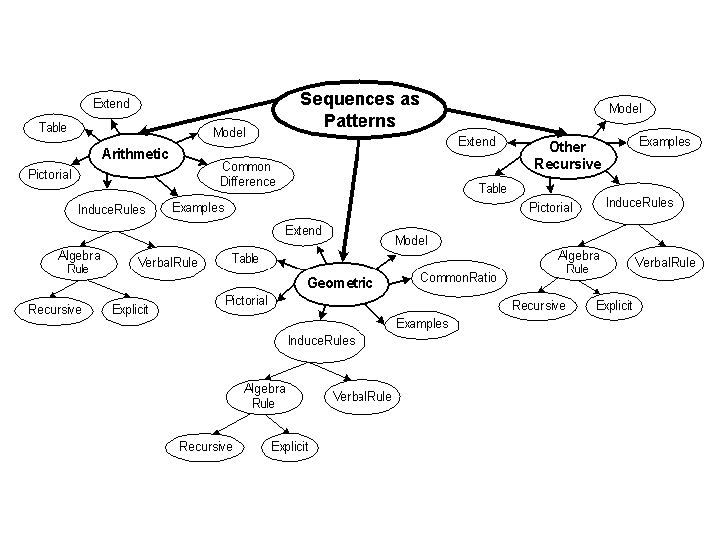
ACED Proficiency Model

Slide 21
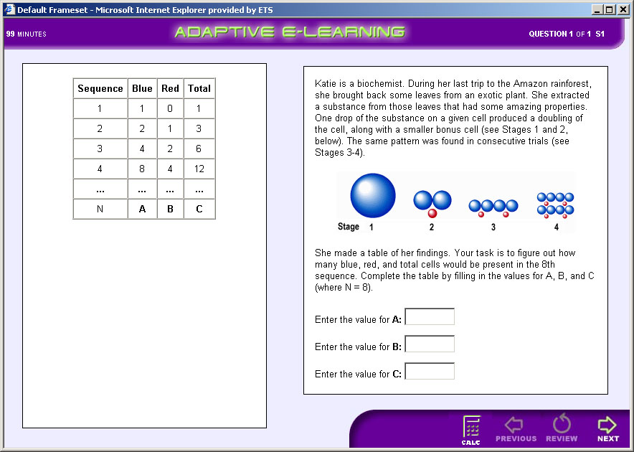
Typical Task

Slide 22
ACED Design/Build Process
Identify Proficiency variables
Structure Proficiency Model
Elicit Proficiency Model Parameters
Construct Tasks to target proficiencies at Low/Medium/High difficulty
Build Evidence Models based on difficulty/Q-Matrix

Slide 23
Parameterization of Network
Proficiency Model:
Based on Regression model of child given parent
SME provided correlation and intercept
SME has low confidence in numeric values
Evidence Model Fragment
Tasks Scored Right/Wrong
Based on IRT model
High/Medium/Low corresponds to θ = +1/0/-1
Easy/Medium/Hard corresponds to difficulty -1/0/+1
Discrimination of 1
Used Q-Matrix to determine which node is parent

Slide 24
PM-EM Algorithm for Scoring
Master Bayes net with just proficiency model(PM)
Database of Bayes net fragments corresponding to evidence models (EMs), indexed by task ID
To score a task:
Find EM fragment corresponding to task
Join EM fragment to PM
Enter Evidence
Absorb evidence from EM fragment into network
Detach EM fragment
Notes:
Can’t detach and discard fragment in Netica, but can do the other steps.
Demonstrate in Netica.
Also support in Ergo and StatShop.

Slide 25
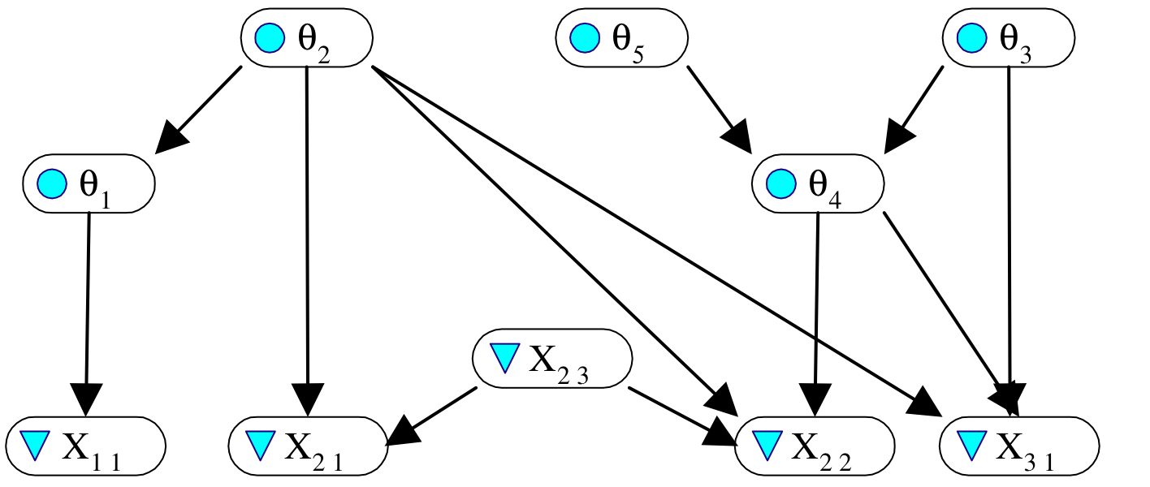
An Example
Five proficiency variables
Three tasks, with observables {X₁₁}, {X₂₁, X₂₂ , X₂₃}, {X₃₁}.

Slide 26
Q: Which observables depend on which proficiency variables? A: See the Q-matrix (Fischer, Tatsuoka).
 | θ₁ | θ₂ | θ₃ | θ₄ | θ₅ | X₂₃
X₁₁ | 1 | 0 | 0 | 0 | 0 | --
X₂₁ | 0 | 1 | 0 | 0 | 0 | 1
X₂₂ | 0 | 1 | 0 | 1 | 0 | 1
X₂₃ | 0 | 0 | 0 | 0 | 0 | N/A
X₃₁ | 0 | 1 | 1 | 1 | 0 | --

Slide 27
Proficiency Model / Evidence Model Split
Full Bayes net for proficiency model and observables for all tasks can be decomposed into fragments.
Proficiency model fragment(s) (PMFs) contain proficiency variables.
An evidence model fragment (EMF) for each task.
EMF contains observables for that task and all proficiency variables that are parents of any of them.
Presumes observables are conditionally independent between tasks, but can be dependent within tasks.
Allows for adaptively selecting tasks, docking EMF to PMF, and updating PMF on the fly.

Slide 28
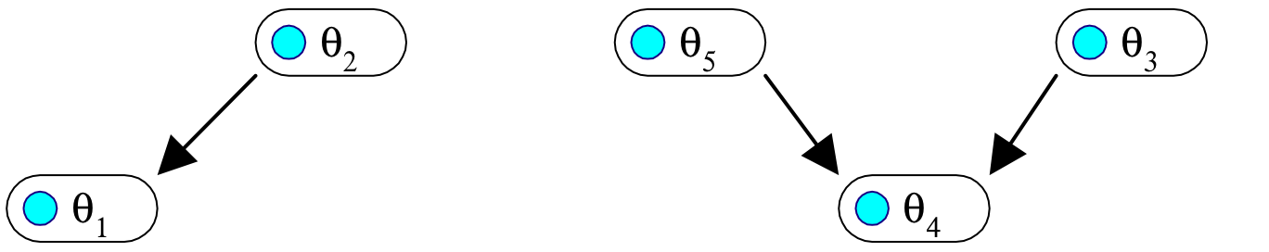
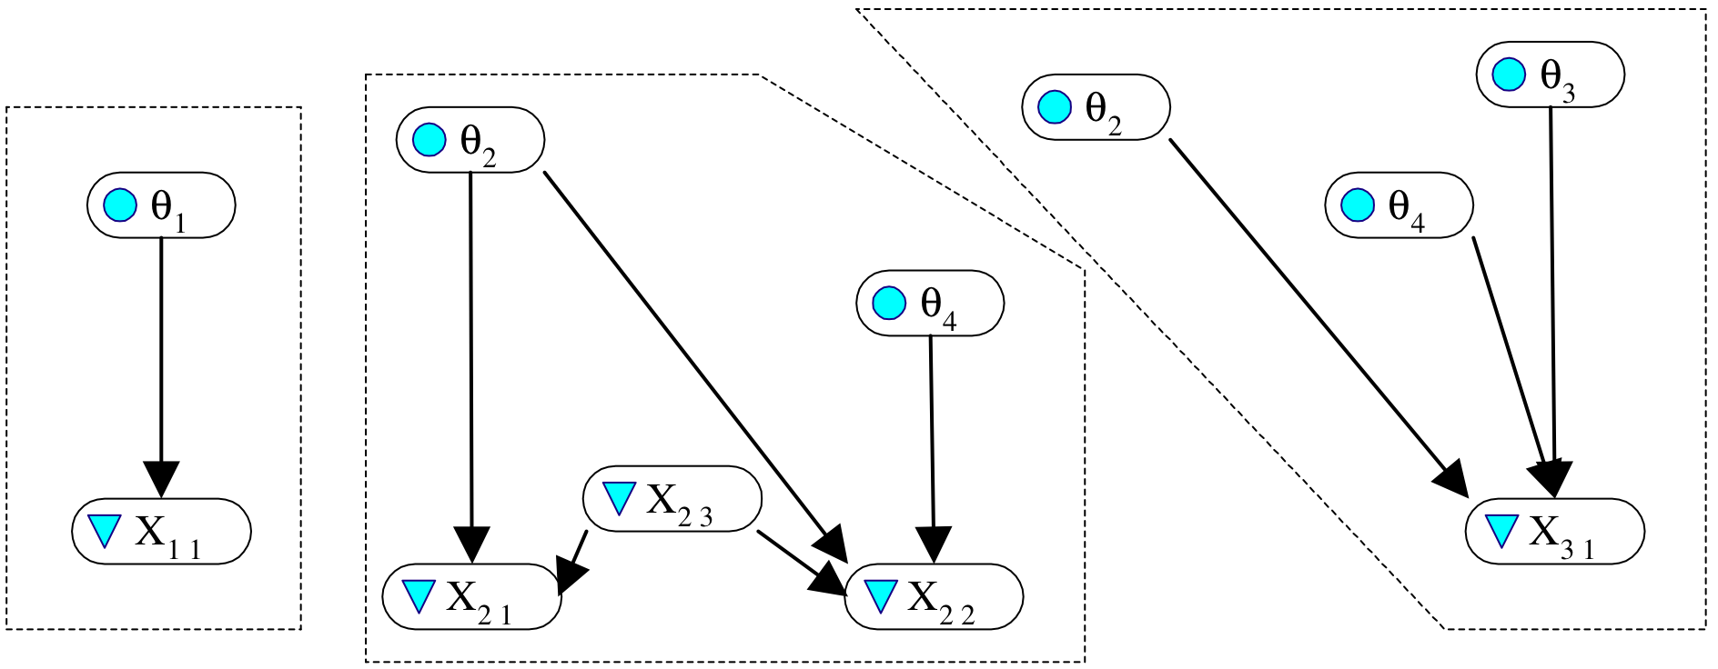
On the way to PMF and EMFs…
Proficiency variables
Observables and proficiency variable parents for the tasks

Slide 29
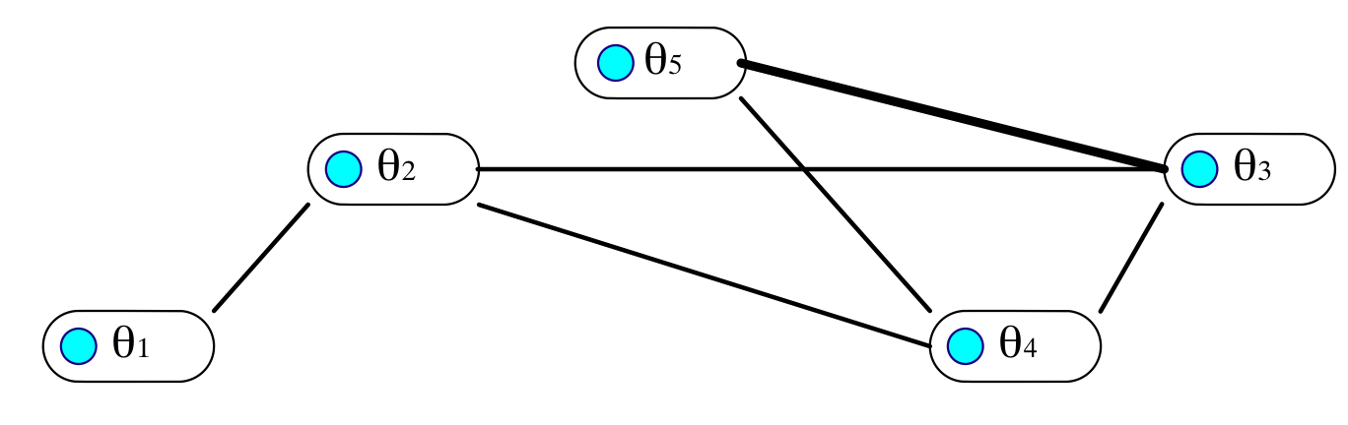
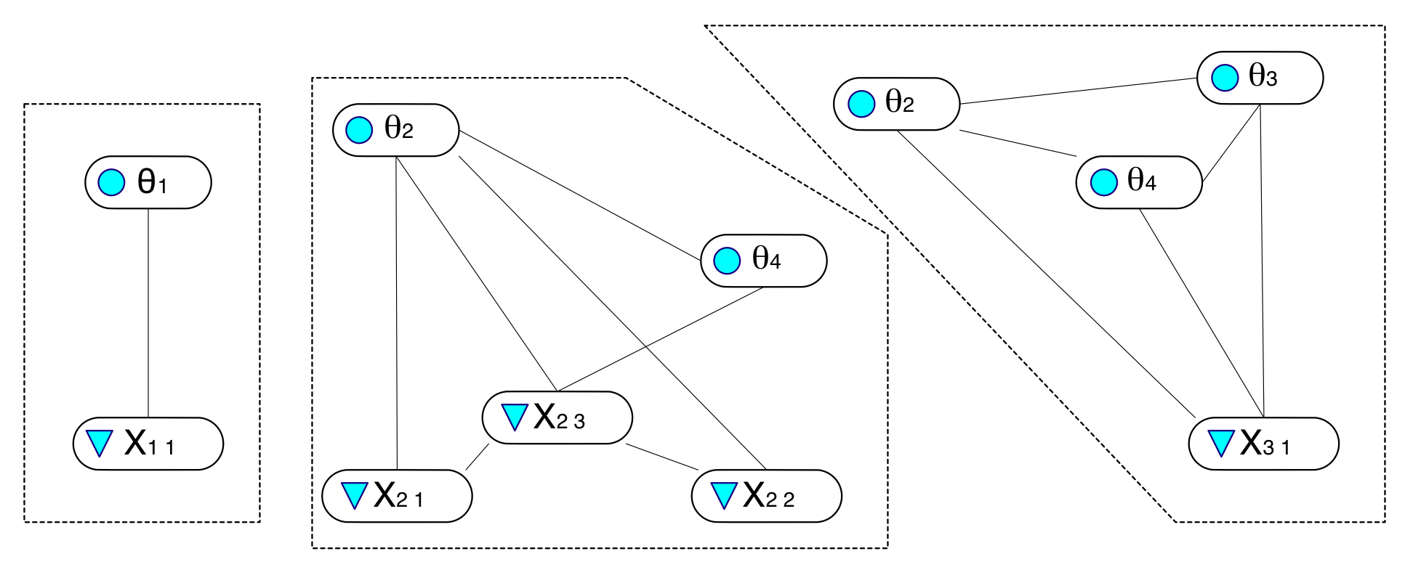
Marry parents, drop directions, and triangulate (in PMF, with respect to all tasks)
PMF
EMF₁
EMF₂
EMF₃

Slide 30


Footprints of tasks in proficiency model (figure out from rows in Q-matrix)

Slide 31
Result:
Each EMF implies a join tree for Bayes net propagation.
Initial distributions for proficiency variables are uniform.
The footprint of the PM in the EMF is a clique intersection between that EMF and the PMF.
Can “dock” EMFs with PMF one-at-a-time, to …
absorb evidence from values of observables to that task as updated probabilities for proficiency variables, and
predict responses in new tasks, to evaluate potential evidentiary value of administering it.

Slide 32
Docking evidence model fragments
θ₅
θ₂
θ₃
θ₁
θ₄
PMF
θ₂
θ₂
θ₃
θ₄
θ₄
X₃₁
X₂₃
X₂₂
X₂₁

Slide 33
Scoring Exercise
Outcome | Task Name | Proficiency Variable | Difficulty
Wrong | tCommonRatio1a.xml | CommonRatio | Easy
Right | tCommonRatio2b.xml | CommonRatio | Medium
Wrong | tCommonRatio3b.xml | CommonRatio | Hard
Wrong | tExplicitGeometric1a.xml | ExplicitGoemetric | Easy
Right | tExplicitGeometric2a.xml | ExplicitGoemetric | Medium
Wrong | tExplicitGeometric3b.xml | ExplicitGoemetric | Hard
Wrong | tRecursiveRuleGeometric1a.xml | RecursiveRuleGeometric | Easy
Wrong | tRecursiveRuleGeometric2b.xml | RecursiveRuleGeometric | Medium
Wrong | tRecursiveRuleGeometric3a.xml | RecursiveRuleGeometric | Hard
Right | tTableExtendGeometric1a.xml | TableGeometric | Easy
Right | tTableExtendGeometric2b.xml | TableGeometric | Medium
Right | tTableExtendGeometric3a.xml | TableGeometric | Hard
Wrong | tVerbalRuleExtendModelGeometric1a.xml | VerbalRuleGeometric | Easy
Wrong | tVerbalRuleExtendModelGeometric1b.xml | VerbalRuleGeometric | Easy
Right | tVerbalRuleExtendModelGeometric2a.xml | VerbalRuleGeometric | Medium
Wrong | tVisualExtendGeometric1a.xml | VisualGeometric | Easy
Wrong | tVisualExtendGeometric2a.xml | VisualGeometric | Medium
Wrong | tVisualExtendGeometric3a.xml | VisualGeometric | Hard
Notes:
This is a fragment of a transcript from an ACED student using the linear method. Score this student.

Slide 34

Weight of Evidence
Good (1985)
H is binary hypothesis, e.g., Proficiency > Medium
E is evidence for hypothesis
Weight of Evidence (WOE) is

Slide 35
Properties of WOE
“Centibans” (log base 10, multiply by 100)
Positive for evidence supporting hypothesis, negative for evidence refuting hypothesis
Movement in tails of distribution as important as movement near center
Bayes theorem using log odds

Slide 36

Conditional Weight of Evidence
Can define Conditional Weight of Evidence
Nice Additive properties
Order sensitive
WOE Balance Sheet (Madigan, Mosurski & Almond, 1997)

Slide 37


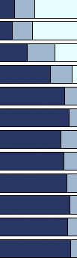
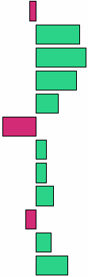
Evidence Balance Sheet
63 tasks total
1 Easy
2 Medium
3 Hard
a Item type
b Isomorph
P(Solve Geom Sequences)
_{H}
_{M}
_{L}
Task | Acc | H | M | L
SolveGeometricProblems2a | 0 | 0.16 | 0.26 | 0.58
SolveGeometricProblems3a | 1 | 0.35 | 0.35 | 0.30
SolveGeometricProblems3b | 1 | 0.64 | 0.29 | 0.07
SolveGeometricProblems2b | 1 | 0.83 | 0.16 | 0.01
VisualExtendTable2a | 1 | 0.89 | 0.10 | 0.01
SolveGeometricProblems1a | 0 | 0.78 | 0.21 | 0.01
SolveGeometricProblems1b | 1 | 0.82 | 0.18 | 0.00
VisualExtendVerbalRule2a | 1 | 0.85 | 0.15 | 0.00
ModelExtendTableGeometric3a | 1 | 0.90 | 0.10 | 0.00
ExamplesGeometric2a | 0 | 0.87 | 0.13 | 0.00
VisualExplicitVerbalRule3a | 1 | 0.91 | 0.09 | 0.00
VerbalRuleModelGeometric3a | 1 | 0.95 | 0.05 | 0.00
WOE for H vs. M, L
.
.
.
Notes:
Madigan, Mosurski and Almond [1996]
Thanks to Val for cleanup.

Slide 38

Expected Weight of Evidence
When choosing next “test” (task/item) look at expected value of WOE where expectation is taken wrt P(E|H).
where represent the possible results.

Slide 39
Calculating EWOE
Madigan and Almond (1996)
Enter any observed evidence into net
Instantiate Hypothesis = True (may need to use virtual evidence if hypothesis is compound)
Calculate for each candidate item
Instantiate Hypothesis = False
Calculate for each candidate item

Slide 40

Related Measures
Value of Information
S is proficiency state
d is decision
u is utility
Notes:
Drawback is it requires formal utilities.
EWOE is a quasi-utility

Slide 41


Related Measures (2)
Mutual Information
Extends to non-binary hypothesis nodes
Kullback-Liebler distance between joint distribution and independence

Slide 42
Task Selection Exercise 1
Use ACEDMotif1.dne
Easy, Medium, and Hard tasks for Common Ratio and Visual Geometric
Use Hypothesis SolveGeometricProblems > Medium
Calculate EWOE for six observables
Assume candidate gets first item right and repeat
Next assume candidate gets first item wrong and repeat
Repeat exercise using hypothesis SolveGeometricProblems > Low

Slide 43
Task Selection Exercise 2
Use Network ACEDMotif2.dne
Select the SolveGeometricProblems node
Run the program Network>Sensitivity to Findings
This will list the Mutual information for all nodes
Select the observable with the highest mutual information as the first task
Use this to process a person who gets every task right
Use this to process a person who gets every task wrong
Notes:
Note: This procedure doesn’t work on the Mac Version.

Slide 44
ACED Evaluation
Middle School Students
Did not normally study geometric series
Four conditions:
Elaborated Feedback/Adaptive (E/A; n=71)
Simple Feedback/Adaptive (S/A; n=75)
Elaborated Feedback/Linear (E/L; n=67)
Control (no instruction; n=55)
Students given all 61 geometric items
Also given pretest/posttest (25 items each)

Slide 45
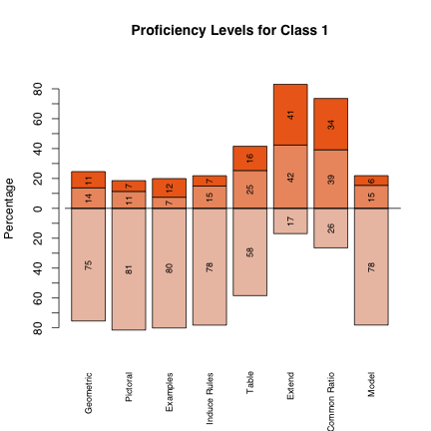
ACED Scores
For Each Proficiency Variable
Marginal Distribution
Modal Classification
EAP Score (High=1, Low=-1)

Slide 46
ACED Reliability
Proficiency (EAP) | Reliability
Solve Geometric Sequences (SGS) | 0.88
Find Common Ratio | 0.90
Generate Examples | 0.92
Extend Sequence | 0.86
Model Sequence | 0.80
Use Table | 0.82
Use Pictures | 0.82
Induce Rules | 0.78
Number Right | 0.88
Calculated with Split Halves (ECD design)
Correlation of EAP score with posttest is 0.65 (close to reliability of posttest)
Even with pretest forced into the equation, EAP score accounted for 17% unique variance
Reliability of modal classifications was worse

Slide 47
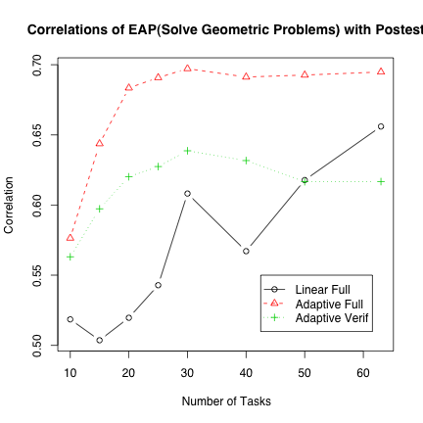
Effect of Adaptivity
For adaptive conditions, correlation with posttest seems to hit upper limit by 20 items
Standard Error of Correlations is large
Jump in linear case related to sequence of items

Slide 48
Effect of feedback
E/A showed significant gains
Others did not
Learning and assessment reliability!!!!!

Slide 49
Acknowledgements
Special thanks to Val Shute for letting us used ACED data and models in this tutorial.
ACED development and data collection was sponsored by National Science Foundation Grant No. 0313202.
Complete data available at: http://ecd.ralmond.net/ecdwiki/ACED/ACED

