Slide 1
Introduction to Partner QE
Kernel QE, Red Hat
April 2015

Slide 2
Overview of Presentation *
Welcome to Red Hat Partner QE
Benefits
Red Hat expectations
Partner QE Engineer responsibilities
What can/cannot be shared
Beaker test system
* Based on Prarit Bhargava’s “Introduction to Partner Engineering” presentation

Slide 3

Welcome!

Slide 4
Welcome to Red Hat Partner QE
Historically no way for Partner to easily get code into Red Hat products
  Scheduling conflicts
  Engineering conflicts (code reviews)
  Hardware conflicts
Red Hat introduced Onsite Engineer Program in 2004
Now called “Partner Engineer Program”
Partner QE Engineer “plugged in” the same as Partner Engineer (serves as remote QE resource)

Slide 5
Welcome to Red Hat Partner QE
Partner QE Engineer
  Schedules
  Unreleased builds and composes
  Internal IRC and communication
Partner Company
  Influences RHEL
  Dedicated person(s)

Slide 6
Benefits

Slide 7
Benefits to Partner: Schedule Information
Internal schedule deadlines
Your opinion on Bugzillas and status
Deadlines for various releases (Alpha, Beta, etc.)

Slide 8
Benefits to Partner: Code and Communication
Internal email lists
Internal IRC
Onsite
  As necessary

Slide 9
Benefits to Red Hat: You!
Better understanding of your company’s concerns
Better knowledge of your company’s products

Slide 10
Expectations

Slide 11
What Partner Should Expect From Red Hat
You are like a Red Hat engineer
  Not adversarial
Red Hat wants you to succeed
Assistance with testing infrastructure
  Usage of beaker
  Physical access to hardware

Slide 12
What Red Hat Should Expect From Partner
Help acquire and support hardware in Red Hat
Create bugs in Bugzilla using established guidelines
Test Red Hat releases for parent company’s hardware
Be aware of and conform to release schedules

Slide 13
Partner QE Engineer Responsibilities

Slide 14
Partner QE Engineer Responsibilities
Bugs
  Enter into Bugzilla: https://bugzilla.redhat.com/
  CC or assign to Partner Engineer
  CC Partner Manager
  Three ACK Process

Slide 15
Bugzilla States
NEW* - Nobody working on it
ASSIGNED* - Engineer is working on it
POST* - Patch is posted internally for review
MODIFIED - Patch is officially committed to tree
ON_QA - Kernel with patch is released for test
VERIFIED - QE has verified patch
RELEASED - Kernel with patch is released to public
* Partner Engineer can control these states

Slide 16
Schedule
Default naming scheme is X.Y.Z
Every major release has a minor release
  Each minor release has an associated schedule
Every minor release has update releases (also known as “z-stream” releases
  Each z-stream release has an associated schedule
Examples: RHEL 7.2, RHEL 6.7, RHEL 6.6.z, etc.

Slide 17
Minor Release QE Schedule Example
Testing Phase Begins March 10, 2015
Alpha April 1, 2015
Beta April 15, 2015
Snapshot 1 May 6, 2015
Snapshot 2 May 20, 2015
Snapshot 3 June 4, 2015
Snapshot 4 June 11, 2015
Snapshot 5 June 18, 2015
Testing Phase Exit July 13, 2015

Slide 18
What Can and Cannot Be Shared

Slide 19
Sharing Information
Consider everything restricted information
“Err on the side of caution”
If you want to share anything, ask your RH manager

Slide 20
What cannot be shared with my company?
Same restrictions as Partner Engineer

Slide 21
Beaker Test System

Slide 22
Beaker Overview
Open-source software for managing and automating labs of test computers
Manage systems across multiple labs
Maintain an automated inventory of system hardware details
Provision task execution environments on systems
Schedule tasks to run on one or more systems
Store and view task results

Slide 23
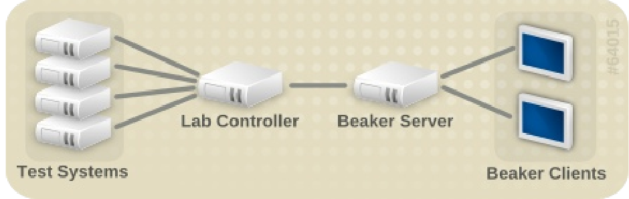
Beaker Architecture

Slide 24
Beaker Architecture
Lab Controller
  Maintains inventory and distro data
Beaker Server
  Central point where all job related activity takes place
  System inventory and ability to provision systems controlled from here
  Holds the repository of tasks

Slide 25
Beaker Architecture
Beaker Client
  Shell based Command Line Interface (CLI)
Test Harness
  Responsible for executing tasks on the system
  Current harness beah

Slide 26
Beaker
Benefits:
  Provision systems
  Create and execute automated tests across one or more systems using multiple languages
  Large hardware inventory with easy device/system look-up capability
  Convenient Beakerlib functions

Slide 27
Beaker
Limitations:
  ???
Future:
  Restraint?
  ???

Slide 28
Beaker – More Information
For more information on Beaker, go to
  Main Beaker Project page
    https://beaker-project.org
  Beaker Quick Start Guide
    https://beaker-project.org/psss-beaker-quick-start-guide-slides.pdf

Slide 29
END

