Slide 1

COMS 2132: Advanced Computing in Python
Intermediate
Columbia University
Spring 2026
Dr. Daniel Bauer

Slide 2
Teaching Team
Dr. Daniel Bauer <bauer@cs.columbia.edu>
(Senior Lecturer in Computer Science)
https://www.cs.columbia.edu/~bauer
Office: 704 CEPSR, Office Hours Monday 1:15-3:00pm
Assistants:
Aditi Chowdhuri | anc2207@columbia.edu
Irene Nam | yn2334@columbia.edu
Olivia Huang | oh2251@columbia.edu
Kristy Martinez | kpm2155@columbia.edu
Sophie Pan | sxp2000@columbia.edu

Slide 3




Columbia Curriculum for CS Non-majors
Humanities
COMS W1002
Python Basics
COMS W2132 (NEW!)
Art
Economics Linguistics
Social Sciences
Python Software Engineering
Data Structures and Algorithms
ENGI E1006
Python Basics
Context-Specific Individual Project
Data Processing
Machine Learning
Visualization
Networking
Engineering

Slide 4
What is this Course About?
“Intermediate course in computing for CS non-majors”
A follow-up course to COMS W1002 and ENGI E1006
  You asked for it, we listened…
  Fill a gap in Columbia’s Python curriculum
Introduction to Python software engineering
Essential data structures and algorithms in Python
  Practical alternative to CS Java data structure classes (COMS 3134 / 3137)
4-6-week individual project to deepen your Python skills
  Learn to design, develop, and publish a Python project

Slide 5
This Course is NOT About
Python language basics.
Rigorous theory of data structures and algorithms.
Passive learning (you will need to write programs and design / work on your own project)

Slide 6
Background
Supported by a DSI / Columbia Entrepreneurship Collaboratory Grant for New Course development
  Led by Adam Cannon, Jan Janak, and involving faculty from a variety of fields.

Slide 7
Learning Objectives
By the end of the course, you should be able to:
  understand essential data structures (linked lists, stacks, queues, trees, graphs) and fundamental algorithm analysis.
  implement the data structures and corresponding algorithms in Python.
  use functional and conceptual abstraction to design and incrementally implement a non-trivial software projects.
  use version control (Git), debugging (PDB, debugpy) and documentation tools (Pydoc, Sphinx).
  use generative AI productively to aid incremental software development.

Slide 8
Disclaimer
This is a relatively new course.
  Based on requests from COMS W1002 and ENGI E1006 students
Please expect adjustments, changes, and course corrections
Feedback is greatly appreciated
Appeal to CS non-majors: Please help us find a model for W2132 that is useful to you!

Slide 9
Programming / Python Prerequisites
Concepts you should know from COMS W1002 or ENGI E1006
Names (variables), values, data types (including lists, tuples, dictionaries)
Statements vs. expressions
Control Structures (if, else, elif statements, for and while loops)
Functions (parameters, return values, function calls)
Files
Exceptions
Classes and instances / objects (basic object-oriented programming)
Review in Lab next week. See topic checklist on Courseworks:
https://courseworks2.columbia.edu/courses/237696/pages/python-basics-checklist

Slide 10
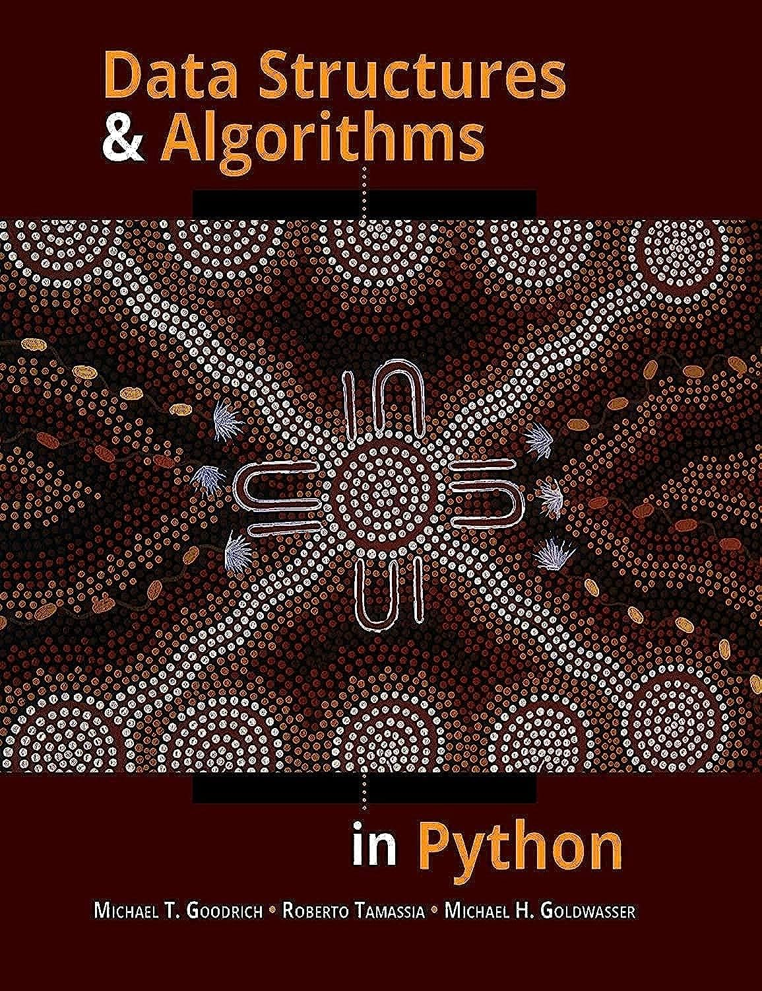
Recommended Textbook
Excellent textbook for CS non-majors !
The right level of rigor
Lectures will mostly follow the textbook
Recommended but not required
Columbia Library ebook:
https://clio.columbia.edu/catalog/ebs2467537e
Goodrich, Tamassia, Goldwasser, “Data Structures & Algorithms in Python”, 1st edition, Wiley, 2013

Slide 11
CourseWorks
Announcements
Syllabus
Important Times & Dates
Contact Information
Course Materials
Homework
Gradebook

Slide 12
Getting Help
Computer science and programming can be difficult for people at all levels.
Getting stuck is normal!
Ask for help early and often!
Ed Discussions (online forum)
TA and Instructor office hours
Labs Sessions!

Slide 13
Lectures and Labs
Lectures: Mon/Wed 10:10am-11::25am, 451 CSB
Labs (Mandatory, pick one – let me know if neither session works for you):
  Fri 4:10-5:25pm, 451 CSB
  Tuesday 6:00pm-7:15pm, 480 CSB (smaller room)
Both in-person. Attendance mandatory and graded. If you need to miss a session, please let the instructor know.

Slide 14
Grading
3 individual homework assignments, plus ungraded HW0 | 24% (8% each)
Midterm Exam (in class, 65 minutes) | 10%
Final Exam (120 minutes) | 10%
Attendance & Participation | 6%
Project | 50%

Slide 15
Individual Homework Assignments
Mostly first half of the semester
Will cover data structures and algorithms, programming and theory
Must be completed individually
Two-week windows to complete
Submit through GitHub Classrooms (to be discussed)

Slide 16
Academic Honesty Policy
Part 1, collaboration policy:
  Individual homework assignments and project.
  You are encouraged to discuss classroom material, problems, and homework with other students, the TAs, and the instructor.
  You can work out the theory together on the whiteboard or paper.
  However, you must do all final writing and programming by yourself without further interaction.
  Do not share your solutions with others.
  Do not copy anyone else’s work without attribution.

Slide 17
Academic Honesty Policy Cont’d
Part 2, AI and online resources policy:
  LLMs can aid in program development; their use is permitted and encouraged responsibly.
  Homework: Avoid problems directly using AI unless specifically requested as part of the assignment.
    We need you to learn the fundamentals. Homework as exam prep.
    AI can be used for validation/testing.
  Projects: Responsible AI use encouraged (do more with less!)
  You must attribute any code taken from an online source
  (full URL, AI prompt, …).
See syllabus for details!

Slide 18
Project: Workflow on GitHub
Submit Proposal
Approved by TAs
Milestone 1
Milestone 2
Report or Presentation
README.md in a GitHub repository
(graded)
TAs request modifications or approve
Milestone 1 tag
(graded)
Milestone 2 tag
(graded)
Release tag
(graded)
Feedback via GitHub comments
Similar to typical open-source software development workflow on GitHub

Slide 19
Project Proposal
Short README.md addressing the following:
  What are you making?
  Why is it important, relevant or interesting?
  Data structures, tools, libraries, or services you intend to use
  Proposed milestones
  Optional: How do you want to publish your work?
We will provide an example when the time comes

Slide 20
How to Pick a Project?
Try to think of a problem that is fun or important to you
Perhaps there is a tool or a script that you have always wanted?
Maybe you have an idea for a web service or website?
Maybe you have a chore that could be automated?
If you have a hobby, can you use Python to get better at it?
There are no bad ideas (only undeveloped). If it is something you want, others probably want it too.

Slide 21
Pick a Project Area (examples)
Computational linguistics / NLP
Computational biology
Social sciences
AI and machine learning
Systems, networking, Internet
Data analysis and databases
Computing in the arts

Slide 22
Pick a Project Area (continued)
Computational linguistics / NLP
  understand or respond to text, summarization, information extraction, dialog systems, …
Computational biology
Social sciences
AI and machine learning
Systems, networking, Internet
Data analysis and databases
Computing in the arts

Slide 23
Pick a Project Area (continued)
Computational linguistics / NLP
Computational biology
  Simulations and modeling of biological systems
Social sciences
AI and machine learning
Systems, networking, Internet
Data analysis and databases
Computing in the arts

Slide 24
Pick a Project Area (continued)
Computational linguistics / NLP
Computational biology
Social sciences
  Economics, political science (analyze datasets), education, environmental studies, law
AI and machine learning
Systems, networking, Internet
Data analysis and databases
Computing in the arts

Slide 25
Pick a Project Area (continued)
Computational linguistics / NLP
Computational biology
Social sciences
AI and machine learning
  Build AI enabled applications. Experiment with some new dataset. Fine-tune existing models for new applications (e.g. computer vision), …
Systems, networking, Internet
Data analysis and databases
Computing in the arts

Slide 26
Pick a Project Area (continued)
Computational linguistics / NLP
Computational biology
Social sciences
AI and machine learning
Systems, networking, Internet
  Internet services, websites, APIs, network analysis, robotics, IoT (Raspberry Pi?).
Data analysis and databases
Computing in the arts

Slide 27
Pick a Project Area (continued)
Computational linguistics / NLP
Computational biology
Social sciences
AI and machine learning
Systems, networking, Internet
Data analysis and databases
  Analyze or visualizae public datasets, Google BigQuery, and Datalab
Computing in the arts

Slide 28
Pick a Project Area (continued)
Computational linguistics / NLP
Computational biology
Social sciences
AI and machine learning
Systems, networking, Internet
Data analysis and databases
Computing in the arts
  Video / Audio demo, algorithmic art, games

Slide 29
Projects by Application Type
Command line tool
GUI program (TkIntern, PyGame, PyQT, Web UI)
Internet service (API) or website
Jupyter Notebook
Embedded program (Raspberry Pi)

Slide 30
Some Pointers for Inspiration
Peter Norvig’s Jupyter Notebooks: https://github.com/norvig/pytudes
Data science: https://www.dataquest.io/path/data-analyst/
Machine learning: https://scikit-learn.org/stable/index.html
Building websites with Django: https://www.tangowithdjango.com/
Making games with Pygame: https://www.pygame.org/wiki/tutorials
Learning robotics using Python (book): https://www.amazon.com/dp/B00YEVZ6UK
Programming the Raspberry Pi (book): https://www.adafruit.com/product/1089
We will also offer a library of more concrete ideas later this semester

