Slide 1
Web Dynpro for Abap

Slide 2
Capítulo 1
Web Dynpro Introduction
Notes:
Exercício: ZNET310_INTR_00

Slide 3
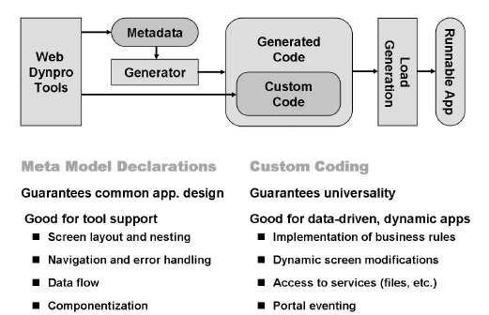
Meta Model and Custom Coding

Slide 4
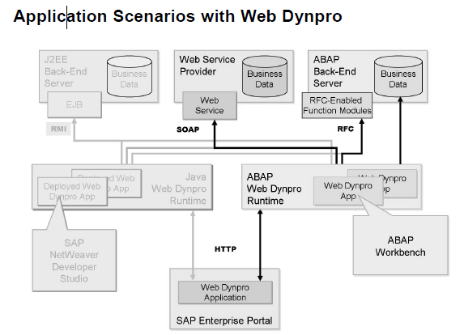

Slide 5
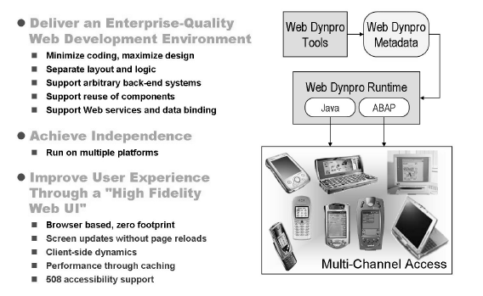
Web Dynpro Beneficts

Slide 6
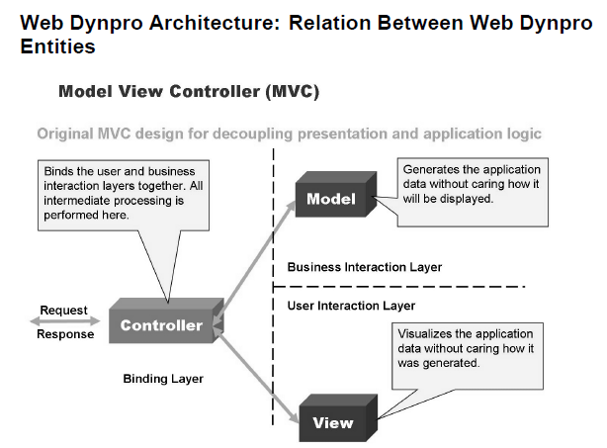
MVC Archicteture

Slide 7
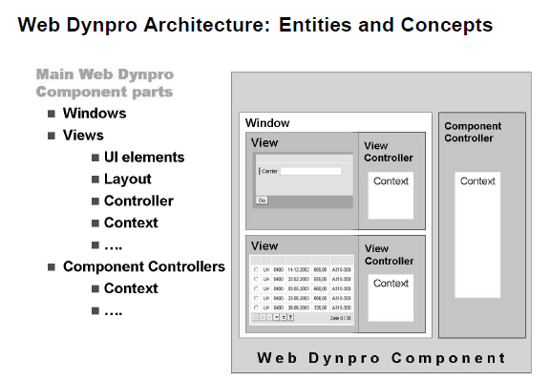

Slide 8
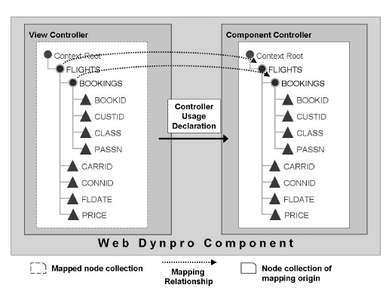
Context Mapping

Slide 9
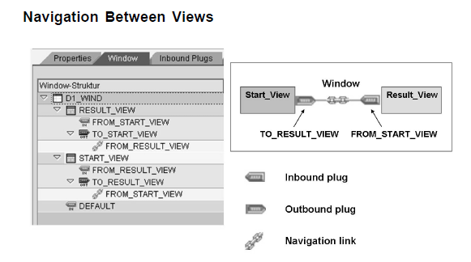
Navigation - Plugs

Slide 10
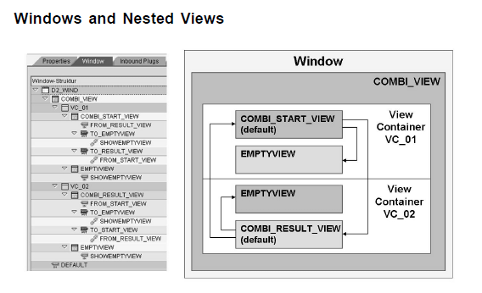
Nested Views

Slide 11
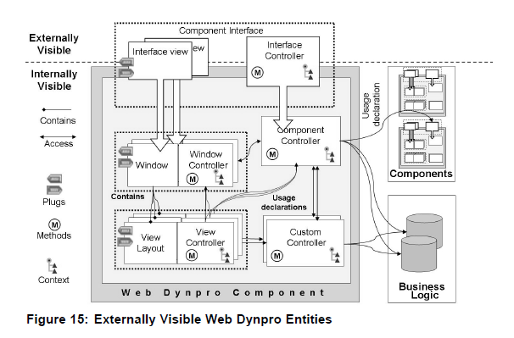
Components

Slide 12
Capítulo 2
Web Dynpro Controllers
Notes:
Exercício ZNET310_CTRL_00

Slide 13
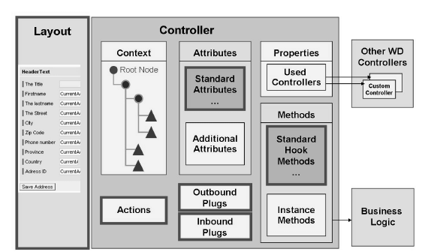
View Controller

Slide 14
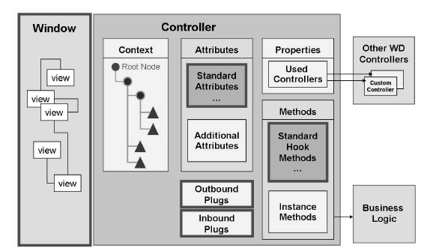
Window Controller

Slide 15
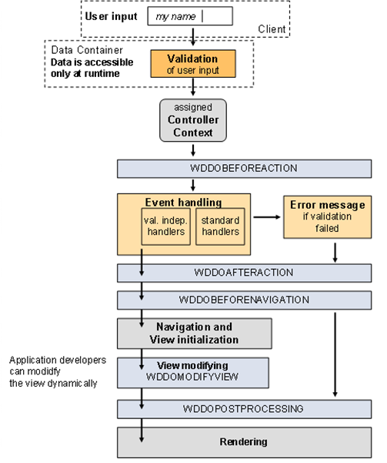
Request/Response Phase

Slide 16
Capítulo 3
The Context at Design Time
Notes:
Exercício ZNET310_COND_00

Slide 17
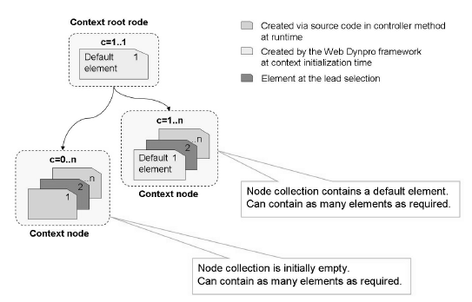
Context

Slide 18
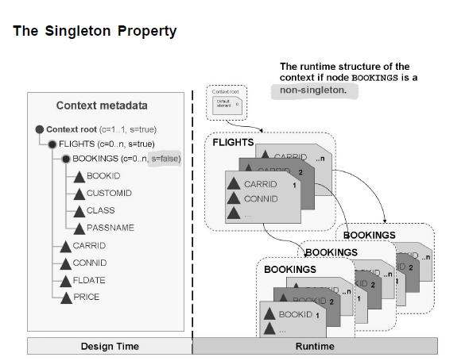
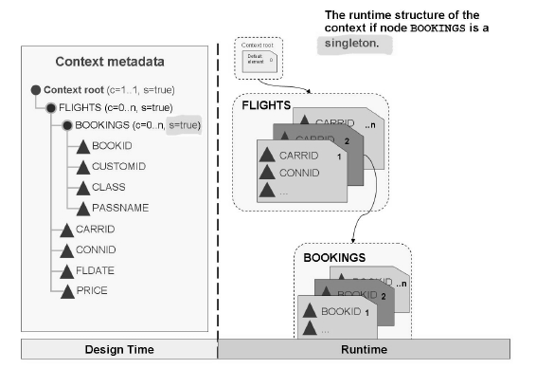
Context - Hierarchy

Slide 19
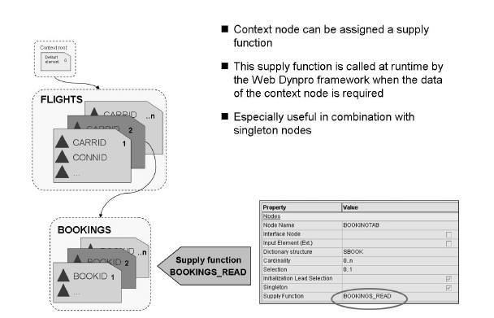
Supply Function

Slide 20
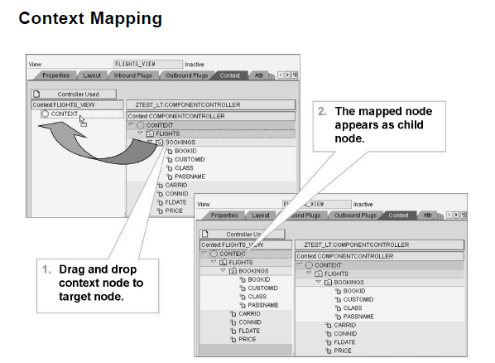

Slide 21
Capítulo 4
Design the User Interface
Notes:
Exercício ZNET310_UI1_00, ZNET310_UI1_00

Slide 22
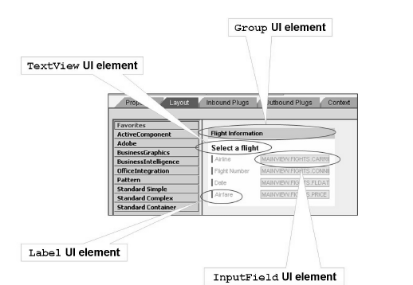
Screen Editor

Slide 23
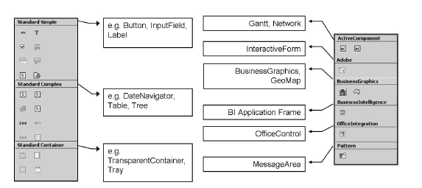
Graphics Elements

Slide 24
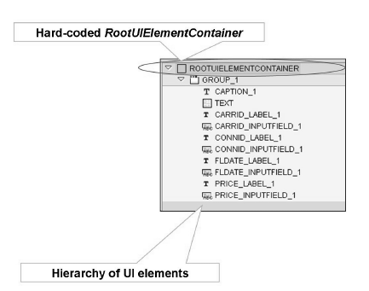
Tree Components Editor

Slide 25
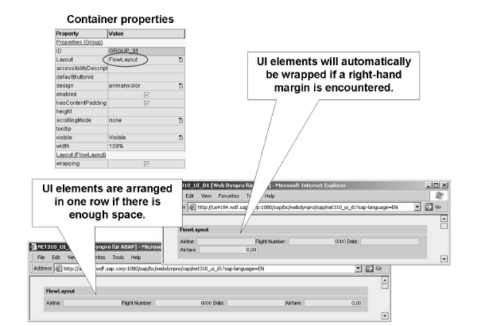
Graph Components Properties

Slide 26
Layout Control
Flow Layout
GridLayout
Matrix Layout

Slide 27
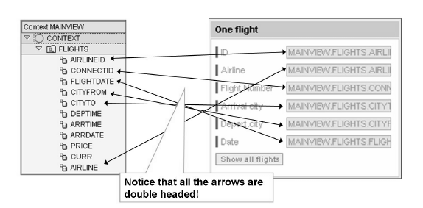
Data Bind

Slide 28
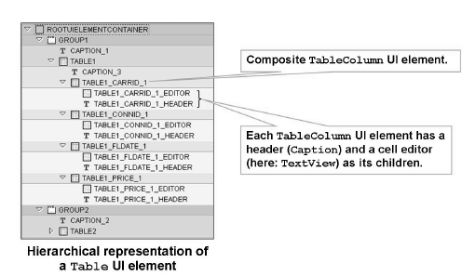
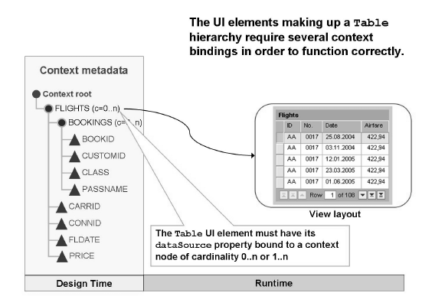
Tables

Slide 29
Capítulo 5
Controller and Context Programming
Notes:
Exercício ZNET310_CONR1_00, ZNET310_CONR2_00, ZNET310_CONR3_00

Slide 30
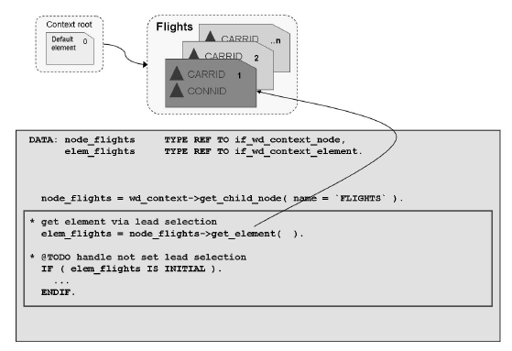
Node/Element Reference

Slide 31
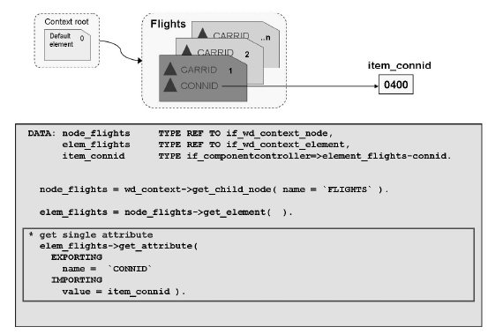
Attribute Read

Slide 32
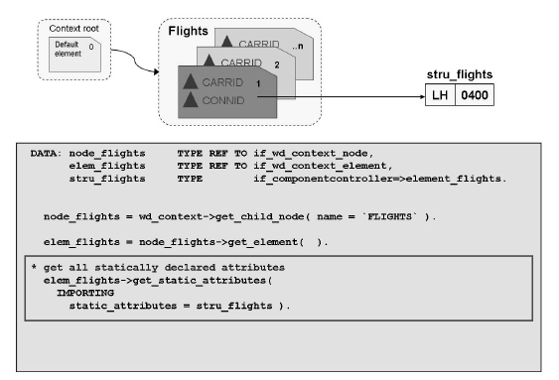
Structure Read

Slide 33
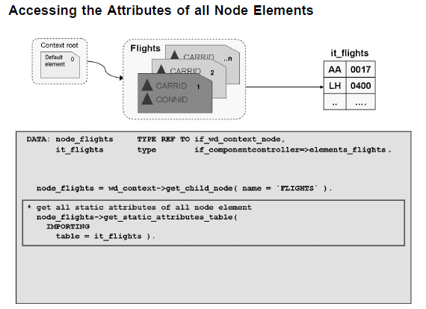
Table Read

Slide 34
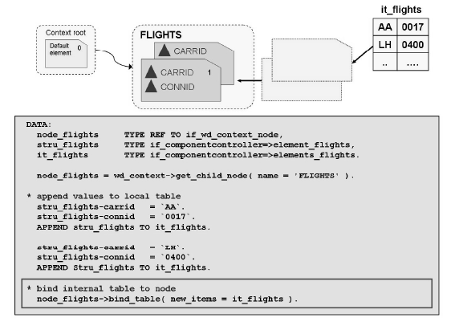
Table Bind

Slide 35
Capítulo 6
Internationalization (I18N) and Messages
Notes:
Exercício ZNET310_I18N1_00, ZNET310_I18N2_00

Slide 36
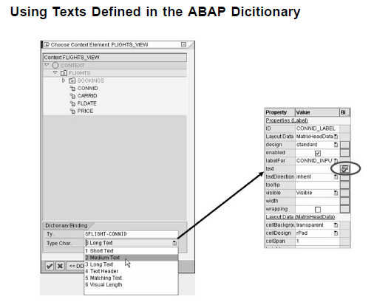

Slide 37
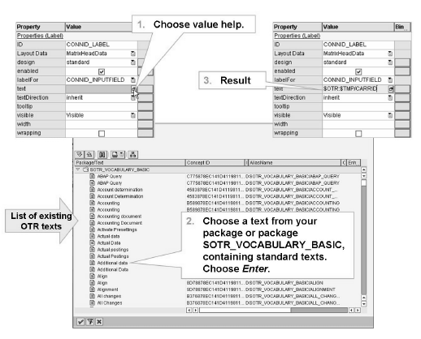
Texts – SOTR_EDIT

Slide 38
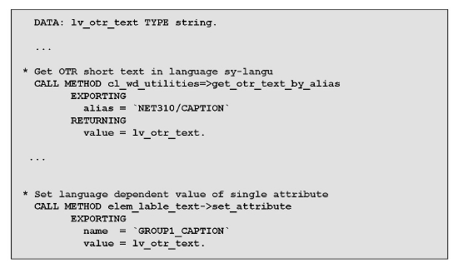
Texts – Programming mode

Slide 39
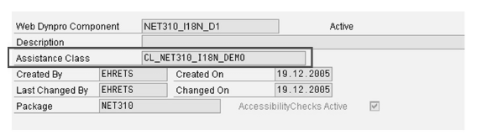

Texts – Assistance Clasee

Slide 40
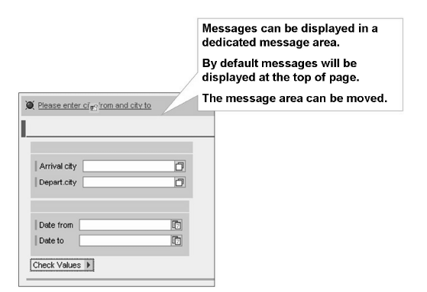
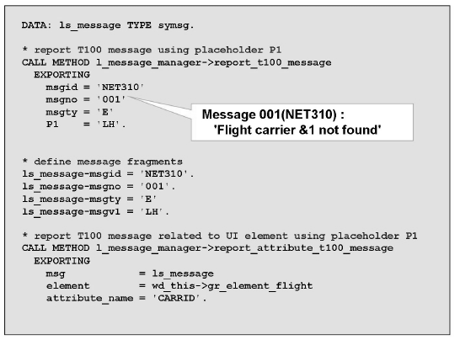

Messages

Slide 41
Capítulo 7
Value Help
Notes:
Exercício ZNET310_HLP1_00, ZNET310_HLP2_00

Slide 42
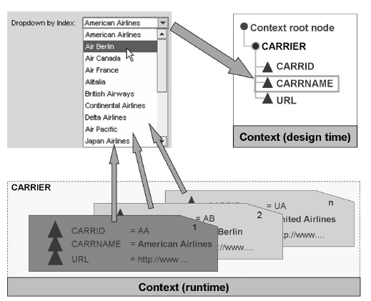
Dropdown by Index

Slide 43
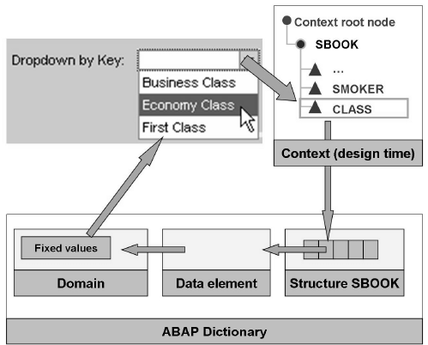
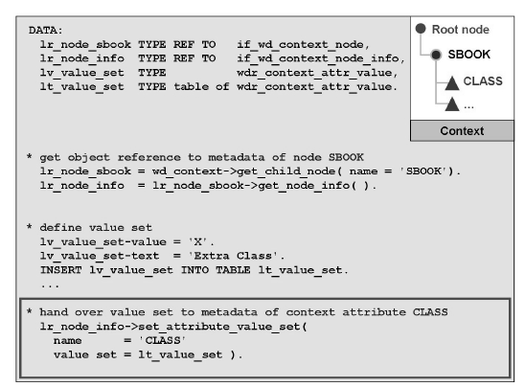
Value Set

Slide 44
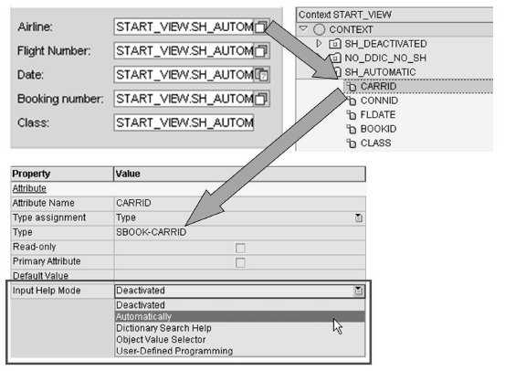
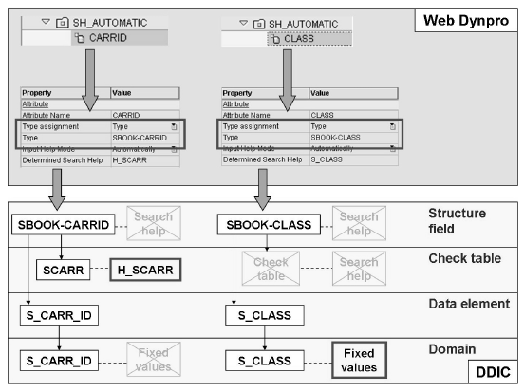
Abap Dictionary

Slide 45
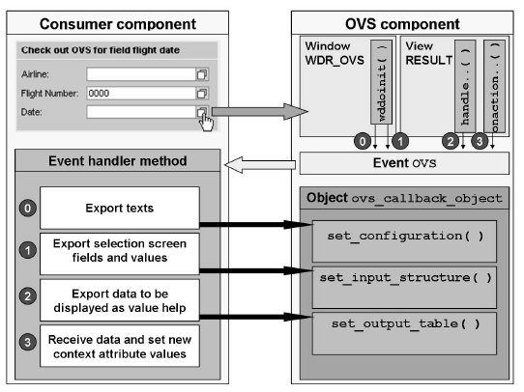
OVS Component

Slide 46
Capítulo 8
Component Reuse
Notes:
Exercício ZNET310_COMP1_00, ZNET310_COMP2_00

Slide 47
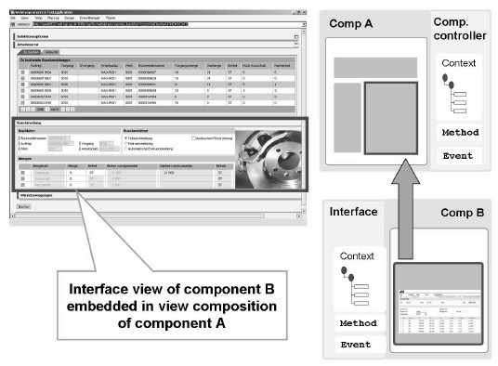
Application Example

Slide 48
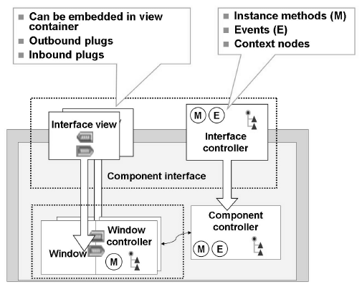
Component Structure

Slide 49
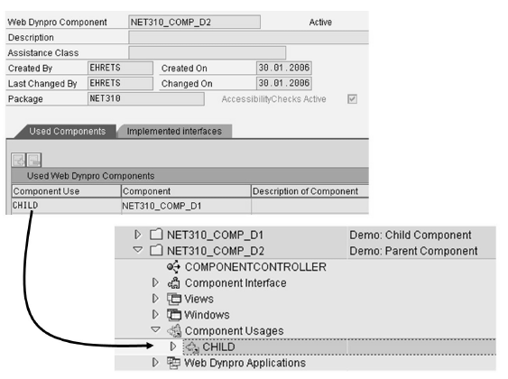
Add Component Reference at Design Time

Slide 50
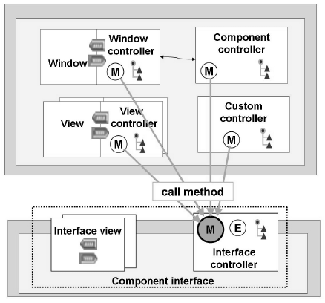
Method Invocation Between Components

Slide 51
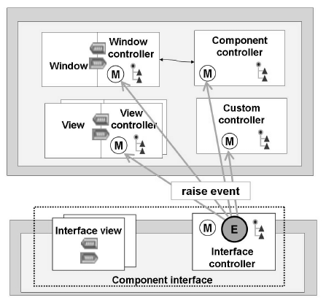
Event Invocation Between Components

Slide 52
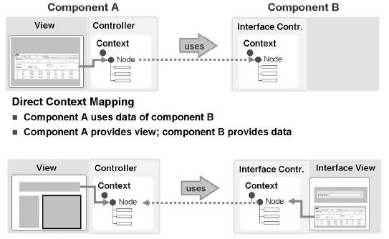
Components Contexts Mapping

Slide 53
Capítulo 9
Dynamic Mlodification
Notes:
Exercício ZNET310_DYN_00

Slide 54
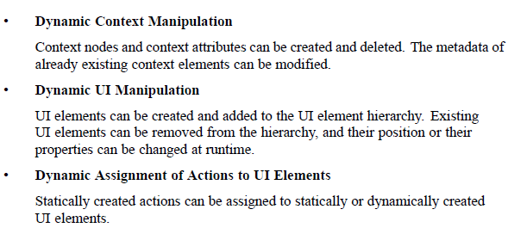
Guide

Slide 55
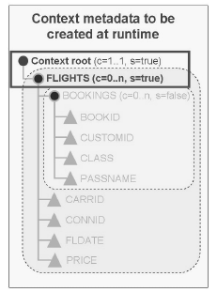
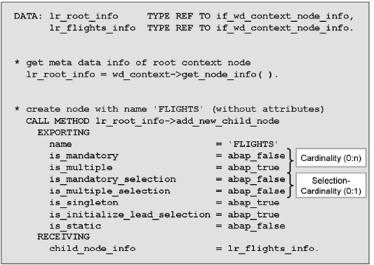
Context Change

Slide 56


View Change

Slide 57
Capítulo 10
Special Topics
Notes:
Exercício ZNET310_CONF_00, ZNET310_ALV_00

Slide 58

Transação Sicf

Slide 59

Web Dynpro Configuration

Slide 60

Web Dynpro ALV
Notes:
Wdt_table, model

Slide 61
Anexos
Tutorial for Beginners
http://www.sdn.sap.com/irj/sdn/index?rid=/webcontent/uuid/367b73e5-0901-0010-daa3-9de4771fc985
ALV Material
http://www.sdn.sap.com/irj/sdn/index?rid=/webcontent/uuid/f0b107e4-dc72-2c10-08a7-b822c9abf0e2
WD Sap Help
http://help.sap.com/saphelp_nw04s/helpdata/en/77/3545415ea6f523e10000000a155106/frameset.htm

