Slide 1
MVC
Free developer of Javascript and Html code

Slide 2
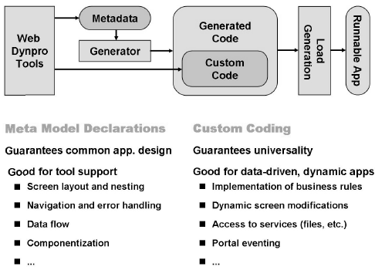

Slide 3
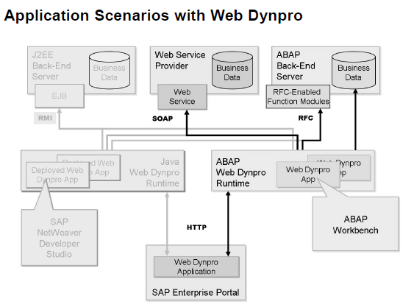

Slide 4
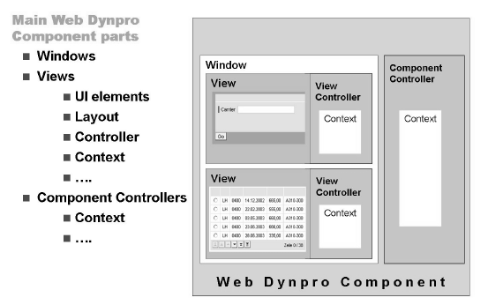

Slide 5
