Slide 1
Vibrational Control of Chaos in
Artificial Neural Networks
Ralph Bean
Adviser: Dr. Roger Gaborski
Observer: Dr. Peter Anderson
Reader: Thomas Borelli

Slide 2
Outline
Introduction of the Problem . . . . . 5 min
Elaboration of Research Concepts . . 15 min
  Artificial Neural Networks
  Dynamical Systems Theory
  Control Theory
Genetic Algorithm. . . . . . . . . 15 min
Results . . . . . . . . . . . . 10 min
Comments and Questions . . . . . 5 min

Slide 3
The Problem
Find an input sequence that
  Stabilizes an otherwise chaotic neural network
  Is of a small a magnitude as possible
Why?
  WJ Freeman (1987) identified chaotic baseline behavior in the olfactory bulbs of mice that stabilized in the presence of stimuli.
  Maass and Jaeger independently demonstrated engineering applications in 2001 at the 'edge of chaos'.

Slide 4
Concepts
Neural Networks
Dynamical Systems Theory and Chaos
Control Theory

Slide 5
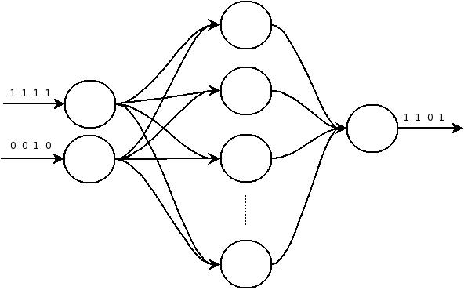
Artificial Neural Networks
Computational model of biological neurons.

Slide 6
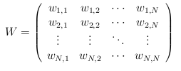

Artificial Neural Networks
A NxN weight matrix, W, connecting N neurons.
An activation function f(x).

Slide 7

Artificial Neural Networks
The state of the ith neuron at time t+1 is the weighted sum of all other neurons' state under the activation function.
The entire network state is the product of the NxN weight matrix and the Nx1 state vector under the activation function.

Slide 8

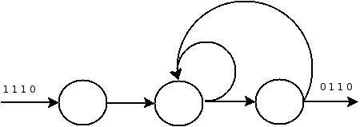
Artificial Neural Networks
Networks with feed-forward connections are well studied.
Inherent problems in applying feed-forward techniques to recurrently connected networks.

Slide 9
Dynamical Systems Theory (DST)
DST is the study of systems defined by change rules.
  Continuous: differential equations
  Discrete: iterated maps
Problems in DST are typically about the fate of trajectories in a given system.
  Do all starting points gravitate to a fixed point or to infinity?
  Are there oscillating cycles or periodic orbits?
Other problems include discussing the similarity of systems.
  Are two systems qualitatively equivalent (homeomorphic)? Alternatively, do their trajectories share the same fates?
  Is a given system situated on the cusp of two qualitatively different regimes (bifurcation point)?
Neural Networks can be considered dynamical systems.

Slide 10
Dynamical Systems Theory
Chaos is a type of dynamical behavior where orbits within a certain basin of attraction ultimately tend towards an aperiodic orbit.
  Countably infinite number of periodic repelling orbits.
  'Butterfly effect': Exponential expansion of nearby orbits.
There are a handful of known and well studied chaotic systems, both discrete and continuous.
  Logistic Map demonstration.

Slide 11
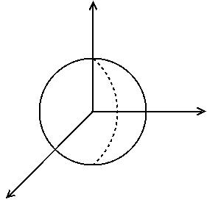
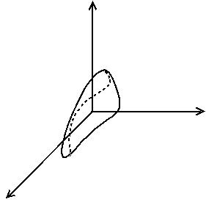

Dynamical Systems Theory
The Lyapunov exponent spectrum of a system characterizes its rates of expansion and contraction.
Defined as the eigenvalues of the matrix:
In practice, this is not solvable.

Slide 12

Dynamical Systems Theory
It is approximable. A method is given in J.C. Sprott's “Chaos and Time-Series Analysis.”
      1. Start with any initial seed within the basin of attraction.
      2. Iterate a few hundred times until the orbit is close to the attractor.
      3. Select a nearby point that is a distance d0 from the current orbit.
      4. Advance both orbits and calculate the new distance d1.
      5. Evaluate log | d1/d0 |
      6. Renormalize the new point so that it is d0 from the new state but in the direction of maximal expansion.
      7. Iterate steps 4-6 and calculate the average of step 5.

Slide 13
Control Theory
Theory of using signals to control behavior of external systems be they physical or modeled.
B. R. Andrievskii published a review paper and identified five major techniques.
  Open loop (vibrational)
  Linear and Nonlinear
  Adaptive
  Poincaré Linearization (OGY)
  Time Delayed Feedback (Pyragas).

Slide 14
Control Theory (OGY)
OGY has been used to control chaos in neural networks.
Relies on the theoretical result of the dense existence of periodic orbits.
Algorithm overview:
  First observe system dynamics until certain conditions are met.
  Then, apply a signal to steer orbits in the direction of a guessed periodic repelling orbit.
The feedback between algorithm control and system dynamics is not in the intended spirit of this thesis.

Slide 15
Control Theory (Open-loop)
Open-loop, or vibrational, control is the trend of techniques that do exactly that. 'Open-loop' refers to the information flow between the controlled system and the controlling signal.
Neural networks, generally speaking, are applied to analyze or classify data over which they have no control.

Slide 16
Control Theory (Open-loop)
Applications include both stabilization and chaotization of controlled systems.
The literature contains many mathematical results that apply only to systems in particular forms or with certain ranges of eigenfrequencies.
A theme across applications is the requirement that the controlling signal be as small as possible, otherwise it drowns out system dynamics.

Slide 17
Genetic Algorithm
Use the principles of evolution to solve computational problems.
    A population of individuals that are potential solutions.
    Some metric to rank how fit they are.
    Some crossover operator to breed children of the more fit.
    Some mutation operator to introduce new genetic material.
    Some selection method to determine how the more fit breed and how the least fit die.
Many ways to do each of these.
    Systematic comparison of possible genetic operators on the task.

Slide 18
Restatement of the Problem
Find an input sequence that
  Stabilizes an otherwise chaotic neural network
  Is of a small a magnitude as possible

Slide 19
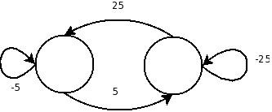
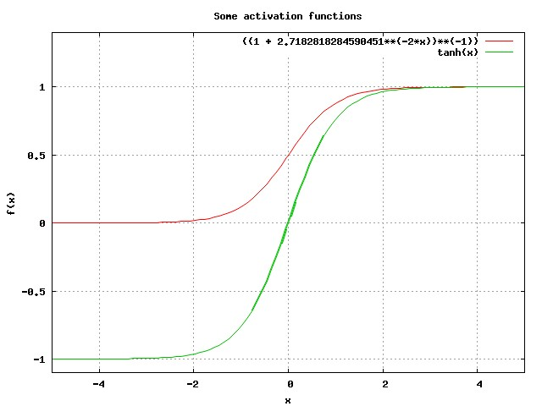
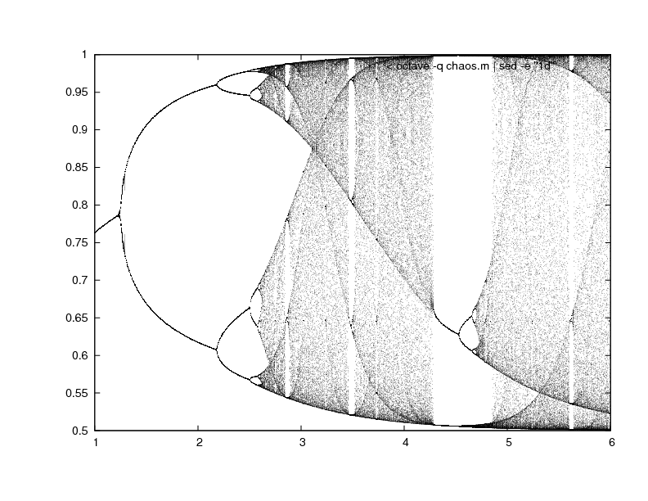
The Chaotic Network in Question

Slide 20
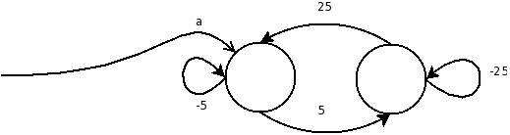

Individuals
I = <S, a>, where:
  S is a finite, variable-length sequence of real values
  a is a scalar called the amplitude coefficient.
The repeated elements of S scaled by a are an input stream to the network.
At each time step t, the term S[ (t % |S|) ] scaled by a is added to the state of the first neuron in the network.

Slide 21


Fitness
One input stream I1 = <S1, a1> can be considered better than another I2 = <S2, a2> if:
An individual that meets the task requirements is one where:
  Minimizing two values presents an interesting problem. As part of the experiment multiple fitness functions are systematically compared.

Slide 22
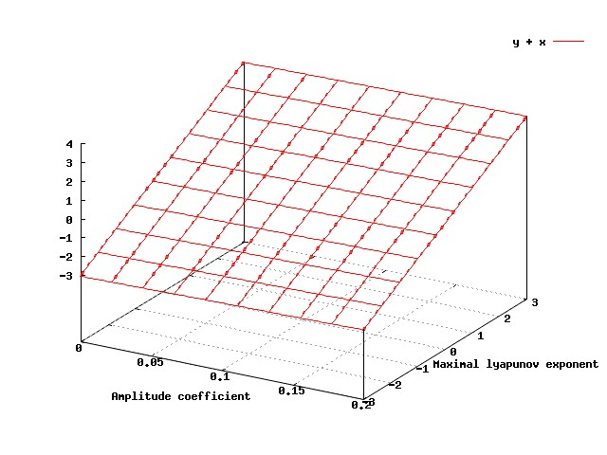
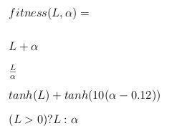
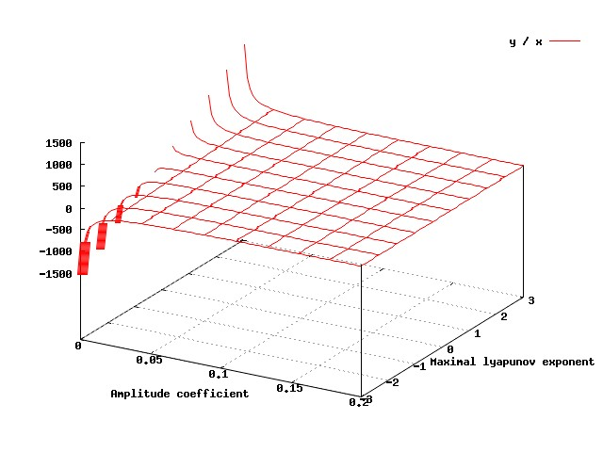
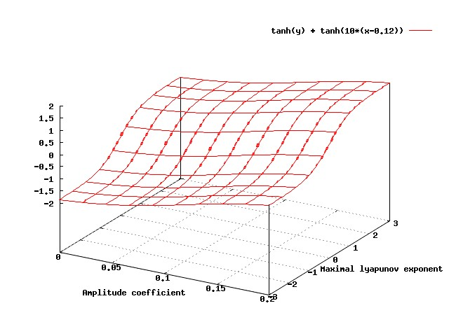
Fitness

Slide 23
Crossover
Along with fitness functions, a variety of crossover operators are to be systematically compared.
    Random Single Point
    Fixed Single Point
    Gaussian “Merge”
    Binary Random Single Point
    Binary Fixed Single Point
    DCT (Discrete Cosine Transform) Random Single Point
    DCT Fixed Single Point
    DCT “Gaussian”
    DCT Binary Random Single Point
    DCT Binary Fixed Single Point

Slide 24
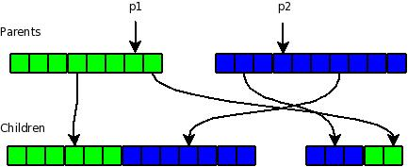
Crossover
Random Single Point:

Slide 25
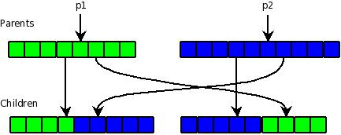
Crossover
Fixed Single Point

Slide 26
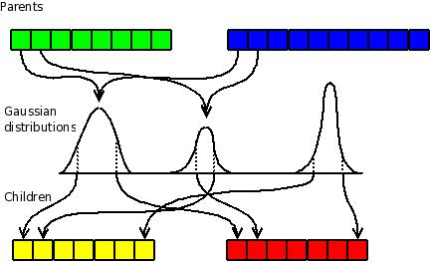
Crossover
Gaussian “Merge”:

Slide 27
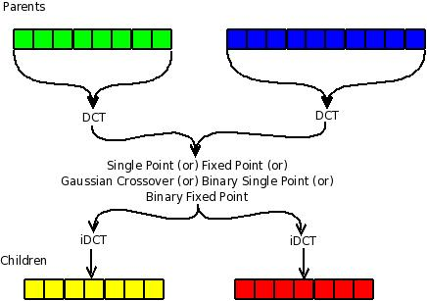
Crossover
Discrete Cosine Transform Operators

Slide 28
Crossover
    Random Single Point
    Fixed Single Point
    Gaussian “Merge”
    Binary Random Single Point
    Binary Fixed Single Point
    DCT (Discrete Cosine Transform) Random Single Point
    DCT Fixed Single Point
    DCT “Gaussian”
    DCT Binary Random Single Point
    DCT Binary Fixed Single Point

Slide 29
Mutation
Mutation rate (percent chance for a new individual to be selected for mutation) is %2.
6 types of mutation, each with an equal chance of occurring.
  Sequence insert
  Sequence delete
  Sequence replace
  Sequence nudge
  Amplitude coefficient replace
  Amplitude coefficient nudge

Slide 30
Selection
Five types of selection are systematically compared:
  Greedy
  Non-greedy
  Mutant Hero
  Greedy Mutant Hero
  Non-greedy Mutant Hero

Slide 31
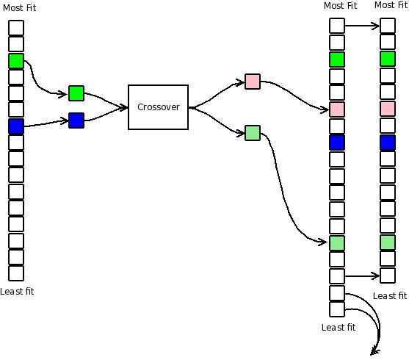
Greedy Selection

Slide 32
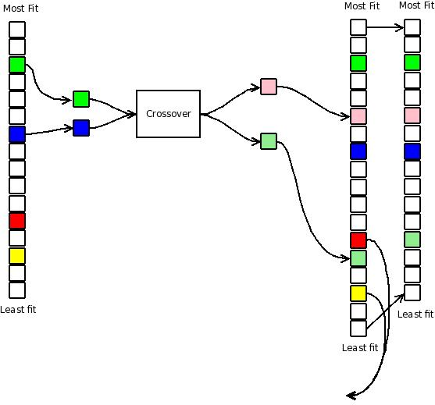
Non Greedy Selection

Slide 33
Selection
  Greedy
  Non-greedy
  Mutant Hero
  Greedy Mutant Hero
  Non-greedy Mutant Hero

Slide 34
Systematic Comparison
Compare the fitness of the most fit.
  10 types of crossover
  5 types of selection
  4 types of fitness function
  Conduct 4 trials of each experiment instance.
10*5*4*4 = 800 trials
    At 1.2 CPU-hours per trial, this took 40 CPU-days.
Do any operators do well across the board?
Which specific combination of operators is best?

Slide 35
Sampling the Solution Space
What do neighboring sequences look like?
Through what kind of “fitness terrain” will the genetic algorithm be searching?
Tangential experiment:
    “Brute-force” sample a toy subclass of the solution space.
    Furthermore, consider only sequences of length 2 (inputs of period 2).
    Ignore the amplitude coefficient, use only sequences.
    These can be mapped to the place and colored according to how well they do or do not stabilize the network.

Slide 36
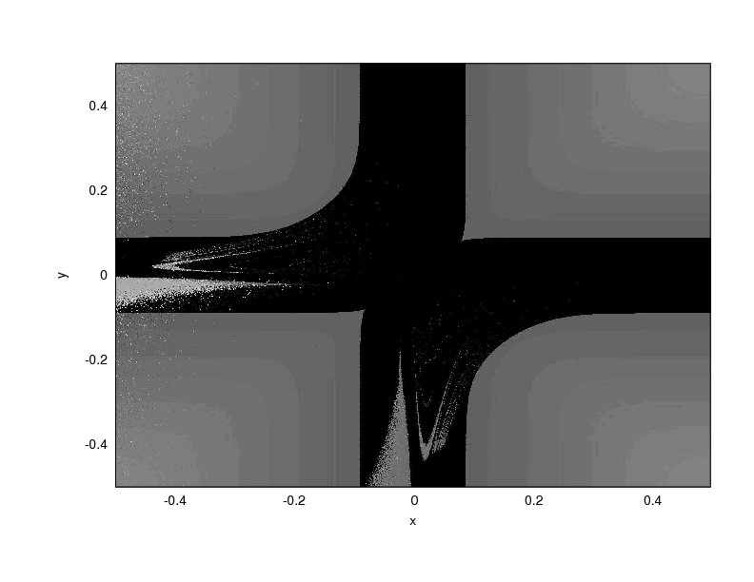

Slide 37
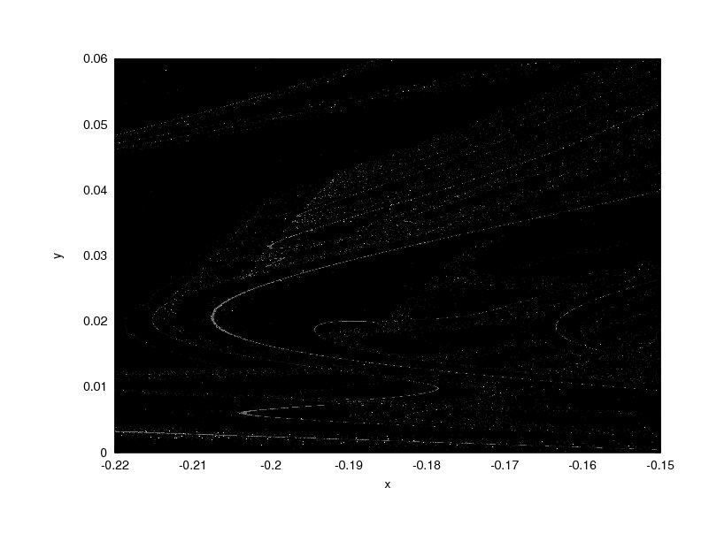

Slide 38


Slide 40


Slide 41
Genetic Algorithm Results
Most fit individuals out of all 800 trials
Comparison of operators
  Fitness Methods
  Selection Methods
  Crossover Methods

Slide 42
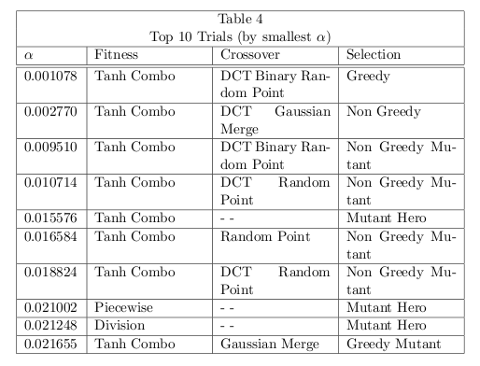
Results: Best Individuals

Slide 43
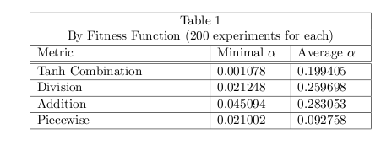
Results: Fitness Metrics

Slide 44
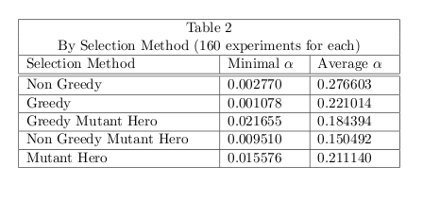
Results: Selection Methods

Slide 45
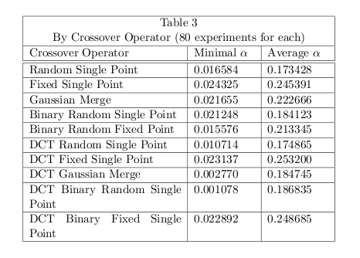
Results: Crossover Operators

Slide 46
Conclusion
Observations:
    Positive answer to central question.
    Solution-fitness map shows complexity even near origin.
    Crossover in the frequency domain performs well.
Open questions:
    Lower bound on amplitude coefficient?
    Choice of DCT somewhat arbitrary. Better transforms?
      GA for the task.
    Other ANNs? Classify networks in terms of their stabilizing sets?

Slide 47
Conclusion
Comments and Questions?

