Slide 1
Thesis Update
Chaotic Artificial Neural Networks
Ralph Bean

Slide 2
Overview
Goal – Describe nonautonomous artificial neural networks exhibiting chaotic motion
Last time –
  Use a genetic algorithm to find equations whose solutions are neural networks with the desired quality.
  Non-promising results and too complex of a problem to have dived straight into.

Slide 3
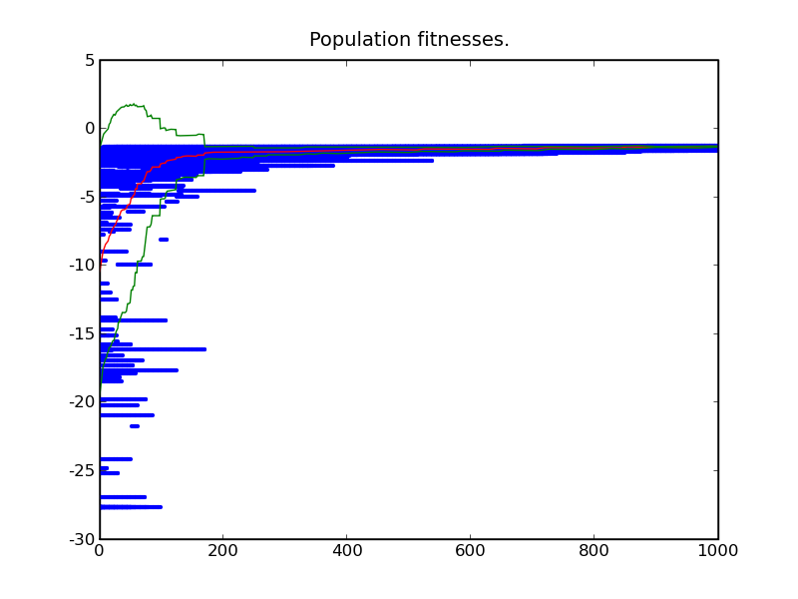
Initial Results

Slide 4
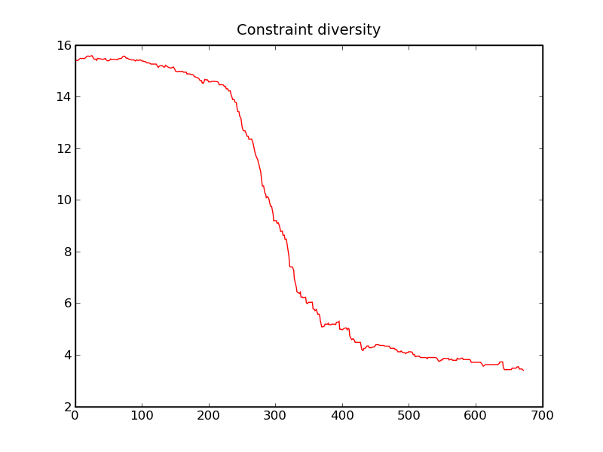
Diversity Metric

Slide 5
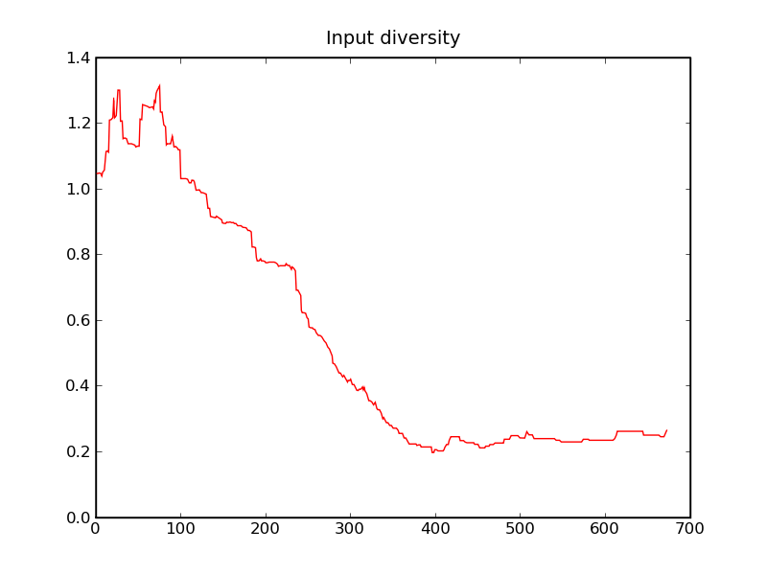
Diversity Metric

Slide 6
Suggested Changes
Parameters ended up fixed within a range – changed crossover to allow values outside their initial bounds.
Simulate the evolution of networks themselves instead of equations whose solutions are networks to simplify the problem.

Slide 7
Significant Fixed Bugs
Memory error in constraint crossover.
Input was disconnected.
  Networks of small size converge much closer to desired fitness values but not > 0 yet.
  Networks of large size initialize with poor fitness.

Slide 8
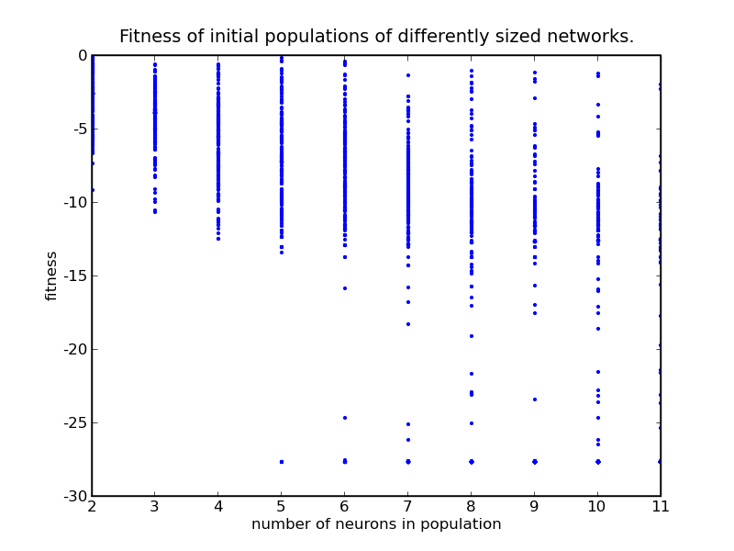
Initial populations for networks of different size:

