Slide 1
Thesis Update
Chaotic Artificial Neural Networks
Ralph Bean

Slide 2
Since last week
Graphed power spectral density for chaotic maps and trained networks.
Trained ANNs to other chaotic target functions, the cubic and quartic maps.
Rewrote thesis proposal.
Installed and experimented with J.

Slide 3
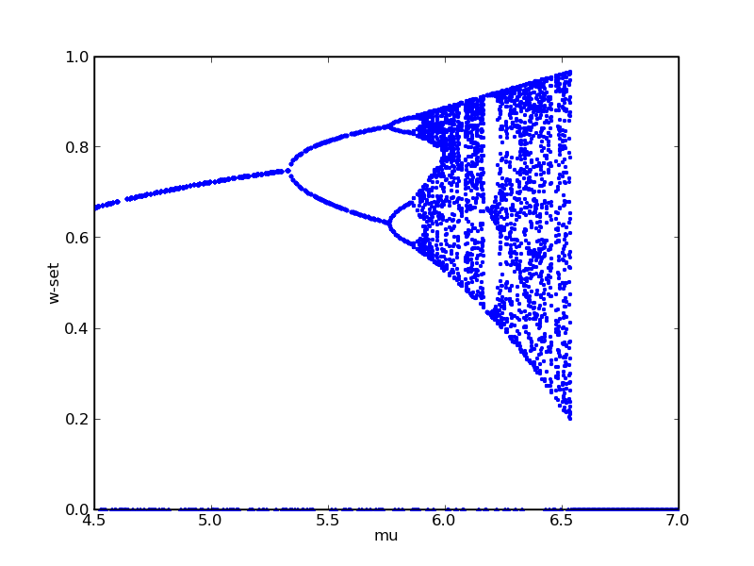
Cubic Map Bifurcation Diagram

Slide 4
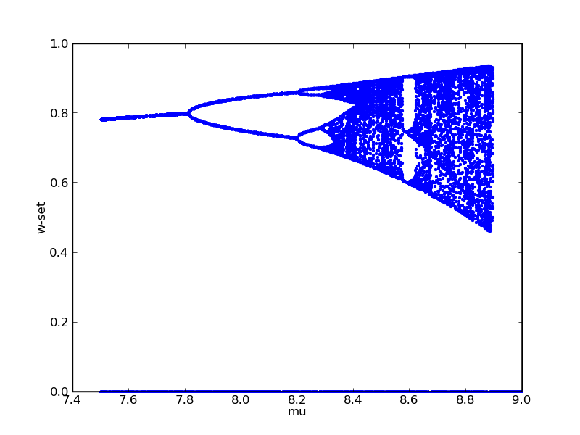
Quartic Map Bifurcation Diagram

Slide 5
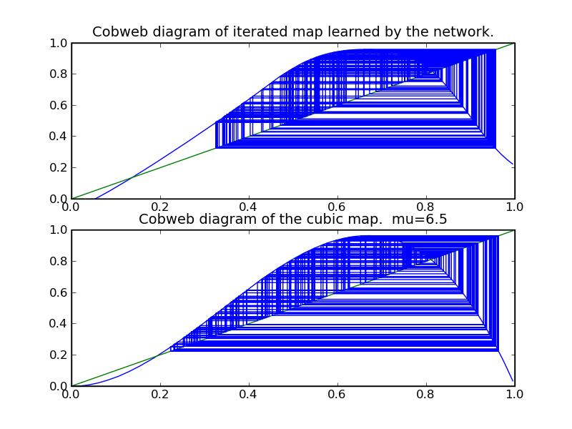
Cubic Map

Slide 6
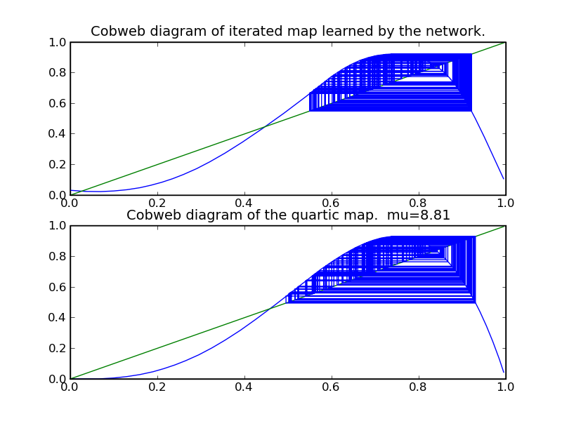
Quartic Map

Slide 7
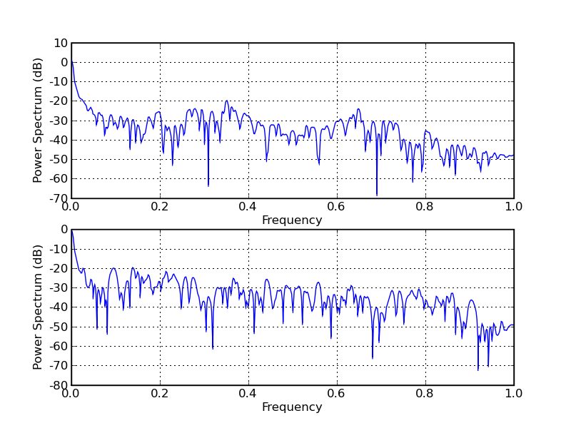
Cubic Map PSD

Slide 8
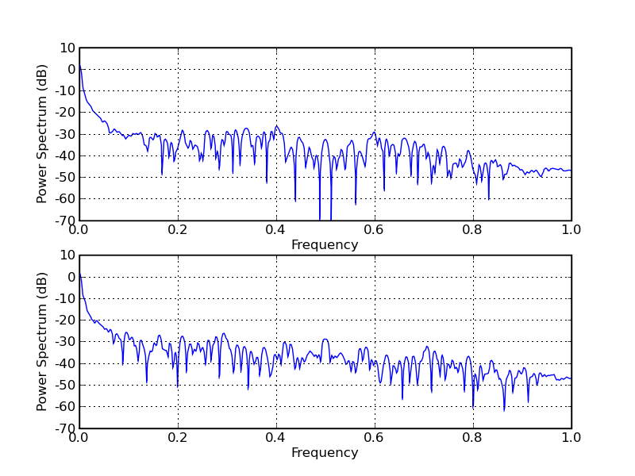
Quartic Map PSD

Slide 9
Updated proposal
Now with networks known to have chaotic baseline patterns, what kind of input sequences can stabilize them?
For the reservoir computing model, input is presented repeatedly until the readout layer stabilizes on an output. What sort of input sequences can induce periodic motion in the otherwise aperiodic previously constructed networks.

