Slide 1
Thesis Update
Chaotic Artificial Neural Networks
Ralph Bean

Slide 2
Overview
Goal – Describe nonautonomous artificial neural networks exhibiting chaotic motion
Motivation
  Usefulness: (Jaeger, 2001), (Maass, 2002)
Difficulties
  No gradient descent: (Doya, 1992)

Slide 3
Method
Modified Genetic Algorithm
  Individuals
  Selection
  Crossover
  Mutation
  Fitness

Slide 4
Individuals
Individuals are a tuple <C,I> where:
  C is a system of n^2 linear equations on n^2 variables each of which represent a weight in an ANN with n neurons.
  I is a tuple <dt, f(t)> describing a one-dimensional driving input.

Slide 5
Selection
Two pairs of individuals are selected at random.
The fitter of each pair is chosen for crossover.
If each child is more fit than the selection losers, then the losers are replaced.

Slide 6
Crossover
Crossover of two parents P1=<C1,I1>, P2=<C2,I2> is comprised of separately combining C1 with C2 and I1 with I2.
Constraint matrices are combined by first selecting a random index, <r,c>. All entries in the child's constraint matrix up to <r,c> are drawn from C1 and the rest from C2.
For driving inputs, <dt, f(t)> the child's dt value is given by the sum of a random weighting of each parents' dt value.
Input functions f(t) are represented as binary trees of operators and operands. The child's f(t) is produced by splicing a random subbranch belonging to one parent onto a random branch along belonging to the other.

Slide 7
Mutation
Constraint matrices are mutated by replacing the value at a randomly selected index with a random value.
Inputs are mutated by either replacing the dt value with a random value or by modifying f(t):
  By pruning a random subbranch
  Replacing the value of the operator or operand at a random node
  Growing a random new branch at a random node.
The mutation rate used is %2.

Slide 8

Fitness
The fitness of an individual is defined as the average of the maximal lyapunov exponents of ANNs that are described by the constraint matrix and driven by the input function.

Slide 9
Fitness
Measuring fitness is accomplished by
  Reducing the system of constraint equations.
  Instantiating ANNs by randomly assigning free variables and back solving for weight matrices.
  Simulating each ANN driven by f(t).
  Measuring the rate of separation of trajectories along the dimension of the maximal rate of separation.
  Averaging this separation over a sample of randomly selected initial seeds.

Slide 10
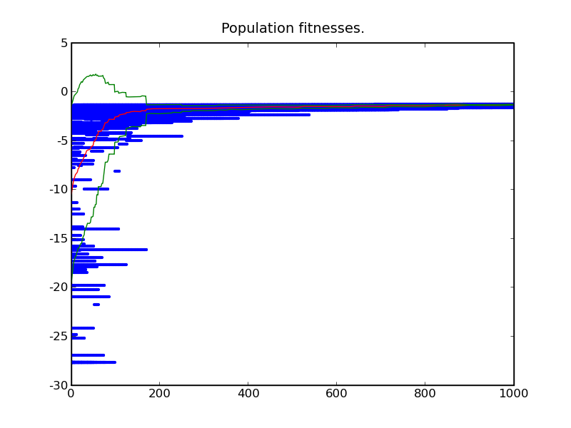
Initial Results

Slide 11
Diversity Metric
Sum of the 'distance' of every individual from every other individual.
A more appropriate metric such as the variance of the population might be suitable but not crucial.

Slide 12
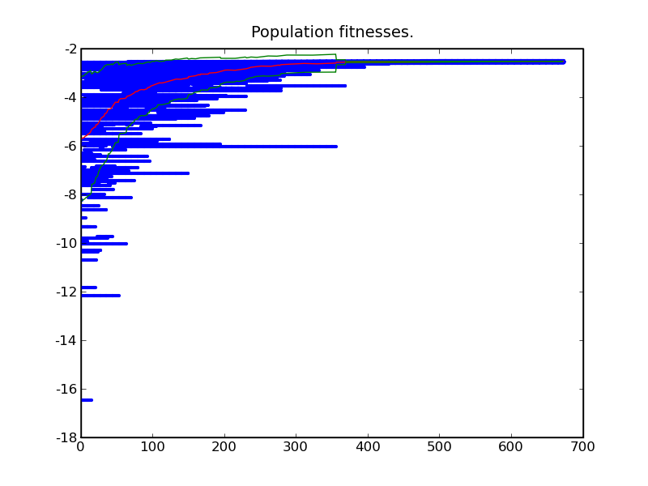
Diversity Metric

Slide 13
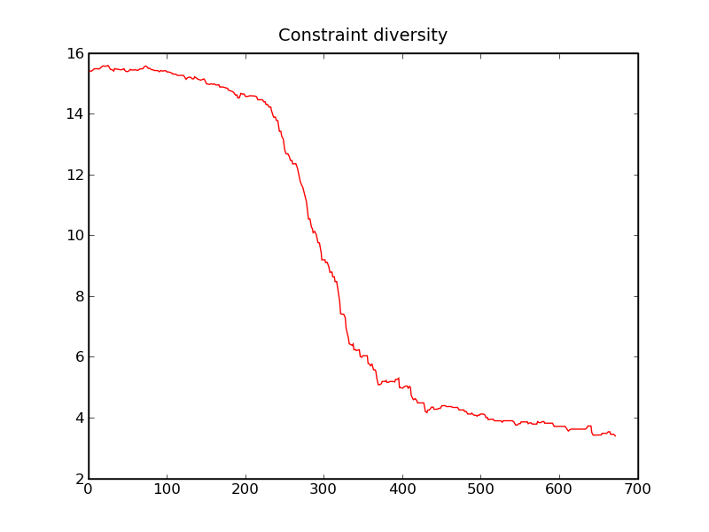
Diversity Metric

Slide 14
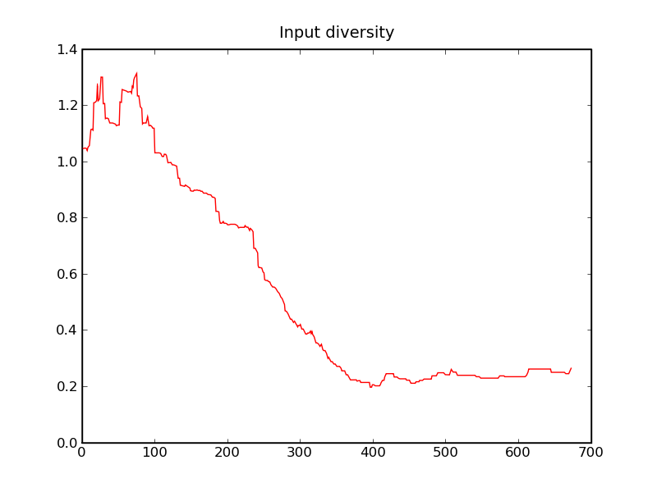
Diversity Metric

Slide 15
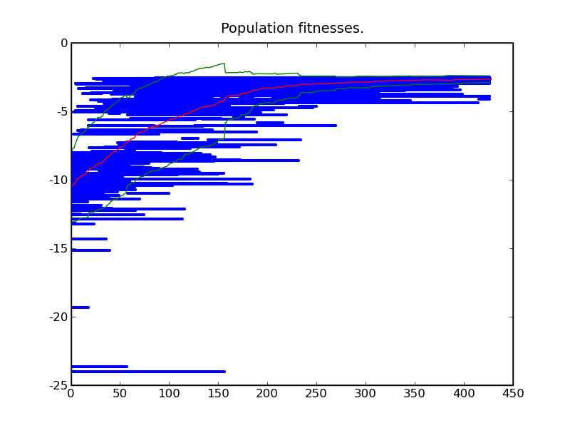
Inhibited Initial Population

Slide 16
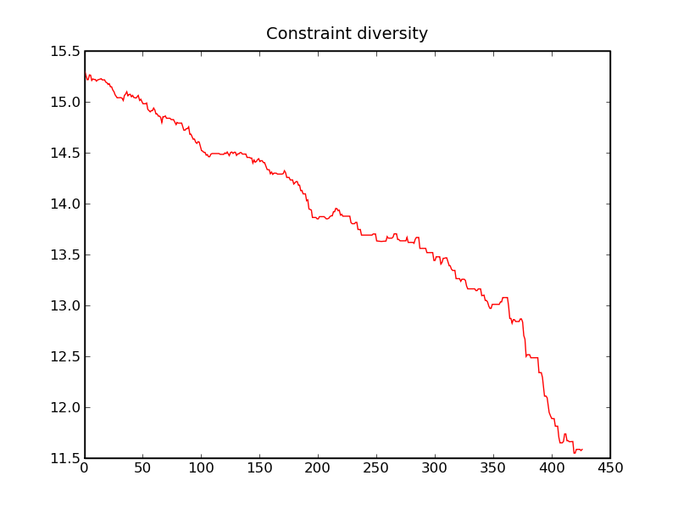
Inhibited Initial Population

Slide 17
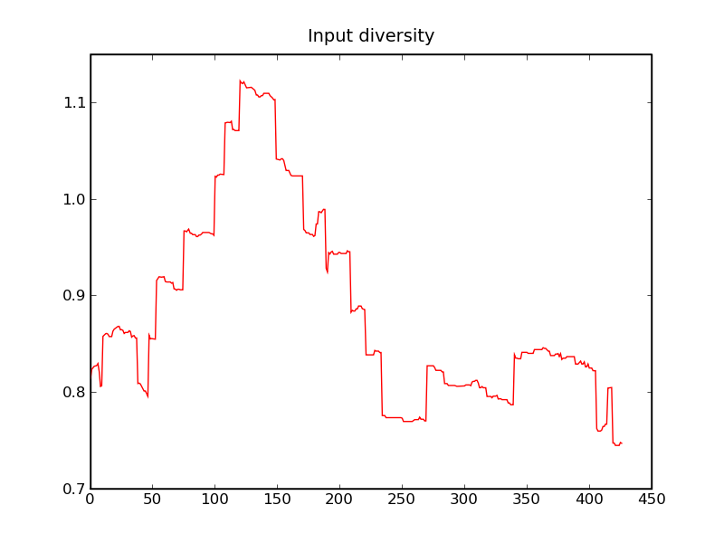
Inhibited Initial Population

