Slide 1
Vibrational Control of Chaos
Ralph Bean
3/25/09

Slide 2
Control of Chaos
Three veins of research in the literature on controlling chaotic systems in general:
  Poincare Linearization (OGY)
  Time-delay feedback (Pyragas)
  Open-loop control (vibrational control)
All rely on the dense mixture of unstable periodic orbits.

Slide 3
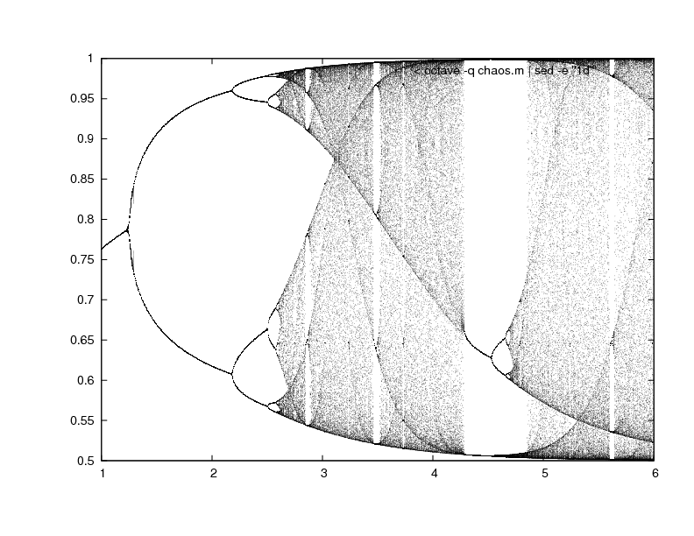
Network Description
Two neurons where a=5;b=25;W=[-a, a; -b, b];
Activation function f(x)=1/(1+e^(-u*x))

Slide 4
OGY Method
Ott-Grebogi-Yorke
Used to stabilize a system to a specific period
  Iterate the system until a close return pair X* is found.
  Consider D(x) = -f(Wx)+ax
  When next x[k] is sufficiently close to X*, apply the stabilizing signal u[k]=D(x[k]) - D(X*)

Slide 5
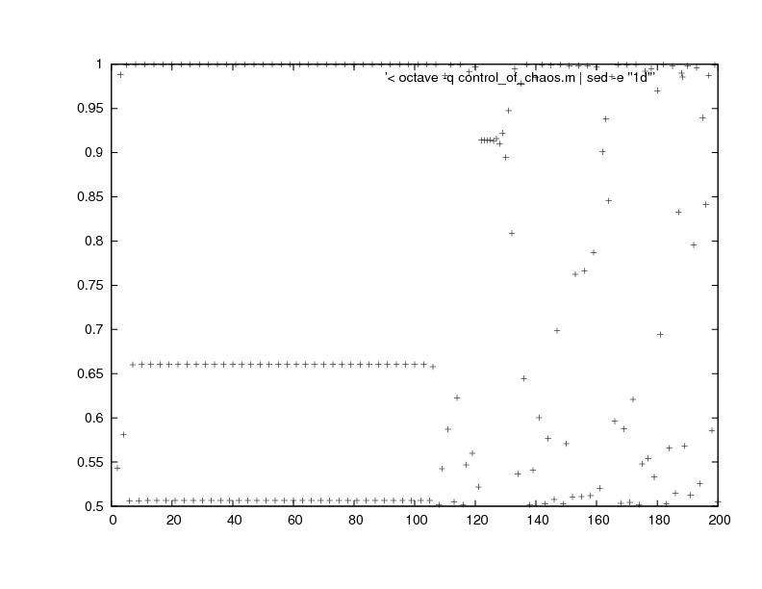
OGY Method Results

Slide 6
Open-Loop Control
Open-loop means an open 'observer-controller' loop.
The OGY method is closed-loop: the algorithm first observes the dynamics of the system then applies appropriate control.
Also called 'vibrational' control: application of a periodic vibration to the aperiodic dynamics.
Open-loop is the control-theoretic framework for the task proposed in my thesis.

Slide 7
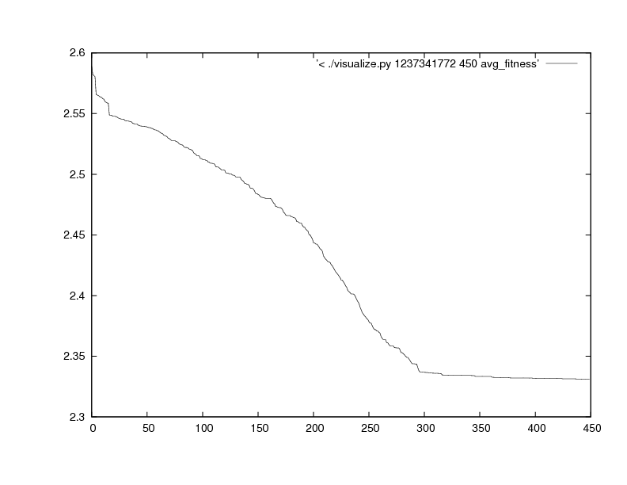
Open-loop Genetic Algorithm Results

Slide 8
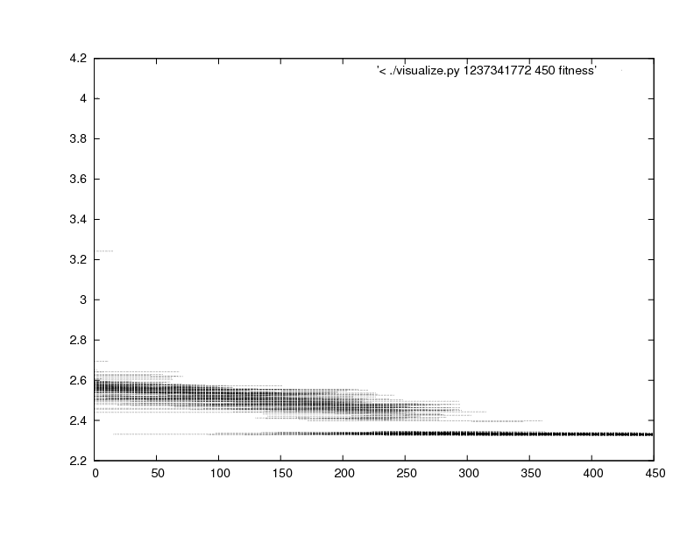
Open-loop Genetic Algorithm Results

Slide 9
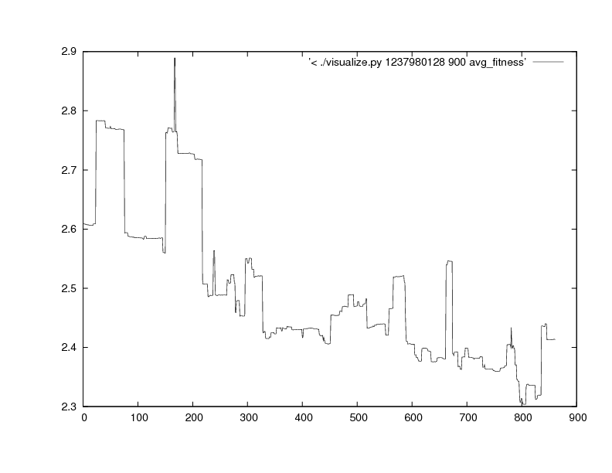
Open-loop Genetic Algorithm Results

Slide 10
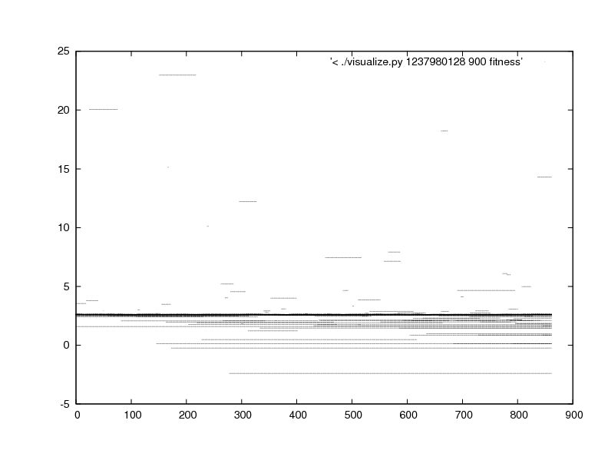
Open-loop Genetic Algorithm Results

Slide 11
Future Work
Analyze PSD of best organism from G.A.
Continue review of control-theoretic literature
  Krylov-Bogolyubov method of averaging for impact of high-frequency excitation on networks.
  Impact of middle-frequency excitation (inside the range of system eigenfrequencies)
  Mel'nikov method

