Slide 1
Vibrational Control of Chaos
Ralph Bean
3/25/09

Slide 2
Overview
GA: Fixed-seed stabilization results
GA: Random-seed stabilization results
  Amplitude threshold
Future work proposal

Slide 3
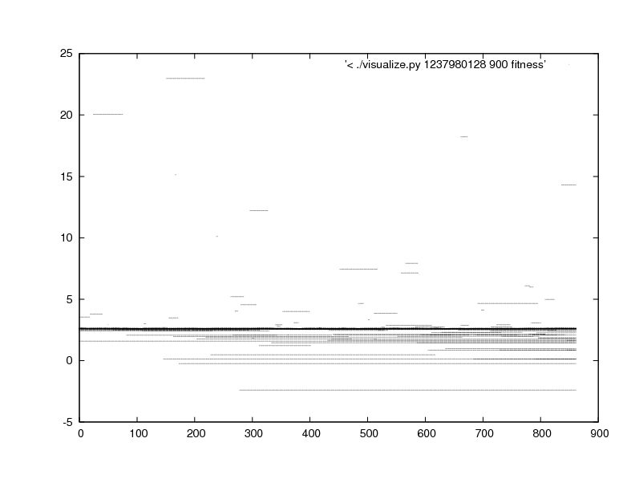
GA: Fixed-seed, population fitness

Slide 4
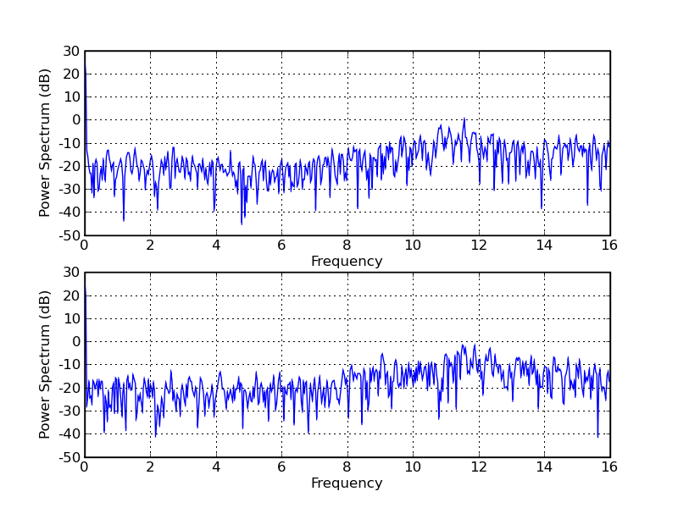
GA: Fixed-seed, psd of best

Slide 5
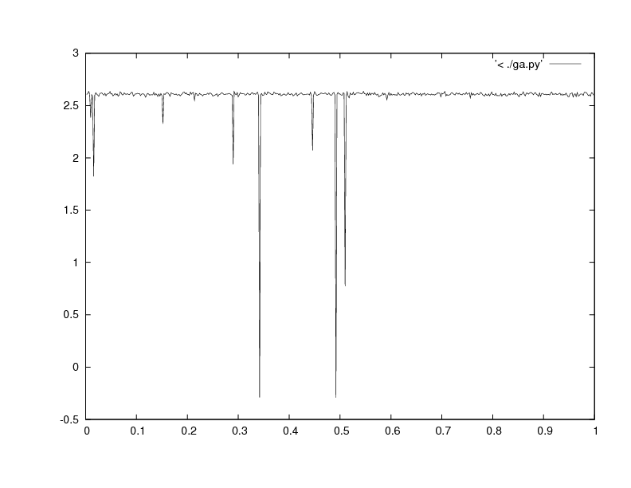
GA: Fixed-seed, lyapunov variance

Slide 6
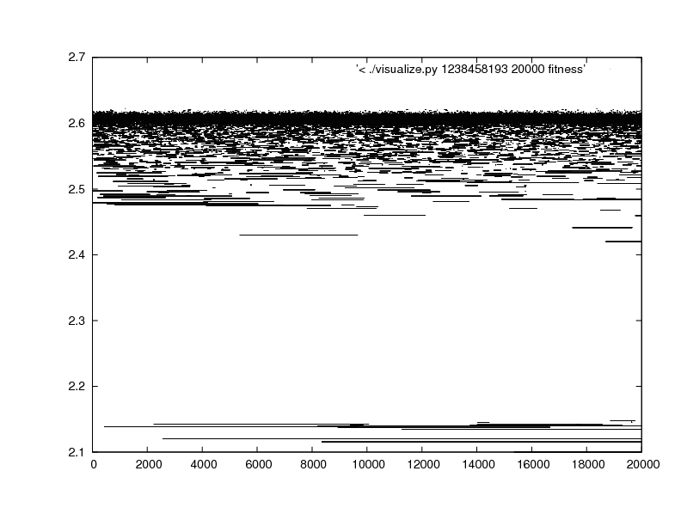
GA: Random-seed, long run

Slide 7
Random-seed hero and amplitude
[ -1, -1, 1, 1, -1, 1, 1, 1, -1, -1, 1, -1, 1, -1, -1, 1, 1, 1, 1] , and [1, -1, 1, -1, -1, -1, -1, -1, 1, -1, 1, 1, 1, 1, 1, -1, -1, 1]
Fitness: 2.0126, after 58000 generations, ~30 hours.
Amplitude: At each time step, I multiply the input I[t] by an arbitrarily chosen constant a. In the last simulation a=0.0000001. Maybe I chose it too small to have much of any effect? Vary a.

Slide 8
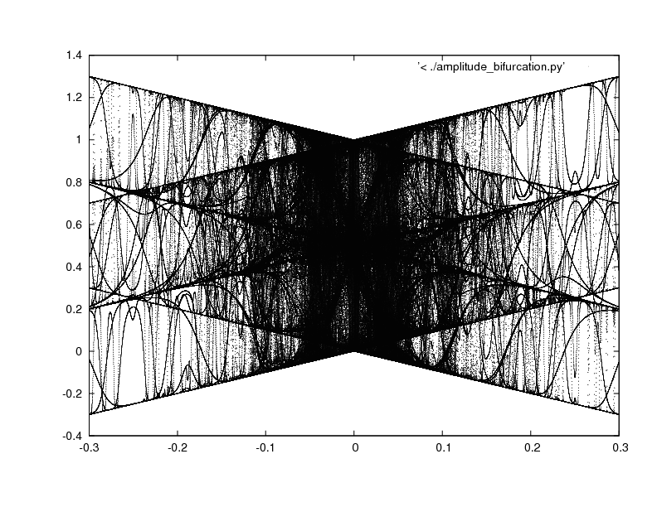

Slide 9
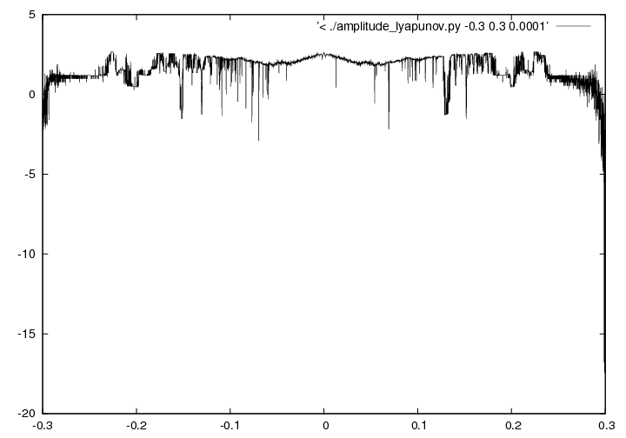
Maximal Lyapunov Exponent over a.

Slide 10
What else was missed?
What do other inputs that scored poorly look like?
    [1,1,1,1], [-1,1,1,1]
    [-1,1,1,1],[1,1,1,1]

Slide 11
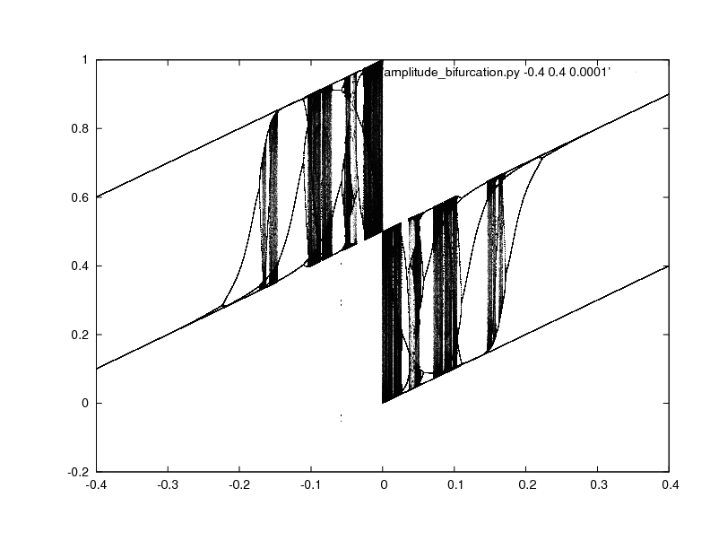

Slide 12
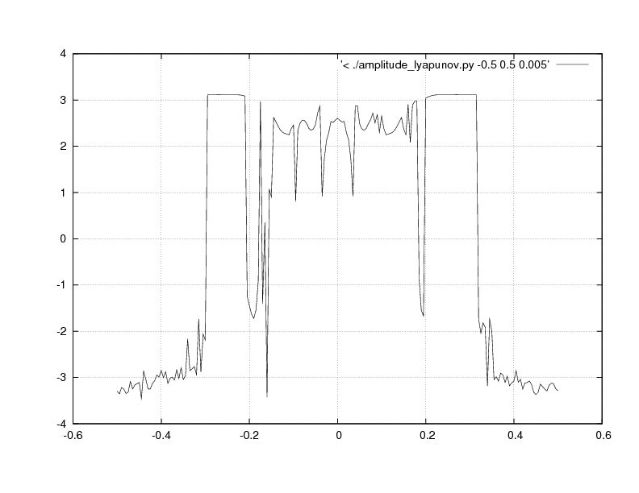

Slide 13
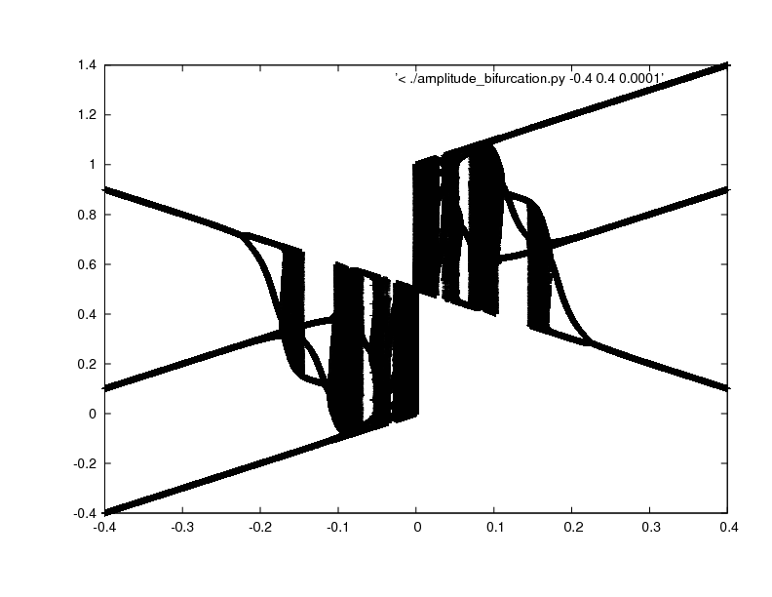

Slide 14
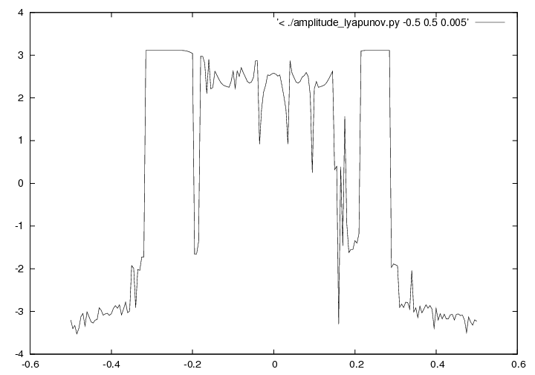

Slide 15
Future Work
What input sequence minimizes maximal lyapunov exponents while also minimizing amplitude?
  Add to genetic algorithm? 2-D fitness function?
  Can we rank or order inputs? Consider a space of them?
Continue reviewing literature on vibrational excitation. Nothing useful, yet.

