Slide 1

State of Fedora Infrastructure
(we've been busy)
PRESENTED BY:
Ralph Bean and Adam Miller
Fedora Engineering Team
Licensed CC-by-SA. A good thing.

Slide 2
Today's Topics
Applications and Services
  Bodhi2
  Mirrormanager2
  Fedora-Packages
  Pagure
  Hyperkitty
  mdapi
  Koschei
  Taskotron
Release Engineering Infrastructure
  AutoCloud/Tunir
  Atomic Websites Automation
  Product Definition Center (PDC)
  Docker Layered Image Build Service (OSBS)
    The Saga that is.

Slide 3
Fedora
Infrastructure

Slide 4
Our environments
Puppet → Ansible (v2) migration
RHEL6 → RHEL7
  516 hosts
  RHEL7, 405
  RHEL6, 19 (jenkins builder, etc.. will stay)
  Fedora, 92 (mostly cloud, with exceptions)
selinux (181 hosts are enforcing)
Openstack migration
  ansibilized RHOS-5 (Icehouse)

Slide 5
Rewrites and
Enhancements

Slide 6
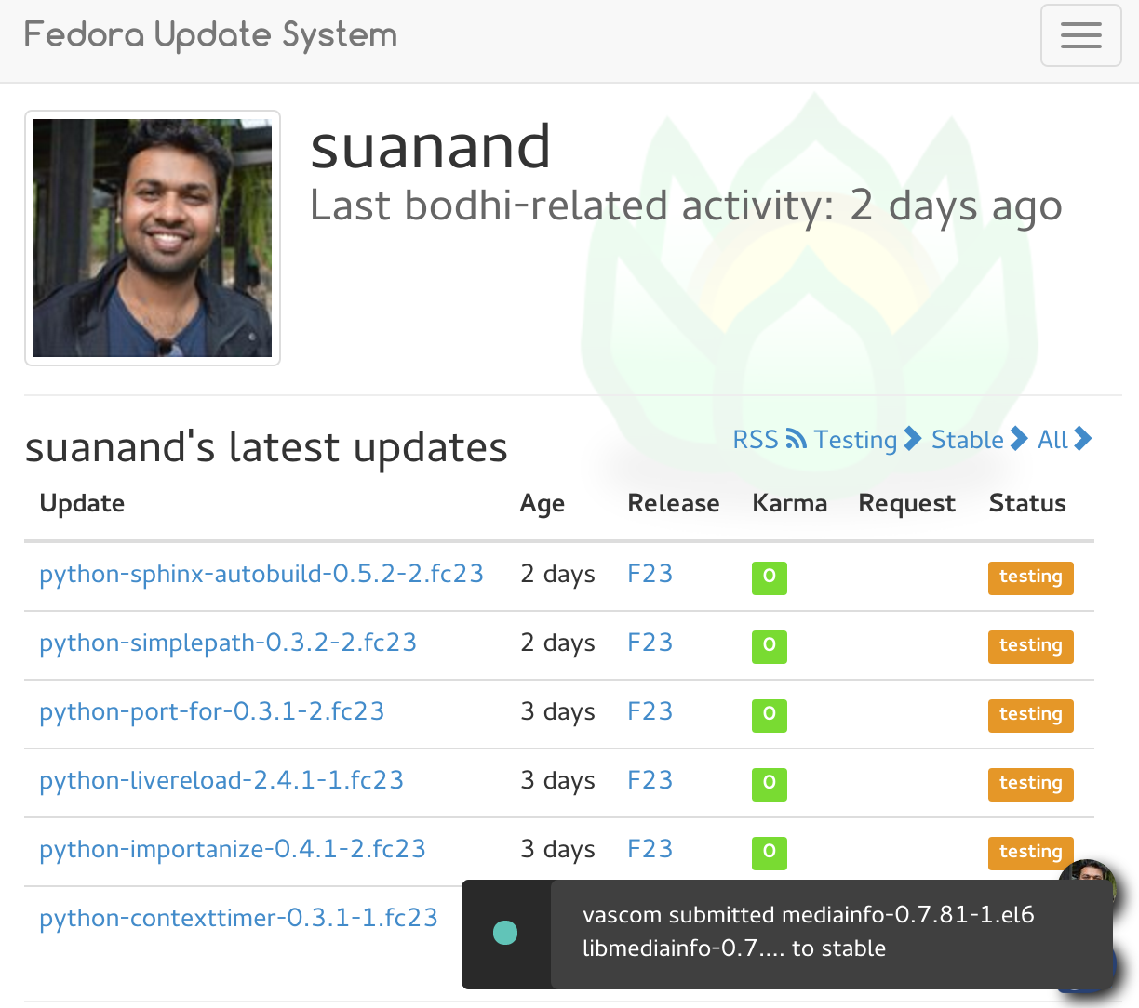
Bodhi2

Slide 7
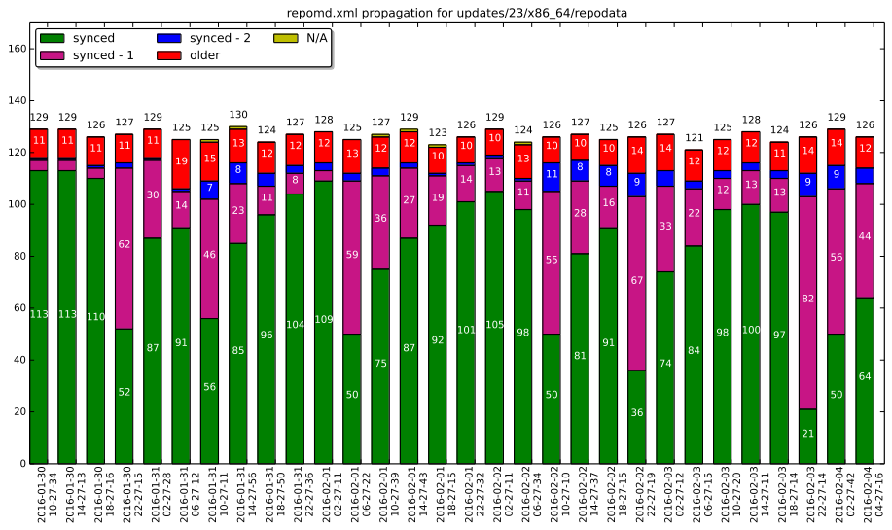
Mirrormanager2

Slide 8
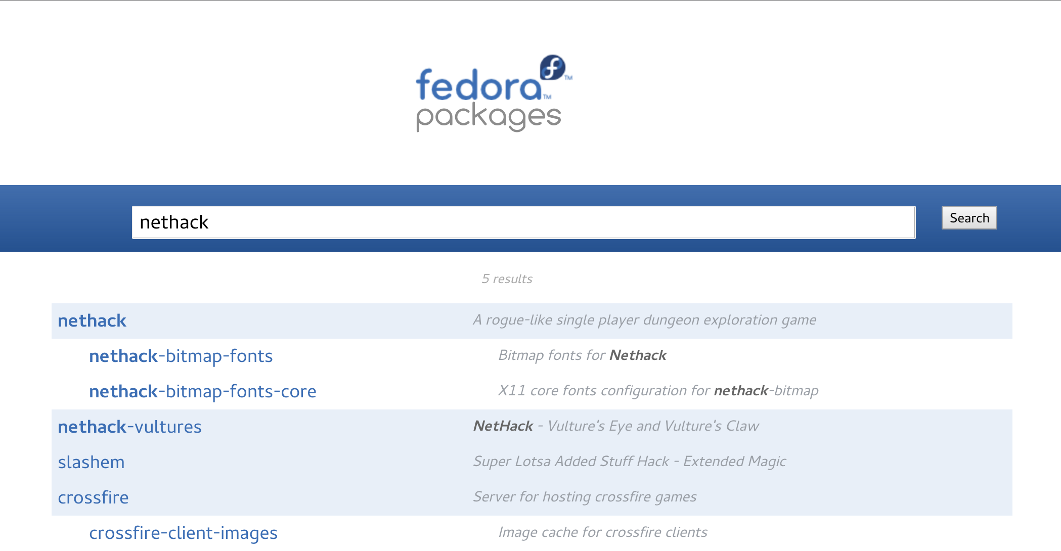
fedora-packages

Slide 9
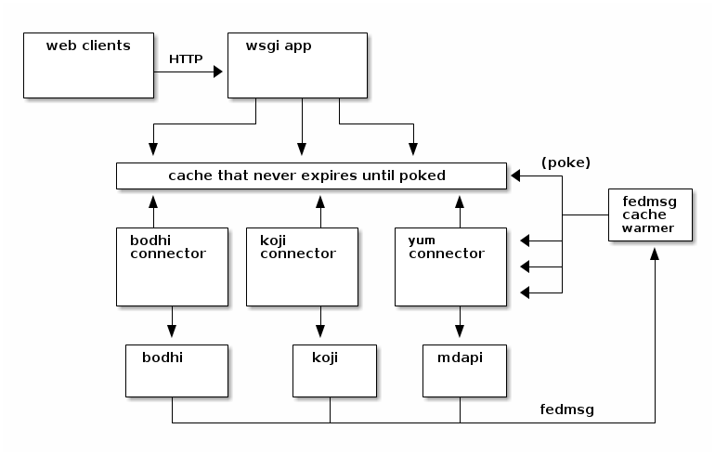
fedora-packages

Slide 10
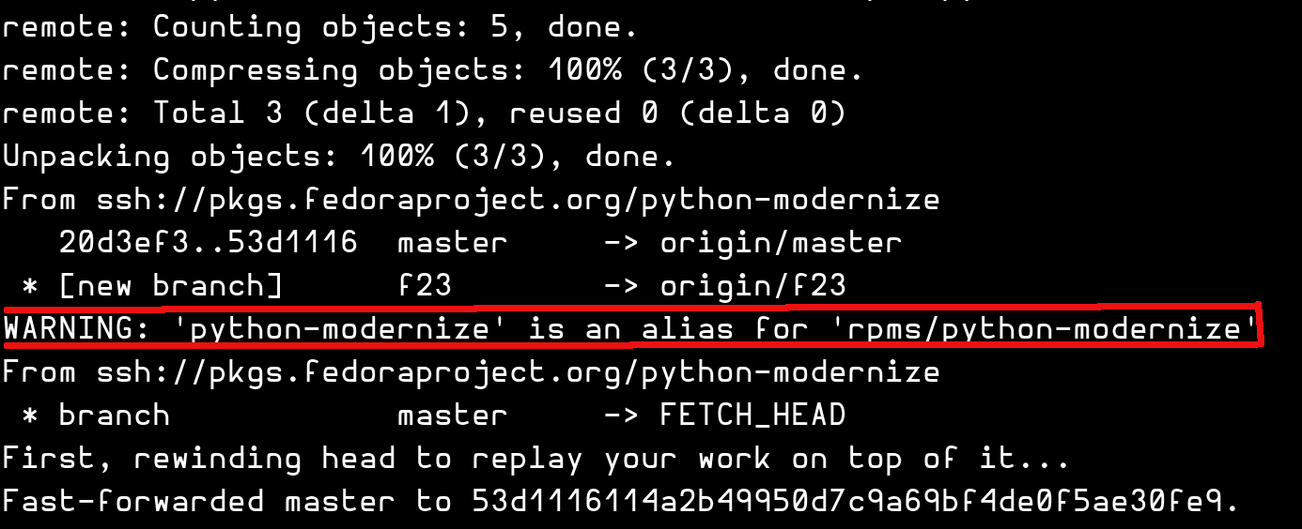
pkgdb2/dist-git

Slide 11
New
Services

Slide 12
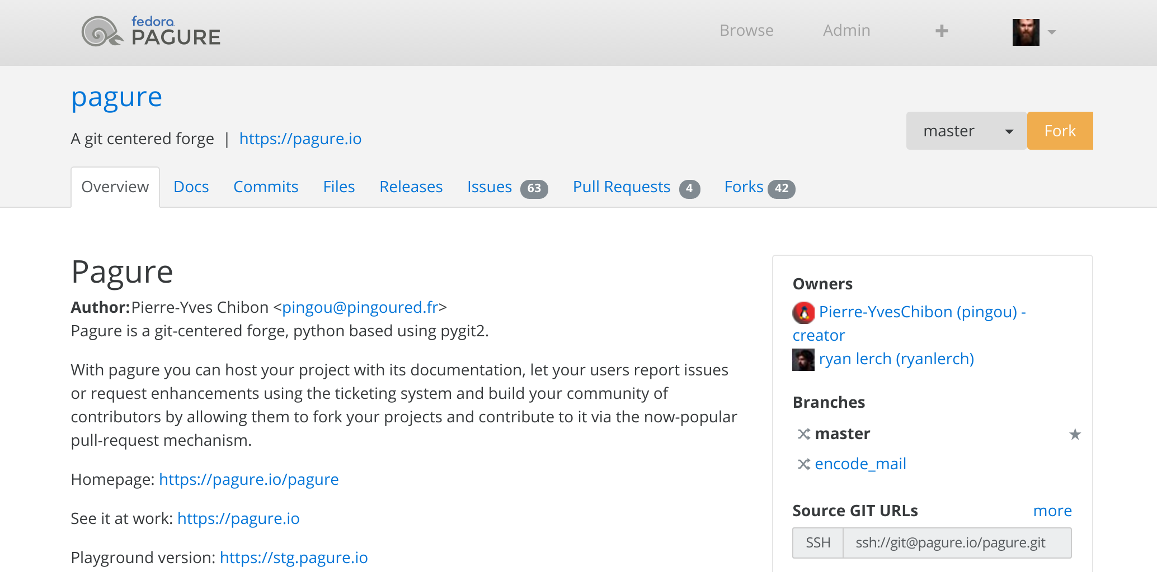
pagure

Slide 13
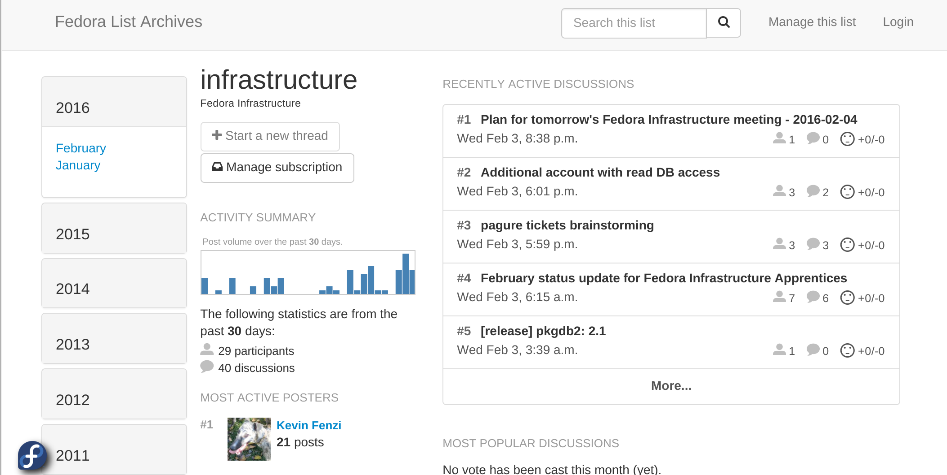
hyperkitty

Slide 14
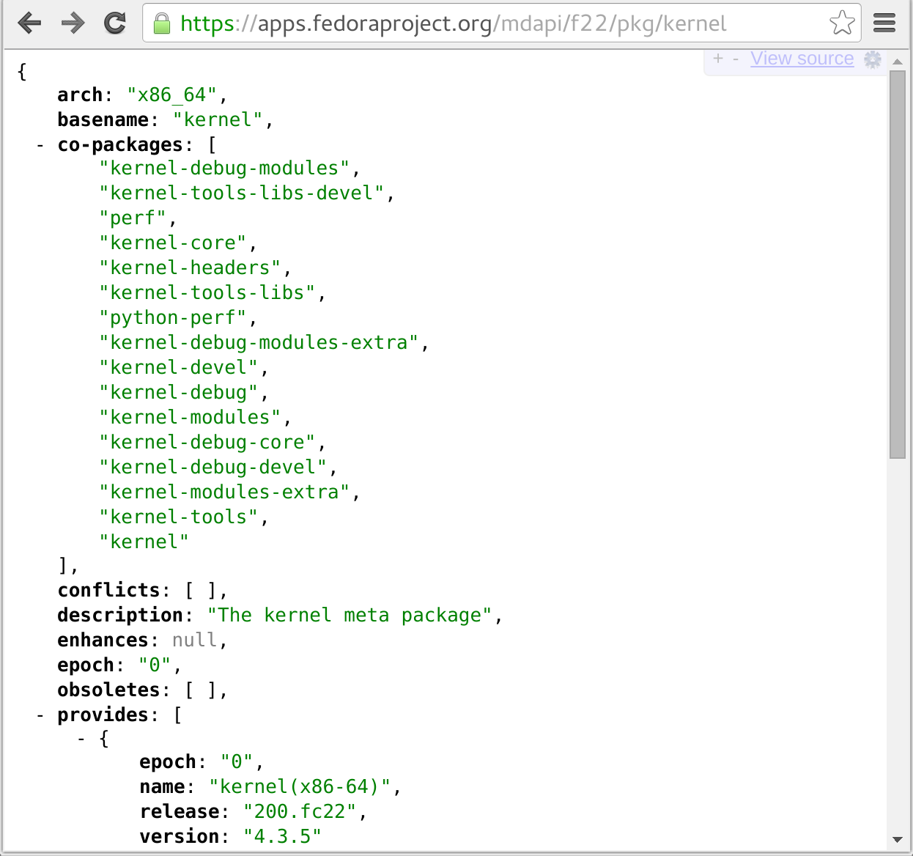
mdapi

Slide 15
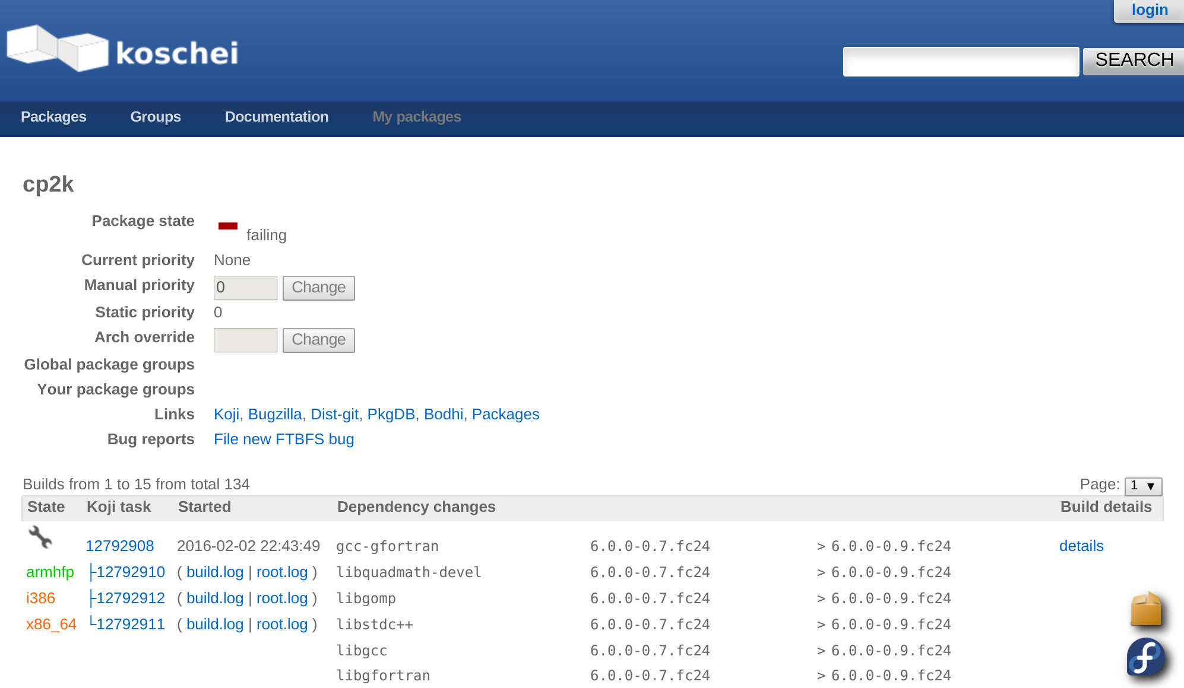
koschei

Slide 16
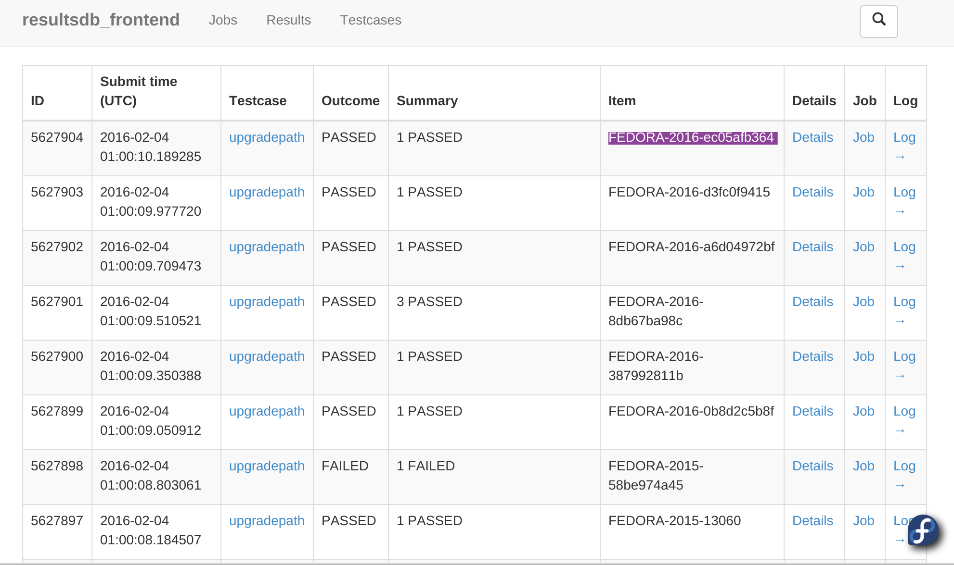
taskotron

Slide 17
Upcoming
Projects

Slide 18
Upcoming Projects
Monitoring Initiative
(dev|ops) tooling
Statistics and analysis
fedmsg expansion (bugzilla, zanata, ...)
Taskotron expansion (dist-git, ...)
Front-end unification
FAS3
Fedora-hubs

Slide 19
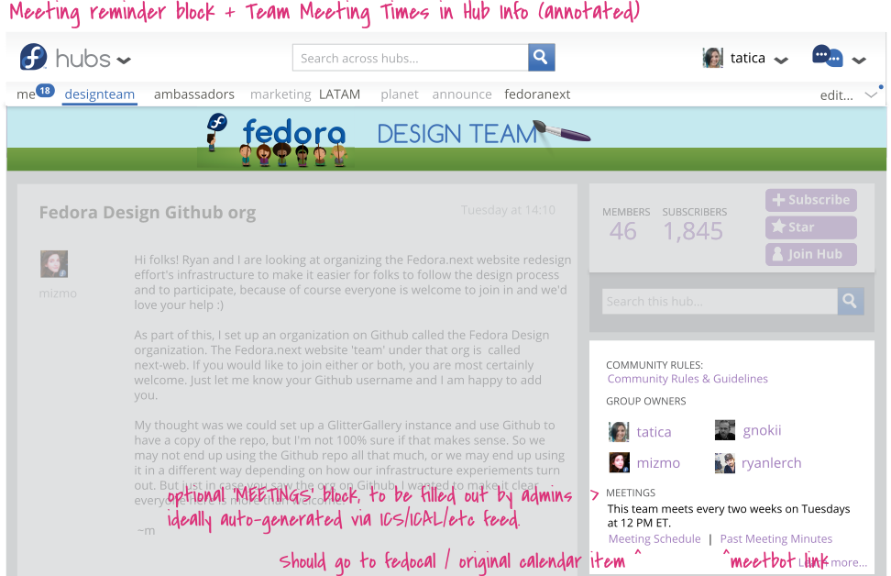
fedora-hubs

Slide 20
Release Engineering
Infrastructure

Slide 21
Thinking about Fedora
Where does the Operating System end and the Application begin?
What if those things weren't tightly coupled?
  Docker, Rocket(rkt), xdg-app, $other(?)
Examples:
  Android
  iOS
  FirefoxOS
  ChromeOS

Slide 22
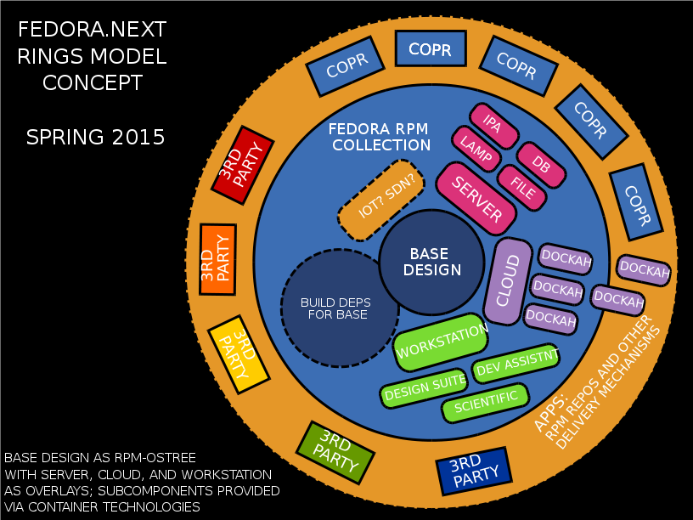
Fedora Rings!

Slide 23
Fedora Modularization!
Addressing use cases of different types of Fedora Users:
  Wish to primarily run Fedora approved applications for the full lifecycle of a given release (or longer)
  Wish to primarily run 3rd party applications for the full lifecycle of a given release (or longer)
  Develop applications based on frameworks provided by Fedora but will ultimately be deployed to a server (i.e. web apps)
  Develop applications based on frameworks provided by Fedora which will be deployed on desktops (e.g. gnome-boxes)
  Develop components of Fedora itself or the frameworks Fedora provides (e.g. kernel, apache, python)

Slide 24
Modularization and RelEng
What does Modularization mean to RelEng?
  We need to be able to adapt more rapidly for build artifact delivery (things change faster than they used to).
  Still need to make sure the Operating System doesn't turn into the wild west.
    Rel-Eng criteria still need to be met
      Reproducable
      Auditable
      Definable
      Deliverable

Slide 25
Tooling
Today

Slide 26
Today (and yesteryday)
Koji
  RPM-centric
  ImageFactory Integration
  LiveCD Creator
Pungi
Lorax
Bodhi
Wild West: COPR

Slide 27
Tooling
Tomorrow

Slide 28
Tomorrow
(Kind of Today too … we're getting there)
Koji 2.0
  Content Generator Centric
    RPM Builds being a first class Content Generator
  Live Media Creator
  Secondard Arches in mainline Koji
Pungi4 (Might go away? Maybe???)
Layered Image Builds for Containers
Fedora Atomic Two Week Releases
Wild West: COPR/DOPR/$Other?

Slide 29
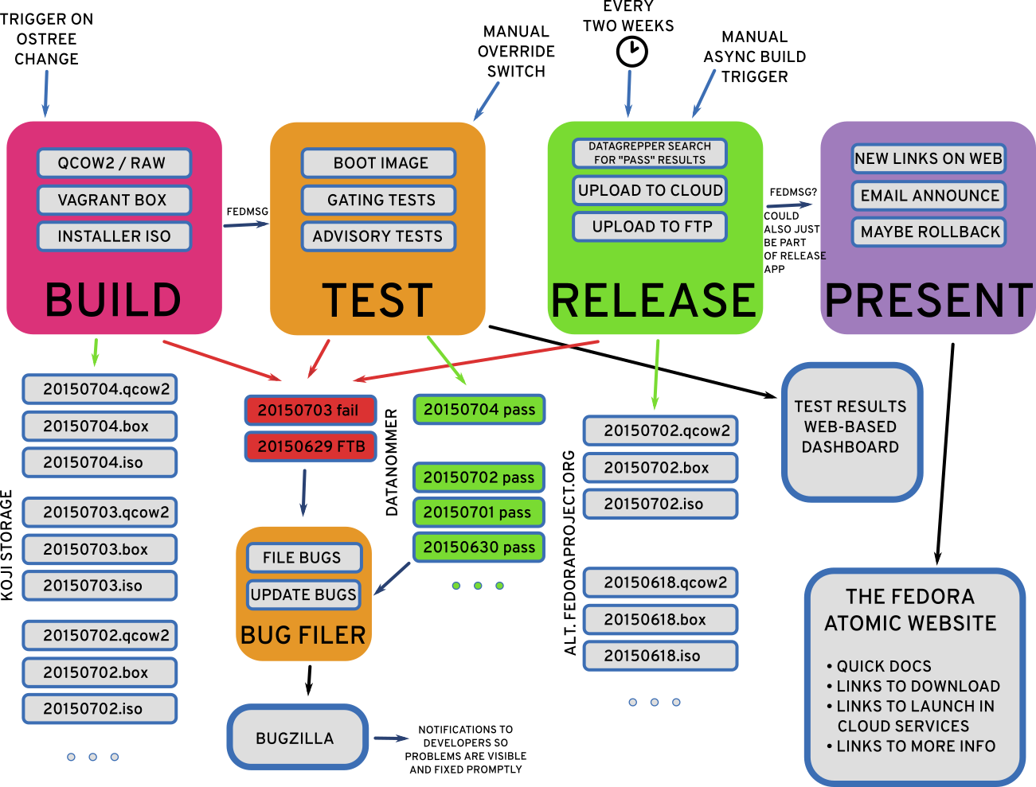
Atomic Two-Week Releases

Slide 30
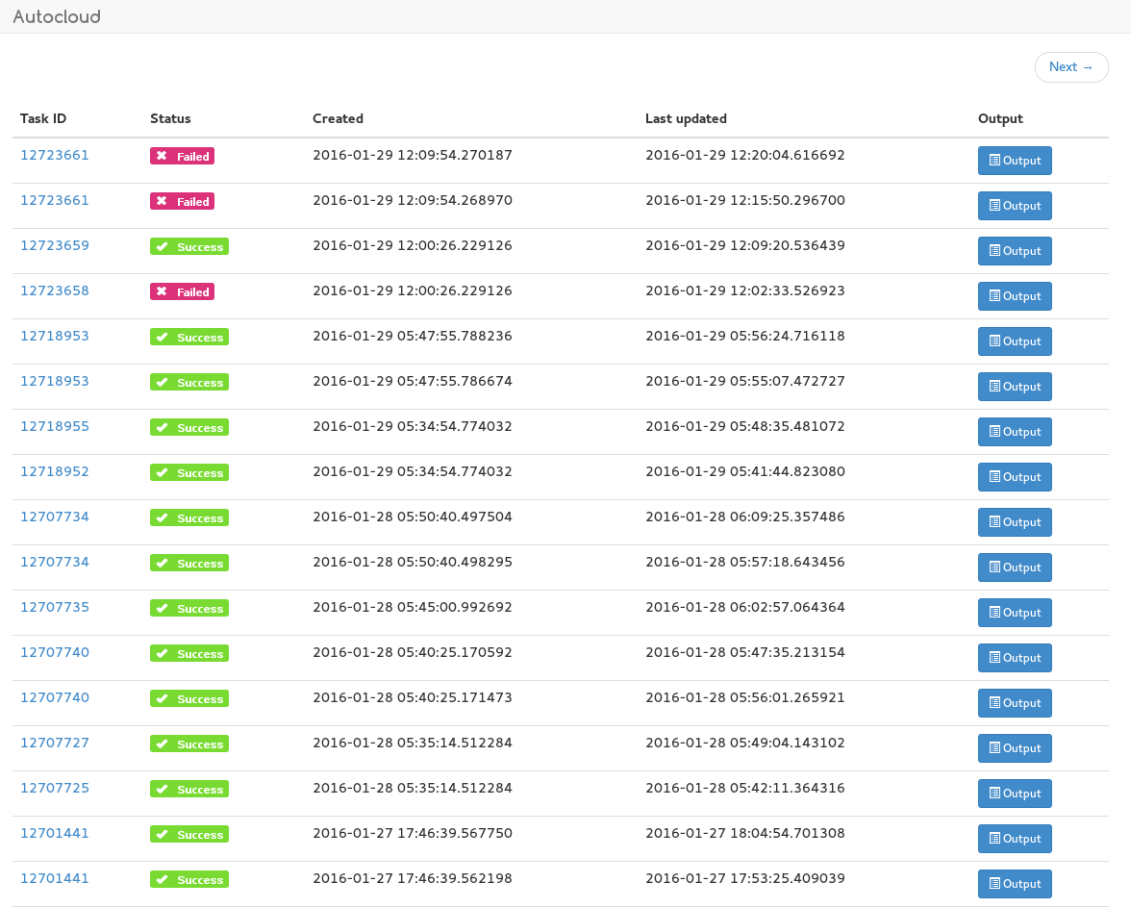
AutoCloud

Slide 31
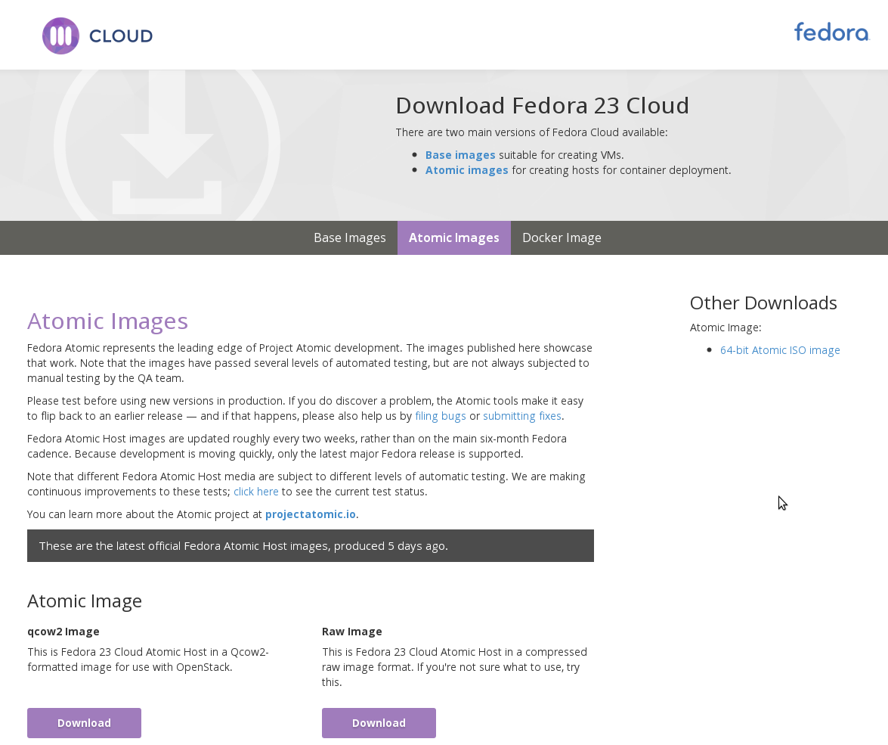
Atomic Two-Week Releases

Slide 32
Product Definition Center
Repository and API for storing/querying “product” metadata
  Product = Fedora Workstation, Server, Cloud
Single source of truth
  Data used to be all over the place
  pdc-updater brings all the data together

Slide 33
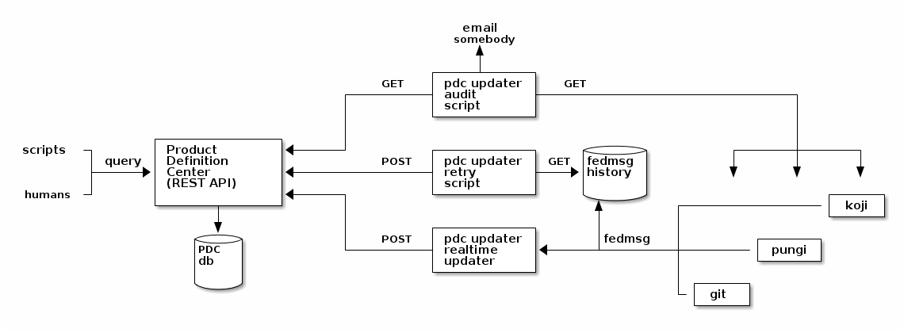
pdc-updater

Slide 34
Docker Layered Images
Powered by:
  OpenShift Build Service
  Koji ContainerBuild Plugin
Most of this had to be rewritten or overhauled since the introduction of Docker Registry Format V2
  (docker-distribution)
OSBS and ContainerBuild Upstreams Rock!
Pulp Integration

Slide 35
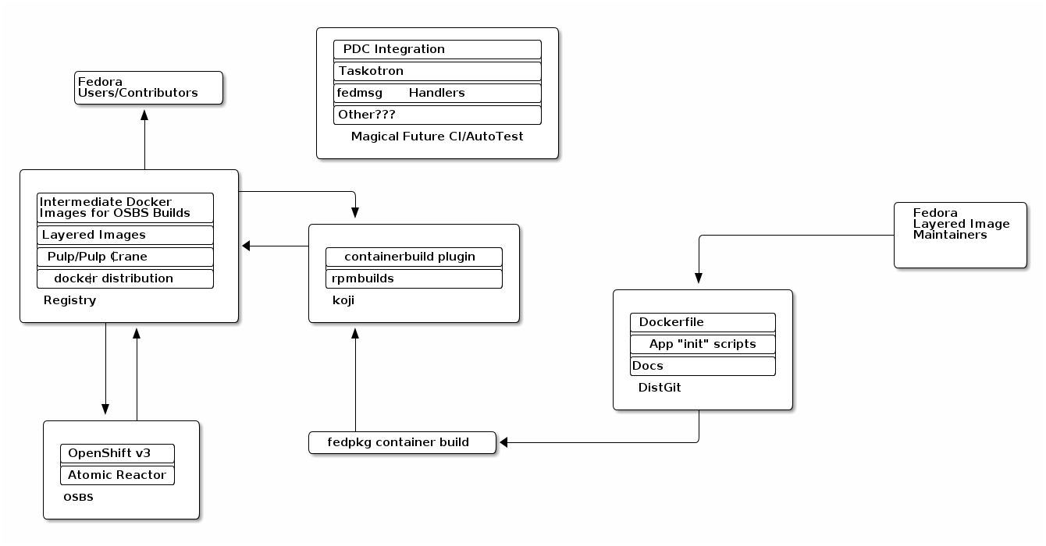
Layered Image Build Service

Slide 36
What's Next?
Containers
  Supporting alternate container formats
    Rocket (rkt)
    runC
    Freight agent
Workstation based on ProjectAtomic tech
Nulecule Apps
  Multi-Container
$NewHotness?

Slide 37
Questions?
CONTACT:
@TheMaxamillion maxamillion@fedoraproject.org
@ralphbean ralph@fedoraproject.org
Licensed CC-by-SA. A good thing.

