Slide 1
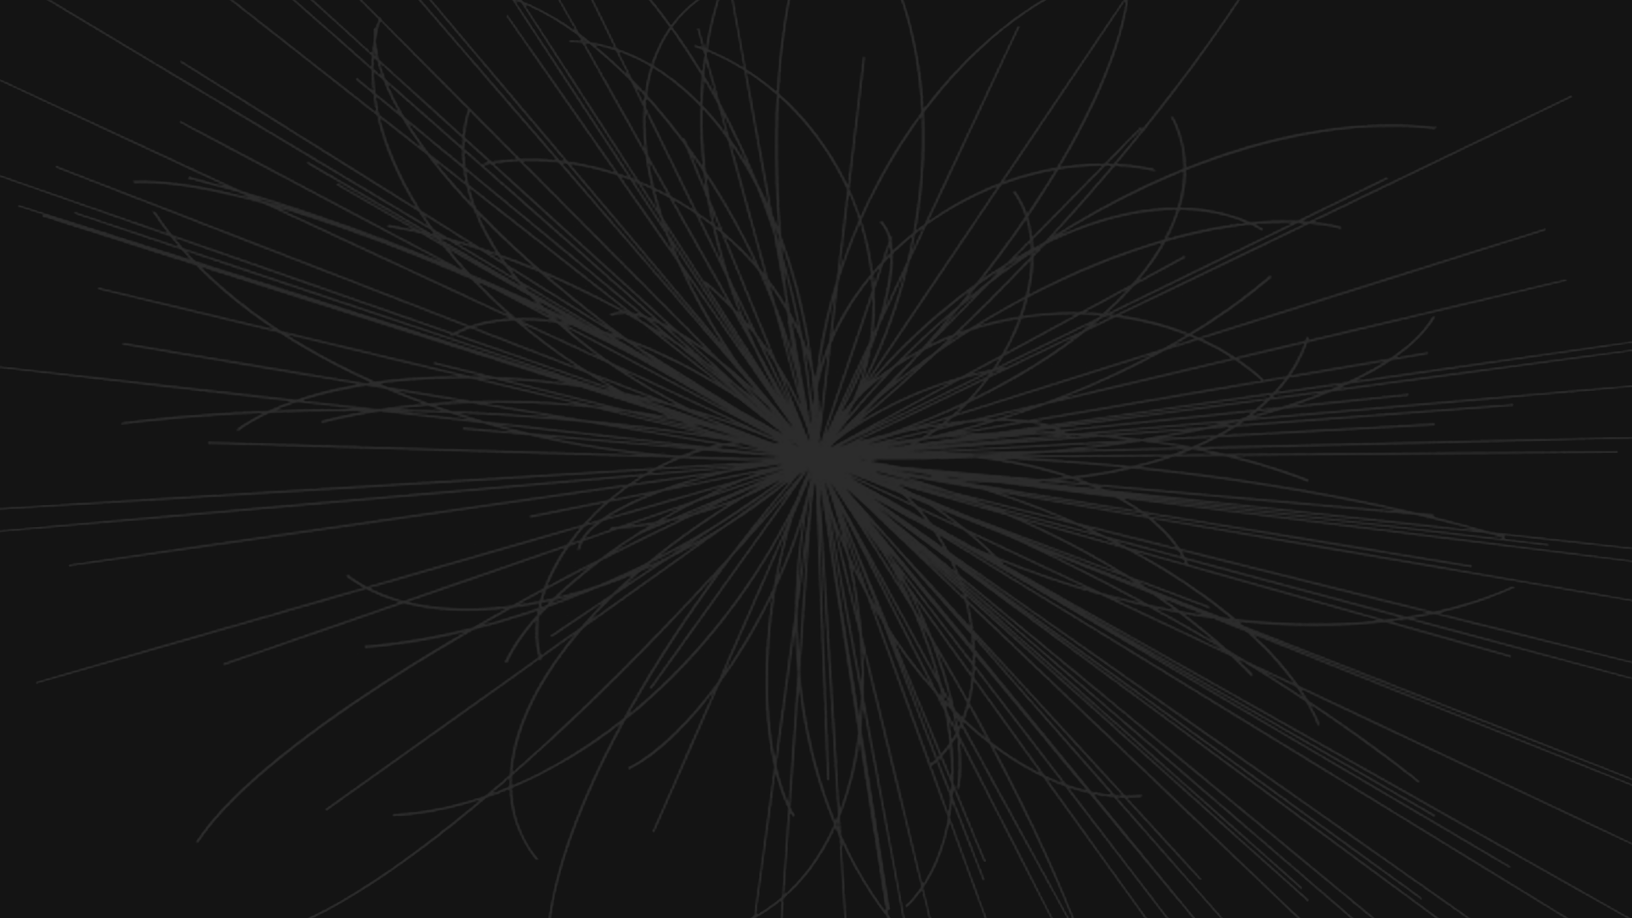
Primary Vertex Identification
Ralph Razzouk
https://github.com/ralphrazzouk/pvid

Slide 2

Proton Bunch Crossing

Slide 3
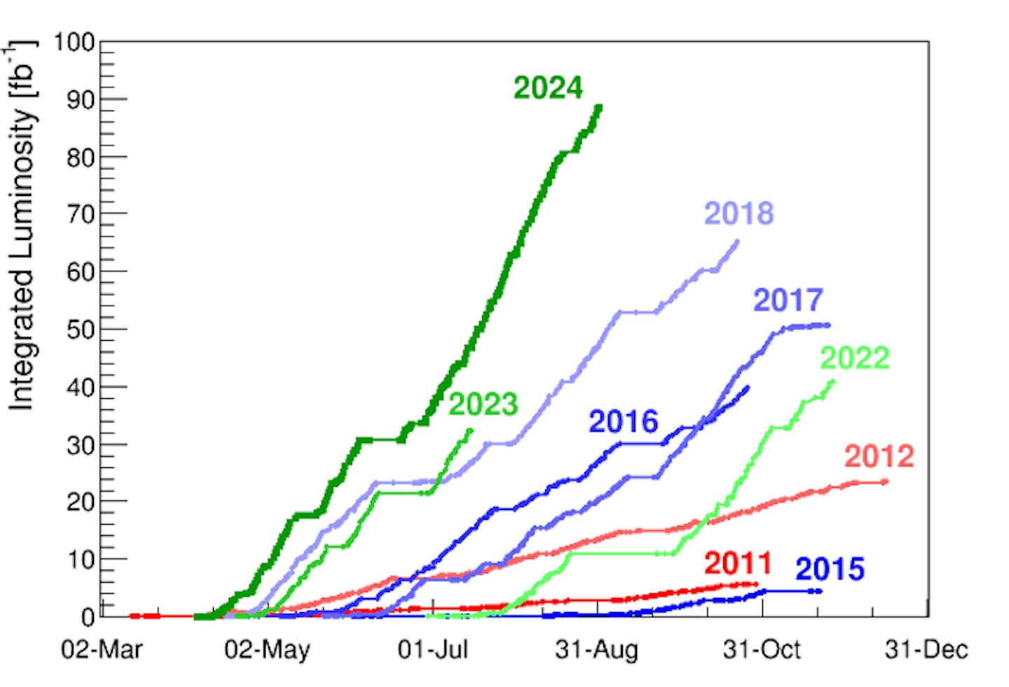
Challenges
Luminosity Overload:
More data is taken per second (instantaneous luminosity) and more data is taken overall (integrated luminosity).
Pile-up Effects:
In high-luminosity collisions, multiple proton-proton interactions occur in the same bunch crossing, making it difficult to distinguish the hard-scatter vertex from pile-up vertices.
Track Association:
Tracks can be reconstructed wrong, have high uncertainties, be shared between multiple vertices, and can come from secondary vertices.
Resolution:
Detector resolution limits tracking and impact parameter measurements have uncertainties.
Overview of integrated luminosity as a function of the date for each year of LHC running.
Notes:
Luminosity Overload:
Reconstruction algorithms will need to run over significantly more data to obtain faithful offline physics reconstruction.
Pile-up Effects:
The number of pile-up interactions can vary significantly between events. Vertices can be spatially close to each other, making separation challenging.
Resolution:
The track reconstruction efficiency varies with transverse momentum (pt), pseudorapidity (eta), detector regions, and pile-up conditions.
Traditional algorithmic approaches include
Deterministic clustering
Adaptive vertex fitting
Sequential vertex finding
The problems faced in traditional methods are
$𝒪$(N ³) scaling with number of tracks
Processing time increases dramatically with pile-up
Resource-intensive during high-luminosity runs

Slide 4
Definitions
A track is the trajectory of electrically charged particles in a particle detector (tracker).
An interaction point is the place where particles collide in an accelerator experiment.
A nominal interaction point is the design position for the collision.
A primary vertex (PV) is the reconstructed location of an individual particle collision.
A secondary vertex is a vertex outside the beam profile in a collider experiment or outside the target region a fixed-target experiment.
Vertex finding is the search for clusters of tracks that originate at the same point in space. It is the process of dividing all or a subset of the reconstructed tracks in an event into classes such that all tracks in a class are produced at the same vertex.
Vertex fitting is the determination the vertex position assuming it is formed by a given set of tracks. The goodness of fit may be used to accept or discard a vertex hypothesis.
Notes:
A secondary vertex is also called a displaced vertex.

Slide 5
Vertexing
In the LHC experiments CMS and ATLAS, there are many primary vertices in each event because in each bunch crossing many collisions may and do occur. As a rule, however, at most one of these primary vertices is of interest to the subsequent analysis; this is called the signal vertex.
Roughly 10% of the overall time of the reconstruction time is vertexing. Primary vertex reconstruction at CMS is done in three steps:
Track selection: preparing inputs
Clustering: grouping nearby tracks into sets of vertex candidates
Fitting: obtaining properties of the vertices themselves

Slide 6
Clustering
For PV reconstruction, all reconstructed tracks in the detector are filtered on a small set of quality criteria: amount of pixel/tracker hits, consistency in the transverse plane, etc.
z
z_{k}
They are then reduced to their positions at the point of closest approach to the beam z_{i}, with their uncertainties $σ$_{i} .
We then perform hard clustering, which is assigning each track to a given vertex candidate (cluster). This requires finding the number of vertices K, their positions z_{k}, and the track-vertex assignment P_{ik} = 0, 1. Thus, we have the following quantity to optimize
Notes:
Issues:
- The non-fixed nature of K means that the number of vertex candidates needs to be extracted from the data.
Any clustering needs to avoid local minima, stable solutions far from optimal settings, i.e. one cluster candidate per input track would be optimal but very much unphysical.

Slide 7
Deterministic Annealing
The hard assignment of vertices to clusters becomes a fuzzy one, i.e. P_{ik} $≠$ 0, 1. Additionally, a term is added to the minimization acting as an entropy regulated by a temperature T.
The idea is that, for high T, the assignment becomes fuzzier which leads to overall broader clusters, and for low T, the opposite is true.
Known solutions for deterministic annealing exist. This is one solution, done specifically for vertex finding at CMS.
We will use deterministic annealing to compare our machine learning model to. The algorithm we will use is a modified version of Jung’s research group’s deterministic annealer.

Slide 8
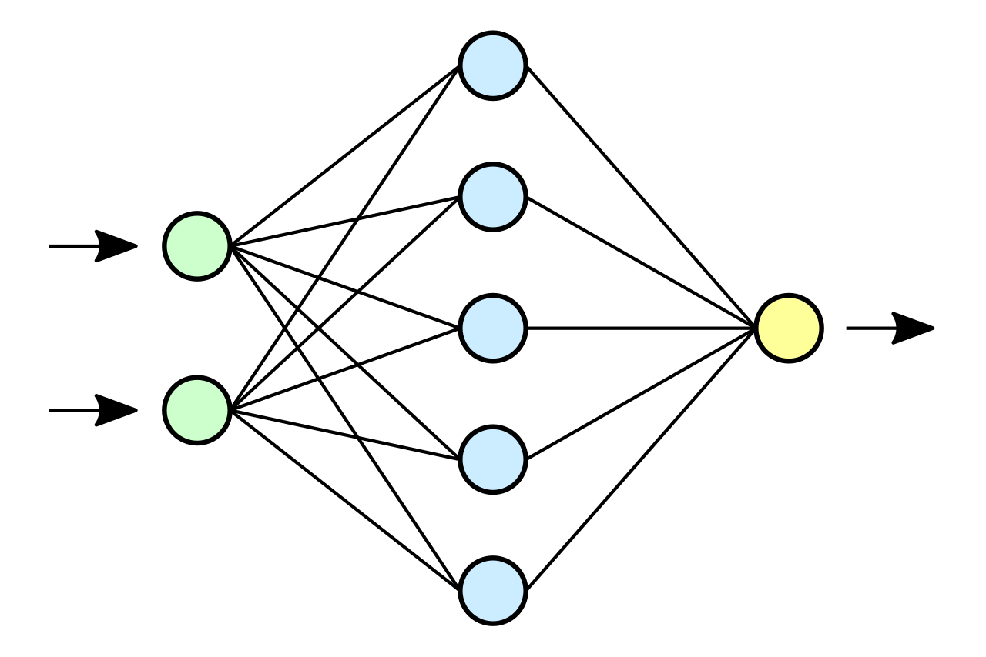
Solution
Goal: Correctly identify primary vertices given a multitude of track data.
Tracking
Clustering
Predict
Interpret
Truth
Training
Validation
Notes:
Kernel generation after tracking refers to the process of creating a set of mathematical functions, called kernels, that can be used to represent the probability distribution of particle tracks.
The first step is to reconstruct the trajectories of particles produced in the collision using the detector measurements. This is typically done using tracking algorithms that group the individual hits in the detector into coherent tracks.
Once the particle tracks have been reconstructed, the next step is to generate kernel functions that can be used to represent the probability distribution of each track. Kernel functions are mathematical functions that are centered around a specific point (in this case, the particle track) and have a certain shape that describes the probability distribution of the track. Common kernel functions used in particle physics include Gaussian kernels, Lorentzian kernels, and spline-based kernels.
The kernel functions are characterized by a set of parameters that describe their shape and position. These parameters are typically determined by fitting the kernel function to the observed track data, taking into account factors such as the detector resolution, multiple scattering, and energy loss.
The final step is to represent the particle tracks using the generated kernels. This can be done by superimposing the individual kernel functions for each track, creating a continuous probability distribution that represents the overall particle distribution in the detector.

Slide 9
Data
Dataset: Simulated data based on real CMS data.
Set 0: 2 - 8 vertices, 2 - 8 tracks/vertex, 1000 samples => 49K files, 225K vertices, 1.225M tracks
Set 1: 60 vertices, 10 tracks/vertex, 1000 samples => 1K files, 60K vertices, 600K tracks
Type: JSON files
Content:
The units of the values generated vary in [0, 1], representing
the position along the interaction region. (16cm)
There are an nVertices number of vertices and an nTracksMax
number of tracks per vertex. Of each combination, there are
a numTests number of samples of the same vertex-track
configuration
[
[
0.3890621143514948, # VERTEX 1
[
[0.38958803179084517, 0.0005833333333333333], # TRACK 1
[0.38945167355474497, 0.0009166666666666668], # TRACK 2
… # up to nTracksMax
]
],
[
0.5263957603055316, # VERTEX 2
[
[0.5266540569579183, 0.0004166666666666667], # TRACK 1
[0.525512393968154, 0.0007500000000000001], # TRACK 2
… # up to nTracksMax
]
],
… # repeated nVertices times
]
[
vertex_position,
[
[track_z0, track_dz0_normalized],
[track_z0, track_dz0_normalized],
]
]

Slide 10
Model (1)
Type: Graph Neural Network (GNN)
Package: PyTorch
Benchmark: Deterministic annealing
Reason: natural physics representation since tracks and vertices naturally form a graph structure, preserves spatial and geometric relationships, and rotational invariance can be implemented later.
Input
Nodes: Track parameters [z0, dz0_normalized] (2 features per node)
Edges: Connections between tracks with features [distance, uncertainty product] (2 features per edge)
Graph: Fully connected – edges between all pairs of tracks within each vertex
Architecture
Initial Embedding: 2 layers of Linear + LayerNorm + GELU + Dropout. Input is configurable.
Graph Convolution: Multiple TrackConv layers (MLP + LayerNorm + GELU + Dropout + Residual Connection)
Global Pooling: Global mean pooling to aggregate node features
Final MLP head: 3 fully connected layers with decreasing width (hidden_dim -> 1)

Slide 11
Model (2)
Output
Single continuous value representing the predicted vertex position
Loss Functions
Primary Loss: Mean absolute error between predicted and true vertex positions
Physics Loss: Mean chi-square (z0 – vertex_pos)²/dz0² for tracks
Total Loss: primary_loss + 0.01 * physics_loss
Hyperparameter Optimization
After running a grid search based on the model defined, we found the following hyperparameters to be the best.
Hidden Dimensions: 256
Hidden Layers: 6
Epochs: 100
Batch Size: 64
Learning Rate: 10⁻⁵
Weight Decay: 10⁻⁵

Slide 12
Model Architecture
class TrackConv(MessagePassing):
"""Custom Graph Conv layer for track data."""
def __init__(self, in_channels: int, out_channels: int, dropout: float = 0.1):
"""
Initialize the track convolution layer.
Args:
in_channels: Number of input features
out_channels: Number of output features
"""
super().__init__(aggr='mean') # Mean aggregation
self.mlp = nn.Sequential(
nn.Linear(in_channels + 2, out_channels),
nn.LayerNorm(out_channels),
nn.GELU(),
nn.Dropout(dropout)
)
self.norm = nn.LayerNorm(out_channels)
def forward(self, x, edge_index, edge_attr):
residual = x
out = self.propagate(edge_index, x=x, edge_attr=edge_attr)
return self.norm(out + residual)
def message(self, x_j, edge_attr):
return self.mlp(torch.cat([x_j, edge_attr], dim=-1))

Slide 13
class VertexGNN(nn.Module):
def __init__(self, node_features: int = 2, hidden_dim: int = 64, num_layers: int = 3, dropout: float = 0.1):
super().__init__()
# Initial node embedding
self.node_embed = nn.Sequential(
nn.Linear(node_features, hidden_dim),
nn.LayerNorm(hidden_dim),
nn.GELU(),
nn.Dropout(dropout),
nn.Linear(hidden_dim, hidden_dim),
nn.LayerNorm(hidden_dim),
nn.GELU(),
nn.Dropout(dropout)
)
# Graph convolution layers
self.convs = nn.ModuleList([TrackConv(hidden_dim, hidden_dim) for _ in range(num_layers)])
# Layer norms for each conv layer
self.norms = nn.ModuleList([nn.LayerNorm(hidden_dim) for _ in range(num_layers)])
# Final MLP for vertex prediction
self.mlp = nn.Sequential(
nn.Linear(hidden_dim, hidden_dim),
nn.LayerNorm(hidden_dim),
nn.ReLU(),
nn.Dropout(dropout),
nn.Linear(hidden_dim, hidden_dim // 2),
nn.LayerNorm(hidden_dim // 2),
nn.ReLU(),
nn.Dropout(dropout),
nn.Linear(hidden_dim // 2, 1)
)

Slide 14
def forward(self, data):
x, edge_index, edge_attr, batch = data.x, data.edge_index, data.edge_attr, data.batch
# Initial node embedding
x = self.node_embed(x)
# Graph convolutions with residual connections
for conv, norm in zip(self.convs, self.norms):
x_new = norm(conv(x, edge_index, edge_attr))
x = x + x_new # Residual connection
# Global pooling
x = global_mean_pool(x, batch)
# Final MLP
vertex_pos = self.mlp(x)
return vertex_pos
def compute_physics_loss(self, out, data):
"""Compute physics-based loss using track parameters."""
z0 = data.x[:, 0] # Track z0 positions
dz0 = data.x[:, 1] # Track z0 uncertainties
# Convert output to match z0 dimensions
out = out.squeeze()
# Each track in data.batch maps to a vertex in out
vertex_pos_expanded = out[data.batch]
# Compute chi-square for each track
vertex_chi2 = ((z0 - vertex_pos_expanded) / dz0) ** 2
return vertex_chi2.mean()

Slide 15
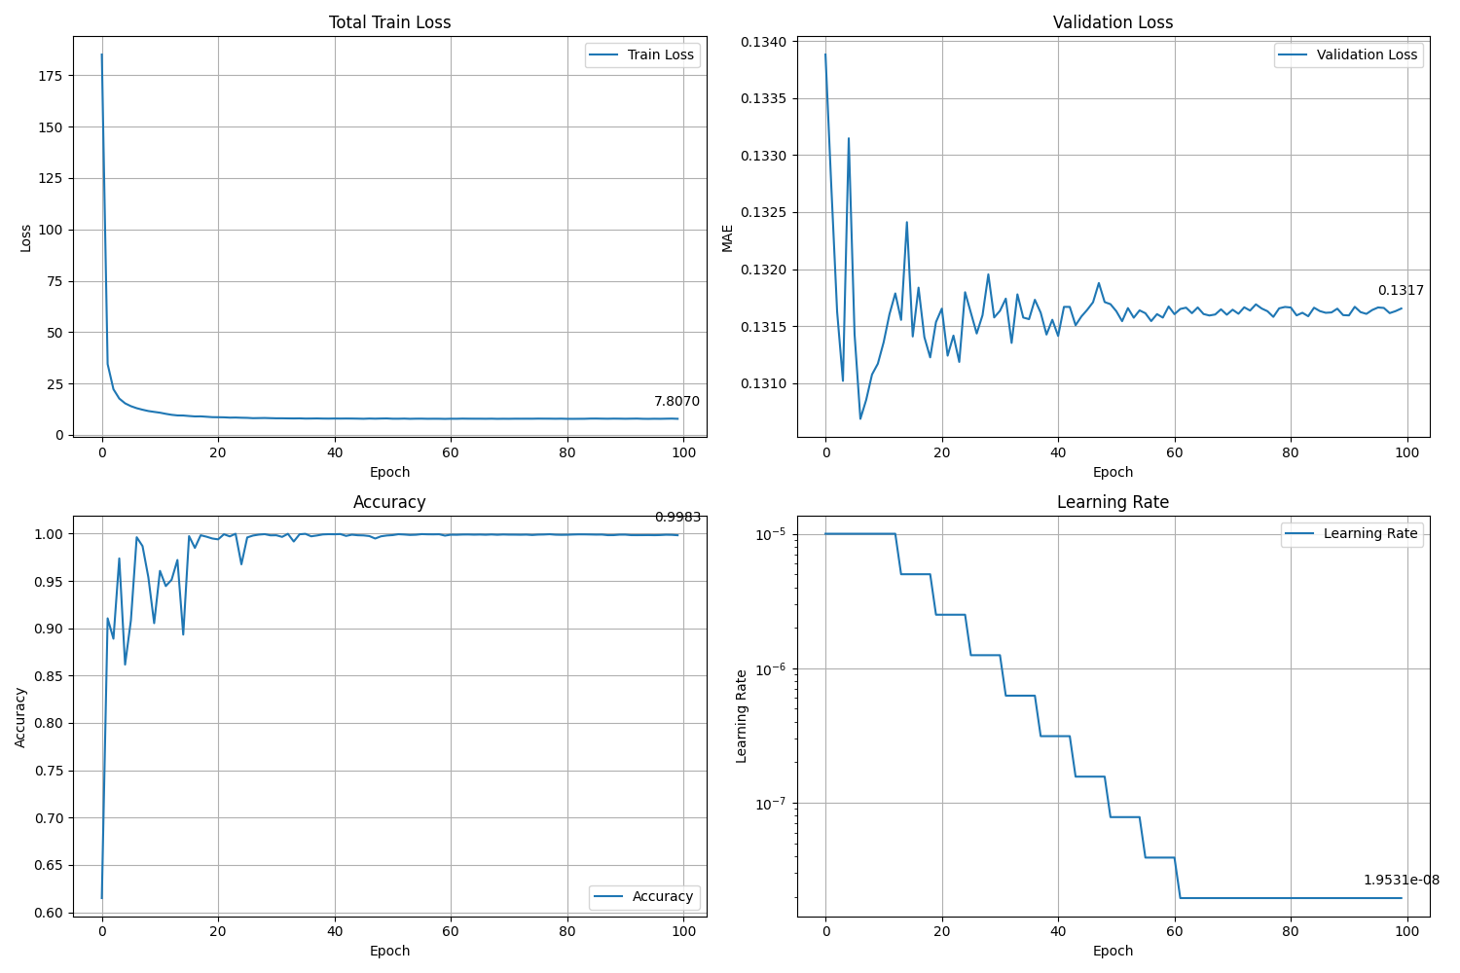
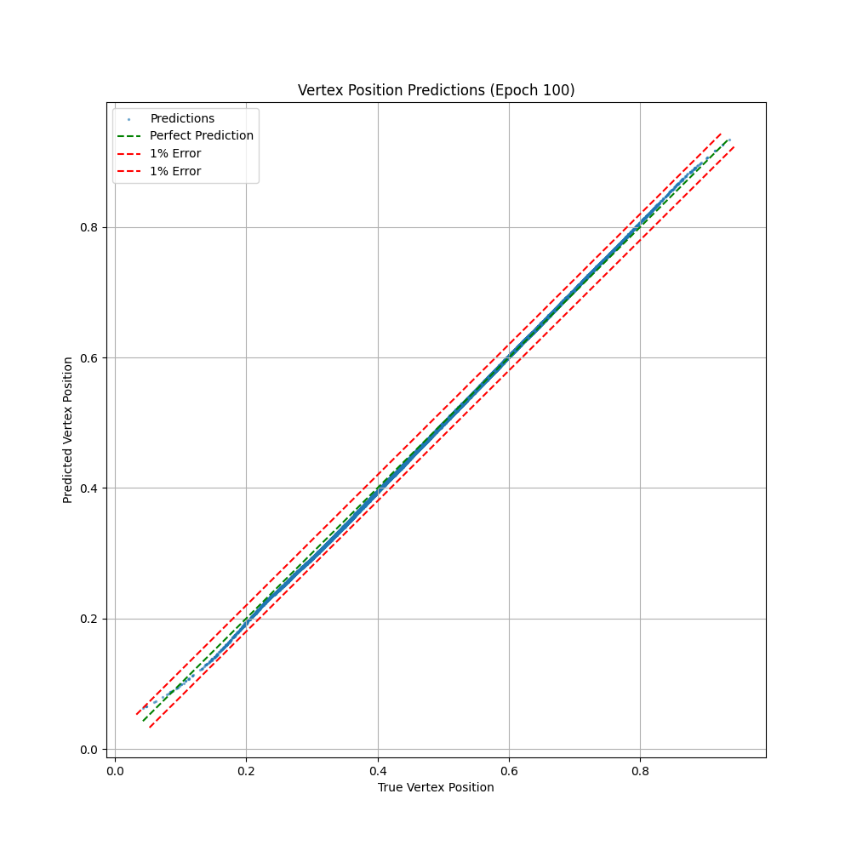
Training Metrics (1)
Trained on set0 which has an unrealistic (according to CMS) variation of vertices and tracks.
Training metrics for model training on unrealistic simulated data
Prediction scatter plot of performance

Slide 16
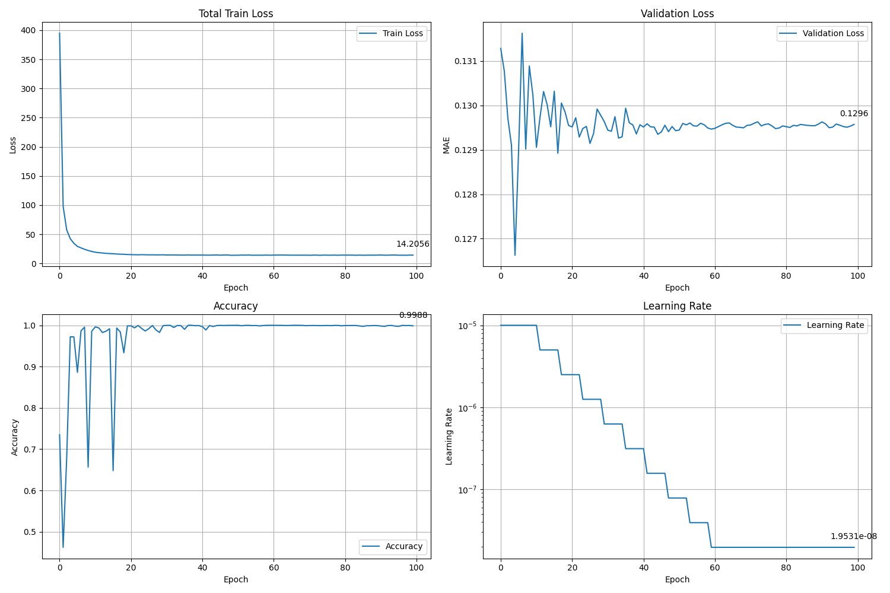
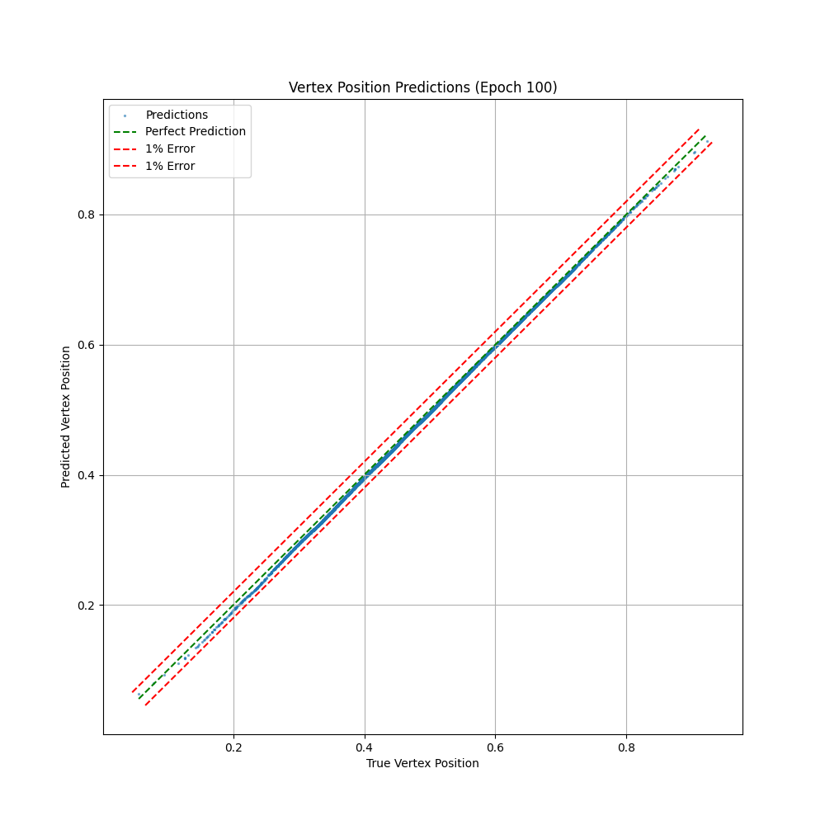
Training Metrics (2)
Trained on set1 which has a realistic variation of vertices and tracks.
Training metrics for model training on realistic simulated data
Prediction scatter plot of performance

Slide 17
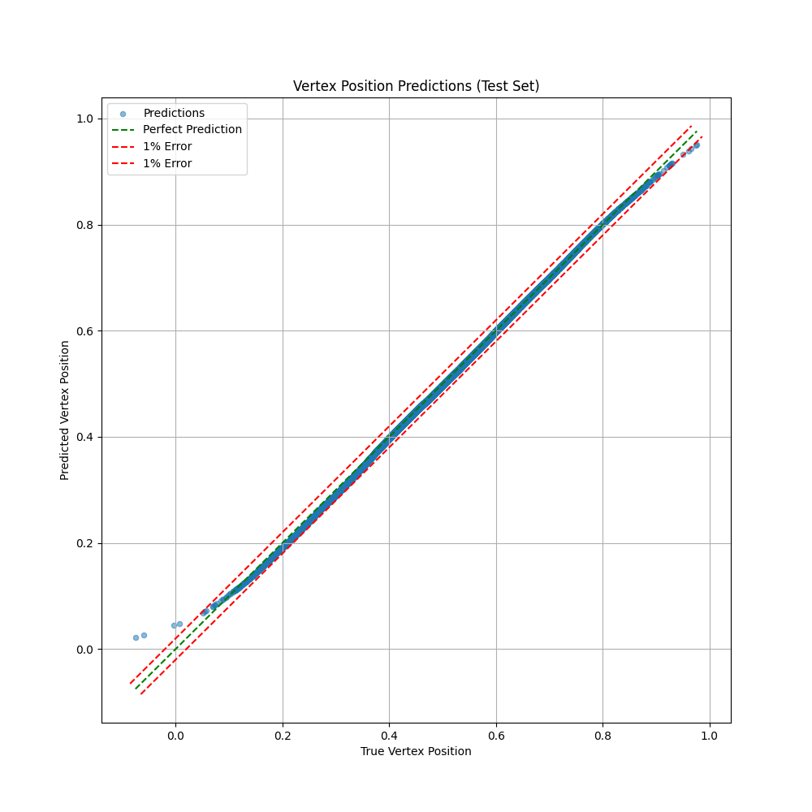
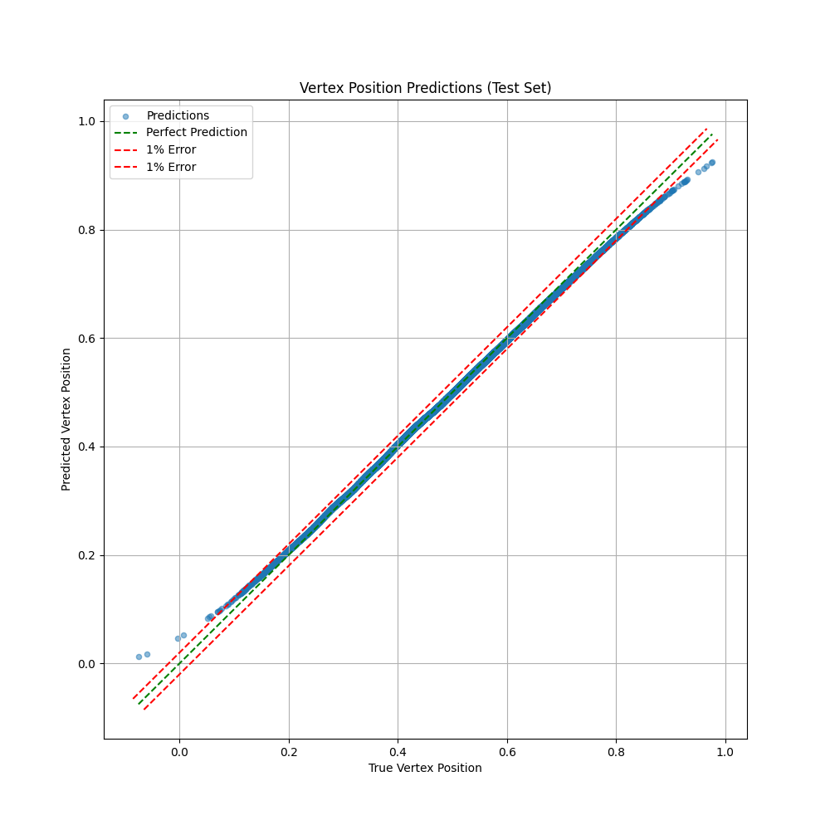
Testing Predictions
Average accuracy of 99.81% of
predictions are within 1% error.
Average accuracy of 97.25% of
predictions are within 1% error.

Slide 18
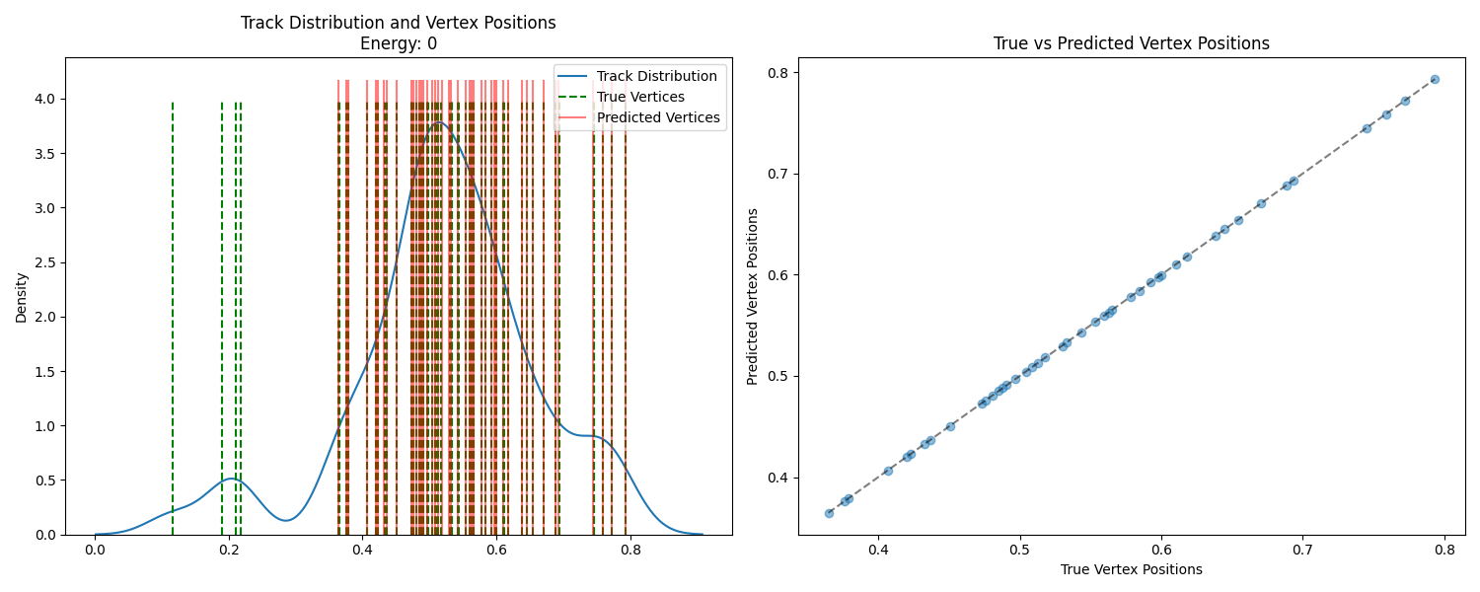
Comparison vs Deterministic Annealing
Accuracy: average of 97.25% of predictions are within 1% error.

Slide 19
Future Prospects
As we require more accuracy, the machine learning model falls off faster than the deterministic annealer. Hence, model architecture should be worked on for the next version of this model. From that, we can say that there definitely is more work to be done, and those approaches include:
Experimenting with different models, for e.g. transformer encoder to decoder structure
Use real data and fully incorporate real world data like pT, eta, phi, d0, z0, within uncertainties
Use quantum machine learning to be able to handle more data
Use quantum annealing to benchmark
Project Link: https://github.com/ralphrazzouk/pvid

Slide 20
References
[1] https://phys.org/news/2024-09-lhc-luminosity.html
[2] https://iopscience.iop.org/article/10.1088/1742-6596/110/9/092009/pdf
[3] https://www.slideserve.com/dbernal/vertex-and-track-reconstruction-in-cms-powerpoint-ppt-presentation
[4] https://opendata.cern.ch/
[5] https://www.lhc-closer.es/taking_a_closer_look_at_lhc/0.lhc_p_collisions
[6] Pattern Recognition, Tracking and Vertex Reconstruction in Particle Detectors by Rudolf Frühwirth and Are Strandlie
[7] https://www.youtube.com/watch?v=pLcVVwx4tcw
[8] https://indico.cern.ch/event/870237/

Slide 21


