Slide 1





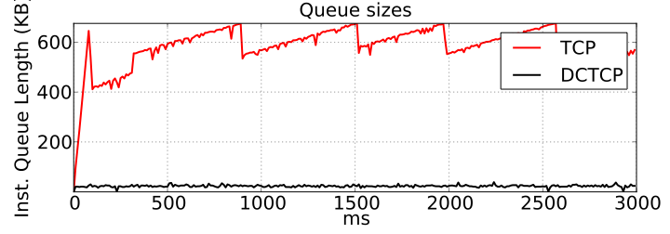
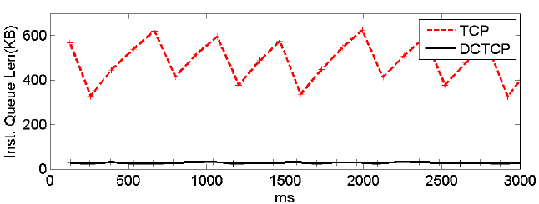
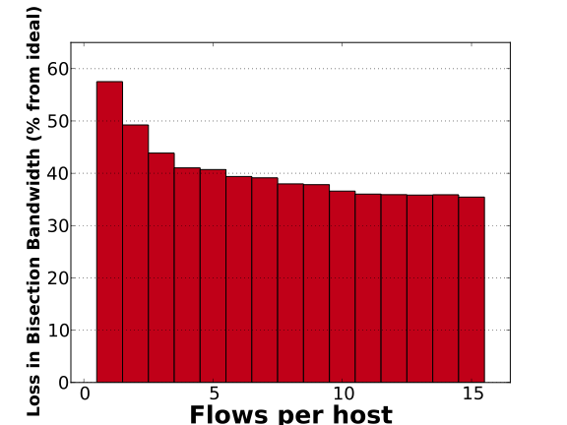
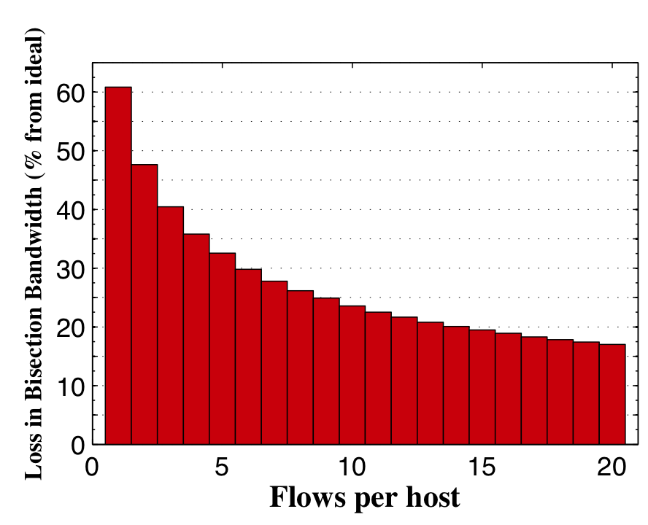
Mininet-HiFi: Rapid, High Fidelity SDN Prototyping
Nikhil Handigol*†, Brandon Heller*†, Vimal Jeyakumar*†, Bob Lantz*, Nick McKeown†
*Equal Contributors
†Stanford University
Problem
Software-Defined Networks (SDNs) create complex interactions between hosts, switches, and controllers. Testbeds may lack sufficient visibility for debugging; simulators may lack the desired code realism.
Solution
Mininet-HiFi is a container-based emulator that runs a complete network of hosts, switches, and controllers on a single PC. It provides performance fidelity by adding resource-isolation mechanisms.
Mininet-HiFi enables a rapid-prototyping workflow for building SDNs:
Prototype
Interactively build, debug using Mininet-HiFi
Analyze
Measure realistic performance metrics
Deploy
Run native, or in a slice of a production network
Share
Package the network as a complete, runnable VM
SDN 3
SDN 2
SDN 1
Mininet-HiFi runs networks on a single PC, using lightweight OS virtualization:
Resource
Mechanism
Controller
Switches
Links
Hosts
Unmodified NOX, Beacon, etc.
=
Open vSwitch instances
Rate-limited virtual Ethernet pairs
Unmodified apps in CPU-limited process groups
To the controller, each virtual resource appears identical to its corresponding physical one.
Mininet-HiFi provides the realism to reproduce published results:
Test 1: DCTCP
Mininet
Data-Center TCP, or DCTCP, modifies TCP’s congestion control algorithm to reduce latency and buffer usage. The topology is a simple 2-into-1 fork, and we measure buffer sizes.
TCP (large sawtooth buffer)
Hardware
DCTCP (small buffer)
TCP (large sawtooth buffer)
DCTCP (small buffer)
Mininet-HiFi
from DCTCP paper [SIGCOMM 2010]
Test 2: Multipath Routing
Mininet-HiFi
Flows are commonly spread across paths in a data center using ECMP, but in Fat Trees, hash collisions reduce the effective bandwidth. This test shows the bisection bandwidth loss for varying traffic dispersions.
from Hedera paper [NSDI 2010]

