Slide 1




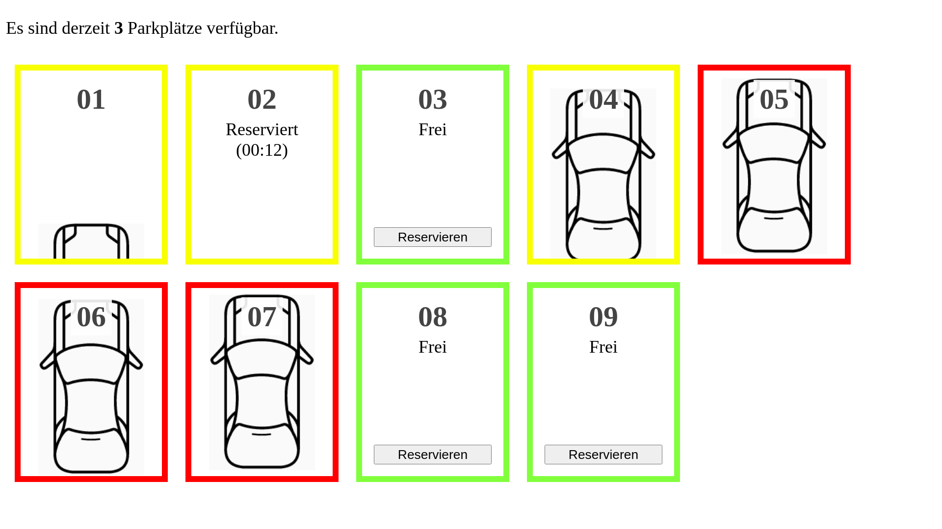

state
distance, state
distance, state
state
MQTT Broker
PS
WS

