Slide 1
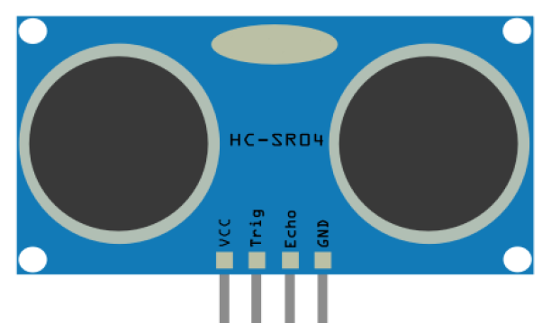
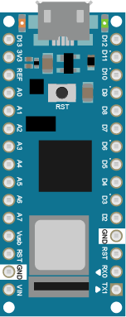
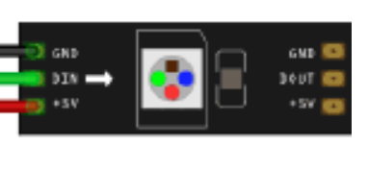
Arduino Nano 33 IoT
Ultraschall Sensor
LED Strip 8x
GND
3V3

Slide 2
Quellen
Arduino Nano: https://itp.nyu.edu/physcomp/wp-content/uploads/Nano_33_IoT.png
Ultraschall Sensor: SEN-US01-Anleitung.pdf (Material Ordner)
LED: https://learn.adafruit.com/assets/18619

