Slide 1




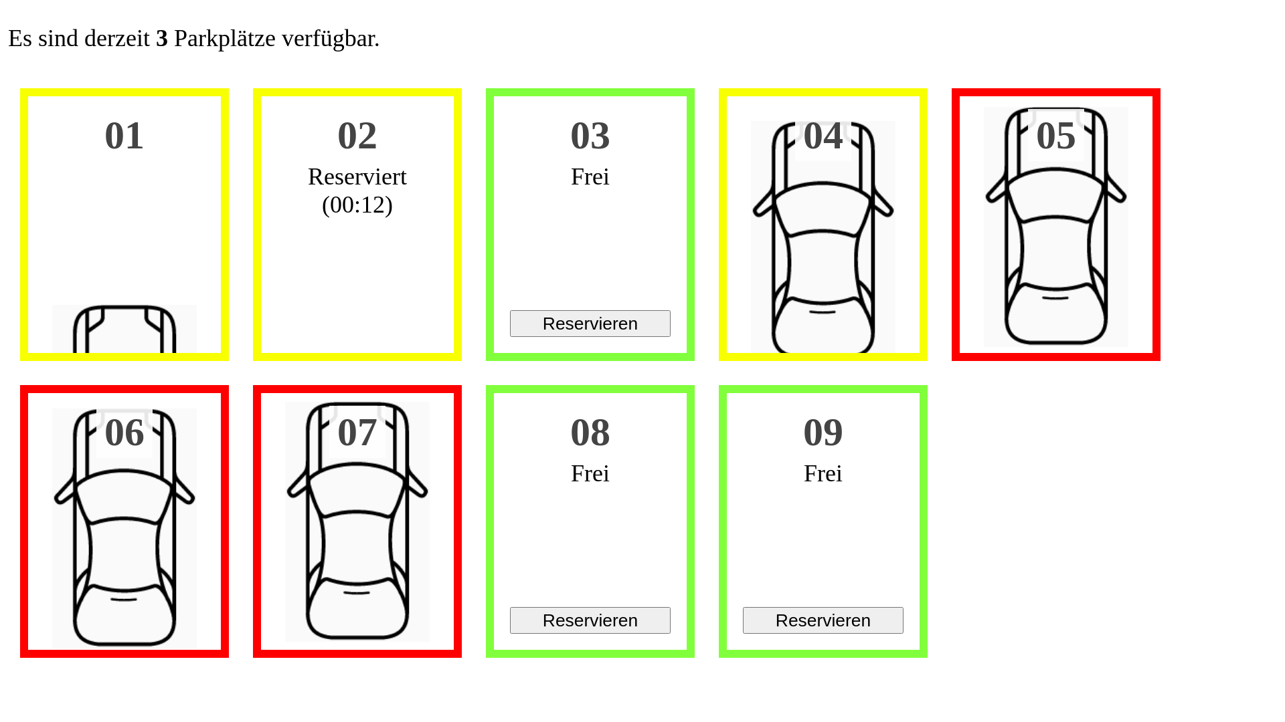

state
distance, state
distance, state
state
PS
MQTT Broker
WS

