Slide 1
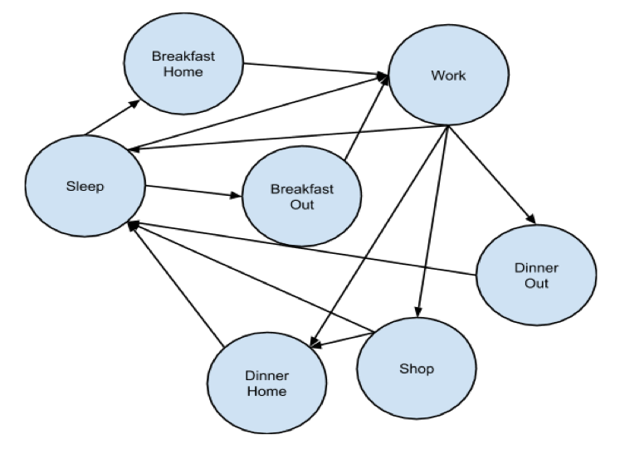
City Simulator
Lawrence Moore, Ralph Blanes, Saleh Hamadeh
CX 4230
INTRODUCTION
CONCEPTUAL MODEL
DISCUSSION & OUTLOOK
In the past 30 years, technological innovation has reduced the price of transportation and communication dramatically. This has led to an increase in worldwide trade, which has greatly expanded our economy. The increased economic activity has transformed countries and built cities where none existed before. For this project, we simulated the economy and vitality of such a city. Ideally, we hope to understand how and why different starting conditions, such as the wealth and the disposition of its citizens, affect the overall prosperity.
The city simulation includes a dynamic population, residences, businesses, and entertainment venues. As people interact with the world, each component evolves. The main driving force of the model are skills and needs of individuals. These factors determine the actions of the model’s inhabitants and overall outcome of the city. To determine the vibrancy of the city, we were mainly concerned with the wealth of the citizens and success of the businesses, among other factors.
Overview
The simulation is an agent-based discrete-event simulator. Every hour, the simulator notifies all the entities (people, businesses, residences, and entertainment venues) that time has passed, and each part of the model updates its properties accordingly.
People
The people represent the agents in our simulation. A person has three basic needs: food, shelter, and fun. In addition, each person has personality which dictates their specific preferences. If an individual is happy for a long enough time, they have kids, while if they are in poor health, they die. Every day people have unique experiences; however, they always follow the circle of life.
In our simulation, the circle of life is simplified to sleep, eat, work, and shop. People sleep at night, eat in the morning and afternoon, work during the day, and shop in the evening. People can choose to eat at home or at any of the restaurants in the city. In our simulation, shopping refers to all forms of entertainment, which include malls, movies, bars, and night clubs.
Businesses
In our model, the success of the businesses depends on the productivity of its workers. The productivity of the workforce depends on several factors: the ambition, skill, and general well being of the individuals. Every five days, companies review their overall productivity and decide whether to expand or decline. If they expand, the net-worth of the company along with its pay and number of employees increase. They also decide whether to hire or fire employees based on their current employees and those currently seeking a job. There are four different types of businesses: sales, manufacturing, research, finance, and tech. The quality and wage of the work depends on these types.
Person State Machine
We chose to show some general highlights of model in the graphs below. The trends we see make sense both in terms of the model but also reality itself. In our model, people are paid by their place of work around midday, and they spend money on shopping during the morning and evening. The average money owned by an individual throughout 24 hours reflects this. Further, the average amount of money owned by individuals does ultimately increase over a month, though there is some noise in the process. Considering the random nature of the transitions, it makes sense that we would see certain dips in money, but given the companies grew over this period, as pictured below, ot makes sense that the individuals ultimately became richer.
The graph showing the steady rise in business productivity was shown given a reasonable ratio of businesses to people. When only a few companies exist, only the skilled individuals do well. The rest suffer as they can’t find a place of good work.
Another set of experiments showed the number of deaths versus the number of children. We see that the number of children born outweighs the number of people who die in the long term. Given that people make money over the course of the month while businesses expand, it follows that their happiness increases. Given that the chance of producing a child depends on the good health of a person, it follows that many children would be born. On the other hand, because few are exceptionally poor and destitute, only a few die as the simulation proceeds.
Overall, this model only broke the surface in terms of modeling the complex dynamics of a city. Several things could be done to expand the model. Namely, the dynamics of businesses and entertainment stores could be improved by creating a market that other businesses and consumers would be apart of. This would better model how people and businesses actually operate. The residence model could also be expanded by allowing individuals to renovate their home or buy a new one altogether. The needs of individuals could also be made more robust, and the spending models could be refined by tying their actions even more closely to their basic needs.
Residences
Residences provide individuals with shelter and serve as the launching point for the days activities. In this model, the worth of a residence depends on its quality and proximity to high quality businesses. Residents must pay a mortgage payment based on the net-worth of the property. If an individual fails to pay the mortgage, they are locked out of their home until they can repay their debt.
Entertainment
When individuals want to go out and increase their happiness, they go shopping at an entertainment establishment. There are four types: restaurant, movie, adult, games. Each type satisfies the needs of an individual differently, and the quality of the store influences the price.
PURPOSE
This simulation can serve people in different domains. Our main customers are policy makers. Policy makers can feed the simulation with a model of their city. The simulation will show them how the city’s economy is expected to change in the future. In a sense, the simulation acts as a fast-forward for real life. This would help them see what they could do to prevent unemployment that may happen later on.
The simulation can also be used by researchers in politics, international affairs, economics, civil engineering, and environmental engineering. For example, economics researchers can use the simulation to find out how the increase in construction can reflect on the happiness and economic well-being of individuals. Civil engineers can find out how fast they need to expand the city in order to handle the growing population without ever having a bad shortage. Politicians can use it to study the effect of tax rates on businesses as well as individuals.
RESULTS
The following results were gathered under optimal conditions
REFERENCES
Itzak, Benenson. “Multi-agent simulations of residential dynamics in the city.” Department of Geography, University of Tel-Aviv, Tel-Aviv, Ramat-Aviv, 69978, Israel. Computers Environment and Urban Systems (Impact Factor: 1.79). 04/1998; 22(1):25-42. DOI: 10.1016/S0198-9715(98)00017-9
Moore, Blanes, Hamadeh. Conceptual Model. Computer Simulation (CX 4230), 2015.
ACKNOWLEDGEMENTS
Thanks to Dr. Vuduc for a great class.

