Slide 1
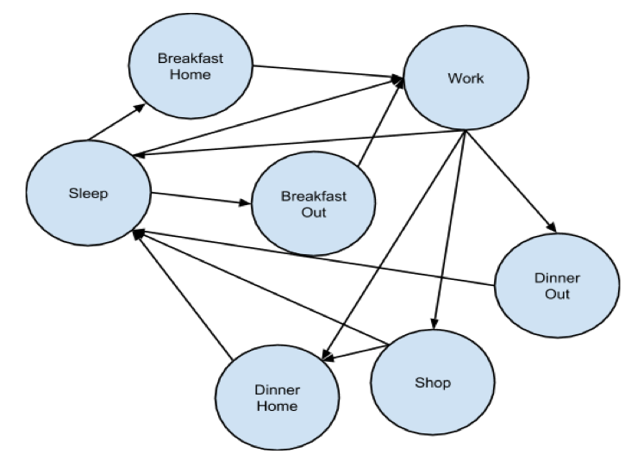
City Simulator
Ralph Blanes, Lawrence Moore, Saleh Hamadeh
CX 4230
INTRODUCTION
CONCEPTUAL MODEL
Essentially describe the motivation and purpose of the simulator.
Describe who can use the simulator and to what use.
Mention scope
Overview
The simulation is an agent-based discrete-event simulator. Every hour, the simulator notifies all the entities (people and businesses) that time has passed, and the individuals and businesses update their properties.
People
The people represent the agents in our simulation. Every day people have unique experiences; however, they always follow the circle of life.
In our simulation, the circle of life is simplified to sleep, eat, work, and shop. People sleep at night, eat in the morning and afternoon, work during the day, and shop in the evening. People can choose to eat at home or at any of the restaurants in the city. In our simulation, shopping refers to all forms of entertainment, which include malls, movies, bars, and night clubs.
Businesses
Residence
State machine
Shopping (both grocery and enterintainemt)
Mentioned how map is generated
Key assumptions (refer to original conceptual mode and of course our own code)
Discuss trends in the data here.
How do they fit in with reality and how we set up the model itself
Discuss further modifications to make simulator more realistic
Without lose of generality, how would this influence policy makers
Person State Machine
Just post the people we mentioned in the original conceptual mode
And reference our own cocneptual model just to be fancy
PURPOSE
Describe who can use the simulator and to what use.
Mention scope
RESULTS
Shout out to Dr. Vuduc for a chill class

