Slide 1
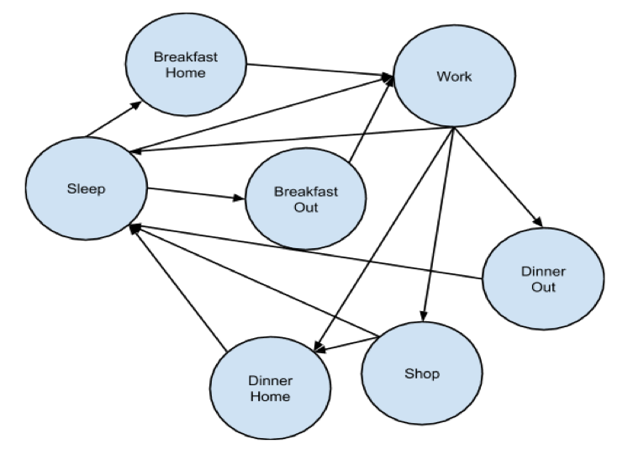
City Simulator
Ralph Blanes, Lawrence Moore, Saleh Hamadeh
CX 4230
INTRODUCTION
CONCEPTUAL MODEL
In the past 30 years, technological innovation reduced the prices of transportation and communication dramatically. This led to an increase in worldwide trade, which greatly expanded our economy. The increased economic activity transformed some countries and built cities where none existed before. For this project, we will simulate the economy and vitality of such a city. Ideally, we hope to understand how and why different starting conditions, such as the wealth and the disposition of its citizens, affect the overall prosperity.
The city simulation includes a dynamic population, residences, businesses, and entertainment venues. People can give birth to children. Children move to a new residence when they grow up. This affects the prices of residences and the average income of the population. People’s skills and ambitions determine the success of businesses, and businesses can expand or contract based on how hard their workers work.
Overview
The simulation is an agent-based discrete-event simulator. Every hour, the simulator notifies all the entities (people and businesses) that time has passed, and the individuals and businesses update their properties.
People
The people represent the agents in our simulation. Every day people have unique experiences; however, they always follow the circle of life.
In our simulation, the circle of life is simplified to sleep, eat, work, and shop. People sleep at night, eat in the morning and afternoon, work during the day, and shop in the evening. People can choose to eat at home or at any of the restaurants in the city. In our simulation, shopping refers to all forms of entertainment, which include malls, movies, bars, and night clubs.
Businesses
Residence
State machine
Shopping (both grocery and enterintainemt)
Mentioned how map is generated
Key assumptions (refer to original conceptual mode and of course our own code)
Discuss trends in the data here.
How do they fit in with reality and how we set up the model itself
Discuss further modifications to make simulator more realistic
Without lose of generality, how would this influence policy makers
Person State Machine
Just post the people we mentioned in the original conceptual mode
And reference our own cocneptual model just to be fancy
PURPOSE
This simulation can serve people in different domains. Our main customers are policy makers. Policy makers can feed the simulation with a model of their city. The simulation will show them how the city’s economy is expected to change in the future. In a sense, the simulation acts as a fast-forward for real life. This would help them see what they could do to prevent unemployment that may happen later on.
The simulation can also be used by researchers in politics, international affairs, economics, civil engineering, and environmental engineering. For example, economics researchers can use the simulation to find out how the increase in construction can reflect on the happiness and economic well-being of individuals. Civil engineers can find out how fast they need to expand the city in order to handle the growing population without ever having a bad shortage. Politicians can use it to study the effect of tax rates on businesses as well as individuals.
RESULTS
Shout out to Dr. Vuduc for a chill class

