Slide 1
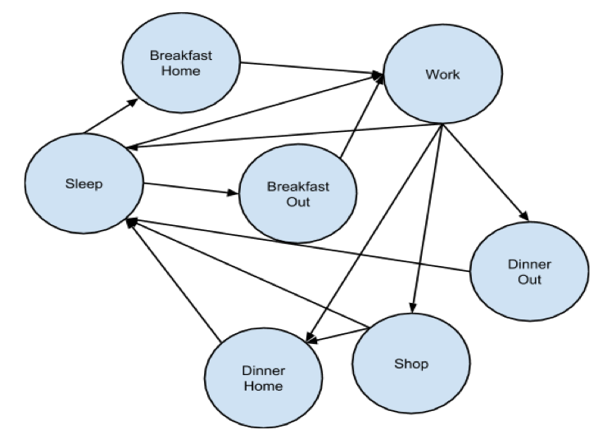
City Simulator
Ralph Blanes, Lawrence Moore, Saleh Hamadeh
CX 4230
INTRODUCTION
CONCEPTUAL MODEL
In the past 30 years, technological innovation has reduced the prices of transportation and communication dramatically. This led to an increase in worldwide trade, which greatly expanded our economy. The increased economic activity transformed some countries and built cities where none existed before. For this project, we will simulate the economy and vitality of such a city. Ideally, we hope to understand how and why different starting conditions, such as the wealth and the disposition of its citizens, affect the overall prosperity.
The city simulation includes a dynamic population, residences, businesses, and entertainment venues. As people interact with the world, each component of world changes. People’s skills and ambitions determine how their actions and outcome of model, such as the success of businesses. In turn, businesses can expand or contract based on how hard their workers work. People can also give birth to children, who move into a new residence and become part of the world when they grow up.
Overview
The simulation is an agent-based discrete-event simulator. Every hour, the simulator notifies all the entities (people and businesses) that time has passed, and the individuals and the other parts of the model update their properties.
People
The people represent the agents in our simulation. Every day people have unique experiences; however, they always follow the circle of life.
In our simulation, the circle of life is simplified to sleep, eat, work, and shop. People sleep at night, eat in the morning and afternoon, work during the day, and shop in the evening. People can choose to eat at home or at any of the restaurants in the city. In our simulation, shopping refers to all forms of entertainment, which include malls, movies, bars, and night clubs.
Businesses
In our model, the success of the businesses depends on the productivity of its workers. The productivity of the workforce depends on several factors, namely the ambition, skill, and general well being of the individuals. Every five days, companies review their overall productivity and decide whether to expand or decline. In the case when they expand, the net-worth of the company along with its pay and number of employees increase. They also make the decide whether to hire or fire employees based on their current workforce and those currently seeking a job. There are four different types of businesses: sales, manufacturing, research, finance, and tech. The quality and wage of the work depends on these types.
Person State Machine
Discuss trends in the data here.
How do they fit in with reality and how we set up the model itself
Discuss further modifications to make simulator more realistic
Without lose of generality, how would this influence policy makers
Businesses
Residences provide individuals with shelter and serve as the launching point for the days activity. In this model, the worth of a residence depends on its quality and proximity to high quality businesses. Residents must pay a mortgage payment based on the net-worth of the property. If an individual fails to pay the mortgage, they are kicked out of their home until they can repay their debt.
Entertainment
When individuals want to go out and increase their happiness, they go shopping at an entertainment establishment. There are four types: restaurant, movie, adult, games. Each influences the needs of an individual, and the quality of the store influences the price.
Just post the people we mentioned in the original conceptual mode
And reference our own cocneptual model just to be fancy
PURPOSE
This simulation can serve people in different domains. Our main customers are policy makers. Policy makers can feed the simulation with a model of their city. The simulation will show them how the city’s economy is expected to change in the future. In a sense, the simulation acts as a fast-forward for real life. This would help them see what they could do to prevent unemployment that may happen later on.
The simulation can also be used by researchers in politics, international affairs, economics, civil engineering, and environmental engineering. For example, economics researchers can use the simulation to find out how the increase in construction can reflect on the happiness and economic well-being of individuals. Civil engineers can find out how fast they need to expand the city in order to handle the growing population without ever having a bad shortage. Politicians can use it to study the effect of tax rates on businesses as well as individuals.
RESULTS
Shout out to Dr. Vuduc for a chill class

