Slide 1


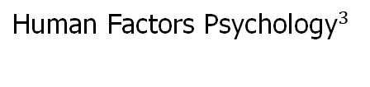
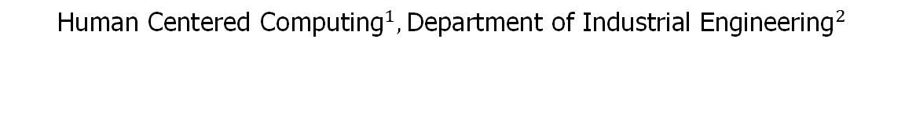


Dashboard Interface Design for IT Ticketing System
TEAM 3
${\text{Kalvry} \text{A}\text{. }\text{Cooper}}^{1}$, ${\text{Raphael} \text{Maris}}^{1}$
$${\text{Sahil} \text{Rajesh} \text{Sawant}}^{2},{ \text{A}\text{shwin} \text{Sudhakar} }^{2}$$
${\text{Maria} \text{Levanidova}}^{3}$, ${\text{John} \text{Solorio} }^{3}$
$${\text{Human} \text{Centered} \text{Computing}}^{1},{\text{Department} \text{of} \text{Industrial} \text{Engineering}}^{2}$$
$${\text{Human} \text{Factors} \text{Psychology}}^{3}$$
1 of 15

Slide 2
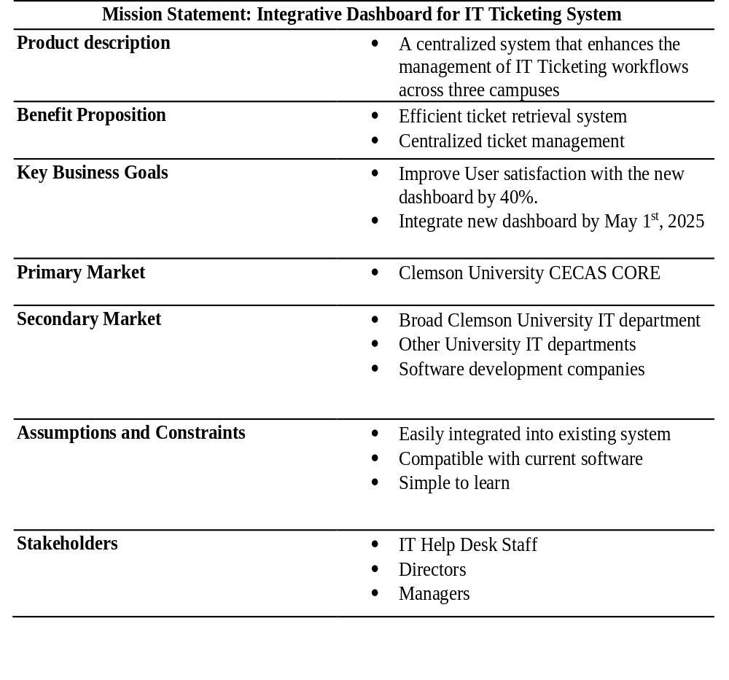
Incorporating Mission Statement
Developed a centralized, user-friendly dashboard to streamline IT ticketing workflows across three Clemson campuses.
Key goals we focused on:
Increase user satisfaction with the new dashboard by 40%
Ensure full integration of the new dashboard by May 1st, 2025
Conducted stakeholder meetings with IT Help Desk staff, directors, and managers to gather feedback and align functionalities with user needs.
Ensured the dashboard was compatible with existing software systems and easy to learn.
Aligned timeline and features with the mission to deliver a fully functional system by the target deadline
2 of 15

Slide 3
Findings of Needs Analysis
Semi-structured interviews were conducted with 10 participants, including IT Help Desk staff, managers, and Directors.
The identified needs were then organized into a “Hierarchical list of needs”.
The needs were then grouped into eight subgroups of primary need statements.
After conducting the importance survey, eight final need statements were identified after considering statements rated above 3.0 average
Need Statements | Imp Survey Ratings
The system provides an intuitive, distraction-free interface. | 3.8
The system accommodates diverse roles and accessibility. | 3.6
The system allows comprehensive ticket management workflows. | 4.2
The system provides powerful ticket search capabilities. | 3.8
The system manages accidental tickets efficiently. | 3.2
The system supports task prioritization and organization. | 4
The system facilitates communication and collaboration across teams. | 3.8
The system enables customization and system integrations. | 3.6
3 of 15

Slide 4
Developed Target Specifications
Metric No. | Metric | Units | Need Nos. | Imp | Ideal Value | Marginal Value
1 | User satisfaction score for intuitiveness (1= the least intuitive and 5= most intuitive) | Score | 1, 16 | 4.8 | 5 | >=3
3 | Average Time taken to complete a standard navigation task (e.g., find a specific feature) | Seconds | 1, 16 | 4.8 | <15 | <50
11 | Average Time taken to access the status link (high priority, low priority) | Seconds | 2, 9, 15 | 3.5 | = 100 | >=70
15 | Number of users who complete role-specific tasks error-free within 2 minutes. | % of users | 11 | 3.5 | >= 95 | >=60
20 | Number of tickets filtered correctly (out of 20). | % | 15 | 4.1 | =95 | >=70
22 | Number of users completing 5 core tasks without assistance within 45 seconds | % | 16 | 4.8 | =100 | >=70
4 of 15

Slide 5
Usability Test Summary
Key Metrics Evaluated
  Average time to complete a standard navigation task (e.g., locating a specific feature)
  Average time to access the status link (categorized as high/low priority)
  User Satisfaction Score for system intuitiveness
Key Stakeholder Feedback
  Dashboard should prioritize displaying tickets
    Unresolved and in-progress tickets should be the primary focus of the home screen
    Other elements are secondary
  Positive reception to several design elements
  AI assistance was specifically highlighted as a valuable feature to retain
Next Steps
  Update home screen to prioritize tickets requiring attention
  Retain and build upon positively received design elements
5 of 15

Slide 6
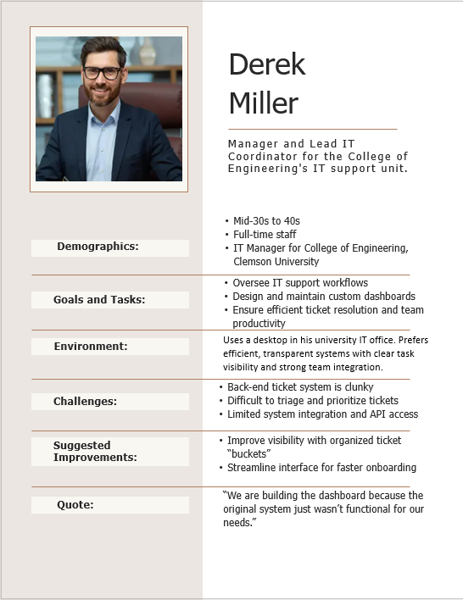
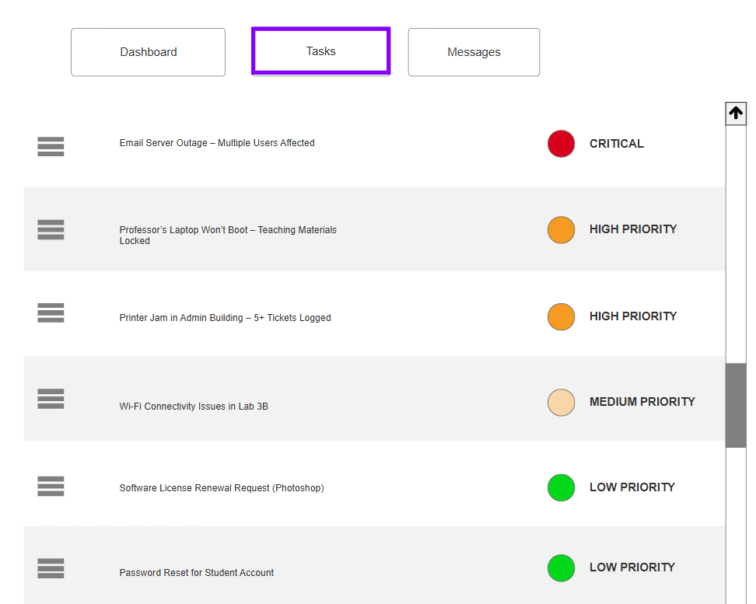
Examples of stakeholder's interactions being integrated in final concept
1. Organized ticket “buckets” for rapid triage.
2. Clear, transparent task visibility for the whole team.
3. The minimalist three-tab navigation.
4. Quick prioritization & assignment.
6 of 15

Slide 7

7 of 15

Slide 8
Don Norman Principles
1. Making Things Visible
Each task has an associated priority indicator (circle with color and label). This immediately makes the urgency of tasks visible, allowing users to grasp what needs attention quickly.
Explanation: Users don’t have to dig into details — visual signals do the job. The "CRITICAL" red dot especially stands out.
8 of 15
Notes:
Let’s start with the principle of visibility. In our dashboard, each task is accompanied by a priority indicator—represented by a colored circle and label. This makes the urgency of tasks immediately apparent. Users don’t need to click or dive deeper to understand what’s important. The red dot labeled 'CRITICAL' is especially effective in grabbing attention. This visual cue ensures users can triage tasks quickly and confidently."

Slide 9
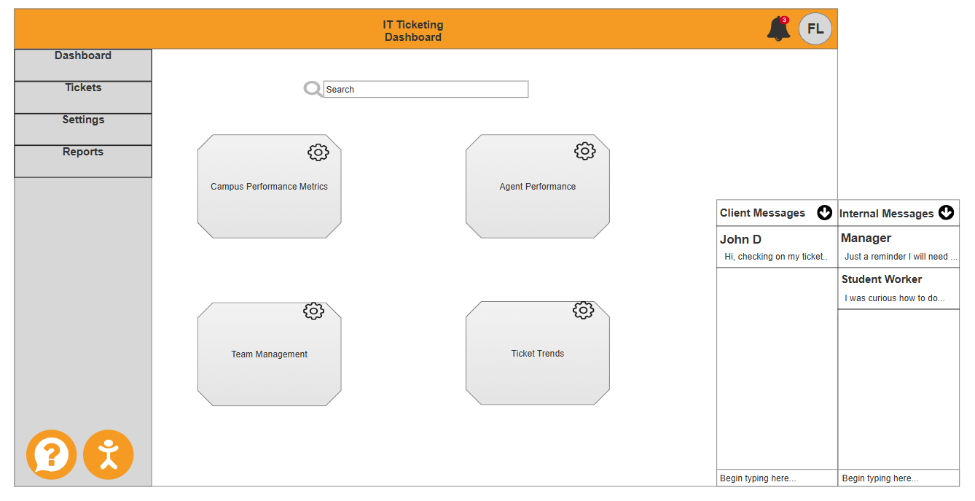
Don Norman Principles
2. Provide affordances
Each module (e.g., “Campus Performance Metrics,” “Team Management”) is represented by a raised, button-like shape with a gear icon in the corner. These shapes afford clicking for settings or further actions.
9 of 15
Notes:
"Next is affordance. We designed each functional module—like 'Campus Performance Metrics' or 'Team Management'—to appear as raised, button-like elements with a gear icon in the corner. These clearly afford clicking. Even without explicit instructions, users instinctively recognize that these modules are interactive and customizable. Much like how a knob affords turning, our icons suggest interaction."

Slide 10
Don Norman Principles
3. Natural Mappings
The human figure icon, typically associated with accessibility tools, maps intuitively to user settings related to disability access.
Users instinctively associate the bell with alerts due to its common usage in digital platforms.
10 of 15
Notes:
"This slide highlights natural mappings. We’ve used common iconography to make the interface intuitive. For example, a human figure icon is used for accessibility settings, and a bell represents alerts. These choices rely on users’ pre-existing mental models from other digital tools, making our system easier to learn and navigate without additional guidance."

Slide 11
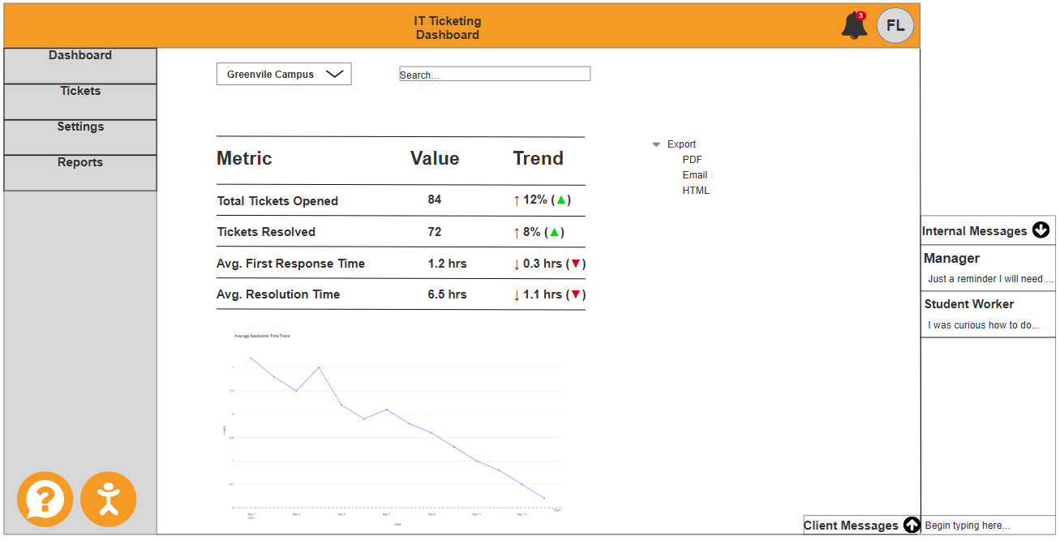
Don Norman Principles
4. Make use of constraints
The sidebar only shows Dashboard, Tickets, Settings, Reports — users are constrained to these major categories, which reduces confusion. This constraint ensures users do not deviate into unsupported or non-permitted areas, reinforcing task-focused navigation.
11 of 15
Notes:
"Here, we illustrate the use of constraints. The sidebar menu limits users to four main categories: Dashboard, Tickets, Settings, and Reports. By restricting the navigation options, we reduce potential confusion and prevent users from drifting into unsupported features. It also helps guide them toward their most critical tasks."

Slide 12
Don Norman Principles
5. Provide Feedback
Users get visual and numerical confirmation that their actions (ticket handling) have been processed, and they know how well the system is performing as a result. This is clear, timely, and meaningful feedback
12 of 15
Notes:
"Finally, feedback. Users receive immediate visual and numeric confirmation when they handle a ticket. They can clearly see that their action has gone through, and even better, they know how well the system is performing in response. This kind of real-time, relevant feedback is key to reinforcing user confidence and supporting smooth workflows."

Slide 13
Final Target Specifications
Metric No. | Metric | Units | Need Nos. | Imp | Developed Ratings
1 | User satisfaction score for intuitiveness (1= the least intuitive and 5= most intuitive) | Score | 1, 16 | 4.8 | 4
3 | Average Time taken to complete a standard navigation task (e.g., find a specific feature) | Seconds | 1, 16 | 4.8 | 30 secs
11 | Average Time taken to access the status link (high priority, low priority) | Seconds | 2, 9, 15 | 3.5 | 20 secs
15 | Number of users who complete role-specific tasks error-free within 2 minutes. | % of users | 11 | 3.5 | 60 secs (manager) 105 secs (students)
20 | Number of tickets filtered correctly (out of 20). | % | 15 | 4.1 | Preconfigured - Net 0
22 | Number of users completing 5 core tasks without assistance within 45 seconds | % | 16 | 4.8 | Active filtering 10 – 15 secs
13 of 15

Slide 14
SUS Questionnaire Results
Questions For SUS | Ratings given | Adjusted Score
I found the system unnecessarily complex. | 1 | 4
I thought the system was easy to use. | 4 | 3
I think that I would need the support of a technical person to be able to use this system. | 5 | 0
I found the various functions in this system were well integrated. | 3 | 2
I thought there was too much inconsistency in this system. | 4 | 1
I would imagine that most people would learn to use this system very quickly. | 4 | 3
I felt very confident using the system. | 5 | 4
I found the system very cumbersome to use. | 1 | 4
I needed to learn a lot of things before I could get going with this system. | 1 | 4
I think that I would like to use this system frequently | 4 | 3
The SUS is a standardized set of 10 statements. Respondents rate each on a 5-point Likert scale from 1 (Strongly Disagree) to 5 (Strongly Agree).
Total Raw Score: 4 + 3 + 0 + 2 + 1 + 3 + 4 + 4 + 4 + 3 = 28
Multiply by 2.5: 28 × 2.5 = 70
SUS Score: 70
14 of 15
Notes:
just above the industry average (~68)

Slide 15
Next Steps required to implement the system
System Integration: Integrate backend components and test system functionality across all campuses.
Training: Conduct stakeholder-specific training sessions with user guides and videos.
Monitoring: Track key performance metrics like response time and user satisfaction.
Refinement: Use user feedback to enhance filters, accessibility, and workflows iteratively.
Deployment: Roll out the system in Initial, partial, and full phases with dedicated support.
15 of 15

Slide 16
References
Ulrich, K. T., & Eppinger, S. D. (2016). Product design and development. McGraw-hill.

Slide 17
THANK YOU!
Questions?

