Slide 1
C206 L10 Part A
Sprint Execution I – Test-Driven Development I

Slide 2
The Scrum Framework
Processes of Scrum Framework
Product Backlog Grooming
Sprint Planning
Sprint Execution
Test-Driven Development (TDD)
Daily Scrum
Code Refactoring
Code Review
Sprint Review
Sprint Retrospective
Lesson 9
Lesson 10
Lesson 10 and 11
Lesson 11 Part A
Lesson 11 Part B
Lesson 12 Part A
Lesson 12 Part B

Slide 3
C206 L10 Part A Learning objectives
Sprint Execution
Daily Scrum / Stand-up meeting
Test Driven Development

Slide 4
Sprint Execution

Slide 5
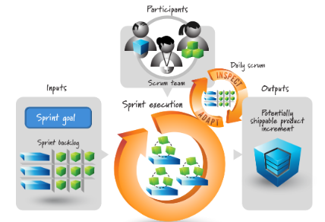
Sprint Execution
Input:
Sprint Backlog
Sprint Duration:
usually 2- 3 weeks
Key activities:
Daily stand-up meeting
Coding
Testing
Output:
shippable product increment
Participants:
the Scrum team

Slide 6
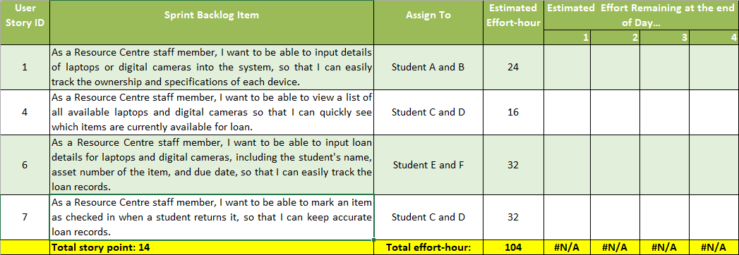
1st Sprint – Sprint Backlog (given in student folder)

Slide 7
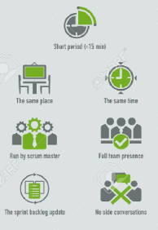
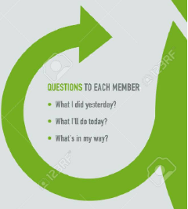
Daily Scrum/Stand-up meeting
10-15 min
Same place & same time in the morning
Run by the Scrum Master and full team presence
Sprint backlog update
No side conversation
3 questions to each member
What did you do yesterday?
What will you do today?
Are there any impediments in your way?

Slide 8
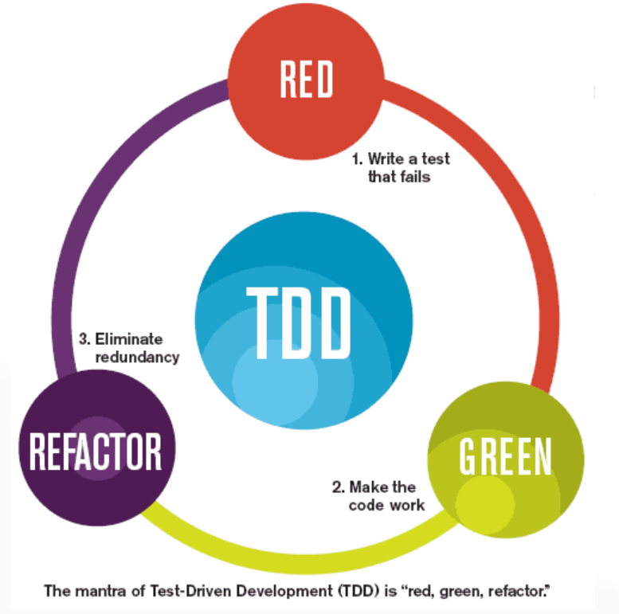
Test Driven Development

Slide 9
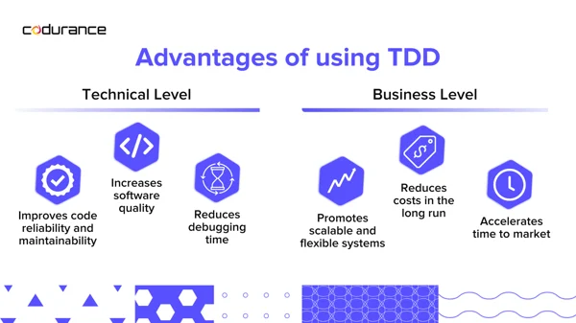
Test-Driven Development (TDD)
Test-Driven Development (TDD) is a software development process where you write tests before writing the actual code.
Ensures your code works as expected.
Why Use TDD?
Improves code quality
Catches bugs early
Ensures code meets requirements
Encourages simple designs
Image source: https://www.codurance.com/test-driven-development-guide

Slide 10
Test-Driven Development (TDD)
Challenges of TDD
Initial time investment.
Requires discipline.
Can be overkill for simple projects.
TDD Best Practices
Write small, focused tests.
Keep tests independent.
Refactor regularly.
Use descriptive names for tests.

Slide 11
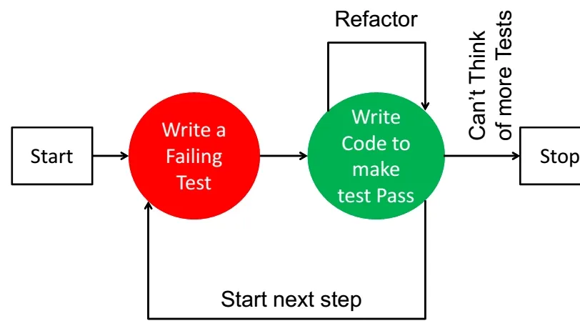
TDD Workflow
Write a Test: Write a test for a small piece of functionality.
Run the Test: Run the test to see it fail (since the code is not written yet).
Write the Code: Write the minimum amount of code to make the test pass.
Run the Test Again: Ensure the test passes.
Refactor: Clean up the code while keeping the test green.
Image source: https://medium.com/getir/test-driven-development-tdd-a-step-by-step-guide-2046a075b9d0

Slide 12
TDD - Lecturer Demonstration
Notes:
https://docs.pytest.org/en/8.0.x/getting-started.html

Slide 13

TDD Demonstration (30 mins)
Lecturer demonstrates the TDD of User Story 1 as shown in US_01_TDD (found in User Guides folder).
Student follows the demonstration and complete the development of User Story 1 in their own VS Code.
User Story 1
As a Resource Centre staff member, I want to be able to input details of laptops or digital cameras into the system, so that I can easily track the ownership and specifications of each device.
Given that there is a new laptop or digital camera, when the Resource Centre staff member inputs the details of laptops or digital cameras into the system, then the system should store the ownership and specifications of each device for easy tracking.
Priority: Must have
Acceptance Criteria:
The system allows the staff member to input all required details of a laptop or digital camera.
The system validates that all required details are entered before allowing the data to be saved.
The system displays a confirmation message to the staff member once the data is successfully saved.

Slide 14
Hands on activity - TDD for User Story 4 (60 min)
Perform TDD process to develop the User Story 4 (US_04).
Follow the process of US_01_TDD, demonstrated by your lecturer, as close as possible.
User Story 4
As a Resource Centre staff member, I want to be able to view a list of all available laptops and digital cameras so that I can quickly see which items are currently available for loan.
Given that I am a Resource Centre staff member, when I access the system, then I can view a list of all available laptops and digital cameras.
Priority: Should have
Acceptance Criteria:
The list should display the asset number tag, model description, and operating system for laptops.
The list should display the asset number tag, model description, and optical zoom capability for digital cameras.
The list should only show items that are currently available for loan.

Slide 15
Summary
Start of Sprint Execution
First Scrum/stand up meeting
Understand and perform Test-Driven Development (TDD)

