Slide 1

Movie Recommendation System
FORDHAM UNIVERSITY
TEXT ANALYTICS - GROUP 6
KRISTEL KALM , THERESA THIRI OO,
REGAN ALT, CHLOE PLATEK, OWAKHELA KANKHWENDE

Slide 2
AGENDA
Introduction
Problem Statement
Data Description
Methodology
Sentiment Analysis
Classification
Topic modeling
Derivative Insights
Scope & Limitations
Conclusion & Recommendations
References
Notes:
Introduction
Problem Statement
Data Description
Methodology
Sentiment Analysis
Classification
Topic Modeling
Derivative Insights
Scope & Limitation
Conclusion & Recommendations
References

Slide 3




INTRODUCTION
Which movies would be the most profitable for streaming platforms to purchase?
Extraction of movie sentiments from Rotten Tomatoes Data from 2019 to 2020
Determining the popularity of films to mitigate loss of revenue.
Utilizing audience sentiment and tomatometer rating for popularity of films
Utilizing different models to determine sentiment of reviews to find the most effective approach
Notes:
Chloe

Slide 4
RESEARCH QUESTION
Which movie recommendation method is the most cost efficient?
How does the Audience Rating and Tomatometer Rating compare to the Sentiment Analysis score?
Notes:
Chloe

Slide 5

DATA DESCRIPTION
Data source
Kaggle
rottentomatoes.com (required Oct 31st, 2020)
Size
31.9 MB
11 Columns x 55743 rows = 55,74
Format
csv
Programming Tools
Python: Nltk, VaderSentiment, Sklearn, TFIDF, Lemmatizer
Visualization Tools
Tableau & Python: Treemap, Bar Chart, Scatterplot, Area Chart
Notes:
Chloe

Slide 6
EXAMPLE VARIABLES
Name | Type | Examples
Title | Nominal | Capital Marvel, The Lion King, Dumbo, Aladdin, Parasite
content_rating | Ordinal | PG-13
tomatometer_rating | Interval | 79
audience_rating | Interval | 47
review_type | Ordinal | Fresh, Rotten
review_content | Nominal | "A bit of a misstep at a very crucial time..."
Notes:
Chloe

Slide 7



METHODOLOGY
Data Collection & Pre-processing
Tool: Python
Data cleaning
Evaluation:
Utilizing review_type column
Fresh as 1
Rotten as 0
Classification Report
Confusion Matrix
Cost Effectiveness
Topic Modeling
Document Term Matrix
Derive Insights
Data Visualization
Tool: Tableau
Sentiment Analysis
Vader/BingLiu
Feature Selection & Classification Modeling
Selected Features:
Bag of Words, TFIDF
Selected Classification Models:
Naive Bayes, Decision Tree,
Random Forest
Notes:
Thiri

Slide 8
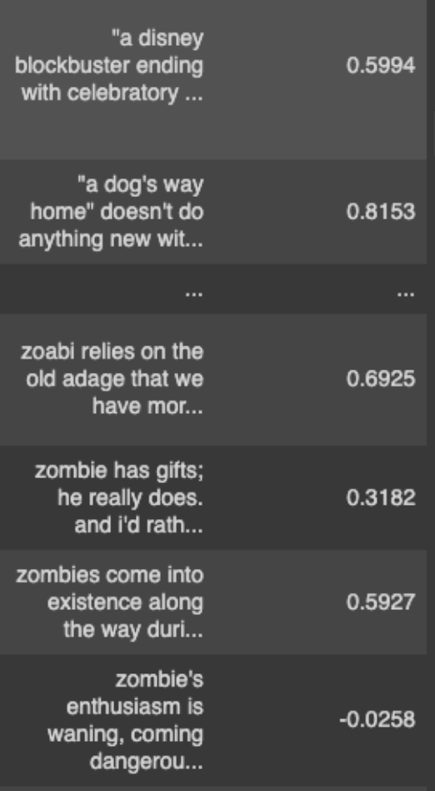
SENTIMENT ANALYSIS:
BING LIU & VADER
 | Confusion Matrix |  | Cost
Vader | 7179 | 9457 | 8199*$5) + (9457 *$1) = $50,452
 | 8199 | 30884
Bing Liu | 10679 | 5957 | $59,352
 | 17041 | 22042
*Considering that it cost
$5 for guessing a negative critique as positive.
$1 for guessing a positive critique as negative.
Notes:
Thiri

Slide 9
FEATURE SELECTION
&
CLASSIFICATION
 | Naïve Bayes |  | Decision Tree |  | Random Forest
Bag of Words | 3252 | 1610 | 2578 | 2284 | 1905 | 2957
 | 1371 | 10483 | 1857 | 9997 | 281 | 11573
Cost | (1371 x $5) +(1610 x $1) = $8,465 |  | = $11,569 |  | = $12,482
TFIDF | 10 | 4852 | 1399 | 3463 | 224 | 4638
 | 21 | 11833 | 3370 | 8484 | 543 | 11311
Cost | = $4,957 |  | = $20,313 |  | = $7,353
*Considering that it cost
$5 for guessing a negative critique as positive.
$1 for guessing a positive critique as negative.
Notes:
Thiri

Slide 10
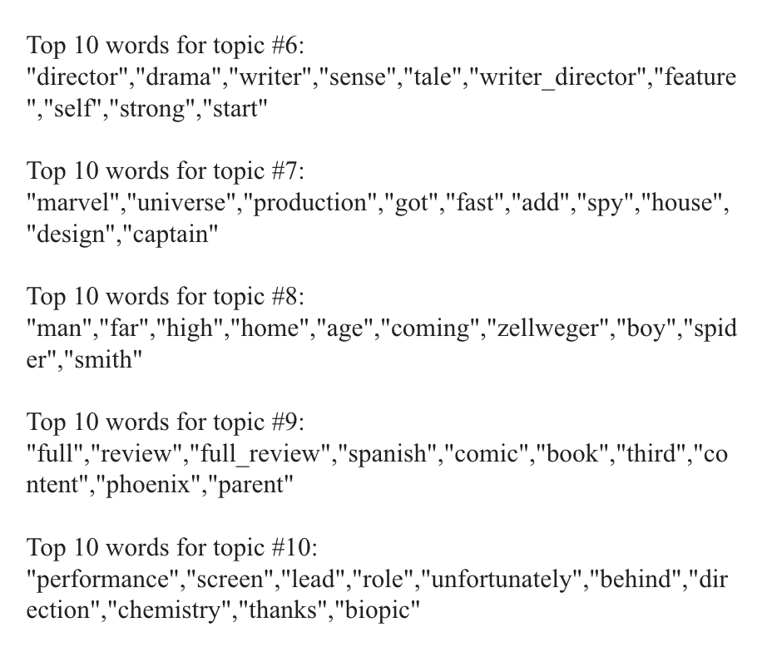
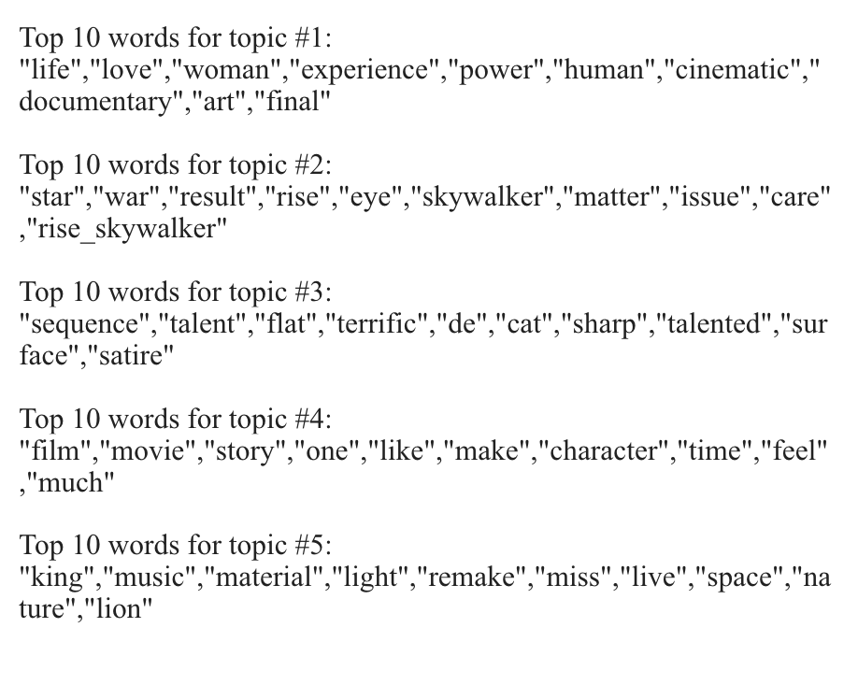
TOPIC MODELING: LATENT DIRICHLET ALLOCATION (LDA) MODEL
Notes:
Regan

Slide 11
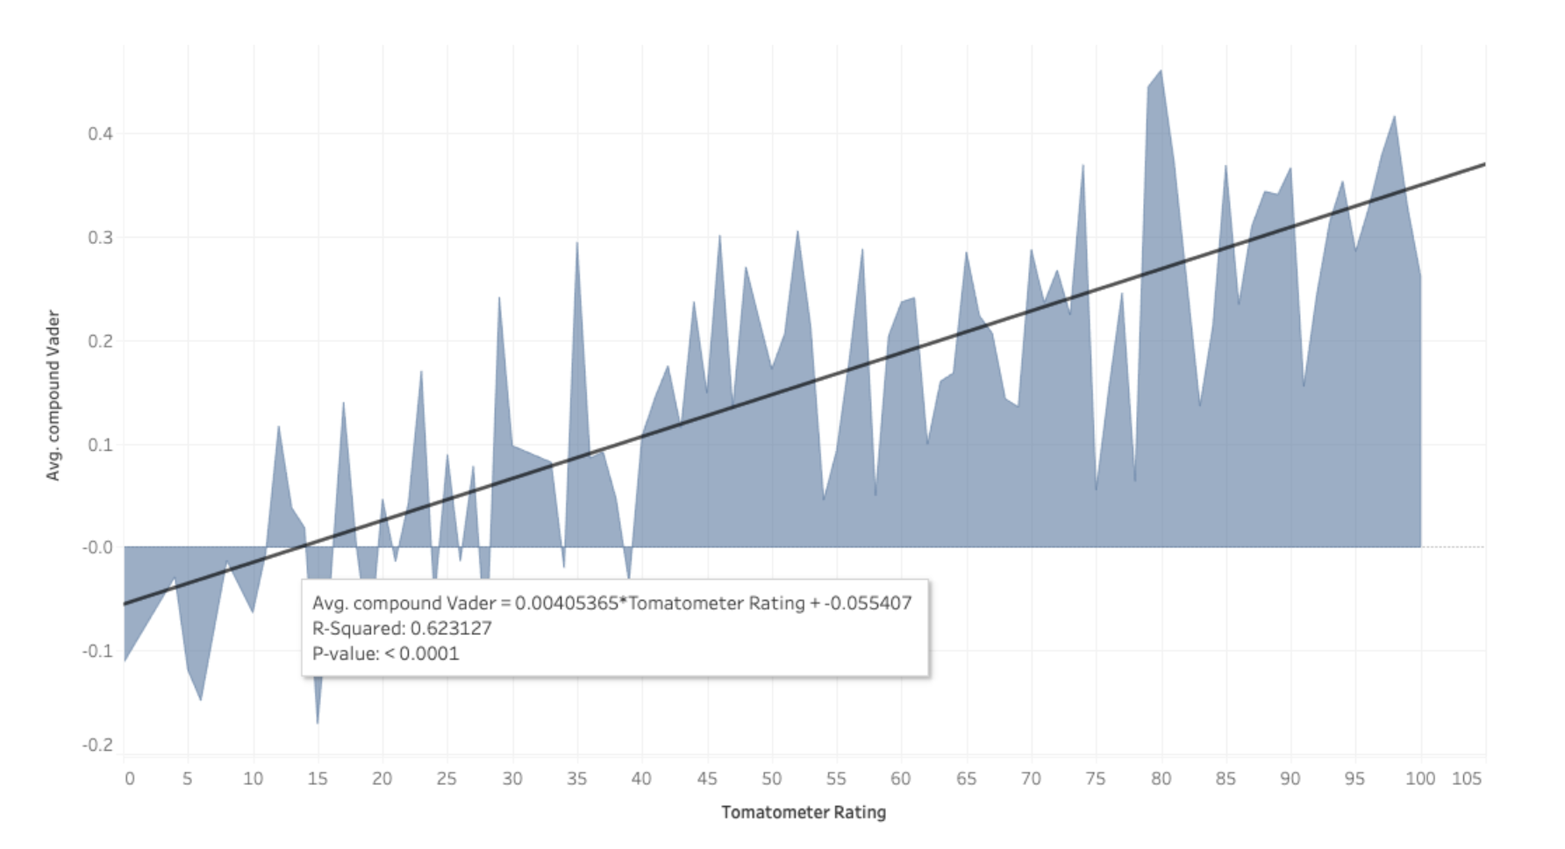
Tomatometer Rating Vs. Avg. Vader Score
Notes:
Owa
Tomatometer Rating and Average Vader Score are positively correlated with a significant p score of less than 0.0001. The regression equation shows that for every additional rating in tomatometer, the vader score can be expected to increase by 0.004.
R square is 0.63. This means that approximately 63% of the variability of the vader score is explained by the model.

Slide 12
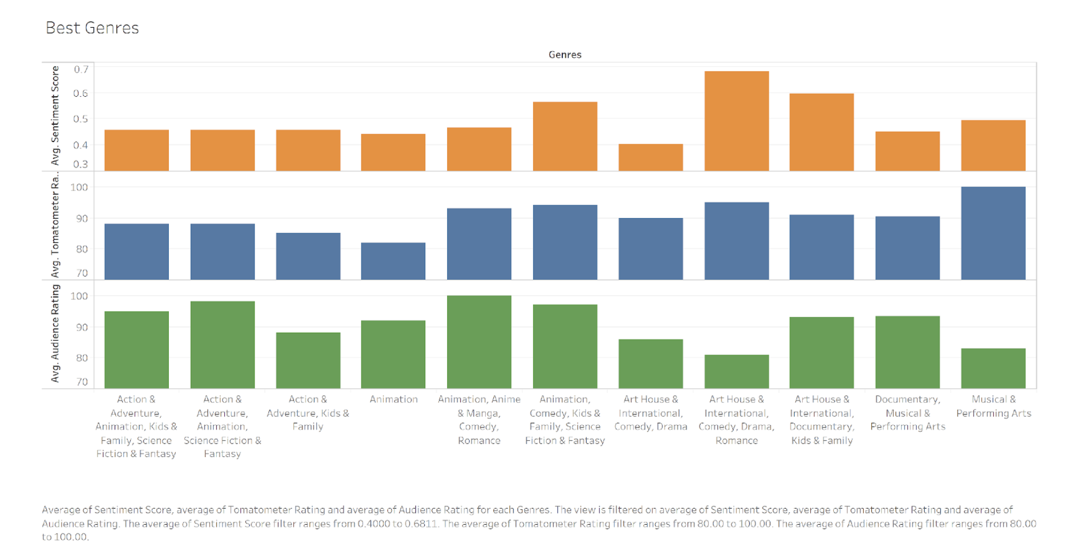
Avg Audience, Tomatometer, Vader Rating (Best Genres)
Notes:
Owa

Slide 13
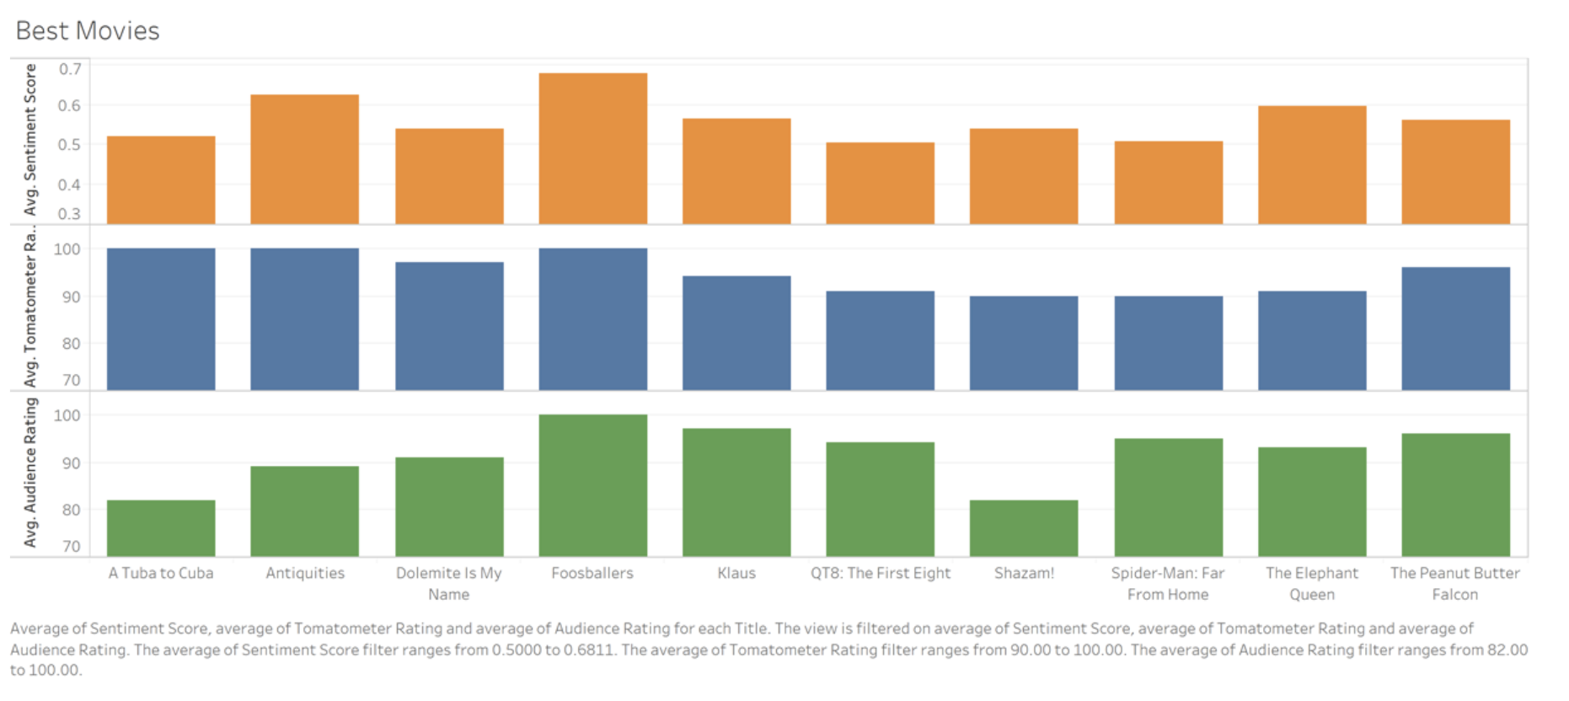
Avg Audience, Tomatometer, Vader Rating (Best Movies)
Notes:
Owa

Slide 14
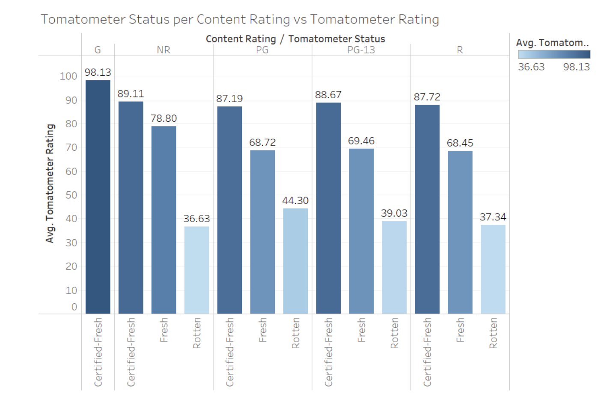
Tomatometer Status Per Content Rating Vs. Tomatometer Rating
Notes:
Regan

Slide 15
SCOPE AND LIMITATIONS
Further research using larger dataset
Need to consider number of ratings and how that affects ratings overall
Viewers opinions of movies can change overtime
- For example, an actor’s last film success may develop an audience cult following, this could drives up interest in a particular movies.
Notes:
K

Slide 16


INSIGHTS AND CONCLUSION
Sentiment Analysis Vader is the most cost effective compared with Bing Liu
Confusion Matrix: TFIDF with Naive Bayes models proves to be the most cost-effective recommendation system.
Topic Modeling: Average topic coherence: -8.7887/ Coherence Score: 0.30830
RECOMMENDATION
Client can invest on buying movies that has the most positive comments using the most cost-effective recommendation system.
i.e., Vader for Sentiment Analysis & TFIDF with Naive Bayes Classification Model.
Notes:
Kristel

Slide 17
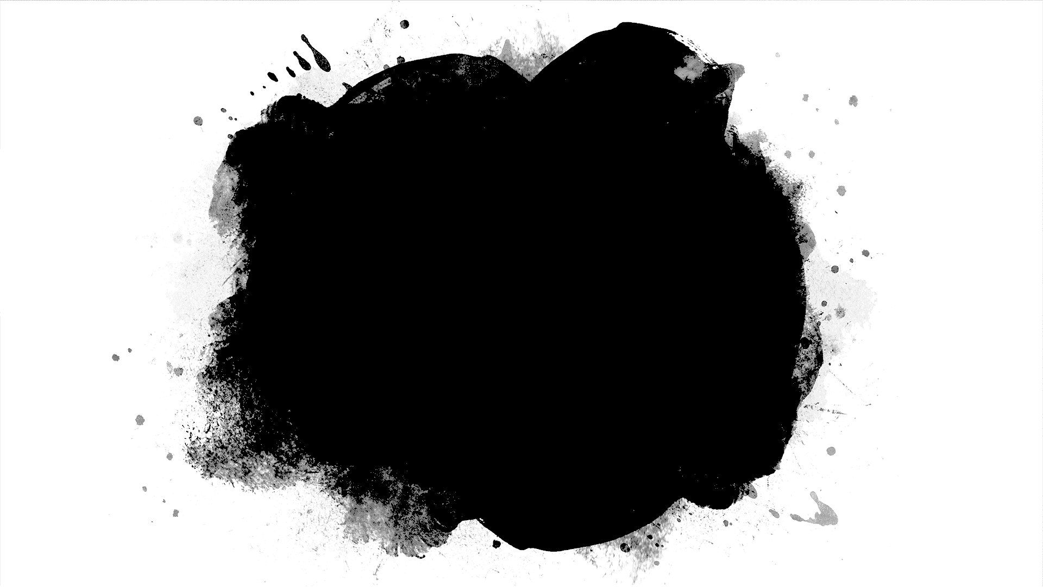
REFERENCE
https://www.kaggle.com/stefanoleone992/rotten-tomatoes-movies-and-critic-reviews-dataset

