Slide 1


ReaL Estate Project
Made by:
Crepcea Raluca-Maria

Slide 2
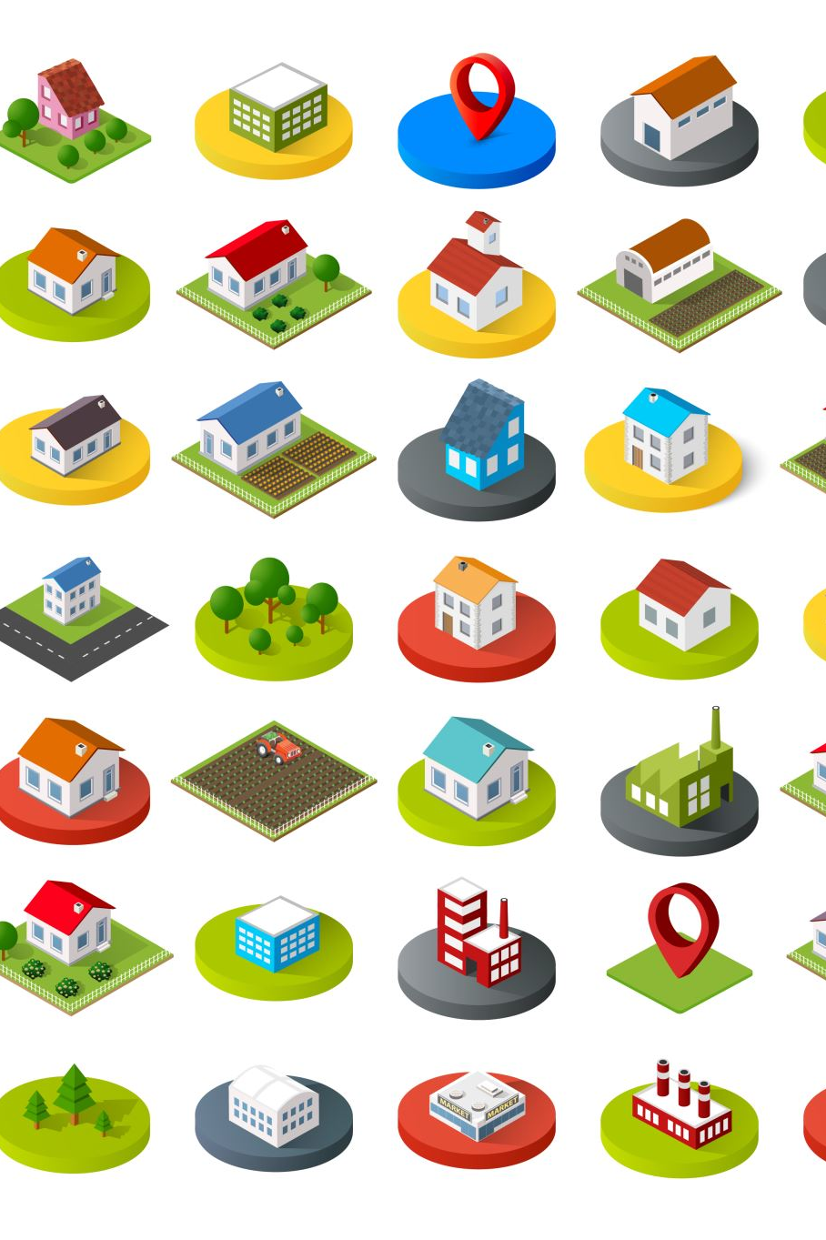
What is the application about?
The application is an online real estate platform where users can browse and explore what properties are on the market. It allows potential buyers to explore real estate listings, add properties to their cart, and contact sellers. It integrates Google authentication for a seamless login experience and Firebase for backend services.

Slide 3

2. Why did you choose to build this application?
Real estate is a vital industry with increasing demand for digital solutions. The idea was to simplify the property-viewing process by offering a user-friendly platform for browsing and having the possibility to be contacted.

Slide 4
3. How did you develop the project (Individual project)
Frontend Development: Built using React to create an interactive and responsive user interface.
Authentication and Backend Integration: Firebase Authentication and Firestore Database were set up to manage user data and store property details.
Deployment: Firebase Hosting was used to make the application accessible online.

Slide 5
4. What is the problem that your application solves? (What is the target audience?)
Problem: Real estate buyers often find it challenging to manage and keep track of properties they’re interested in. They need a centralized and organized way to explore, save, and contact sellers.
Solution: This application provides an intuitive interface where users can browse properties, add them to their cart, and get quick access to seller contact information.
Target Audience: Potential real estate buyers and sellers looking for a convenient platform for managing listings and interests.

Slide 6
5. What is the architecture of your application?
Frontend: React is used to build the user interface and manage state with React Context API.
Backend: Firebase Firestore serves as the database to store property and user information.
Authentication: Firebase Authentication provides secure login options, including email-password and Google sign-in.
Hosting: Firebase Hosting delivers the application to users efficiently.
Routing: React Router is used for navigating between pages.

Slide 7
6. What are the core data structures that you use?
Firestore Database Collections:
Properties: Stores details about each property (e.g., name, price, image, description).
Users: Stores user information such as email and name after sign-up or login.
Cart: Stores property IDs for each user’s cart.
The application uses arrays and objects to manage cart items and maintain application state.

Slide 8
7. What technologies did you use?
Frontend:
React
React Router
React Context API
Backend:
Firebase Firestore (Database)
Firebase Authentication
Additional Libraries:
React-Icons
React-Toastify (for notifications)
Deployment:
Firebase Hosting

Slide 9

8. Did you use any Design Patterns?
Yes, I used Observer Pattern to manage state changes and ensure that all dependent components update automatically. For example: when a user adds a product to the cart, the cart's total price and quantity are recalculated, and the UI updates instantly.
Similarly, the authentication state is observed to redirect users to the login page if they are not logged in. These functionalities rely on a shared state that notifies subscribed components of any changes.

Slide 10
Hosted at:
https://realestateproject-a07dd.web.app/
Git link:
https://github.com/ralucacrepcea/RealEstateProject.git

