Slide 1


IMPLEMENTATION OF CHATBOT USING NLP
Presented by:
Name: Sirimella Ram Prabhath
AICTE Reg.ID: STU63e50ab4445d11675954868

Slide 2

Learning Objectives
Develop a chatbot using Natural Language Processing (NLP).
Train the chatbot using intents and responses stored in JSON.
Implement the chatbot using Python, NLTK, and Scikit-learn.
Apply TF-IDF and Logistic Regression
Deploy the chatbot using Streamlit for an interactive UI.
GOAL

Slide 3
Tools & Technologies Used:
Python
Streamlit
Scikit-learn
NLP Techniques (TF-IDF, Tokenization)
JSON for Intent Management
Logistic Regression Model

Slide 4
Methodology
Load data from intents.json ( User queries and responses ).
Preprocess text (Tokenization, TF-IDF Vectorization)
Train a Logistic Regression Model for intent classification.
Create a Streamlit UI to take user input and display chatbot responses.
Store conversation history.

Slide 5
Problem Statement:
Traditional chatbots struggle with accurately identifying user intents, leading to poor conversational experiences. Our goal is to enhance intent recognition using NLP and Intents.

Slide 6
Solution:
Implemented a chatbot using NLP techniques
Used Logistic Regression for intent classification
Ensured dynamic learning and improved user experience
Developed an interactive UI with Streamlit
Maintain chat history for better user experience.

Slide 7
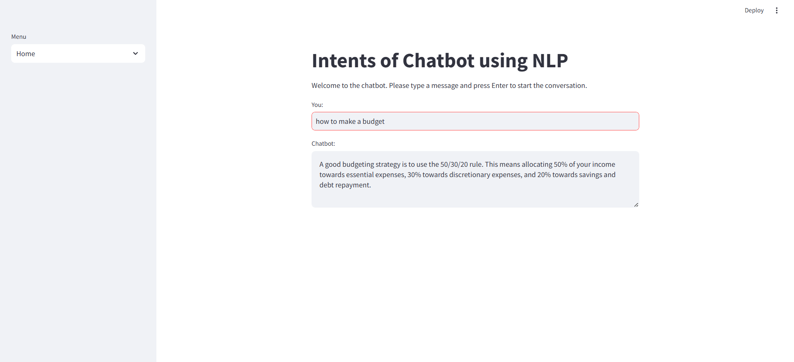
Screenshots of Output:

Slide 8
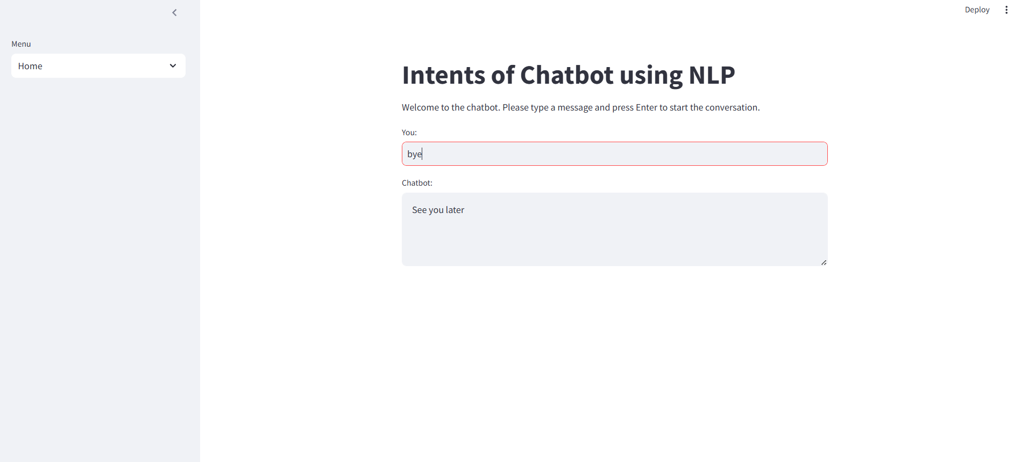

Slide 9
Conclusion:
Successfully built an interactive chatbot using NLP & ML techniques.
Model effectively classifies user input and responds accurately.
Future improvements can include deep learning models & real-time data fetching for enhanced performance.
GitHub Link:
Link: https://github.com/ram-19/Chatbot_using_NLP_AICTE.git

