Slide 1
Secure Data Hiding in image using Steganography
CAPSTONE PROJECT
Presented By
Name: Sirimella Ram Prabhath
College Name : SR Engineering College
Department : Electrical and Electronics Engineering

Slide 2
OUTLINE
Problem Statement
Technology used
Wow factor
End users
Result
Conclusion
Git-hub Link
Future scope

Slide 3
Problem Statement
With increasing concerns about data privacy and security, traditional encryption methods are sometimes not enough. Steganography provides a solution by hiding encrypted data within images, ensuring confidentiality without raising suspicion.

Slide 4
Technology used
✅ Programming Language: Python 🐍 ✅ Libraries Used:
OpenCV – For image processing (reading, modifying, and saving images).
PyCryptodome – For AES encryption and decryption.
Tkinter – For GUI design and user interaction.
Base64 – Encoding encrypted data before embedding it into an image.
Hashlib – For hashing the passcode securely.
✅ Encryption Algorithm: AES (Advanced Encryption Standard) with CBC Mode 🔐 ✅ Steganography Technique: LSB (Least Significant Bit) Image Encoding ✅ Platform: Compatible with Windows, Linux, and MacOS

Slide 5
Wow factors
Hides encrypted messages within images without visible changes.
Uses AES encryption for strong security.
Modern GUI with Dark Mode & Status Updates.
Easy to use for non-technical users.
Can be extended for future enhancements like video steganography.

Slide 6
End users
👤 Government agencies for confidential communication.
👨‍💻 Cybersecurity professionals for secure data transfer.
🛡️ Individuals concerned about privacy & data protection.
🎭 Journalists & Whistleblowers for secret information exchange.

Slide 7
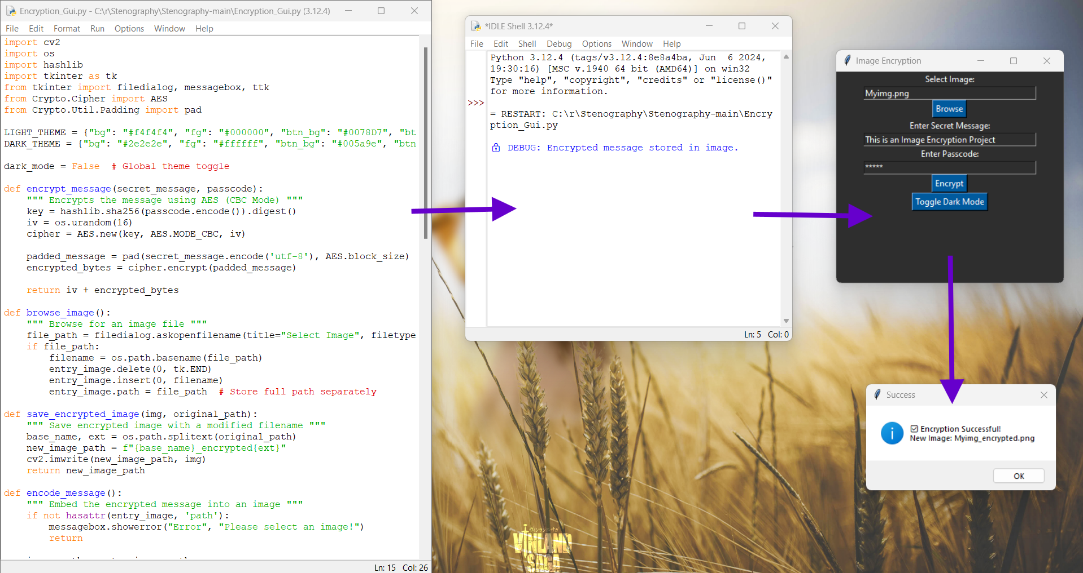
Results
Fig. 1 : Image Encryption Code, Image Encryption GUI Pop-up and
Successfully Encrypted Pop-up along with the Encrypted output file name.

Slide 8
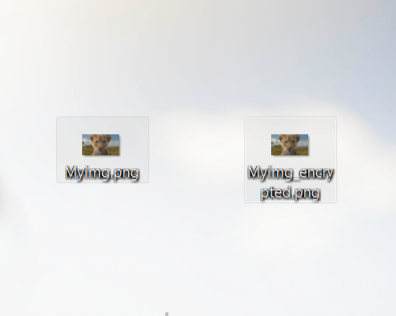
Fig. 2: Image Before and After Encryption

Slide 9
Fig. 3: Decryption Code, Decryption GUI Pop-up and
Successfully Decrypted Message Pop-up

Slide 10
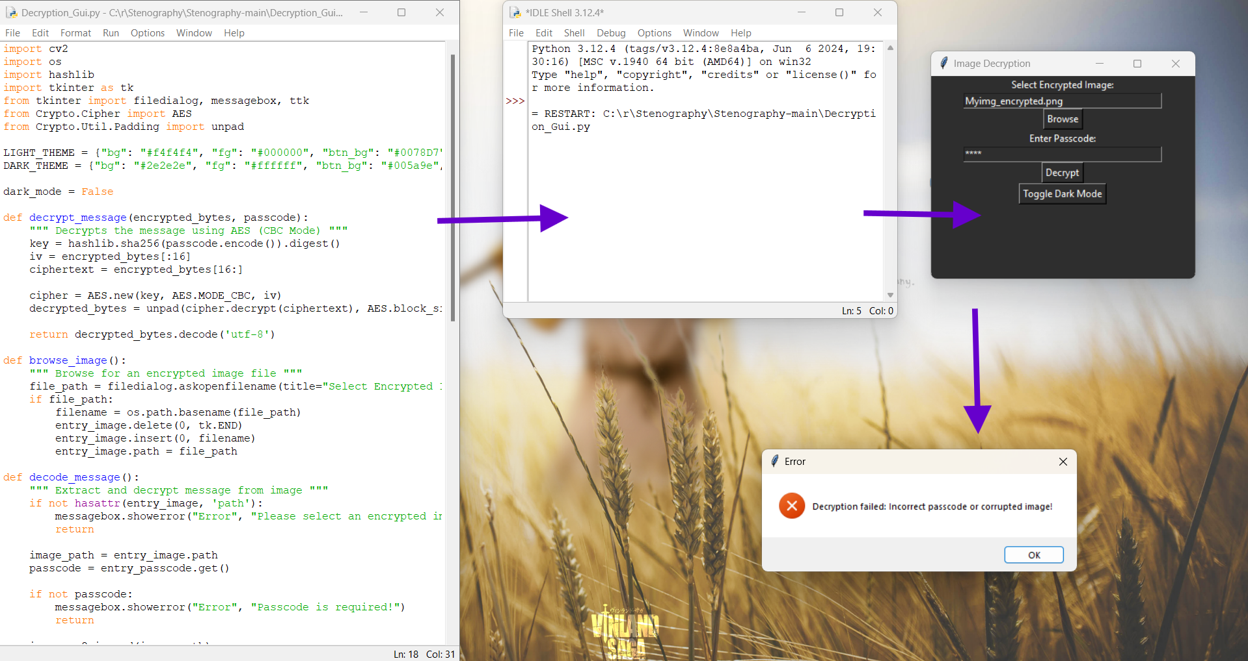
Fig. 4: Decryption Code, Decryption GUI Pop-up and
Error Pop-up if selected image wrong or Password entered is wrong.

Slide 11
Conclusion
🔐 Steganography provides a robust way to hide sensitive data.
📷 Our system ensures security via AES encryption & LSB encoding.
🚀 Future improvements include multi-layer encryption & video steganography.

Slide 12
GitHub Link
📌 Find the complete source code & documentation here:
🔗 https://github.com/ram-19/Image-Stenography_AICTE

Slide 13
Future scope(optional)
🚀 Extending to Video Steganography.
📱 Mobile App for secure communication.
💡 AI-powered enhancements for better security.
🔐 Multi-layer encryption for additional protection.

Slide 14
THANK YOU

