Slide 1
Maxwell's Equations (EM Theory) and Generation of Light
V Sharma

Slide 2
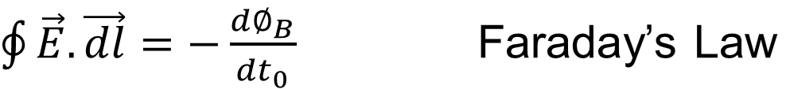
Maxwell’s Equations in Integral form
where E → electric field,
B → magnetic field,
ε → permittivity, μ → permeability of the medium.
Notes:
When you solve the Maxwell’s equations and you get the waves. Its beautiful. Maxwell might not have thought about it when he was deriving these. Here are a few Maxwell’s equations, shown here on screen.
The first one says there are things that manufacture Electric field lines and they are charges. They make them and they eat them. Depending on how many got in a volume, the net will decide the flux out of that volume.
The second one tells you, when you draw any surface and integrate B over that surface means you count the number of lines coming out, what you get here is “zero” that’s because lines begin and end with charges. There are no magnetic charges. If you have seen any magnetic lines, whatever goes in has to come out. That’s the statement of no magnetic charges here.
The third one here, without right hand side says that electric field is conservative. But in time domain what we found that “E.dl” is the rate of change of magnetic field.
Fourth one says that changing Electric field produces magnetic field, in addition a current can also produce a magnetic field.

Slide 3
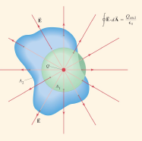

Charges make the electric field lines. They make them they eat them. Depending on how much got in the volume the net will decide the flux out of that volume.
Notes:
The first one says there are things that manufacture Electric field lines and they are charges. They make them and they eat them. Depending on how many got in a volume, the net will decide the flux out of that volume.

Slide 4
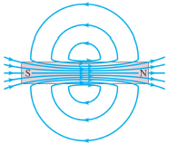

If you draw any surface and integrate B over that surface then you get zero.
Notes:
The next one tells you that if you draw any surface and integrate B over that surface, namely, you're counting the net number of lines coming out, you're going to get 0. That's because lines begin and end with charges and there are no magnetic charges. If you look at any magnetic field problem, the lines don't have a beginning or an end. They end on themselves. So if you put any surface there, whatever goes in has to come out. That's the statement of no magnetic charges.
The second one tells you, when you draw any surface and integrate B over that surface means you count the number of lines coming out, what you get here is “zero” that’s because lines begin and end with charges. There are no magnetic charges. If you have seen any magnetic lines, whatever goes in has to come out. That’s the statement of no magnetic charges here.

Slide 5
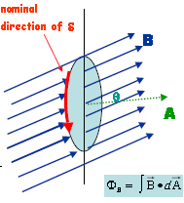

Faraday’s Law
E⋅dl → rate of change of the magnetic field. So changing magnetic field sustains an electric field.
Notes:
The third one here, without right hand side says that electric field is conservative. But in time domain what we found that “E.dl” is the rate of change of magnetic field.

Slide 6
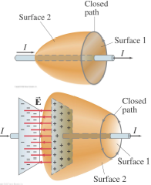


Ampere-Maxwell Law
A magnetic field is produced by an electric current is given by
A changing electric field will also produce a magnetic field. Finally;
A changing electric field can produce a magnetic field. In addition, a current can also produce a magnetic field.
Notes:
Fourth one says that changing Electric field produces magnetic field, in addition a current can also produce a magnetic field.

Slide 7
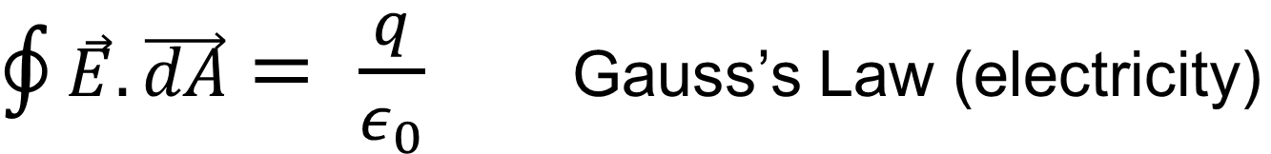
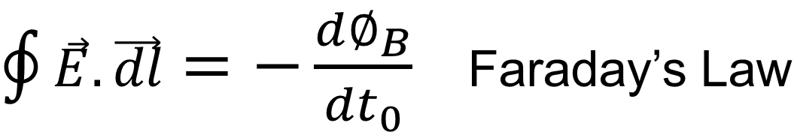
Maxwell’s Equations in Free Space
Notes:
We are going to focus on free space where we are no where near charges and current. Equation then look more symmetric. So, first two equations got no surface integral. In last equation current becomes zero. And last two equations become identical. Rate of change of electric field will give you magnetic field and rate of change of magnetic field will give you electric field.

Slide 8
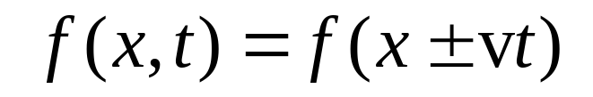
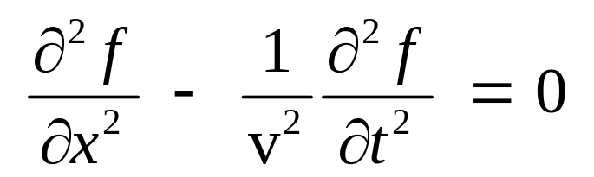
Now we need to derive the wave equation.
Satisfies wave equation
Notes:
In last class we discussed about the wave equation.

Slide 9
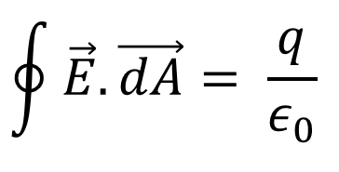

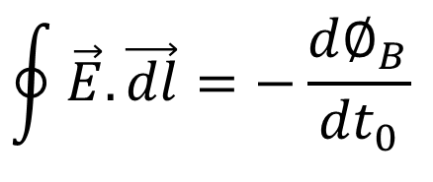
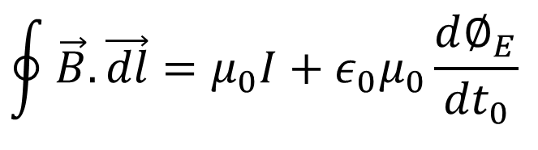
How about Maxwell equations?
On what surface we have to do integrations? Where is the surface, where is it located, how big it is?
Notes:
Now lets go back to the old Maxwell equations. Now we want to do them and ask myself. We will write down a solution and we see if it obeys these four Maxwell equations. If we write down the solution for electric field and the magnetic field they have to obey all these four conditions or those four equations up here.
Lets take the first case of working in the vacuum, when there is no current and when there is no charge. So you want a surface integral of E on any surface to be 0 and the surface integral of B on any surface to be 0. Look at the surface integral first. Do you understand?
This was never going to be non-zero. This will be non-zero near matter but we are far from any charges, so there is nothing to enclose in the volume. There are no charges there. Look at those equations. I give you a function and I say, "Tell me if it satisfies Maxwell's equations," what do you have to do? Operationally, what is it that you have to do? Any ideas on what you must do at this point to test? You have no idea what you may have to do? What if I give you a function and say, "See if it satisfies the wave equation," what will you do then? Take the function and then what? Yes?
On what surface we have to do integrations? Where is the surface, where is it located, how big it is? It could be anywhere, it could be of any size, it could be of any shape.
We need to find out the surface and integrate it over the different surfaces, it’s a huge task. Same is true for loops. There is a quicker way to do it.
If true for a tiny surface, true for big ones. If true for a tiny loop, true for big ones.

Slide 10
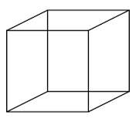
If true for a tiny surface, true for big ones. If true for a tiny loop, true for big ones.
Surface Integral on infinitesimal surface
surface integral on one cube + surface integral on second cube = the surface integral on the union of the two
Notes:
If I take a infinitesimal loop or the surface and these guys satisfy on that infinitesimal thing, its gonna satisfy at macroscopic thing. How does it come about?
If you draw a cube and draw a normal to it. And take integral of E.dA and add it. The area vector is defined outward pointing normal to every face. Then we take the second cube here, and its got its own outward normal and this is surface 2 (S2). Bring this common face together and glue them. The joining face is common to both. Then the we can claim that the surface integral on one cube + the surface integral on second cube = the surface integral on the union of the two. If the surface integral on the small object is made zero then the surface integral on the big object will be zero.

Slide 11
Line Integral on infinitesimal surface
Prove for three independent loops in different planes and combine little pieces and you make any surface.
Notes:
Any Maxwell equation if it is true for a tiny square, it is true for bigger square.

Slide 12
E = k E_{z}(y,t)
z
da
da
da
Direction of Propagation
da
y
x
da
B = i B_{x}(y,t)
E.da → zero .. Whatever comes in from bottom goes out from top.
Notes:
I'm going to take an electric field that is entirely in the z direction and the z field will depend on y and t. And I'm going to take a magnetic field which is going to be in the x direction and the B field is going to depend on the y and t. So let me tell you how my axes are defined here. This is x, this is y, this is z. The electric and magnetic fields, the electric field will always point along the z axis. The magnetic field will always point along the x axis. They will not vary, as you vary x or z. They'll vary only if you vary y by assumption. In general, it can vary with everything, but I'm trying as a modest goal to find a simple solution which has a dependence on only two of the four possible coordinates. It depends on only y and t, rather than x, y, z and t. Let's get any solution. We cannot get every possible one; let's get something and something, I assume, has this form. So this is called a plane wave, because if you take the plane y = 0, Eand B are constant on that plane. Because when y is fixed or some value, E and B are not changing as you vary x and z. So you should think of it as plane after plane and on each plane, the field is doing something. It's doing the same thing. If I draw a plane here, that field is a constant. E is a constant and that plane and B is a constant on that plane.
On another plane, it could be a different constant, but within the plane, it varies from plane to plane. So that is not an axiom, that's not a law. That's an assumed simplicity in the function I'm looking at. There's no theorem that says that every solution to Maxwell equations much obey this condition. In general, these functions will be functions of x, y, z and t. The trick will be superposition. If I can get a solution that depends only y and t, and you can get a solution that depends on z and t, I can add them up and they will still be a solution, because the wave equation is linear. You can add solutions. Then our sum of the two solutions will be a function of y and z. You can bring in the x and so on. So you do the simplest one, then you can add them. So here is my function and I have to know what I can say about these two functions. You understand? In general, the electric field has three components, the magnetic field has three components. Each of them depends on four quantities, x, y, z and t. Big mess. In our simplified solution, the only unknown component of E is E_{z}. I'm assuming there is no E_{x} and there is no E_{y}. And there is no B_{y} and there is no B_{z}.

Slide 13
z
E
da
da
da
y
Direction of Propagation
da
x
B
da
B.da → zero
Notes:
Now you might say, "Why don't you go a little further? Kill the B also." You can try that. If you kill theB, you will find the only solution is to get everything equals 0. So by trial and error, we know this is the first time you can get something interesting going. If you make it simpler than that, you get nothing. You can make it more complicated, but not simpler.
So now, will this satisfy the surface integral condition? Let's check that? So what do I need to do for that? I have to take a cube, right? Let me take the cube. It's infinitesimal, but I'm just keeping it near the origin. It can be anywhere you want, but I'm drawing it near the origin. It's a surface, and it's got these outward going normals. And I must take E ⋅ surface area for every face. And I've got to get 0. That's the condition. So is that going to work or not? Let us see. There are six faces in this cube, so I'm going to draw 1, 2 and 3 that I can see, and -1, -2 and -3 refer to the faces on the opposite side. This is 3, that's -3.
So I can only show you 1, 2 and 3. Let's look at surface 1 and ask what I get from the surface integral of E. Do you agree that E points this way? So E⋅dA is a non-zero contribution on surface 1. But on surface -1, E still points up, but dA points down, because E doesn't vary from the upper face to the lower face, because in going from upper to lower, I'm varying the coordinate z, but nothing depends on z. The same electric field is sitting on the upper plane of this cube as on the lower plane of the cube. Therefore the surface integrals will cancel and give you 0, because the area vectors are opposite. That is a simple statement, that if you've got a constant electric field going through a cube, the net flux will be 0 because what's coming in on one side goes out of the other side. So that's the cancelation of 1 and -1 giving me 0. But there are other faces, like 3 and -3. What surface integral will I get from 3? The area vector looks like this, the electric field looks like that, the dot product is 0. In other words, the field lines are parallel to this face, so they are not going to penetrate it. You're not going to get any flux. Or the area vector is perpendicular to the field vector.
So on this face, E is 0, on the opposite face is also 0. The same thing goes for 2 and -2. If you go to face number 2 here, the electric field is pointing like that, but there is no flux and there is no flux on the opposite face. So if you get 0, either because the field is parallel to the face, or if it's perpendicular, it has the same value on opposite faces, with opposite pointing normals, or opposite pointing area vectors and you get 0. That's how you get the surface integral of E to be 0 on this tiny cube. But if it's 0 on a tiny cube, it's 0 on anything you can build out of tiny cubes. That means 0 on any surface. If you repeat the calculation for B, you'll get pretty much the same logic, except that Bnow points like this. So on the top face, B will have no flux because it's running along the face. There is no flow through that. Top and bottom are 0 and 0. The only faces that matter are 2 and -2, because 2 is coming out of the board and B is coming out of the board. But on the other face, which you cannot see, the -2, B is still going this way, but E, the area vector is going the opposite way. The key to this is that B does not vary.
You see, if the flux was not constant, if the field was not constant, the fact that you've got two faces with opposite pointing area vectors doesn't mean the answer is 0. Even though the area vectors are opposite, the field strength would be bigger on one face, smaller on the opposite face, in which case they won't cancel. But the field is not varying in the coordinate in which I've displaced the planes. That's the reason you get 0 for both of those. All right. So far what I've shown you is that the solution I have automatically satisfies 0 surface integral without any further assumptions. Of course, it's very important that E did not vary with x and z. But with the assumed form, I don't have to worry. I still have to only worry about the other two Maxwell equations involving line integrals. I've got to make sure that works out.

Slide 14
For other two equations we need to take loops.

Slide 15

Applying Faraday to radiation
E = k E_{z}(y,t)
z
Δx
Δz
da
Direction of Propagation
y
B = i B_{x}(y,t)
x
B
Zero again

Slide 16
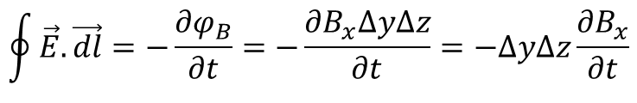
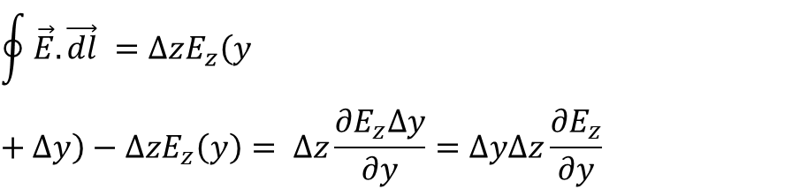
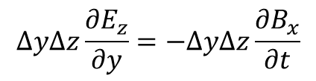
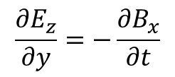
Applying Faraday to radiation
E = k E_{z}(y,t)
z
Δy
da
Δz
y
x
B = i B_{x}(y,t)
Zero

Slide 17
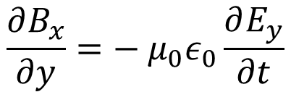
Applying Ampere to radiation
E
z
da
Similarly,
y
Δy
Δx
x
B
Zero
Assignment 1 (Part 2)

Slide 18
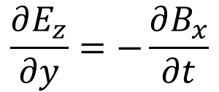
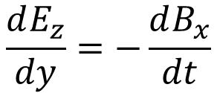
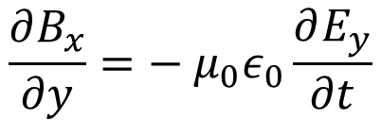
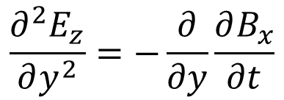
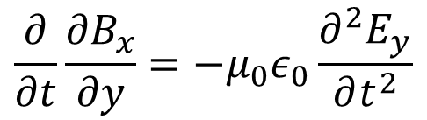
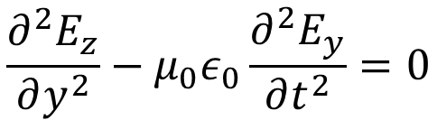
Fields are functions of both position (x) and time (t)
Partial derivatives are appropriate
This is a wave equation!

Slide 19
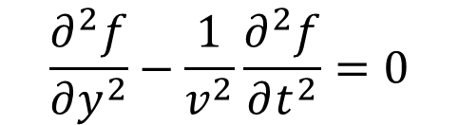
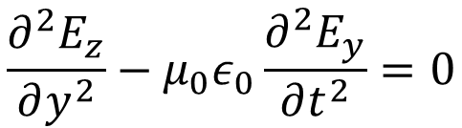
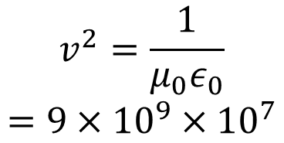

This is the speed of light in a vacuum, which means that…
electromagnetic waves propagate at the speed of light
light is an electromagnetic wave.
These are two very important conclusions from this mathematical excursion.

Slide 20
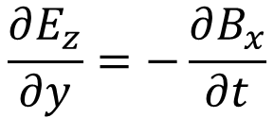
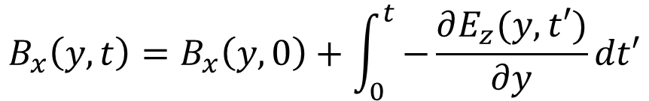
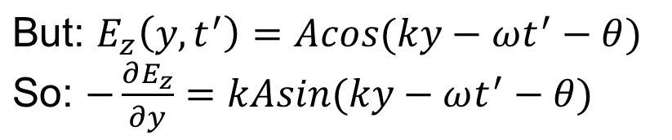
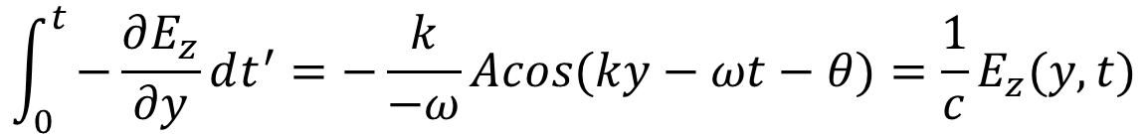

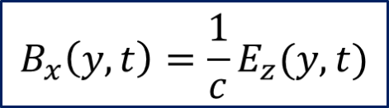
The Magnetic-Field Strength in a Light Wave
Take B_{x}(y,0)=0 (not a wave)
Minus signs cancel
Integral’s lower limit (t’ = 0) isn’t a wave.
And:
ω / k = c:
So:

Slide 21
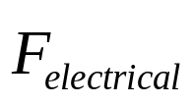
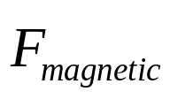
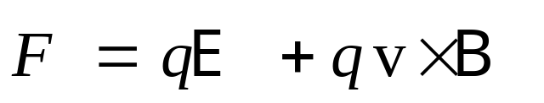

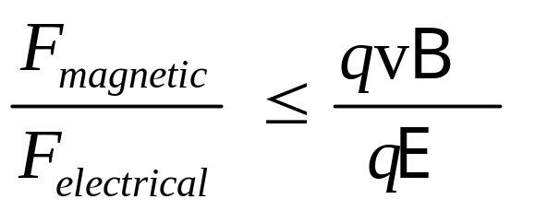
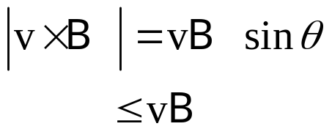
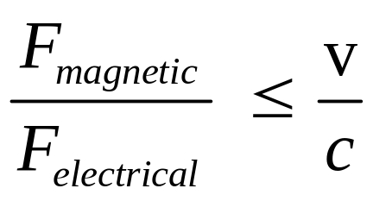
Why We Neglect the Magnetic Field
The force on a charge, q, is:
Taking the ratio of
the magnitudes
of the two forces:
Since B = E /c:
where is the charge velocity
So as long as a charge’s velocity is much less than the speed of light, we can neglect the light’s magnetic force compared to its electric force.

Slide 22
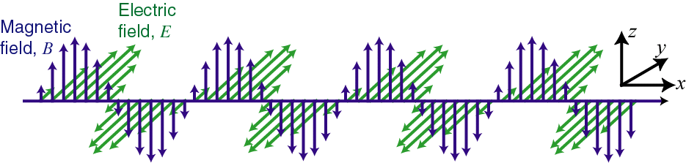

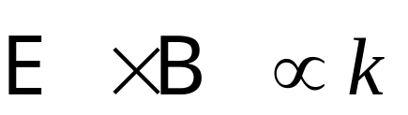
An Electromagnetic Wave
The electric and magnetic fields are in phase.
Snapshot of the wave at one time
y
E
x
z
B
The electric field, the magnetic field, and the k-vector are all perpendicular:

Slide 23
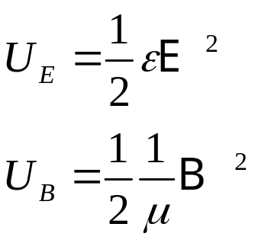
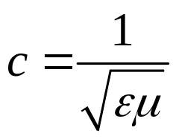
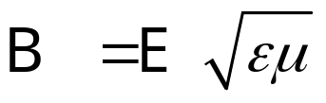
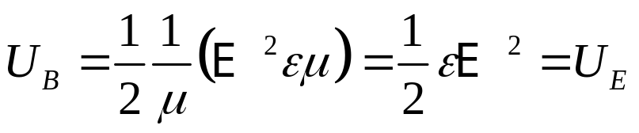
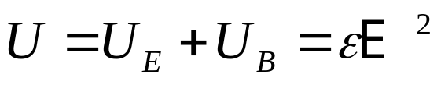
The Energy Density of a Light Wave
The energy density of an electric field is:
The energy density of a magnetic field is:
Using B = E /c and , we have:
So:
Total energy density:
So the electrical and magnetic energy densities in light are equal.

Slide 24

The Poynting Vector: S = c² ε E × B
The power per unit area in a beam.
Justification (but not a proof):
Energy passing through area A in time Δt:
= U V = U A c Δt
So the energy per unit time per unit area:
= U V / ( A Δt ) = U A c Δt / ( A Δt ) = U c = c ε E ²
= c² ε E B
And the direction is reasonable.
U = Energy density
A
c Δt

Slide 25
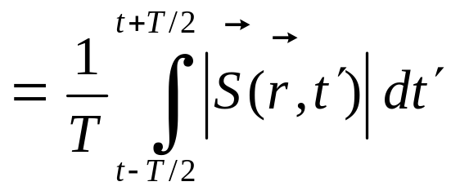
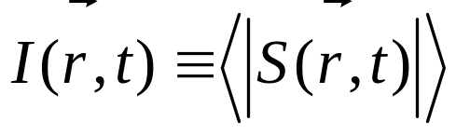

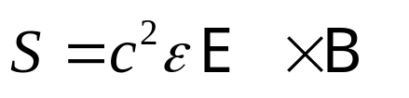
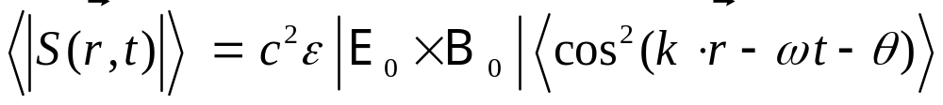
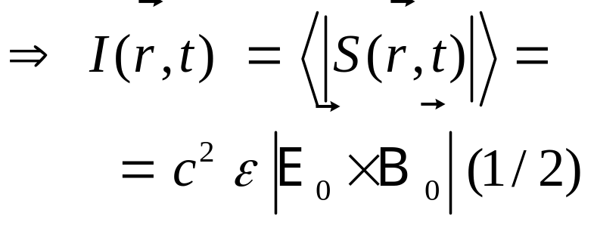
The Irradiance (Intensity)
|Vector magnitude|
A light wave’s average
power per unit area is
the irradiance.
Substituting a light wave into the expression for the Poynting vector,
yields:
real amplitudes
The average of cos² is 1/2:
cos²(ωt−a)
1
1/2
t

Slide 26

Sunlight at earth’s surface: 1 kW/m²
Moonlight at earth’s surface: 2 mW/m²
Notes:
Moon image from http://www.fourmilab.ch/earthview/figures/perigee.jpg
Magnitude data and explanation below from http://www.astro.northwestern.edu/labs/m100/mags.html
Given that the eye is a logarithmic detector, and the magnitude system is based on the response of the human eye, it follows that the magnitude system is a logarithmic scale. In the original magnitude system, a difference of 5 magnitudes corresponded to a factor of roughly 100 in light intensity. The magnitude system was formalized to assume that a factor of 100 in intensity corresponds exactly to a difference of 5 magnitudes. Since a logarithmic scale is based on multiplicative factors, each magnitude corresponds to a factor of the 5th root of 100, or 2.512, in intensity. The magnitude scale is thus a logarithmic scale in base 1001/5 = 2.512.

Slide 27



Sums of fields: Electromagnetism is linear, so the principle of Superposition holds.
If E₁(r,t) and E₂(r,t) are solutions to the wave equation,
then E₁(r,t) + E₂(r,t) is also a solution.
Proof:
and
This means that light beams can pass through each other.
It also means that waves can constructively or destructively interfere.

Slide 28
Waves using complex numbers
The electric field of a light wave can be written:
E (x,t) = A cos(kx – ωt – θ)
Since exp(iϕ) = cos(ϕ) + i sin(ϕ), E(x,t) can also be written:
E (x,t) = Re { A exp[i(kx – ωt – θ)] }
We often write these expressions without the ½, Re, or +c.c.
or
E (x,t) = 1/2 A exp[i(kx – ωt – θ)] + c.c.
where “+ c.c.” means “plus the complex conjugate of everything before the plus sign.”

Slide 29





The Irradiance of the Sum of Two Waves
If they’re both proportional to , then the irradiance is:
Different polarizations (say x and y):
Intensities add.
Same polarizations (say ):
Therefore:
Note the cross term!
The cross term is the origin of interference!
Interference only occurs for beams with the same polarization.

Slide 30





The Irradiance of the Sum of Two Waves of the Same Polarization, But Different Color
We can’t use the formula because the k’s and ω’s are different.
So we must use the Poynting vector,
At least, identical polarizations allow us to ignore the vector magnitude.
I₁
I₂
Consider a cross term:

Slide 31


The Irradiance of the Sum of Two Waves of the Same Polarization, But Different Color
Waves of different frequencies
go in and out of phase. So their product is as often positive as negative.
It integrates (averages) to zero.
t
Thus the product, E₁ B₂, averages to zero, as does E₂ B₁.
Different colors:
Their intensities add.
Waves of different color (frequency) do not interfere!

Slide 32


Irradiance of the Sum of Two Waves
Same polarizations
Perpendicular polarizations
Coherent addition
Same colors
Incoherent addition
Assignment 1 – Part 2
Different colors
Interference only occurs when the waves have the same color and polarization.
Assignment 1 – Part 1 & 2 – Due date 1st November 2016 before 12 noon- Office E-103

Slide 33

Where does light come from?
HOW ARE EM WAVES PRODUCED?

Slide 34




Where does light come from?
We’ve seen that Maxwell’s Equations (i.e., the wave equation) describe the propagation of light.
But where does light come from in the first place?
Electron clouds
Light is emitted by matter. This happens via the matter’s polarization:
Nuclei
if all the charges are the same
where N is the number density of charged particles, q_{i} is the charge
of each particle, and is the position of the charge, q_{i}.
Here, we’ve assumed that each charge is identical, q, and has identical motion, .

Slide 35
Polarized and Unpolarized Media
Slightly polarized medium (lots of cancellations)
Highly polarized medium
Unpolarized media
The displacements of the charges are random
The displacements of the charges are correlated, so it is polarized at any given time (and its polarization is oscillating).

Slide 36







Maxwell's Equations in a Medium
The induced polarization, , contains the effect of the medium and is included in Maxwell’s Equations:
This extra term also adds to the wave equation, which is known as
in
the homogeneous wave equation:
The polarization is the source term and tells us what light will be emitted.
Note that is just the charges’ acceleration!
So light is emitted by accelerating charges!

Slide 37

Sources of Light
Accelerating charges emit light!
Linearly accelerating charge
Synchrotron radiation—
light emitted by charged
particles deflected by a
magnetic field
Bremsstrahlung (Braking radiation)—
light emitted when charged particles
collide with other charged particles
Read about all these radiation sources

Slide 38
But most light in the universe is emitted by atomic and molecular vibrations.
Electrons vibrate in their motion around nuclei.
High frequency: ~10¹⁴ - 10¹⁷ cycles per second.
Nuclei in molecules vibrate
with respect to each other.
Intermediate frequency:
~10¹¹ - 10¹³ cycles per second.
Nuclei in molecules rotate.
Low frequency: ~10⁹ - 10¹⁰ cycles per second.

Slide 39

Atomic and molecular vibrations correspond to excited energy levels in quantum mechanics.
Energy levels are everything in quantum mechanics.
Excited level
ΔE = hν
Energy
Ground level
The atom is vibrating at frequency, ν.
The atom is at least partially in an excited state.

Slide 40
Excited atoms emit photons spontaneously.
When an atom in an excited state falls to a lower energy level, it emits a photon of light.
Excited level
Energy
Ground level
Molecules typically remain excited for no longer than a few nanoseconds. This is often also called fluorescence or, when it takes longer, phosphorescence.

Slide 41

Different atoms emit light at different widely separated frequencies.
Each colored emission line corresponds to a difference between two energy levels.
These are emission spectra from gases of hot atoms.
Frequency (energy)
Atoms lack nuclear vibrations and rotations and so have relatively simple energy level systems (and hence simple spectra).

Slide 42
Einstein showed that another process, stimulated emission, can also occur.
Before After
Spontaneous emission
Absorption
Stimulated
emission

Slide 43


Slide 44


