Slide 1
SPACE-EFFICIENT SLIDING WINDOW
FREQUENCY ESTIMATION VIA DLS-CMS
Decayed Lazy Sparse Count-Min Sketch
Harsh Patil (BT24CSD033)
Sutikshan Upman (BT24CSD043)
Akshat Pareek (BT24CSD041)
Notes:
Title slide. Introduce the paper and authors. Mention this is about sliding-window frequency estimation using a novel data structure called DLS-CMS, which stands for Decayed Lazy Sparse Count-Min Sketch.

Slide 2
PROBLEM STATEMENT & MOTIVATION
Data Streams
Frequency Estimation
Sliding Window
Continuous, unbounded data flows from networks, IoT sensors, e-commerce. Must be processed in a single pass with limited memory.
Count how often item x appears. Exact counting is infeasible at scale. Probabilistic sketches like CMS provide approximate counts efficiently.
Applications care about RECENT data only (last N elements). Standard CMS never forgets — old counts accumulate forever.
Key Question: How can we efficiently forget old data while maintaining accurate frequency estimates at standard CMS memory cost?
Notes:
Explain why this problem matters: network operators, recommendation engines, and cache systems all need recent-window counts, not lifetime totals. Standard CMS accumulates all insertions forever — it has no mechanism to forget old data.

Slide 3
BACKGROUND: COUNT-MIN SKETCH & LIMITATIONS
Count-Min Sketch (CMS)
Critical Limitations
Maintains a d × w counter matrix
Each row uses a distinct hash function
Insert(x): increment d counters
Query(x): return minimum counter across all rows
Space: O(1/ε · log(1/δ))
Guarantee: f̂(x) ≤ f(x) + ε·||f||₁ w.p. ≥ 1−δ
Limitation | Impact
Counters only increment | Cannot remove old data
No expiry mechanism | Old items stay forever
Error grows with ||f||₁ | Degrades on long streams
No deletion support | Can't handle flow expiry
Hard-reset workarounds | Spike artifacts at boundaries
d×w counter grid (values only increase)
Notes:
Explain the CMS architecture briefly. The key limitation is that CMS counters are monotonically non-decreasing — insertions only add, never subtract. This makes windowed queries impossible without auxiliary structures.

Slide 4
FROM DA-CMS TO DLS-CMS
DA-CMS (Foundation)
DLS-CMS (Proposed)
Multiply all counters by λ ∈ (0,1) before each insert
Older items naturally fade — soft sliding window
Total weight bounded: F = 1/(1−λ)
Sketch sized to F, not total stream length M
No hard-reset spikes at window boundaries
Fixes DA-CMS engineering limitations:
Eager global decay costs O(dw) per insert
No deletion support in DA-CMS
DLS-CMS solution:
Lazy decay — apply only to accessed buckets → O(d)
Two sparse sketches (CMS+ / CMS−) for deletions
Pruning threshold τ = εF/2 removes near-zero entries
▶
DLS-CMS retains the same O(1/ε · log(1/δ)) space guarantee as DA-CMS, with O(d) per-event cost instead of O(dw)
Notes:
Explain the two-step evolution: DA-CMS was the theoretical contribution, DLS-CMS is the practical realization. The key insight is that we can defer the decay computation until a bucket is actually touched, making per-event cost O(d) instead of O(dw).

Slide 5
DLS-CMS ARCHITECTURE
Incoming Event (x, Δ, t)
▼
Route: Δ>0 → CMS+ Δ<0 → CMS−
▼
CMS+ (Insertion Sketch)
CMS− (Deletion Sketch)
d sparse hash maps (row → bucket)
Each bucket: (value, last_access_time)
Lazy decay: v ← v · λ^(t−ts)
Prune if v < τ = εF/2
Identical structure to CMS+
Tracks negative (delete) events
Same lazy decay + pruning
Absent bucket = implicit zero
Query: f̂(x) = max(0, min_i(v⁺ᵢ − v⁻ᵢ))
Params: d = ⌈ln(1/δ)⌉ w = ⌈e/ε⌉ λ ∈ (0,1) F = 1/(1−λ) τ = εF/2
Notes:
Walk through the architecture. Two sparse sketches: CMS+ for insertions, CMS- for deletions. Each sketch uses sparse hashmaps (not dense arrays). Lazy decay means the decay multiplier is applied only when a bucket is actually touched. Pruning deletes very small entries to save memory.

Slide 6
ALGORITHM WORKING IN DETAIL
DLS-INSERT(x, Δ, t)
DLS-DELETE(x, Δ, t)
DLS-QUERY(x, t)
for i = 0 to d−1:
j ← hᵢ(x) mod w
if j ∈ CMS+[i]:
v,ts ← CMS+[i][j]
v ← v · λ^(t−ts)
else: v ← 0
v ← v + Δ
if v < τ: del CMS+[i][j]
else: CMS+[i][j] ← (v,t)
Cost: O(d)
for i = 0 to d−1:
j ← hᵢ(x) mod w
if j ∈ CMS−[i]:
v,ts ← CMS−[i][j]
v ← v · λ^(t−ts)
else: v ← 0
v ← v + Δ
if v < τ: del CMS−[i][j]
else: CMS−[i][j] ← (v,t)
Cost: O(d)
for i = 0 to d−1:
v⁺ᵢ ← decayed(CMS+[i],t)
v⁻ᵢ ← decayed(CMS−[i],t)
estᵢ ← v⁺ᵢ − v⁻ᵢ
return max(0, minᵢ(estᵢ))
decayed(bucket,t):
if bucket exists:
return v · λ^(t−ts)
else: return 0
Key Efficiency Insight
Lazy decay: Decay is applied only to the d touched buckets, not all d×w counters. Eager (DA-CMS): O(dw) per event ≈ 1360 float multiplications for ε=0.01, d=5 Lazy (DLS-CMS): O(d) per event → 109× speedup over SD-CMS in experiments
Notes:
Walk through the three algorithms. Insert and Delete are mirror images — only the target sketch differs. Emphasize that lazy decay means the exponential multiplier λ^(t-ts) is computed ONLY for the bucket being accessed, not for the whole matrix. This is the core optimization.

Slide 7
MATHEMATICAL FORMULATION & GUARANTEES
Definitions
Error Bound
Stream: {(x_{s}, Δ_{s}, t_{s})}_{s=1->m} (Δ can be ±)
Decayed frequency at time t:
f_{λ}(x,t) = Σ Δ_{s}·λ^(t−t_{s}) for x_{s=x}, Δ_{s>0}
− Σ|Δ_{s}|·λ^(t−t_{s}) for x_{s=x}, Δ_{s<0}
Total weight converges: Σₓ f_{λ}(x,t) ≤ F
Effective window: F = 1/(1−λ)
Pruning threshold: τ = εF/2
Max active entries / row: ≤ 2/ε (pruning lemma)
Pr[ f̂(x,t) − fλ(x,t) > ε·F ] ≤ δ
where w = ⌈e/ε⌉ and d = ⌈ln(1/δ)⌉
Space Bound
DLS-CMS uses O(1/ε · log(1/δ)) space.
Pruning lemma: ≤ 2/ε active entries per row;
DLS-CMS keeps only active buckets .
Proof Sketch (Error Bound)
Standard CMS Markov+union-bound applies with ||f||₁ replaced by F (geometric series). Each row overestimates by at most εF in expectation. Min over d rows gives failure prob ≤ (e/w)^d ≤ δ.
Notes:
The key mathematical result: the error is bounded relative to F = 1/(1-λ), the effective window weight, NOT the total stream length M. This is what allows DLS-CMS to have fixed space even on very long streams. The proof reuses the standard CMS analysis with F in place of ||f||₁.

Slide 8
EXPERIMENTAL SETUP & RESULTS
Experimental Setup
Algorithm | Space (KB) | vs DLS-CMS
Count-Min Sketch | 5.31 | 4.5×
Count Sketch | 585.94 | 500.8×
Hokusai | 21.25 | 18.2×
λ-HCount | 5.84 | 5.0×
FDCMSS | 42.50 | 36.3×
SD-CMS | 106.21 | 90.8×
DLS-CMS ✓ | 1.17 | 1.0×
Synthetic uniform-distribution stream
Stream length M = 10,000
Vocabulary size = 15 words
ε = 0.01, δ = 0.01, λ = 0.95
Python 3, NumPy, time.time()
7 algorithms compared
DLS-CMS Space: 1.17 KB
DLS-CMS Time: 0.0465 s
vs CMS: 5.31 KB (4.5× reduction)
vs CMS:0.0365s (just 1.27x slower)
Notes:
The experiments compared 7 algorithms at ε=δ=0.01. DLS-CMS achieves the smallest memory footprint of all methods — 1.17 KB — due to sparse storage and aggressive pruning. The 109× speedup over SD-CMS is entirely due to lazy vs eager decay.

Slide 9
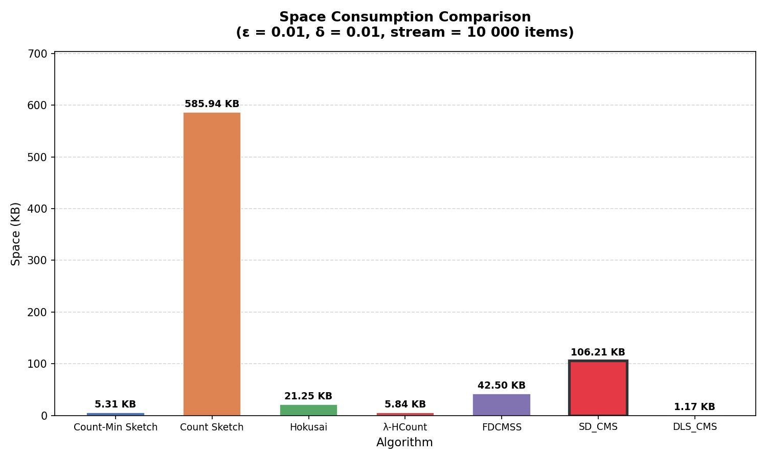
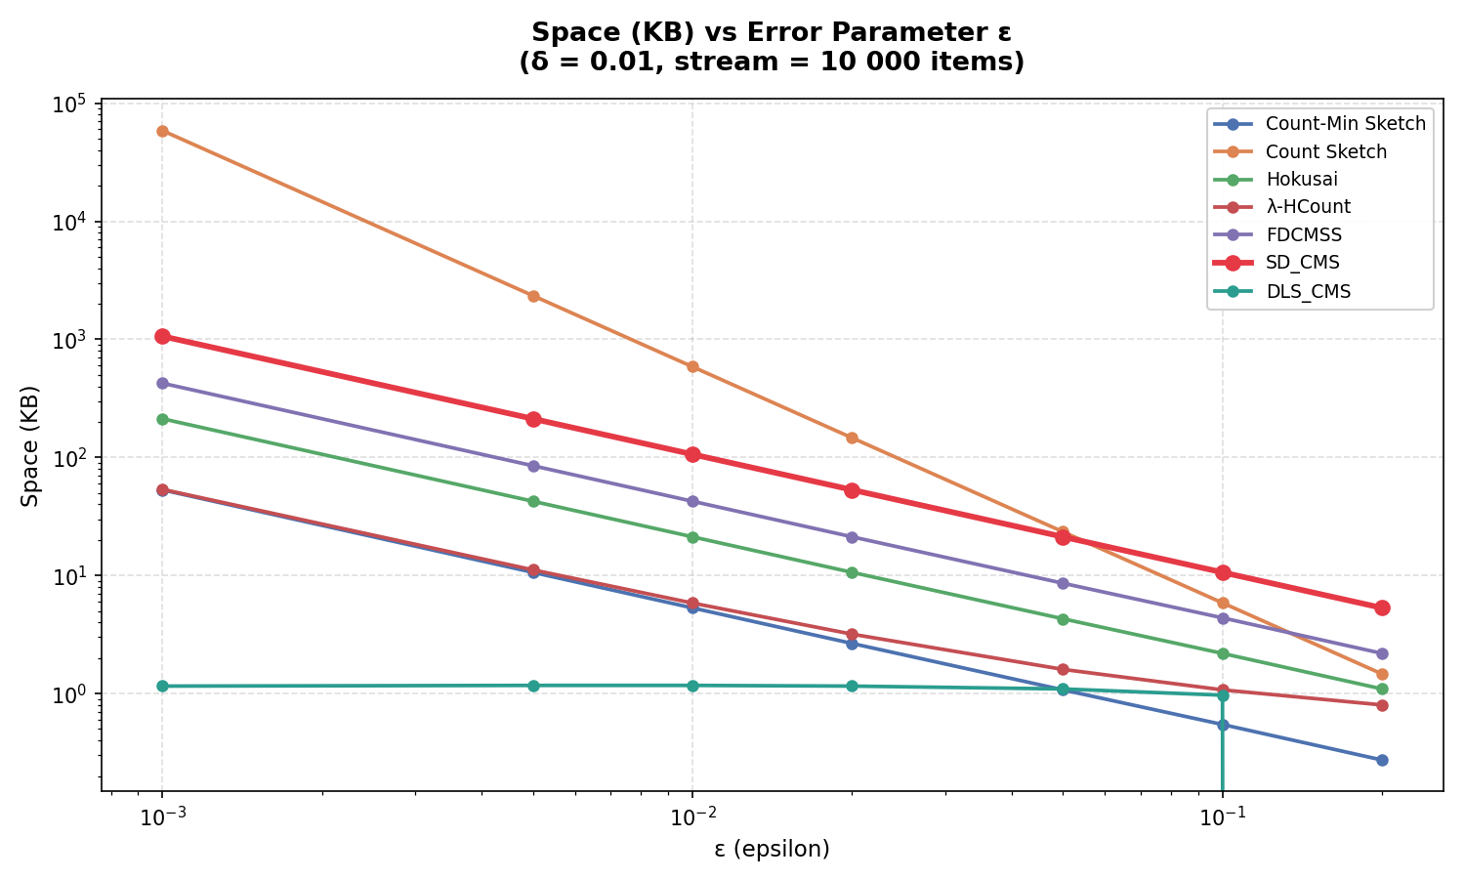
RESULTS
Notes:
Summarize the five key contributions of DLS-CMS. The take-home message: DLS-CMS is the first method to simultaneously achieve standard CMS space, windowed accuracy, deletion support, and smooth decay — validated both theoretically and empirically.

Slide 10
COMPARISON WITH PRIOR WORK
Method | Space | Window | Deletion | No Spikes
CMS | O(1/ε log 1/δ) | ✗ | ✗ | ✓
Count Sketch | O(1/ε² log 1/δ) | ✗ | ✓ | ✓
Hokusai | O(1/ε log N log 1/δ) | ✓ | ✗ | ✓
ECM-Sketches | O(1/ε² log N log 1/δ) | ✓ | ✗ | ✓
Simple Reset | O(1/ε log 1/δ) | ≈ | ✗ | ✗
Prop. Decay | O(1/ε log 1/δ) | ≈ | ✗ | partial
SD-CMS | O(1/ε log 1/δ) | ✓ | ✓ | ✓
DLS-CMS ★ | O(1/ε log 1/δ) | ✓ | ✓ | ✓
DLS-CMS is the ONLY method achieving all four properties simultaneously at standard CMS asymptotic cost
Notes:
This table is the key comparison slide. Point out that no prior method has all four properties — windowed accuracy, deletion support, no hard-reset artifacts — at O(1/ε log 1/δ) space. DLS-CMS is unique in achieving all four simultaneously.

Slide 11
CONCLUSION
Key Contributions of DLS-CMS
🔹 Space
Only 1.17 KB at ε=δ=0.01 — lowest of all 7 tested methods; 4.5× less than CMS
🔹 Speed
O(d) per event via lazy decay → Doesn’t sacrifice much on speed over CMS
🔹 Deletion
Dual-sketch (CMS+ / CMS−) enables first-class deletion without extra space
🔹 Smooth
Exponential decay eliminates hard-reset spikes at window boundaries
Future Work
Real network traces (CAIDA) · Bursty-stream pruning · P4 programmable switch implementation
Notes:
Summarize the five key contributions of DLS-CMS. The take-home message: DLS-CMS is the first method to simultaneously achieve standard CMS space, windowed accuracy, deletion support, and smooth decay — validated both theoretically and empirically.

Slide 12
REFERENCES
[1] Cormode & Muthukrishnan, Count-Min Sketch, J. Algorithms 2005
[2] Datar et al., Exponential Histogram, SIAM J. Comp. 2002
[3] Papapetrou et al., ECM-Sketches, VLDB 2012
[4] Matusevych et al., Hokusai, UAI 2012
[5] Shrivastava et al., Ada-Sketch, SIGMOD 2016
[6] Rivetti et al., Simple Reset / Prop. Decay, IEEE NCA 2015
[7] Zeng et al., Survey on Sliding Window Sketch, 2023
[9] Yuan et al., UCL-Sketch, arXiv 2024
[10] S. Sun, J. Zheng, and D. Li, “HEE-Sketch: an efficient sketch for sliding-window frequency es_x0002_timation over skewed data streams,” in IEEE ISPA/BDCloud, 2019.
[11] X. Chen et al., “Fine-grained queue mea_x0002_surement in the data plane,” in Proc. ACM CoNEXT, pp. 15–29, 2019.
[12] J. Wang, J. Lu, and Z. Su, “SWDAKT: Knowl_x0002_edge tracing using sliding window-based dy_x0002_namic ability perception,” IEEE Access, 2023.
[13] Y. Wang, Y. Wang, and C. Chen, “DPSW_x0002_Sketch: A differentially private sketch frame_x0002_work for sliding windows,” Technical Report, 2023.
[14] S. Nagawanshi et al., “Learning-augmented mo_x0002_ment estimation on time-decay models,” 2026.
[15] Y. Wu et al., “SHE: A generic framework for data stream mining over sliding windows,” ACM TKDD, 2024.
Notes:
Summarize the five key contributions of DLS-CMS. The take-home message: DLS-CMS is the first method to simultaneously achieve standard CMS space, windowed accuracy, deletion support, and smooth decay — validated both theoretically and empirically.

