Slide 1
Microsoft’s TypeScript: JavaScript for the SharePoint Dev Guy
John Liu

Slide 2

about John Liu
Senior Consultant for SharePoint Gurus Sydney
User Groups, SharePoint Saturday, SharePoint Conferences,
http://johnliu.net
@johnnliu
Notes:
Loves .NET, SharePoint & Windows Phone
Our team building event was to build a Pergola for John.

Slide 3
Contents
What is TypeScript
Why do we need TypeScript
How
Demo
Pinteresp
Working with your existing JavaScript

Slide 4
What is TypeScript
Free and open source, strongly supported by Microsoft
Based on ecmascript 4 + ecmascript 6
Created by the father of C# Anders Hejlsberg
A superset of JavaScript
To answer why we need JavaScript+, we need to understand what's wrong with vanilla JavaScript

Slide 5
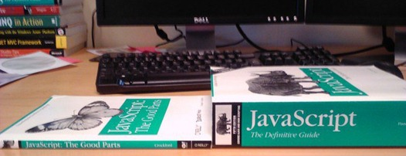
What is the problem
Why do people hate working in JavaScript?

Slide 6
What is the problem
JS is designed for small things
We now use to do big things
AJAX and REST = never refresh the page
But JavaScript is not suited for building large applications
Your JavaScript code gets complex; it becomes extremely unwieldy
Notes:
Who is using lots of JavaScript in their project now?
What libraries are you using?
JavaScript is designed as a scripting language to do small things on a browser document.
We now use it as a full programming language to do all sort of things, a "page" can be the application, and all logic runs in JavaScript.
AJAX and REST end points allow us to communicate to the server without refreshing the page.
But JavaScript is not suited for large applications
As JavaScript code gets complex, it is extremely unwieldy.

Slide 7
Problem - dynamic types
Variables are untyped and dynamic. Good because they are flexible.
Bad because it is so easy to get wrong
var x = 1; var y = x + 1; // OK, type is inferred. can assume x and y are both numbers.
var x = 1; x = "hello"; // NOT OK, type is mixed up. We can't assume what type is x.
var intX = "hello"; // I am most guilty too - var i, j, k, x, y, z, a, b, c, i1, i2; // JS is interpreted. There are no design-time or compile-time assistance to help you point out errors

Slide 8
Problem - dynamic types
Variables are untyped and dynamic. They are flexible
Bad because it is so easy to get wrong
var x = 1; var y = x + 1; // OK, type is inferred. can assume x and y are both numbers.
var x = 1; x = "hello"; // NOT OK, type is mixed up. We can't assume what type is x.
// I am most guilty too - var i, j, k, x, y, z, a, b, c, i1, i2; // JS is interpreted. There are no design-time intellisense or compile-time assistance to help you point out errors

Slide 9
Problems - parameters
Define a function with arguments. That is your contract with your caller. Unfortunately, in JavaScript, function parameters are more like guidelines, because callers don't take them seriously
function f(x) { return x + 1; }
f("hello"); f(1234); f(); f(function(){}); f([4]); f("hello", "world");
// and then we have this magic object. function f() { console.log(arguments.length); } f(1,1,2,2);
// Where did arguments come from? // Caller can still do whatever they want. Callee has to be defensive and check everything.
// It is so easy to get wrong

Slide 10
Problem - scope
JavaScript's scope looks like C#, but does not work at a block level. It is at the function level.
It is so easy to get wrong
var i = 1; if (i == 1) { var i = 2; } function x() { var i = 3; } x(); console.log(i);
var foo = 1; var y; function x() { var foo = 2; y = function(){ foo = 3; } } x(); y(); console.log(foo);
Notes:
// not a reference to coffeescript
// y is function closure - exposes an inner function, allowing the inner variable x.foo to be modified externally.
// extremely important in event handling, but difficult without strong coffee.

Slide 11
Problem - scope
JavaScript's scope looks like C#, but does not work at a block level. It is at the function level.
It is so easy to get wrong
var i = 1; if (i == 1) { var i = 2; } var y = function { var i = 3; }
Notes:
// not a reference to coffeescript
// y is function closure - exposes an inner function, allowing the inner variable x.foo to be modified externally.
// extremely important in event handling, but difficult without strong coffee.

Slide 12
Problem - object extension, not class-based
Based on objects. Easy to extend existing objects
This can be good, because you aren't restricted to defining your object at compile time only.
It is so easy to get wrong
var x = { a : 1, b : 2 } x.c = 3; console.log(x.a + x.b + x.c);
var x = { a : 1, b : 2, a : 3 } console.log(x.a + x.b);
// object inheritance is possible, but too messy, so we learn to live without it. // This means we don't define contracts for our code, we don't describe the shape or capabilities of our object upfront, we expect it to all just work at runtime. No design time checking.

Slide 13
Problem - object inheritance is hard
Based on object extension. Not class inheritance (at a syntax level)
var animal = { var name; }; var cat = jQuery.extend( animal, var claw = function() { /*claw*/ }; });
//Syntax complicated, so nobody really does it.

Slide 14
Problem - hoisting
Hoisting is essentially a scoping problem, nearly all cases, the behaviour is completely wrong.
var foo = 1; function x() { foo = 2; var foo = 3; } console.log(foo); // what is foo? // what is x.foo?
var foo = 1; function x() { var foo; foo = 2; foo = 3; }
// example of where Javascript just give you weird results

Slide 15
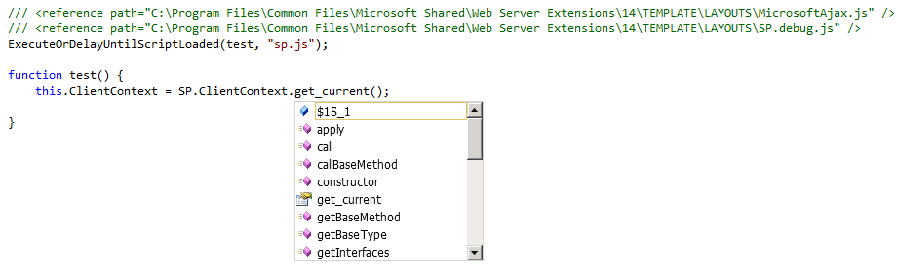
Problem - multiple files
Last problem for today.
JavaScript doesn't understand multiple files.
VS.NET helps with <reference>, but doesn't help you check the correctness of your reference code

Slide 16
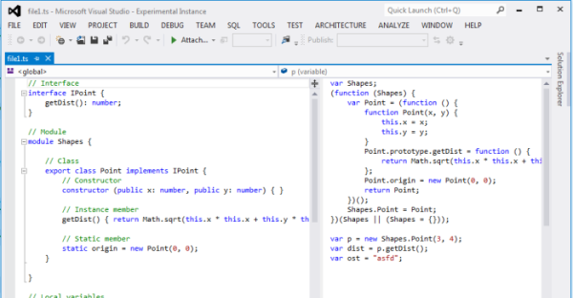
Let's look at TypeScript
To get started with TypeScript, grab it from http://typescriptlang.org this includes VS2012 extensions
Next, grab Web Essentials 2012 VS Extension. http://visualstudiogallery.msdn.microsoft.com/07d54d12-7133-4e15-becb-6f451ea3bea6
Notes:
Some of you might find these examples interesting… Just wait until you had to fix someone else bug in their script
You can do it with VS.NET 2010, but there are manual bits involved. Installer doesn't help you.

Slide 17
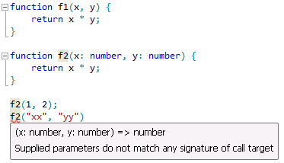
TypeScript - first glance - optional strong type checking
// js function f(x, y) { return x * y; }
// ts function f(x : number, y : number) : number { return x * y; }
// Type information is enforced in design and
// compile time, but removed at runtime

Slide 18
TypeScript - demo.ts
Let's go see demo.ts in Visual Studio

Slide 19
TypeScript - Interfaces
// ts interface

Slide 20
TypeScript features
Static Type Checking
Modules and Export
Interface and Class for traditional Object Oriented Programming
Works with all your existing JavaScript libraries
Low learning overhead compared to similar JavaScript systems (CoffeeScript or Dart)
Amazing Visual Studio tooling
Outstanding team and refactoring scenarios

Slide 21
How - new projects
Visual Studio 2012
SharePoint Solutions and Sandbox Solutions
Visual Studio 2010 can be done, but the installation of the Visual Studio extension is tricky and manual

Slide 22
TypeScript - pinteresp.ts
see pinteresp.ts - building a sandbox webpart with TypeScript

Slide 23
Real world story
Brian Harry (of TFS) converts TFS Web UI to TypeScript
80,000 lines of code
Heavily tested by unit tests and functional tests, JSLint clean
Finds 13 bugs after initial conversion
http://blogs.msdn.com/b/bharry/archive/2012/10/24/typescript-a-real-world-story-of-adoption-in-tfs.aspx

Slide 24
How - existing projects - practical guidelines
Q: I have spaghetti JavaScript how do I update them to TypeScript?
You don't have to start with your largest file. You don't have to convert all your files. Start with the smaller file. Everything will still work.

Slide 25
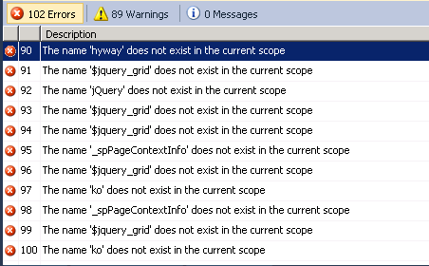
How - existing projects
#1 copy the JS file and paste into a TS file. Remember: JS is subset of TS
Notes:
This is my largest, 1500 line file
. TS will complain though, because it thinks you can be more specific

Slide 26
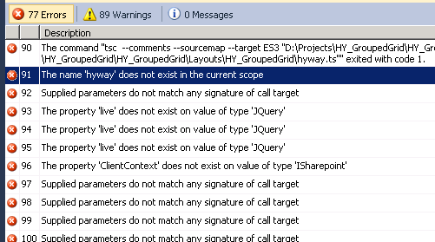
How - existing projects
#2 Add <reference> for definition files
#3 Optional arguments in your functions
#4 Fix ad-hoc objects to match definition interfaces.
#5 Create missing definitions (e.g. 3rd party JQuery extensions)
Majority of errors are TypeScript asking you to describe the interface better.

Slide 27
How - existing projects
#6 Fix minor issues is TS
Fix deprecated method references (JQuery.live should be JQuery.on)
Fix Date - Date
These are common issues - easy to find solutions on StackOverflow (the official support forum for TypeScript)
Good news: That's it!

Slide 28
How - existing projects
Now, you can start to refactor and improve your TypeScript
#1 Group utility functions into a separate scope. Move them out into a commonly shared file. Add Type information and jsdoc comments for them.
#2 Use F2 rename symbol to finally standardize the variable/function names in JS, without fearing things would break
#3 If you are working with a number of files, TypeScript will now check across files to make sure you are still calling valid functions, if your team member change them.

Slide 29
How - existing projects
Congratulations you (and your team) are on your way to cleaner, maintainable code

Slide 30
Summary - why TypeScript
Have to learn one more thing - there is a learning curve, very easy if you already know JavaScript, or if you know C# very well.
You still have to learn JavaScript - Understanding how TypeScript converts to JavaScript will teach you better JavaScript
Some definition files don't exist or incomplete, but I think this will vanish very quickly. These aren't hard to write if you really need something.
Visual Studio is amazing
Modules and classes enable large projects and code reuse
Compile-time checking prevents errors
Definition files for common JavaScript libraries makes them very easy to work with, and provides strong type checking
Source map debugging makes debug easy

Slide 31
Conclusion - if I have to make a decision for you…
If you see yourself using more JavaScript. You have to look at TypeScript.
If you and your team has to work on JavaScript together, you have to look at TypeScript.
Once you've done the initial hard work and converted a project. You can't stand going back.
TypeScript is currently in beta. There are occasionally bugs. But the forums and support (in Stack Overflow) is very good.
But they are moving very quickly. v0.9 will give us generics! I expect to see strong take-up of TypeScript in MS community.
You can use TypeScript for ASP.NET / MVC / SharePoint as well as Windows Apps
Notes:
If you are already using JavaScript, and you see yourself using more JavaScript. You have to look at TypeScript.
The strong tooling in Visual Studio is a key differentiator for Microsoft. TS will be here at least until ECMAScript v6 comes out, whenever that is. Even then, old browsers won't support most of it so you'll still need a way to compile down to plain-old-JavaScript
Once you've done the initial hard work and converted a project. There is no going back. It'd be like going back to the dark ages.
TypeScript is currently in beta. v0.9 will give us generics! I expect as TS matures and more and more Microsoft teams migrate to it internally, we'll see a lot more TS in one year than now.
You can use TypeScript for ASP.NET / MVC / SharePoint as well as Windows Apps

Slide 32
In Summary…
Awesome VS.NET tools for design, compile and debug
Helps you understand and write better JavaScript
Works with any existing third party JS libraries
Refactoring, multiple files enables code reuse and team work
Requires very little new learning. Combine what you already know from Javascript and C#
TypeScript is great for your SharePoint projects.

Slide 33
References - TypeScript
http://www.typescriptlang.org/
http://blogs.msdn.com/b/typescript/
http://visualstudiogallery.msdn.microsoft.com/07d54d12-7133-4e15-becb-6f451ea3bea6
http://channel9.msdn.com/Shows/Going+Deep/Anders-Hejlsberg-and-Lars-Bak-TypeScript-JavaScript-and-Dart
https://github.com/borisyankov/DefinitelyTyped
http://www.slideshare.net/jeremylikness/introduction-to-typescript
http://prezi.com/zkhsz49ownaw/coffeescript-vs-typescript/

Slide 34
References - SharePoint + TypeScript
http://www.chaholl.com/archive/2013/01/03/typescript-in-a-sharepoint-farm-solution.aspx
http://sptypescript.codeplex.com/
http://johnliu.net/blog/2013/3/13/building-sharepoint-solutions-with-microsofts-typescript-why.html

Slide 35
References - JavaScript
http://javascript.crockford.com/javascript.html
http://javascript.crockford.com/inheritance.html
http://www.adequatelygood.com/2010/2/JavaScript-Scoping-and-Hoisting
http://www.jibbering.com/faq/notes/closures/

Slide 36

Questions?
Comments?
More info
John.Liu@SharepointGurus.net
@johnnliu http://JohnLiu.net

Slide 37
Thanks for listening
Remember to submit your feedback

