Slide 1

TypeScript
eirik årdal | eirik.ardal@bouvet.no | eirikardal.no

Slide 2

What is it?
Typed superset of JavaScript
Is built on, and compiles to, JavaScript
Supports any ES3 to ES6-compatible environment

Slide 3
What does it give me?
Type safety at compile time
Modules, classes (with constructors and public/private members), enums, interfaces, generics, lambdas, and more.
Auto completion (IntelliSense) in your favourite IDE

Slide 4
What do I need to run it?
Compiles from any command line on any OS
Not required, but strongly recommended: nodejs
Bext experience in:
  Visual Studio
  IntelliJ / WebStorm
  Eclipse
  SublimeText 2/3
  Emacs
  Vim
  ... But any text editor + command line works

Slide 5
Installation
npm install –g typescript
Ensure tsc.exe is on your PATH by: tsc --version in command line
Use automation tools grunt or gulp to automatically build .ts to .js on file changes.
Any IDE

Slide 6
Installation
IDE’s can do the .ts to .js compile on file save
This workshop assumes compiling with command line and writing code in any text editor.

Slide 7

Language features

Slide 8
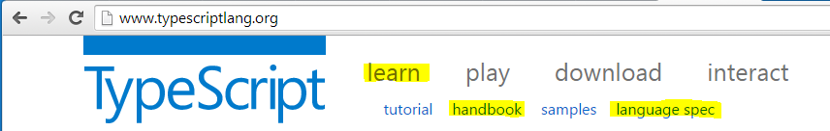
Resources

Slide 9
Code!
\CheatSheet\src\typescript-cheatSheet.ts

Slide 10
Definition files
.d.ts
Provides typed definitions of existing libraries
  Jquery, bootstrap, angular, knockout, etc
Provides auto completion for the IDE
Referenced in a .ts file
  /// <reference path="../scripts/typings/jquery.d.ts" />

Slide 11
Definition files
https://github.com/borisyankov/DefinitelyTyped

Slide 12
Work work
Clone/download repo https://github.com/bouvet-openlab/typescript-angular-workshop
Install TypeSript & follow instructions in readme
See the wiki for a step-by-step on the first tasks

