Slide 1
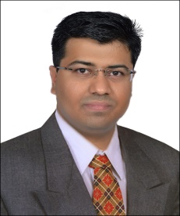
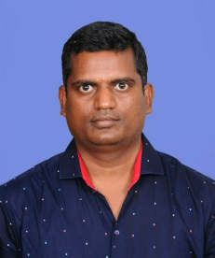
Ramkumar P M DCX Practice
Name
Ramkumar P M
Professional Experience
Grade
Consultant (B2)
Has successfully participated in various projects spanning across different roles for clients such as AXA, Quikr, Residual, Ayovel, ProgressiveRx
Delivered a complex testing forecasting of Test on Demand on PHP 5.6/ Laravel 5.2, Perfecto API for a Axa Technologies. Major technical challenge of this project was analyzing and transforming the client data and cloud based system via an Agile delivery model
Delivered a complex Project Delivery product of Turk on PHP 5.6/ Laravel 5.2 for a Axa Technologies. Major technical challenge of this project was analyzing and transforming the client data via an Agile delivery model
Product Feature Development on PHP 5.3/ Cloud API for a Quikr client in different Veritical via Agile Delivery Model.
Delivered a complex cash forecasting Social Lending developed on PHP 5.3/ CakePHP for a Greenprint Technologies. Major technical challenge of this project was analyzing and transforming the client data and migrating it to the new application platform via an Agile delivery model
Product Feature Development and maintainence of Ecommere Domain of ProgressiveRX on PHP 5.2/ Xcart for ProgressiveRx Client
Corporate Product Website Development with Ecommerce in Ahsan client on PHP 5.1 / Silverstripe CMS. Major Technical challege of this project was analyzing and migrated from different technologies.
SSO with four different client in one place on PHP 5.1/ Javascript.
Residual, which makes the Affiliate on PHP 5.1/Javascipt and it’s very useful to affiliate with other site and highlighting feature parent client rule for affiliate id.
Nationality
Indian
Residence
Bangalore
Role
Web Development / PHP
Personal Statement
Ram has over 9 years of profound development experience delivering complex IT transformation projects in global organisations across Insurance, Health, Product and Service industry verticals, following to deliver short-term successes in line with strategic business goals.
Ram has extensive experience in successfully handling end-to-end Full Stack projects getting involved right from inception through development and stabilization phases. He has a proven track record delivering complex solutions using technologies based-on PHP/Javascript platforms, PHP MVC Frameworks, HTML/CSS and Web-Services
Expertise & Competencies
Agile Delivery Management using SCRUM Methodology
Development across platforms such as PHP, REACTJS, Javascript, JQuery, CMS , MVC PHP Framework and familiar to entire HTML web technologies
Have experience on MVC Framework and CMS
Web services
Education & Certification
Master of Computer Application – University of Madras
Bachelor of Computer Application – University of Madras

