Slide 1
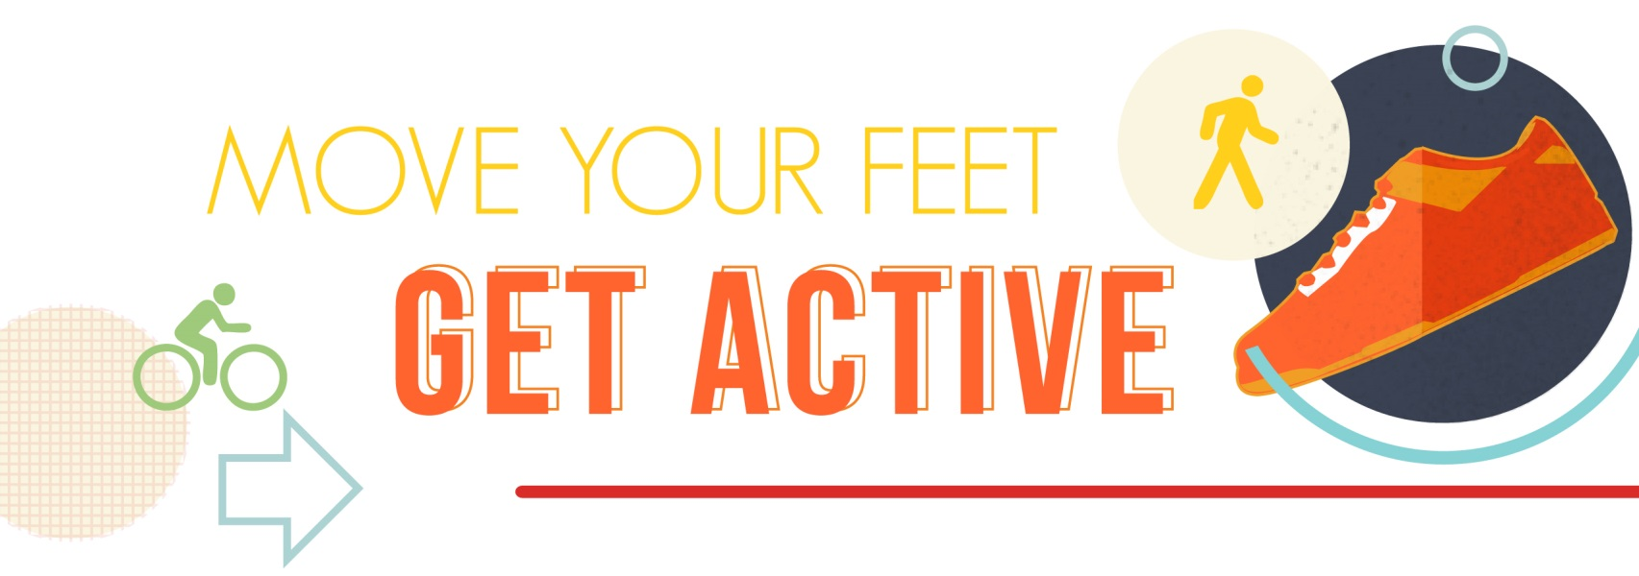
JANUARY
GET MOVING!
For the month of January, we will focus on Getting Moving. The following pages contain verbiage, tips, a printable poster and other articles and resources that you can reference and share with your co-workers and employees.

Slide 2
WHAT AND WHY:
Given all our modern conveniences including cars, elevators, escalators and computers, it is easy to go through an entire day without getting much physical activity. Activities that you can fit into your daily routine, such as taking the stairs instead of the elevator, are easy steps toward increasing activity. Adding even small amounts of exercise can provide significant health benefits.
Your well-being is important to us. This month, and each month going forward, we will focus upon a different aspect of wellness. A healthier you makes for a healthier workplace and vice-versa.
In kicking off the New Year, let’s make being more active a goal for 2015. [Insert information on the activity you are going to do this month and how to start it and/or sign up.]
MORE:
The consequences of physical inactivity are staggering.
More of us are overweight. Adult (and childhood) obesity/overweight level continues to increase: 68% of all Adults are obese or overweight.
It is more difficult today to create an active lifestyle. People are less active due to technology and better mass transportation. Sedentary jobs have increased 83% since 1950; Physically active jobs now make up only about 25% of our workforce. That is 50% less than 1950. Our average work week is longer. Americans work 47 hours a week - 164 more hours a year than 20 years ago.
Extra weight costs us physically and financially. Obesity costs American companies $225.8B per year in health-related productivity losses. The average healthcare cost exceeds $3,000 per person annually. An obese employee costs employer additional $460 to $2,500 in medical costs and sick days per year.

Slide 3
IDEAS FOR ACTIVITIES:
Sign up for Live Healthy Iowa (http://www.livehealthyiowa.org/) This cost-effective 10-week team challenge starts January 26. You can have as few as two people on a team, or as many as 10 per team. The competition is in two areas: activity and weight loss. Pick which one best suits your organization and sign up. Consider including an incentive for participating, even if it is something small or simply playing for pride.
Start a walking group at the office. Recruit your co-workers to go for a walk at lunch or on a break. Even if you just do it on Mondays, it is a step in the right direction.
Pedometers are relatively inexpensive. Perhaps you can buy one for each member of your staff to have them track activity.
Find a work out buddy. We have all just made our New Year’s Resolutions. Find someone that has a goal similar to you so that you can encourage one another and keep each other motivated.
Add in simple activities like parking in the back of the parking lot so that you get some extra steps in before you make it to the door.
Take the stairs, not the elevator.
Walk over to talk with a colleague instead of emailing or calling.

Slide 4
ARTICLES:
University of Iowa Healthier Workforce Center for Excellence article on moving more in the workplace: http://us6.campaign-archive2.com/?u=e566ceadd7906f250f5d18ab5&id=78cad234d5
Burn 100 Calories in 10 minutes!: http://www.sparkpeople.com/blog/blog.asp?post=burn_100_calories_in_10_minutes
OTHER RESOURCES:
Couch to 5K running program: http://www.c25k.com/
Workout ideas: http://www.sparkpeople.com/resource/resource_center.asp?id=33

Slide 5
THE MORE YOU KNOW! 25 TIPS, TIDBITS OF TRIVIA AND TWEETS ABOUT BEING ACTIVE. SHARE ONE VIA EMAIL EACH DAY OR POST THEM NEXT TO THE WATER COOLER.
A person who weighs 160 lbs. burns about nine calories during a minute of walking up a set of stairs. During the same activity, a 210-lb person burns about 12 calories.
Exercise is more effective at increasing your energy levels than caffeine.
Walking at a fast pace burns almost as many calories as jogging for the same distance.
Regular physical activity can improve your mood and the way you feel about yourself
Exercise is likely to reduce depression and anxiety and help you to better manage stress.
By the time you have reached 50 years of age, you will have walked approximately 75,000 miles.
Exercise improves blood flow throughout the body and to the brain.
New research proves music motivates. The body responds to upbeat tunes by quickening the pace of activity. Your workout becomes more intense and powerful.
For every 1 lb. of muscle you gain, your body burns an extra 50 calories a day.

Slide 6
MORE TIPS:
If you are 25 lbs. overweight, you have nearly 5,000 extra miles of blood vessels through which your heart must pump blood.
69% of men consider themselves to be physically fit, 13% of men actually are physically fit.
Not only does exercise help fight disease, it also creates a stronger heart.
Exercise can slow or help prevent heart disease, stroke, high blood pressure, high cholesterol, type 2 diabetes, arthritis, osteoporosis (bone loss), and loss of muscle mass.
Less than 5% of adults participate in 30 minutes of physical activity each day, only one in three adults receive the recommended amount of physical activity each week.
Exercise can increase good cholesterol.
For every hour of exercise you do, you could live two hours longer, even if you don’t start working out until you are middle aged!
Regular exercise and weight-lifting in particular, speeds up your metabolism.
When exercising by yourself, recite the alphabet. If it’s no problem, pick up your pace. If you start huffing by the letter F, slow down.

Slide 7
MORE TIPS:
Drink before, during, and after your walk (1-1.5 cups of water for a 20 minute walk).
People who exercise 4 days a week report improved sleep quality, longer sleep, and less time falling asleep.
Finding a workout partner can help keep you on track and motivate you to get out the door.
Try a new sport like tennis or rollerblading. The more that you enjoy exercise, the more likely you are to stick to it.
Don’t sit during your entire lunch break – take time to walk at a moderate or slow pace.
While sitting at your desk, rotate one foot to “write” the alphabet. Rotate the other in the same manner and repeat.
25. Set short-term goals—and reward yourself for achieving them. Choose fitness-focused rewards for reaching your goals, such as new workout gear or a heart rate monitor.

Slide 8
APPENDIX:
We can’t take all of the credit. In compiling this information, we referenced the following organizations and websites:
www.fitness.gov/
www.webmd.com
columbia.edu
harvard.edu
fitnessandwellnessnews.com
exercise.lovetoknow.com
crazyhealthfacts.com
www.nutristrategy.com
visual.ly
www.complete-strength-training.com
www.fitday.com
ucr.edu

